Slide 1
😊 😐 😠
Sentiment Analysis of
Product Reviews
Using TF-IDF and Machine Learning Classifiers
Adithya (253314, GIS) • Gayathri (253019, CSDA) • Vishnumaya (253013, CSDA)
Amazon Reviews
TF-IDF + Chi-Square
Linear SVM

Slide 2
Table of Contents
01
Problem Statement & Motivation
07
Results & Evaluation
02
Dataset Description
08
Top Discriminating Features
03
Methodology Overview
09
Streamlit App Demo
04
Text Preprocessing & Feature Extraction
10
App — Negative & Neutral Predictions
05
Feature Correlation Heatmap
11
App — Positive Prediction
06
Model Training & Comparison
12
Conclusion & Future Work

Slide 3
Problem Statement & Motivation
Classify Amazon customer reviews into Positive, Neutral, and Negative sentiments using traditional Machine Learning — without deep learning black-boxes.
🔍
⚡
💼
Interpretability
Efficiency
Business Value
Understand which linguistic markers (negation, punctuation) drive sentiment — not just the output label.
Traditional ML on TF-IDF runs fast with low compute cost, making it production-friendly.
Enables businesses to act on customer feedback at scale — tracking product issues, praise, and neutral reports.

Slide 4
Dataset Description
📦 Source
Amazon_Reviews.csv — scraped customer reviews
📊 Size
21,214 records total
📝 Text Feature
Raw review text feedback
⭐ Label Feature
Star ratings (1-5) mapped to sentiment
🔤 Encoding
latin1 — handled during preprocessing
⚠ Significant class imbalance: Negative = 67.6%, Positive = 27.4%, Neutral = 4.2% → Macro F1 prioritized for evaluation.

Slide 5
Methodology Overview
1
2
3
4
5
🧹
⚙️
📐
🤖
📊
Data Cleaning
Feature Extraction
Feature Selection
Model Training
Evaluation
Handled latin1 encoding
Removed HTML, URLs, specials
Regex-based normalization
TF-IDF (5,000 unigrams & bigrams)
Sentence length & word count
Punct density, avg word len, negation
Chi-Square (χ²) test
Top 3,000 most significant
features retained
Logistic Regression
Multinomial Naive Bayes
Linear SVM, Gradient Boosting
Macro F1-Score (primary)
Per-class precision-recall
Accuracy across all models

Slide 6
Text Preprocessing & Feature Extraction
Preprocessing Pipeline
Feature Extraction
1
Lowercase all text
TF-IDF Vectorizer
5,000 unigrams & bigrams
sublinear_tf=True, min_df=2
2
Remove URLs, @mentions, #hashtags
Sentence Length
Character count of cleaned text
3
Strip punctuation & digits
Avg Word Length
4
Remove extra whitespace
Mean length of all tokens
Punct Density
5
Neutral keyword detection (rule-based)
Ratio of punctuation characters
Negation Flag
Binary: 'not', 'no', 'never', "n't"

Slide 7
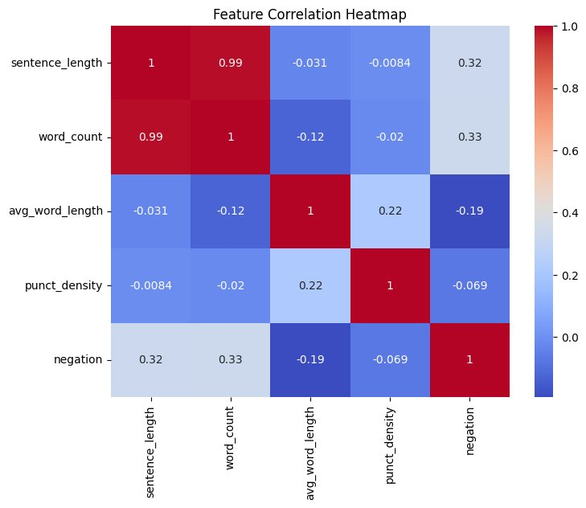
Feature Correlation Heatmap
Key Insights
sentence_length ↔ word_count r = 0.99
Near-perfect correlation — near-redundant features (expected).
avg_word_length ↔ punct_density r = 0.22
Weak positive — slightly longer words appear with more punctuation.
negation ↔ word_count r = 0.33
Longer reviews tend to include negation words more often.
negation ↔ avg_word_length r = −0.19
Negation words are short, pulling avg word length slightly down.

Slide 8
Model Training & Comparison
Detailed Results
Model | Macro F1 | Accuracy
Linear SVM ★ | 0.6235 | 90%
Logistic Reg. | 0.6065 | 90%
Gradient Boost. | 0.5886 | 86%
Multinomial NB | 0.5235 | 79%
🏆 Best Model: Linear SVM
Macro F1: 0.6235
Accuracy: 90%
Best balance across all sentiment classes.

Slide 9
Results & Evaluation
0.6235
90%
21,214
3,000
Macro F1-Score
Global Accuracy
Total Samples
Features Selected
Best — Linear SVM
Linear SVM & Logistic Reg.
Amazon product reviews
Chi-Square χ² reduced
Per-Class Performance (Linear SVM)
Class
Precision
Recall
F1-Score
😠 Negative
93%
96%
94%
😊 Positive
88%
85%
86%
😐 Neutral
~30%
~25%
~27%
⚠ Neutral class suffers due to severe under-representation (only 4.2% of data).

Slide 10
Top Discriminating Features per Sentiment Class
😊 Positive
😠 Negative
😐 Neutral
1. "perfect"
1. "useless"
1. "arrived"
2. "amazing"
2. "terrible"
2. "ordered"
3. "excellent"
3. "horrible"
3. "package"
4. "great"
4. "worst"
4. "received"
5. "love"
5. "not work"
5. "delivered"
6. "fantastic"
6. "broken"
6. "purchased"
7. "awesome"
7. "waste"
7. "item"
8. "highly recommend"
8. "disappointed"
8. "shipment"
9. "best quality"
9. "never again"
9. "bought"
10. "5 stars"
10. "return"
10. "product"
Chi-Square feature selection identifies the words most statistically associated with each class.

Slide 11
Streamlit App — Architecture
📝
🧹
⚙️
📐
🤖
📊
User Input
(Review Text)
Text Cleaning
(Regex)
TF-IDF
Transform
Chi-Square
Select
Linear SVM
Predict
Display
Result
⚡ Shortcut Rule: If the cleaned text contains neutral keywords (arrived, ordered, delivered, received, package, shipment…), the app bypasses the ML model and directly labels the review as 😐 Neutral.
Saved Model Files
Requirements
📁 sentiment_model.pkl
Trained Linear SVM
• streamlit
• pandas
📁 tfidf_vectorizer.pkl
Fitted TF-IDF vectorizer
• numpy
📁 label_encoder.pkl
Class label encoder
• scikit-learn
• nltk
📁 chi_selector.pkl
Chi-Square feature selector
• joblib

Slide 12
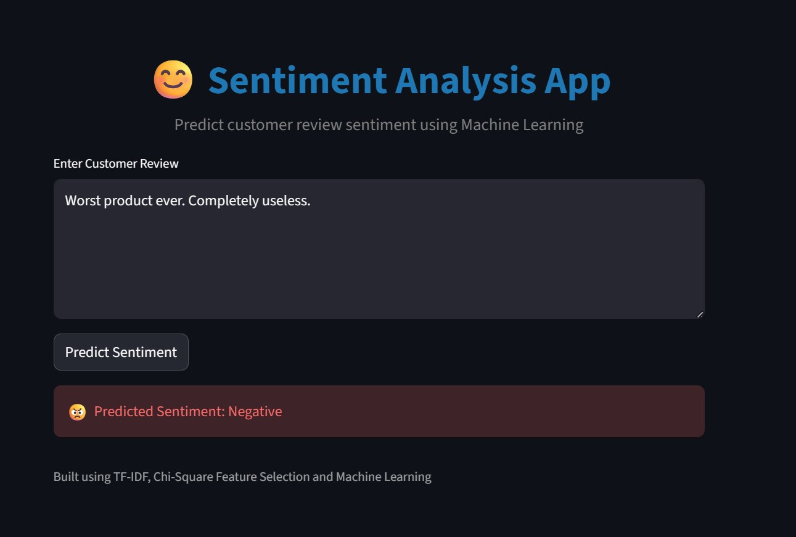
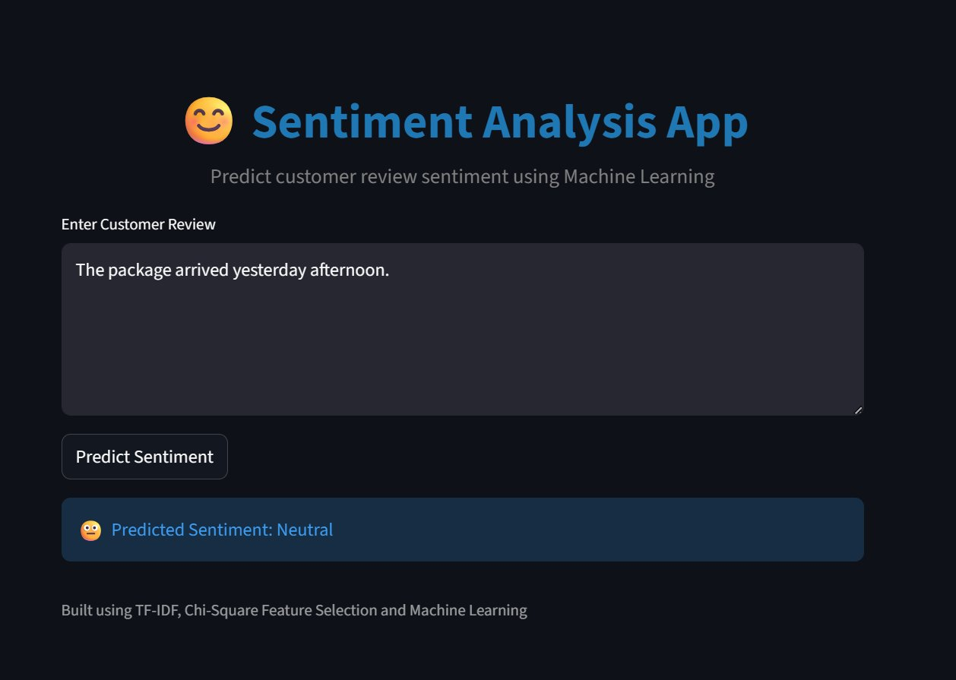
App Demo — Negative & Neutral Predictions
😠 Negative Prediction
😐 Neutral Prediction
Input: "Worst product ever. Completely useless."
Input: "The package arrived yesterday afternoon."
Keywords 'worst' & 'useless' are top negative discriminators → SVM correctly classifies as Negative.
Keyword 'package' triggers the rule-based neutral shortcut — model bypassed for speed.

Slide 13
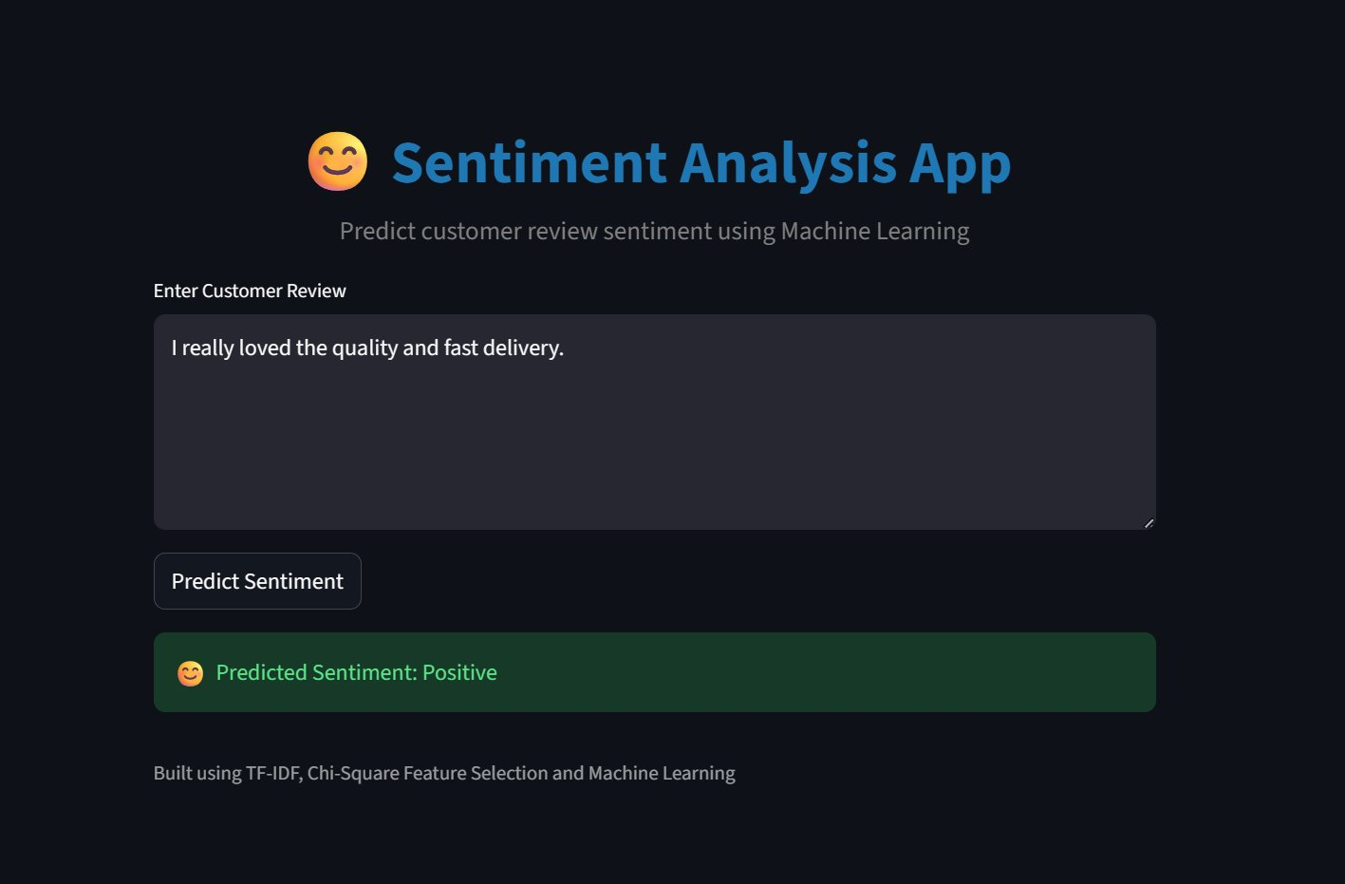
App Demo — Positive Prediction
😊 Positive Prediction
"I really loved the quality
and fast delivery."
Why it worked:
✔ 'loved' — top positive discriminator
✔ No neutral keywords → model runs
✔ No negation words present
✔ SVM assigns Positive confidently
App UI Highlights
• Dark-themed Streamlit interface (background: #f5f7fa overridden)
• Color-coded results: green = Positive, red = Negative, blue = Neutral
• Text area with placeholder and 180px height for comfortable input

Slide 14
Conclusion & Future Work
What We Achieved
Future Work
🎯
Linear SVM with TF-IDF achieves 90% accuracy and 0.62 Macro F1 on imbalanced Amazon reviews
🔄
SMOTE / Class Weighting
Address Neutral class imbalance with oversampling or cost-sensitive learning.
🔍
Chi-Square feature selection reduced 5,000+ features to 3,000 most significant predictors
🧠
Transformer Fine-tuning
Compare with BERT/DistilBERT for richer semantic understanding.
📐
Custom linguistic features (negation, punctuation density) complement TF-IDF effectively
🌐
Multi-domain Expansion
Extend to Yelp, Twitter, and product-specific review corpora.
🚀
Streamlit app deployed with rule-based neutral detection for production efficiency
📈
Aspect-Based Sentiment
📊
Interpretable ML pipeline — businesses can audit which words drive predictions
Move from document-level to aspect-level (shipping, quality, price).
🔧
API Deployment
Package as REST API with FastAPI for integration with business dashboards.

Slide 15
😊 😐 😠
Thank You!
Sentiment Analysis of Product Reviews
Using TF-IDF and Machine Learning Classifiers
Adithya
Gayathri
Vishnumaya
253314 · GIS
253019 · CSDA
253013 · CSDA
Built with TF-IDF · Chi-Square · Linear SVM · Streamlit

