Slide 1

Fake News Prediction
Student Name Student ID
Divya Tejaswi Ejjurothu 700745894
Sushmitha Virri 700742289
Vishnu Ponugoti 700744508
Pavan Gandavarapu 700741173
Team Members :

Slide 2
Role/Responsibilities and Contribution to the Project:
NAME | RESPONSIBILITIES AND CONTRIBUTION
DIVYA TEJASWI EJJUROTHU | Data collection and processing, Text analysis -Exploratory Data Analysis ,Text vectorization
SUSHMITHA VIRRI | Project flow design and work sharing, Data collection and processing, Text analysis -Exploratory Data Analysis
VISHNU PONUGOTI | Project flow design and work sharing, ML model implementation, predictions and model evaluation
PAVAN GANDAVARAPU | ML model implementation, Text vectorization , predictions and model evaluation

Slide 3

Motivation:
Information is present everywhere.
However, the authenticity of the data is lacking.
In many cases, news content is produced intentionally.
Filtering such content is a challenging task.
Many approaches have evolved in aid of spotting Fake News.

Slide 4

Objective:
Collection of news articles (dataset).
Cleaning or preprocessing the dataset using Regular Expressions.
Analyze both categories by extracting vocabularies.
Create Vectorizer and pass a dictionary to the Class Model.
And implement multiple machine learning algorithms to classify real and fake news.

Slide 5

Related Work:
A comprehensive review of existing literature and research on the topic
Analysis of relevant algorithms, models, and techniques used in previous studies
Collection and analysis of relevant datasets to inform the current study
Study and implementation of code or software used in previous studies to inform the current study
Comparison and evaluation of previous studies' findings with the current study's results

Slide 6

Problem Statement
Definition of Fake News: low-quality news with purposefully incorrect information.
Domains such as Machine Learning and NLP provide solutions to these problems.
Predicting Fake News as a Binary Classification type problem.

Slide 7
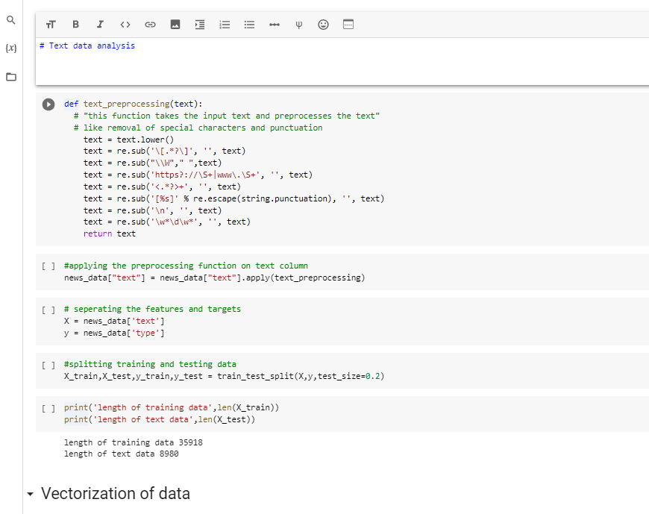
Proposed Solution :
The dataset contains true and fake news files separately. Using Panda’s library, we will create a master dataset by labelling true news as 1 and fake news as 0. In the data preprocessing step, stop words are removed, and special characters and URL tags are also removed from the data. For this task, we have used the regular expression Python library. A TF-IDF vectorizer is applied to convert the text into vectors in the data preparation step. TF-IDF vectorizer is implemented using the sci-kit-learn library. Data exploration is conducted to perform the text analysis.

Slide 8
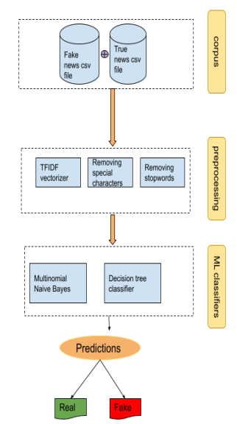
Workflow :

Slide 9
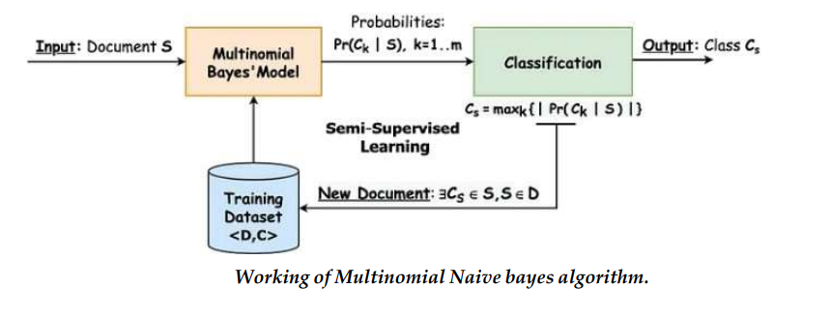
Multinomial Naive Bayes:
The multinomial Naive Bayes classifier is a variant of Naive Bayes classifier. All the variants of the Naive Bayes classifiers work based on the Bayes principle. This algorithm is vividly used in the NLP tasks like filtering spam or ham emails and predicting fake or real news. It calculates each tag’s likelihood for a given sample and outputs the tag with the greatest chance.

Slide 10
Libraries used in the application:
NLTK: NLTK is a Python library for working with human language data, providing various interfaces for natural language processing tasks.
Numpy: NumPy is a Python library for numerical computation that provides powerful data structures for working with multi-dimensional arrays and matrices.
pandas: Pandas is a Python library for data manipulation and analysis. It provides data structures and functions for working with tabular data, including data import/export, data cleaning, merging, reshaping, and aggregation
matplotlib: Matplotlib is a Python library for creating static, animated, and interactive visualizations in Python. It provides a wide range of tools for creating charts, plots, histograms, and other types of visualizations.
seaborn: Seaborn is a Python data visualization library built on top of matplotlib. It provides a high-level interface for creating informative and attractive statistical graphics
re: "re" is a built-in Python module for pattern matching and text manipulation using regular expressions.
Sklearn: Scikit-learn, also known as sklearn, is a popular Python library for machine learning. It provides a wide range of tools for data preprocessing, feature engineering, model selection, and model evaluation.
Pickle:"Pickle" is a Python module for converting Python objects into a byte stream for serialization and de-serialization.

Slide 11
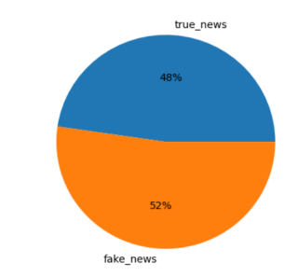
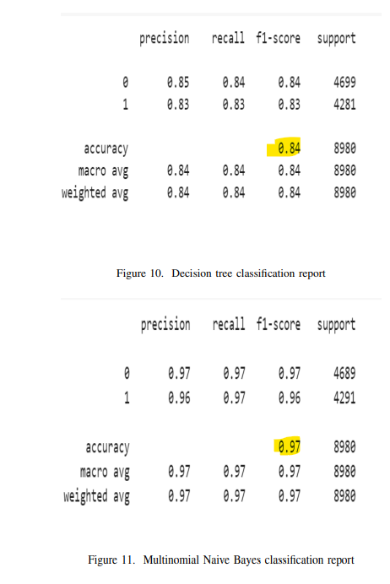
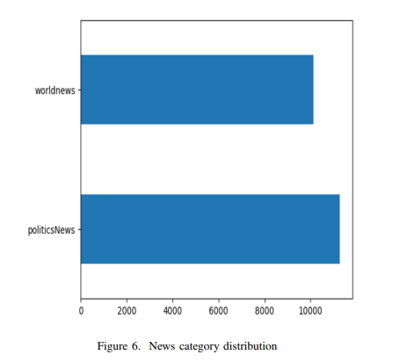
Results/Simulations :
we can conclude that Multinomial Naive Bayes outperformed the decision tree. Multinomial Naive Bayes scored 97 per cent accuracy on the test data whereas the decision achieved 84 per cent accuracy

Slide 12

References:
[1]. S. M. N, K. M. V, S. Verma and S. Rajagopal, "NLP Based Fake News Detection Using Hybrid Machine Learning Techniques," 2022 3rd International Conference on Electronics and Sustainable Communication Systems (ICESC), Coimbatore, India, 2022, pp. 818-822, doi: 10.1109/ICESC54411.2022.9885679.
[2]. B. Ganesh and D. K. Anitha, "Implementation of Personality Detection and Accuracy Prediction for identification of fake and true news using Decision Tree and Random Forest Algorithms," 2022 International Conference on Business Analytics for Technology and Security (ICBATS), Dubai, United Arab Emirates, 2022, pp. 1-5, doi: 10.1109/ICBATS54253.2022.9759039.
[3]. R. Nomesh. and M. S. Saravanan, "Classification of Fake News on Facebook a Novel Social Network with K-Means Clustering Approach for Against Principal Component Analysis Method for Better Accuracy," 2022 3rd International Conference on Smart Electronics and Communication (ICOSEC), Trichy, India, 2022, pp. 722-726, doi: 10.1109/ICOSEC54921.2022.9952063.
[4]. A. Shete, H. Soni, Z. Sajnani and A. Shete, "Fake News Detection Using Natural Language Processing and Logistic Regression," 2021 2nd International Conference on Advances in Computing, Communication, Embedded and Secure Systems (ACCESS), Ernakulam, India, 2021, pp. 136-140, doi: 10.1109/ACCESS51619.2021.9563292.

