Slide 1

By Rakshith Venkatesh
email: rzt0004@auburn.edu

Slide 2
Outline
What is RAID?
RAID configurations used.
Performance of each configuration.
Implementations.
Way forward with RAID.

Slide 3
What is RAID?
Stands for Redundant Array of Independent Disks.
It’s a technology that enables greater levels of performance, reliability and/or large volumes when dealing with data.
How?? By concurrent use of two or more ‘hard disk drives’.
How Exactly?? Mirroring, Stripping (of data) and Error correction techniques combined with multiple disk arrays give you the reliability and performance.

Slide 4
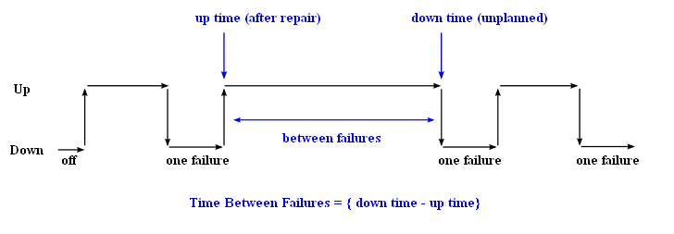
Mean Time Between Failures (MTBF)

Slide 5
RAID flavors
Commonly used ones:
RAID 0
RAID 1
RAID 5
RAID 10
Other types used…but rarely: RAID 2,3,4,6,50……

Slide 6
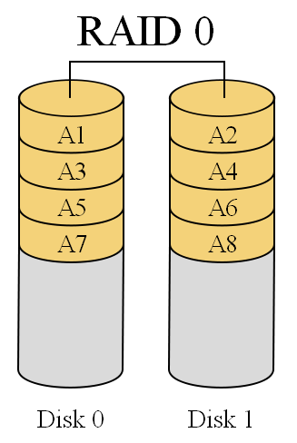
RAID 0
It splits data among two or more disks.
Provides good performance.
Lack of data redundancy means there is no fail over support with this configuration.
In the diagram to the right, the odd blocks are written to disk 0 and the even blocks to disk 1 such that A1, A2, A3, A4, … would be the order of blocks read if read sequentially from the beginning.
Used in read only NFS systems and gaming systems.

Slide 7
RAID 0 analysis
Failure Rate:
MTBF of RAID0 is roughly proportional to the number of disks in the array.
Pr(disk fail) = 5%, then
Pr(atleastonefails) = 1 – Pr(nonefails) = 1 – [1-0.05]² = 9.75%
Performance:
The fragments are written to their respective disks simultaneously on the same sector.
This allows smaller sections of the entire chunk of data to be read off the drive in parallel, hence good performance.

Slide 8
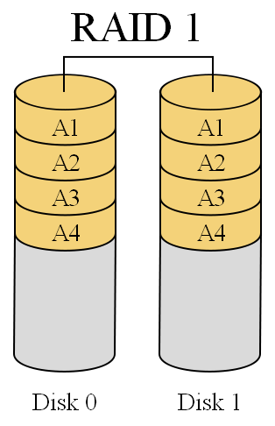
RAID 1
RAID1 is ‘data mirroring’.
Two copies of the data are held on two physical disks, and the data is always identical.
Twice as many disks are required to store the same data when compared to RAID 0.
Array continues to operate so long as at least one drive is functioning.

Slide 9
RAID 1 analysis
Failure Rate:
If Pr(disk fail) = 5%, then the probability of both the drives failing in a 2 disk array is P(both fail) = (0.05)² = 0.25%.
Performance:
If we use independent disk controllers for each disk, then we can increase the read or write speeds by doing operations in parallel.

Slide 10
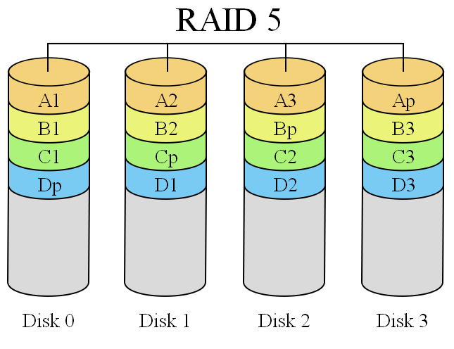
RAID 5
RAID 5 is an ideal combination of good performance, good fault tolerance and high capacity and storage efficiency.
An arrangement of parity and CRC to help rebuilding drive data in case of disk failures.
“Distributed Parity” is the key word here.

Slide 11
RAID 5 analysis
MTBF is slightly better than RAID 0. This is because failure of one disk is not quite a harm. We need more time if 2 or more disks fail.
Performance is also as good as RAID 0, if not better. We can read and write parallel blocks of data.
One of the drawbacks is that the write involves heavy parity calculations by the RAID controller. Write operations are slower compared to RAID 0.
Pretty useful for general purpose uses where ‘read’s’ are more frequent the ‘write’s’.

Slide 12
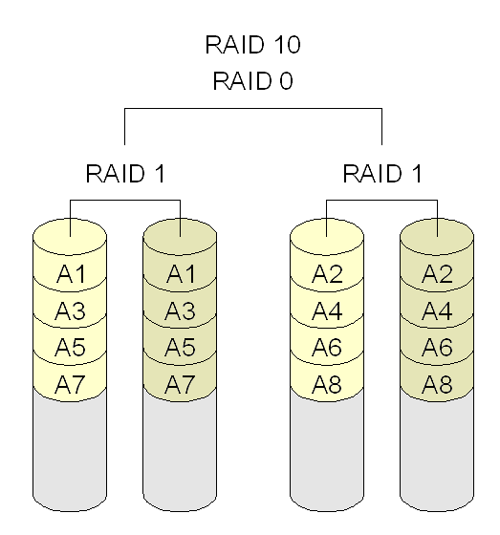
RAID 10
Combines RAID 1 and RAID 0.
Which means having the pleasure of both - good performance and good failover handling.
Also called ‘Nested RAID’.

Slide 13
Implementations
Software based RAID:
Software implementations are provided by many Operating Systems.
A software layer sits above the disk device drivers and provides an abstraction layer between the logical drives(RAIDs) and physical drives.
Server's processor is used to run the RAID software.
Used for simpler configurations like RAID0 and RAID1.

Slide 14
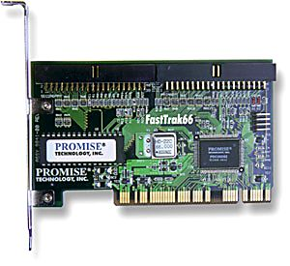
Implementations (contd…)
Hardware based RAID:
A hardware implementation of RAID requires at least a special-purpose RAID controller.
On a desktop system this may be built into the motherboard.
Processor is not used for RAID calculations as a separate controller present.
A PCI-bus-based, IDE/ATA hard disk RAID
controller, supporting levels 0, 1, and 01.

Slide 15
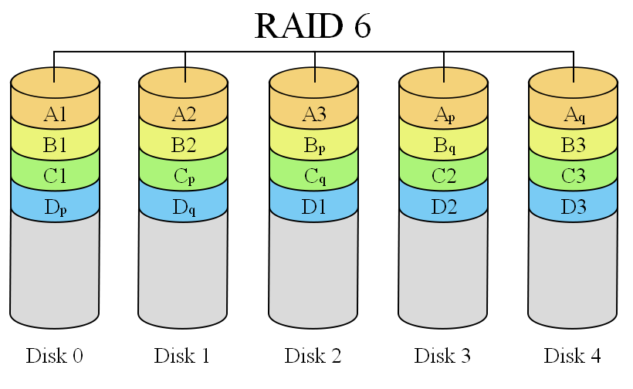
What’s happening present day?
RAID 6:
It is seen as the best way to guarantee data integrity as it uses double parity.
Lesser MTBF compared to RAID5.
It has a drawback though of longer write time.

Slide 16
Road ahead…
The expanded use of RAID-6 and other dual-parity schemes is a virtual certainty.
RAID vendors to support "fast rebuild" features that can restore hundreds of gigabytes in just an hour or so!!
Striping(of data) would extend across RAID groups -- not just across drives within a group.
Improved disk diagnostic features should offer more reliable predictions of impending drive failures, allowing the rebuild process to begin before an actual fault occurs.
Hot Spares!!

Slide 17
References
http://searchstorage.techtarget.com/generic/0,295582,sid5_gci1196310,00.html
http://www.lascon.co.uk/d008005.htm
http://en.wikipedia.org/wiki/RAID_0#RAID_0
http://en.wikipedia.org/wiki/RAID
Paper - A Case for Redundant Arrays of Inexpensive Disks (RAID) - David A Patterson, Garth Gibson, and Randy H Katz

