Slide 1

ST ANN’S COLLEGE OF ENGINEERING & TECHNOLOGY
AUTONOMOUS
DEPARTMENT OF
CSE-ARTIFICIAL INTELLIGENCE & MACHINE LEARNING
Railway Track Fall Detection System Using Region Based Convolutional Neural Networks For Infrastructure Safety
A.SATHWIKA (22F01A4202)
D.VISHNU PRIYA (22F01A4213)
K.AVANTHI (22F01A4227)
B.V.L.SAAHITHI (22F01A4207)
PRESENTED BY
UNDER THE GUIDANCE OF
Dr. P. S. NAVEEN KUMAR, Ph. D
ASSOCIATE PROFESSOR

Slide 2
TABLE OF CONTENTS
Abstract
Introduction
Objective
Existing System
Proposed Approach using RCNN
Modules Description
Hardware and Software requirements
Algorithms Used
Implementation
Testing
Results
Conclusion

Slide 3
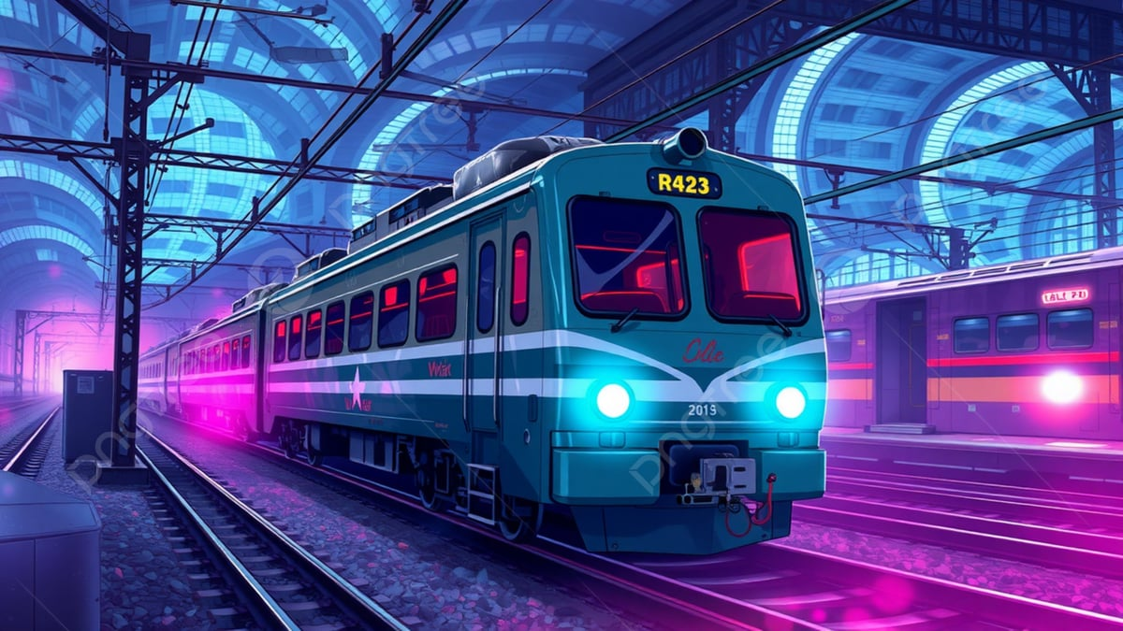
PROJECT TITLE
Railway Track Fall Detection System Using Region Based Convolutional
Neural Networks For people Safety
A real-time, AI-powered system using Region-Based Convolutional Neural Networks (R-CNN) to detect falls, cracks, and obstacles on railway tracks to prevent accidents.

Slide 4
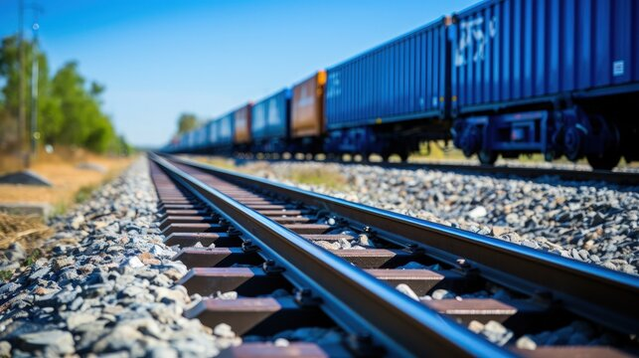
ABSTRACT
Railway track defects can cause serious
accidents if not detected early.
This project uses R-CNN to automatically
identify track falls, cracks, and obstacles.
Detected defects are highlighted with
bounding boxes.
A siren alarm alerts immediately when a
defect is found.
The system improves railway safety through
fast and accurate detection.
Helps reduce manual inspection effort and
supports predictive maintenance.

Slide 5
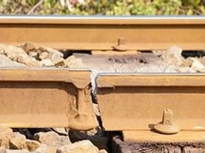
INTRODUCTION
Railway networks are one of the most widely used
transportation systems and require high safety
standards.
Even small defects on the track can lead to major failures if not detected early.
Traditional inspection methods depend on manual checking,
which is time-consuming and cannot cover long
routes efficiently.
With the growth of technology, AI and computer vision offer a modern way to observe track conditions continuously.
Implementing automated detection systems helps railway authorities improve monitoring, reduce human error, and respond quickly to risks.

Slide 6
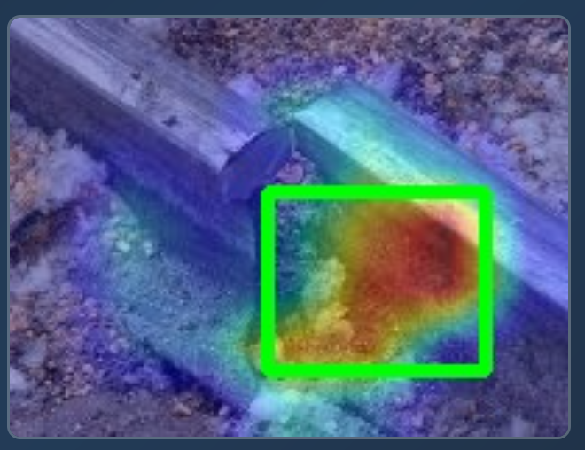
OBJECTIVE
To detect railway track falls, cracks, and
obstacles using R-CNN.
To accurately locate defects with
bounding boxes.
To automate monitoring and reduce manual
inspection effort.
To provide a siren alarm alert when defects are detected.
To improve railway safety through real-time detection.

Slide 7
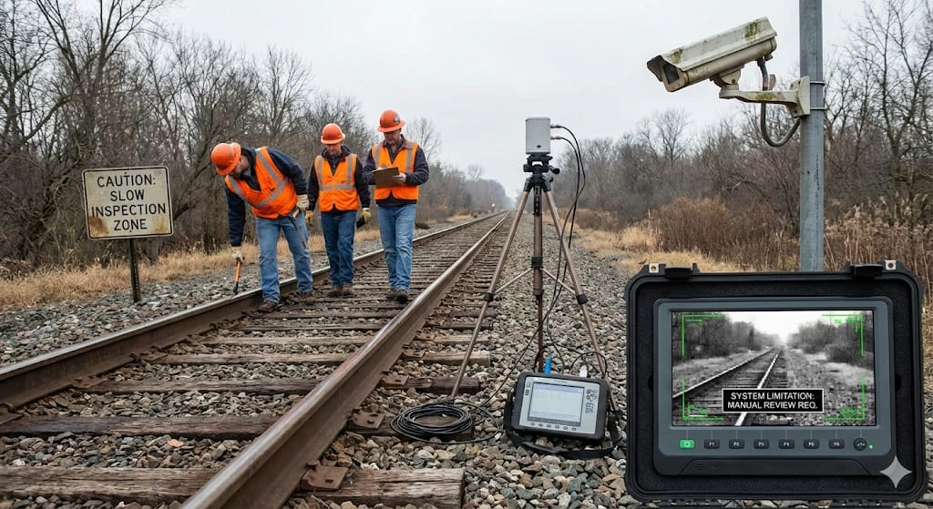
EXISTING SYSTEMS
Manual inspection of railway tracks by workers.
Sensor-based methods (ultrasonic, vibration sensors).
CCTV surveillance along railway lines.
Traditional image processing techniques
Limitations of the Existing System:
Slow and not suitable for long railway routes.
Highly dependent on human judgment → errors possible.
Sensors cannot detect all types of external
defects.
CCTV requires manual monitoring, not real-time detection.

Slide 8
PROPOSED APPROACH
⭐ Why R-CNN for Railway Track Fall Detection
Steps Involved:
Capture railway track images/videos using cameras.
Preprocess data (resizing, normalization).
Use R-CNN to generate region proposals.
Extract features using CNN.
Classify regions as normal track or faulty track.
Localize faults such as cracks, breaks, or missing tracks.
Send alerts for maintenance action.

Slide 9
1. Capture Railway Track Images/Videos Using Cameras
High-resolution cameras are placed along railway tracks or mounted on inspection vehicles.
Cameras continuously record images and video of the railway track surface.
Captures track alignment, rail joints, sleepers, and surrounding areas.
Detects visible defects such as cracks, missing rails, fallen tracks, and obstacles.
Works in real time to provide continuous monitoring.
Data can be collected during both stationary and moving train conditions.
Reduces the need for manual physical inspection.
Ensures early identification of potential hazards.

Slide 10
2. Preprocess Data (Resizing, Normalization)
Raw images are resized to a standard input size for the neural network.
Normalization scales pixel values to improve model stability.
Noise removal reduces effects of dust, blur, and camera vibration.
Improves contrast and visibility of track defects.
Removes unwanted background information.
Enhances consistency across different lighting conditions.
Prepares clean and uniform data for accurate model processing.
Improves overall detection accuracy and speed.

Slide 11
3. Use R-CNN to Generate Region Proposals
The Region Proposal Network (RPN) scans the entire image systematically.
Identifies candidate regions where defects may be present.
Focuses on track areas instead of background objects.
Generates multiple region proposals of different sizes and shapes.
Assigns scores to regions based on defect probability.
Reduces unnecessary computation on irrelevant areas.
Improves efficiency and speed of detection.
Ensures small defects are not missed.

Slide 12
4. Extract Features Using CNN
Each region proposal is passed through convolutional layers.
CNN extracts low-level features like edges, lines, and textures.
Higher layers extract complex features such as cracks and gaps.
Learns defect patterns automatically from training data.
Eliminates the need for manual feature design.
Handles variations in track appearance.
Improves robustness under different environmental conditions.
Enables accurate understanding of track conditions.

Slide 13
5. Classify Regions as Normal Track or Faulty Track
Extracted features are analyzed by the classifier.
Regions are labeled as normal or defective.
Faulty regions are further classified into crack, break, or missing track.
Confidence score is generated for each prediction.
Helps reduce false alarms.
Ensures reliable decision-making.
Improves trust in the automated system.
Enables prioritization of critical defects.

Slide 14
6. Localize Faults Such as Cracks, Breaks, or Missing Tracks
Bounding boxes are drawn around detected defects.
Clearly shows defect location on the railway track.
Helps visualize severity and size of the damage.
Allows precise identification of affected areas.
Assists maintenance teams in quick navigation.
Reduces time needed for inspection and repair.
Improves maintenance planning and scheduling.
Supports accurate reporting and documentation.

Slide 15
7. Send Alerts for Maintenance Action
Alerts are triggered immediately after defect detection.
Siren alarm warns nearby railway staff.
Notification can be sent to maintenance authorities.
Enables quick response to dangerous situations.
Prevents accidents by early warning.
Supports preventive and predictive maintenance.
Reduces service interruptions.
Improves overall railway safety and reliability.

Slide 16
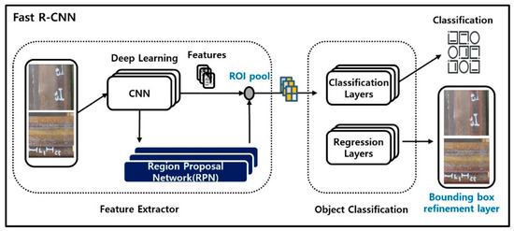
PROPOSED APPROACH

Slide 17
ADVANTAGES
Reduces manual inspection effort
Minimizes the need for workers to physically inspect railway tracks, improving safety and saving time.
High detection accuracy using Faster R-CNN
Deep learning helps detect cracks, track falls, and obstacles more accurately than traditional methods.
Precise defect localization
Bounding boxes clearly show the exact position of defects, making maintenance easier.
Immediate alert system
Siren alarm provides quick warning so that action can be taken without delay.
Real-time monitoring
Tracks are continuously monitored, allowing early detection of faults.
Reduces human error
Automated detection avoids mistakes caused by fatigue or poor visibility.
Supports preventive maintenance
Detecting defects early helps prevent major failures and accidents.

Slide 18
disADVANTAGES
Requires a large annotated dataset
Needs many labeled images to train the model accurately.
High computational cost
Training and processing require powerful hardware like GPUs.
Performance depends on image quality
Poor lighting, shadows, or bad camera angles can affect detection accuracy.
Initial setup cost is high
Cameras, systems, and installation increase the starting cost.
Possibility of false detections
Sometimes non-defect objects may be detected as faults.

Slide 19
MODULES USED
Region Proposal Module (RPN): Identifies possible defect regions.
Image Acquisition Module: Captures railway track images/video through a camera.
Preprocessing Module: Enhances and prepares images for detection.
Feature Extraction Module: Uses CNN to extract important track features.
Faster R-CNN Detection Module: Detects cracks, falls, and obstacles with bounding boxes.
Bounding Box Detection Module: Generates bounding boxes around cracks, falls, and obstacles.
Alert Module (Siren Alarm): Triggers alarm when a defect is found.
Output Visualization Module: Displays detected defects on the screen.

Slide 20
HARDWARE AND SOFTWARE REQUIREMENTS
Hardware Requirements :
Camera / Webcam
Laptop/PC with 8–16 GB RAM
GPU (optional but recommended for training)
Speaker/Buzzer for siren alarm
Software Requirements :
Windows / Linux OS
Python 3.x
TensorFlow, OpenCV
LabelImg (for annotation)
VS Code / Jupyter Notebook

Slide 21
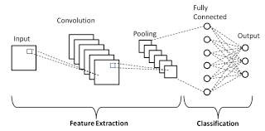
ALGORITHMS USED
1. Convolutional Neural Networks (CNN) :
A Convolutional Neural Network (CNN) is a deep learning algorithm used for image processing and computer vision tasks. It automatically extracts important features from images such as edges, shapes, and patterns. In this project, CNN is used to analyze railway track images and identify defects like cracks, breaks, and missing tracks.

Slide 22
CNN Layers and Their Functions :
Input Layer:
Takes railway track images as input and converts them into pixel values.
Convolution Layer:
Applies filters to extract features like edges, cracks, and track patterns.
Activation Layer (ReLU):
Introduces non-linearity by removing negative values and keeping important features.
Pooling Layer:
Reduces feature map size while preserving essential information, improving efficiency.
Fully Connected Layer:
Combines extracted features to classify the track condition.
Output Layer:
Produces final prediction indicating normal or faulty track with confidence score.

Slide 23
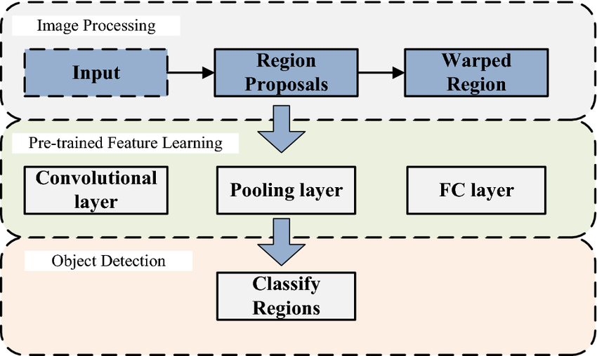
2. REGION-BASED CONVOLUTIONAL NEURAL NETWORK (R-CNN) :
Region-Based Convolutional Neural Network (R-CNN) is an object detection algorithm that identifies objects in an image by first selecting important regions and then classifying them. In this project, R-CNN is used to detect railway track defects such as cracks, falls, and obstacles and to locate them accurately using bounding boxes.

Slide 24
Working of R-CNN :
Input Image:
Railway track images captured using cameras are given as input.
Region Proposal:
The image is divided into multiple region proposals where defects may be present.
Feature Extraction:
Each proposed region is passed through a CNN to extract important features.
Classification:
The extracted features are classified as normal track or faulty track.
Bounding Box Localization:
Bounding boxes are drawn around detected defects to show their exact location.
Advantages of R-CNN:
Detects small and complex defects accurately.
Provides precise defect localization using bounding boxes.
Suitable for safety-critical applications like railway monitoring.

Slide 25
3. Region Proposals in Object Detection :
Candidate regions in an image likely to contain objects.
Focus computation on “interesting” areas rather than the whole image.
Used in R-CNN, Fast R-CNN, Faster R-CNN pipelines.
Purpose:
Efficiency: Reduces number of regions to analyze (~2000 boxes).
Accuracy: Focuses on probable objects, reducing false positives.
Scalability: Works with high-resolution images and large datasets.
How It Works:
Input Image: Original image from camera or dataset.
Region Generation: Multiple candidate bounding boxes created.
Scoring: Each region evaluated for likelihood of containing an object
Filtering (NMS): Overlapping or low-score regions removed.
Output: Top regions sent to a CNN for classification and bounding box refinement.

Slide 26
IMPLEMENTATION
Detect railway track condition using camera input
the siren rings immediately to alert nearby staff.
The model checks for cracks, track falls, or obstacles.
Notifies staff so they can take quick action to prevent accidents.
Each defect is highlighted, making it easy to identify the exact location.
Shows crack/fall/obstacle along with its location for easy review.

Slide 27
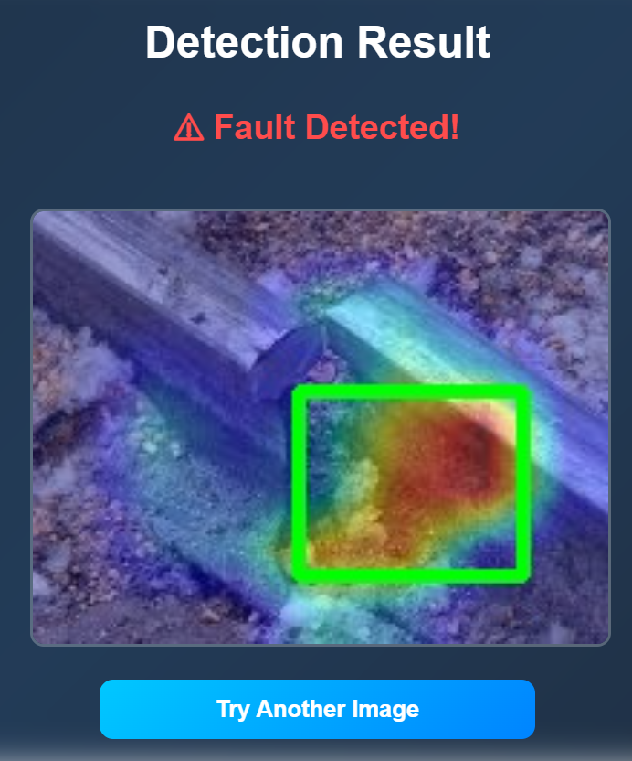
TESTING
Testing :
Tested on Images & Videos: Checked the system on various railway track images and video frames.
Detection Accuracy: Evaluated how well Faster R-CNN identified cracks, falls, and obstacles.
Bounding Box Check: Verified if detected boxes matched the actual defect areas.
Performance Metrics: Measured accuracy, precision, recall, and confidence scores.
Siren Alarm Test: Ensured alarm activates only when a real defect is detected.

Slide 28
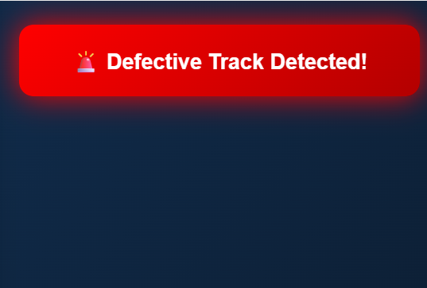
RESULTS
Results :
Correct Defect Detection: System successfully detected cracks, falls, and obstacles.
Accurate Bounding Boxes: Defects were clearly highlighted with precise boxes.
Strong Confidence Scores: Major defects showed high detection confidence.
Instant Alarm Response: Siren triggered immediately after detection.
Better Safety Monitoring: Reduced manual inspection and improved detection speed.

Slide 29

CONCLUSION
The Railway Track Fall Detection System using Faster R-CNN successfully identifies cracks, falls, and obstacles with high accuracy.
The system provides real-time detection with clear bounding boxes, improving the reliability of track monitoring.
The integrated siren alarm gives instant alerts, helping railway staff respond quickly and prevent accidents.
Overall, the project reduces manual inspection, increases safety, and offers an efficient AI-based solution for railway infrastructure monitoring.

