Slide 1

FUTURE SALES PREDICTION:

Slide 2
FUTURE SALES PREDICTION: INTRODUCTION:
Predicting future sales is a critical task for businesses in various industries. Accurate sales predictions allow organizations to optimize inventory, make informed marketing decisions, allocate resources efficiently, and ultimately maximize profitability. With the advent of data analytics and machine learning, businesses have powerful tools at their disposal to forecast future sales with greater precision.

Slide 3
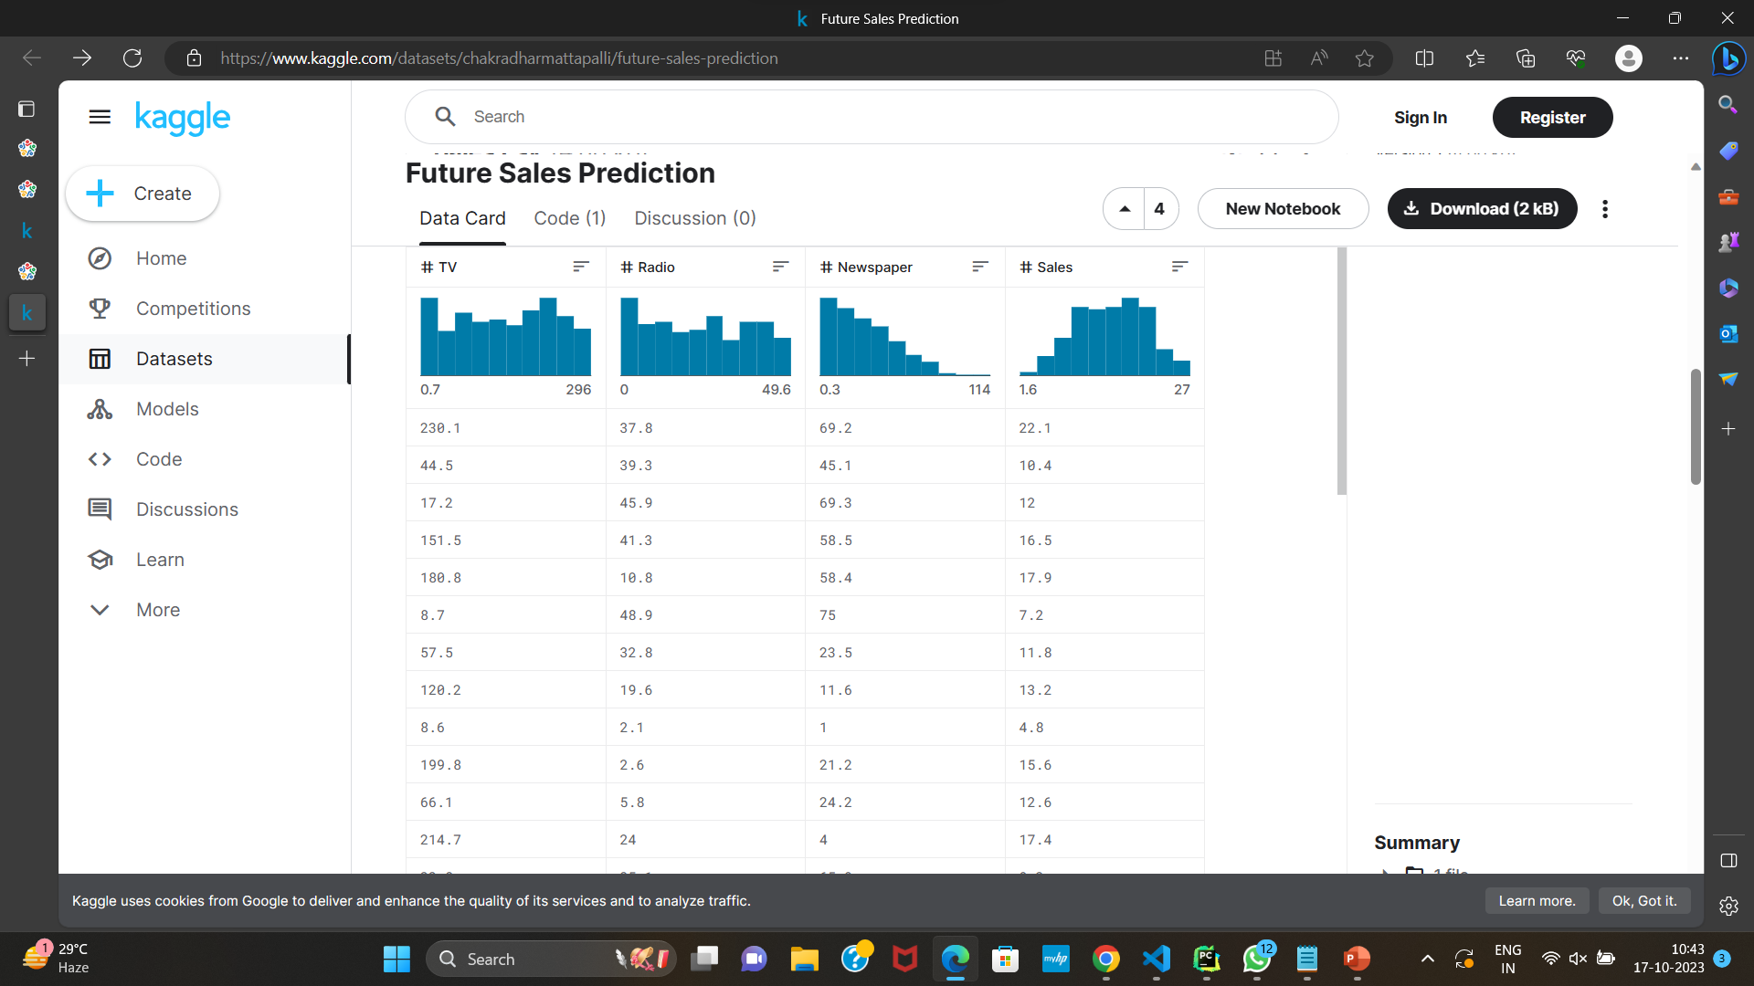
GIVEN DATASET:

Slide 4
Importing libaries
IMPORT NECESSARY LIBRARIES:
Start by importing the required Python libraries, such as Pandas and NumPy, to work with the dataset.
PYTHON CODE:
import pandas as pd
import NumPy as np
LOAD THE DATASET:
You will need to load your historical sales dataset into a Pandas Data Frame. Make sure your dataset is in a format that can be easily read by Pandas, such as CSV or Excel.

Slide 5
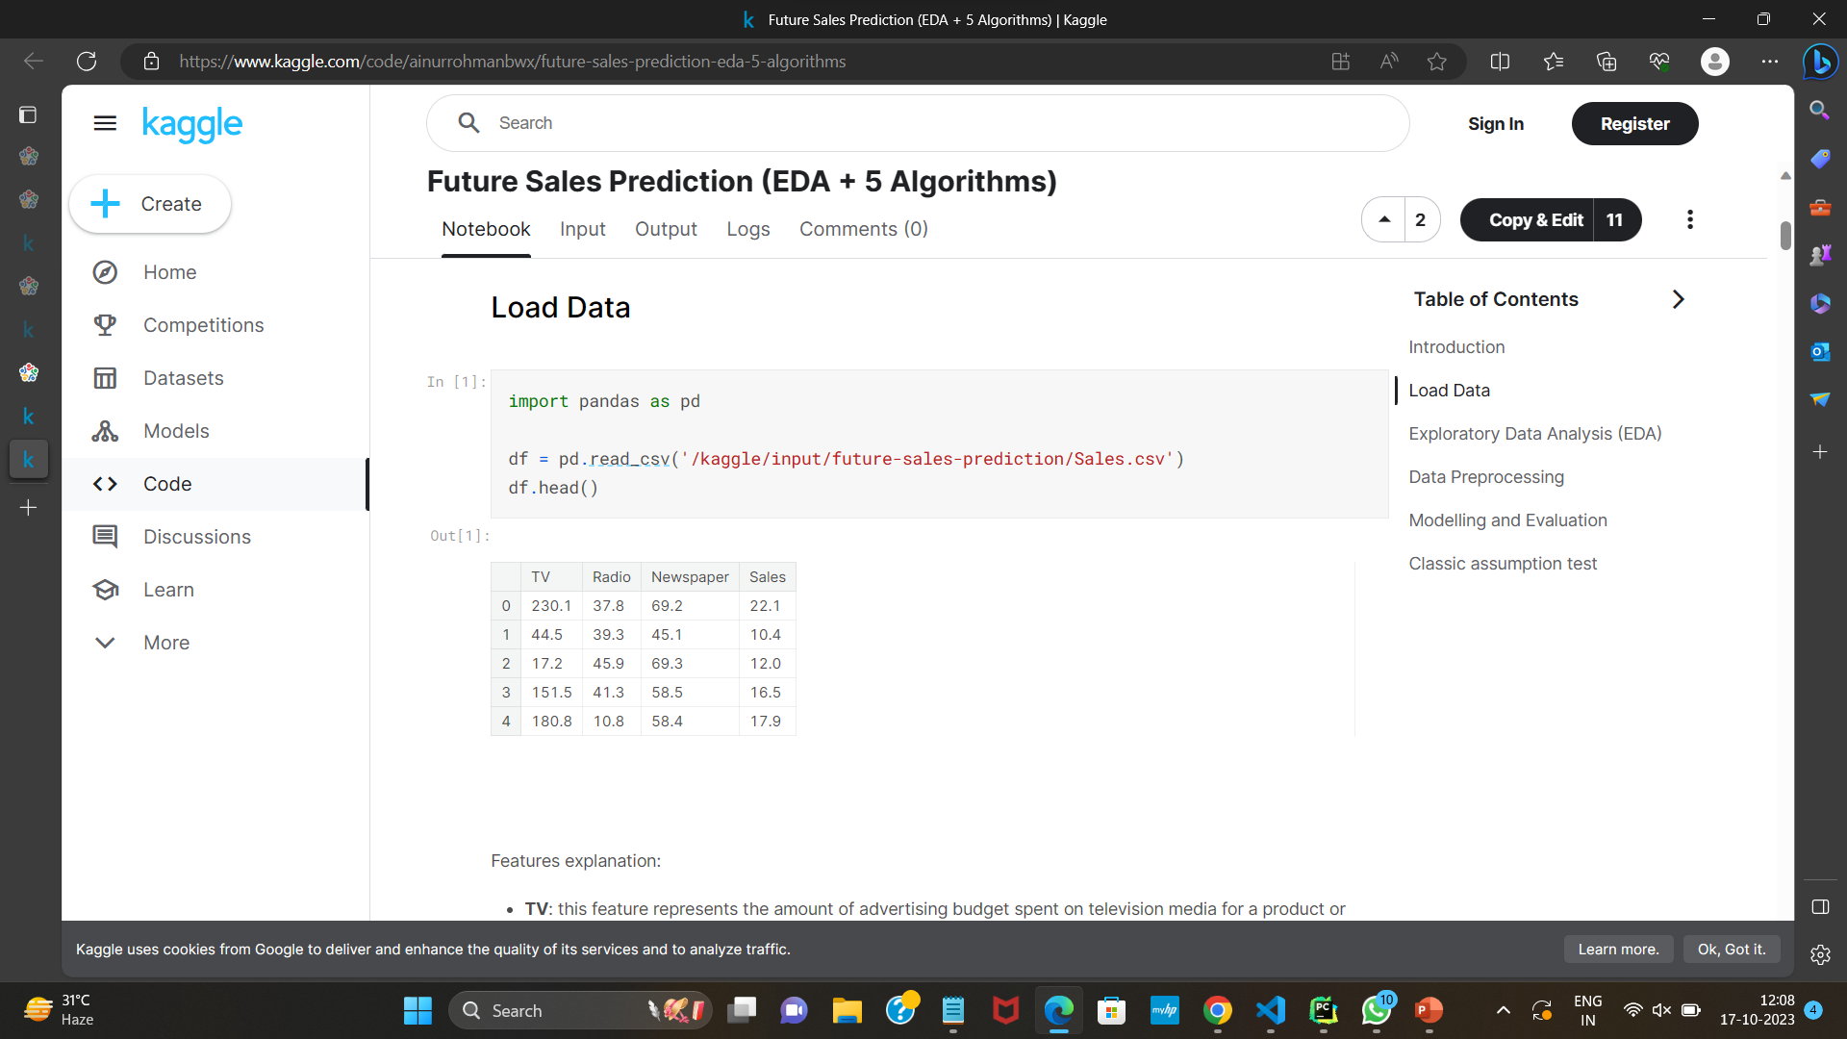

Slide 6
Analysing the dataset:
Sales_data = pd.read_csv('your_dataset.csv')
Explore the Data:
It's essential to have a quick look at your data to understand its structure. You can use functions like head(), info(), and describe().
PYTHON CODE:
print(sales_data.head())
print(sales_data.info())
print(sales_data.describe())

Slide 7
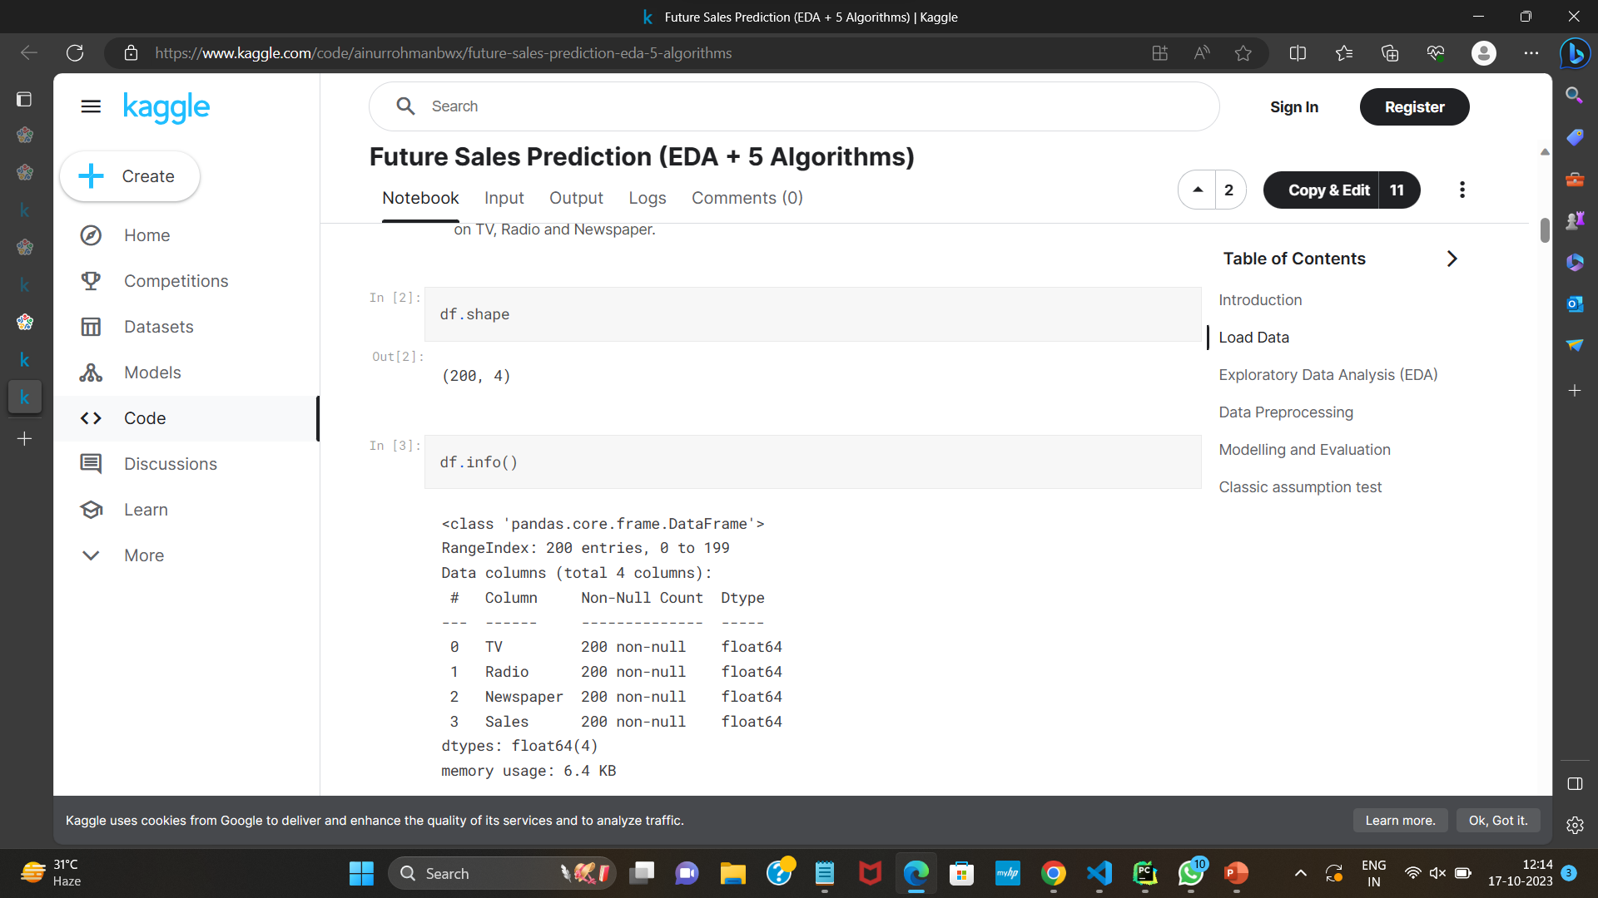

Slide 8
EXPLORATORY DATA ANALYSIS (EDA)
Exploratory data analysis is a crucial initial step in the data analysis process that allows you to understand your dataset, identify patterns, relationships, and anomalies, and gain insights that will guide your future sales prediction model. Here's how to perform EDA

Slide 9
DATA PREPROCESSING:
Handling Missing Values: Check for missing values in your dataset and decide how to handle them. You can remove rows with missing values or impute them with appropriate values.
Data Cleaning:
If your data contains anomalies or errors, clean it by correcting or removing inconsistent records.

Slide 10
FEATURE SELECTION:
Decide which columns are relevant for your prediction task. Remove any unnecessary columns.
PYTHON CODE:
selected_features = ['date', 'item_id', 'item_price', 'item_cnt_day’]
sales_data = sales_data[selected_features]
FEATUR ENGINEERING:
Create new features if necessary. For sales prediction, you might want to create features like month, year, and total sales per month.

Slide 11
STANDARD SCALER
The Standard Scaler, often referred to as Z-score normalization or standardization, is a preprocessing technique used in machine learning and statistics. It is used to standardize the features (independent variables) in a dataset so that they have a mean of 0 and a standard deviation of 1.

Slide 12
TRAIN AND TEST DATA
To split your data into training and testing sets, you can use the
train_test_split function from the sklearn.model_selection module. This
function randomly shuffles and partitions your data into two subsets,
typically one for training and one for testing.
Code:
from sklearn.model_selection import train_test_split
# Assuming 'X' is your input data and 'y' is your target variable
X_train, X_test, y_train, y_test = train_test_split(X, y, test_size=0.2, random_state=42)

Slide 13
To split your data into training and testing sets, you can use the
train_test_split function from the sklearn.model_selection module. This
function randomly shuffles and partitions your data into two subsets,
typically one for training and one for testing.
Code:
from sklearn.model_selection import train_test_split
# Assuming 'X' is your input data and 'y' is your target variable
X_train, X_test, y_train, y_test = train_test_split(X, y, test_size=0.2, random_state=42)

Slide 14
Code
import pandas as pd import matplotlib.pyplot as plt from sklearn.model_selection import train_test_split from sklearn.preprocessing import MinMaxScaler from sklearn.preprocessing import StandardScaler df = pd.read_csv("Sales.csv") date_values = pd.date_range(start='2023-10-28', periods=len(df), freq='D') df["dates"] = date_values

Slide 15
x = df.drop("Sales", axis=1) y = df["Sales"] print(df.head()) x_values = list(range(1, len(df["TV"])+1)) plt.scatter(x_values, df["TV"], label="datapoints", color="blue") plt.xlabel('x-axis label') plt.ylabel('y-axis label') plt.title("scatter") plt.legend() plt.show()

Slide 16
# there are no categorical values so need of onehot encoder X_train, X_test, y_train, y_test = train_test_split(x, y, test_size=0.2, random_state=0) scaler = MinMaxScaler() columns = X_train.drop("dates",axis=1) standard = StandardScaler() b = standard.fit_transform(columns) print(b)

Slide 17
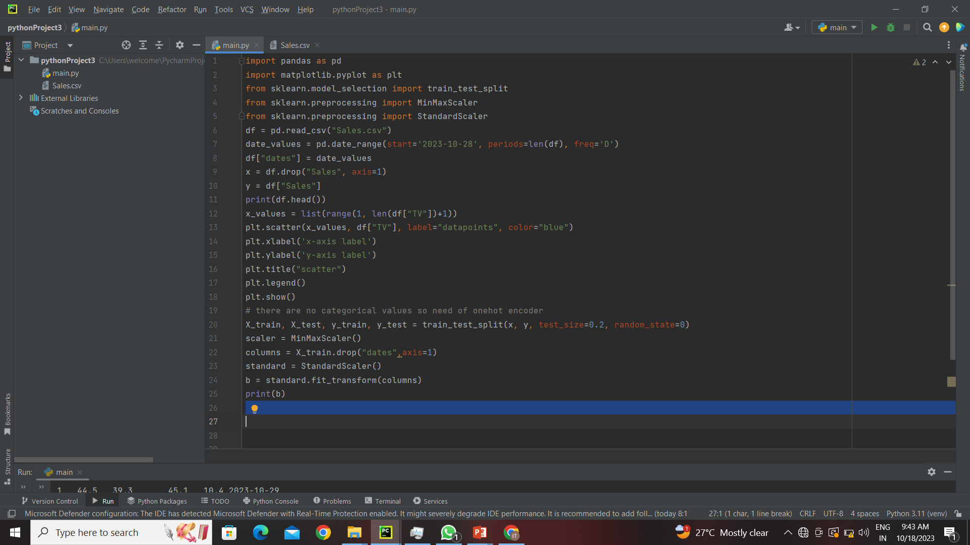

Slide 18
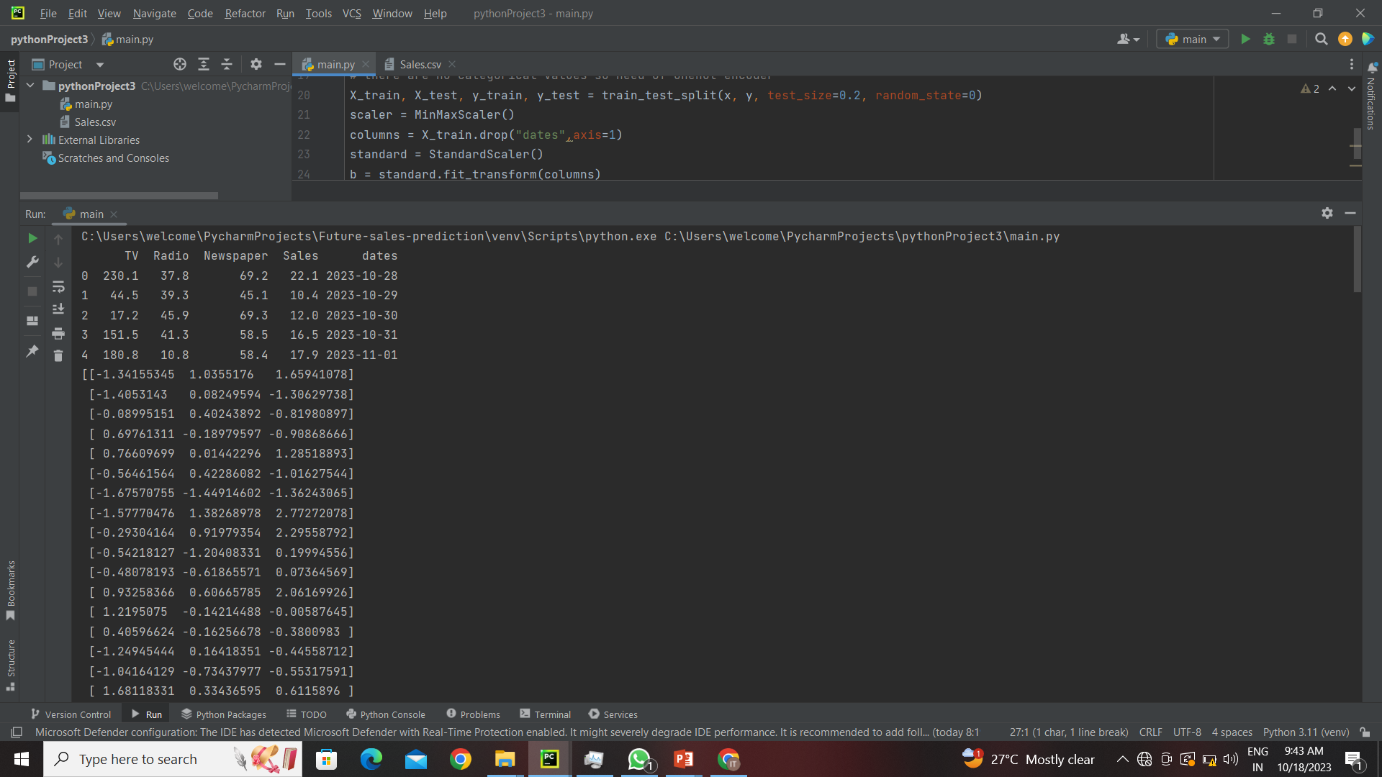
Output

