Slide 2
To achieve this we are going to consider time series modelling using ARMA and ARIMA modelling and evaluation techniques
First we use Co-variance to find the main market/segment to find the top 5 areas that we need to focus the time series analysis on:
Europe Consumer , Asia Pacific Consumer, Latin America Consumer, Asia Pacific Corporate, Europe Corporate are the 5 main Market and Segment combinations that has contributed most of the revenue for Global Mart.

Slide 3
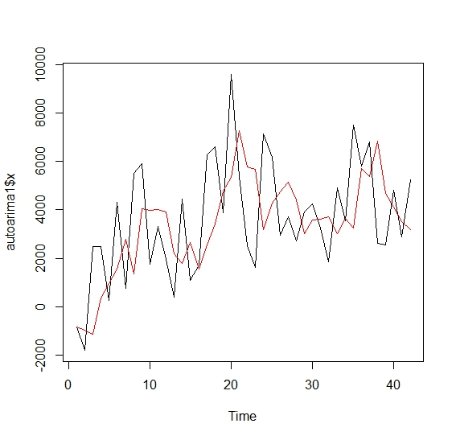
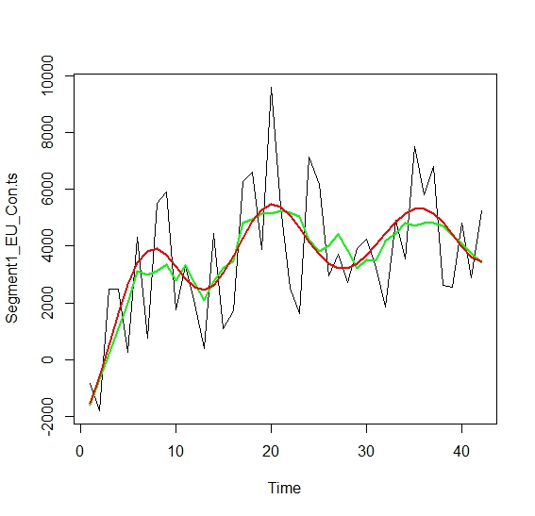
<Model Results/Plots> Market: Europe Segment: Consumer

Slide 4
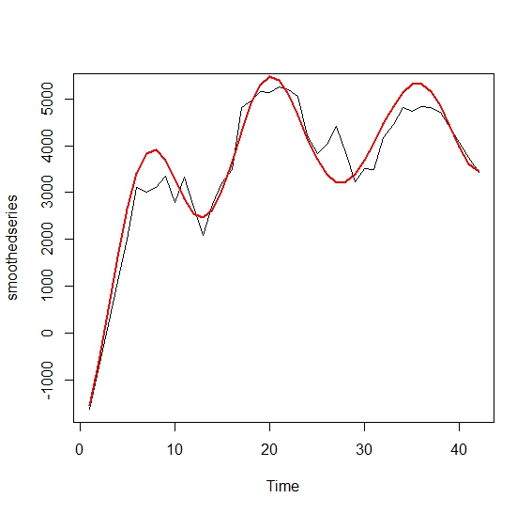
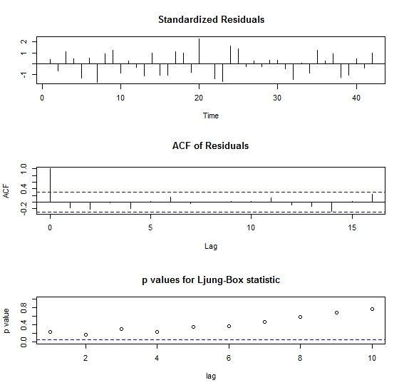
<Model Results/Plots> Smoothed series and Arma fit plots

Slide 5
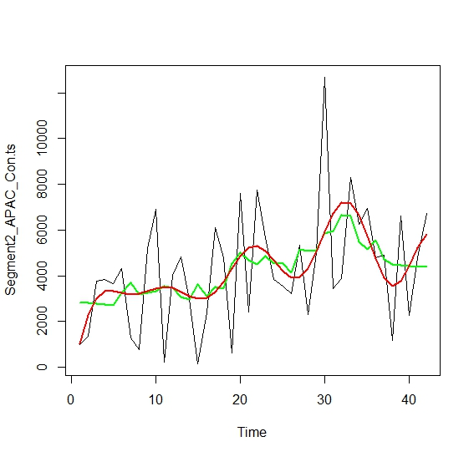
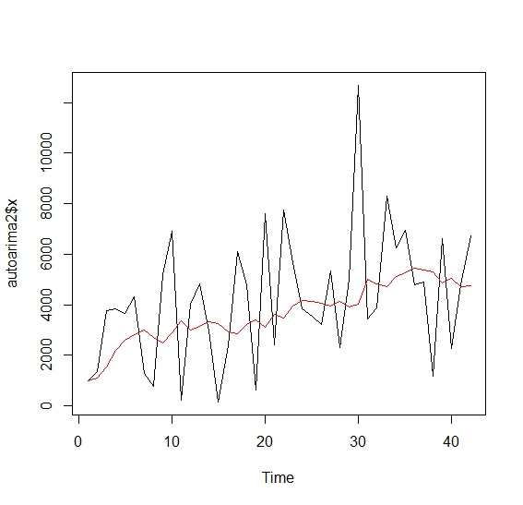
<Model Results/Plots> Market: Asia Pacific Segment: Consumer

Slide 6
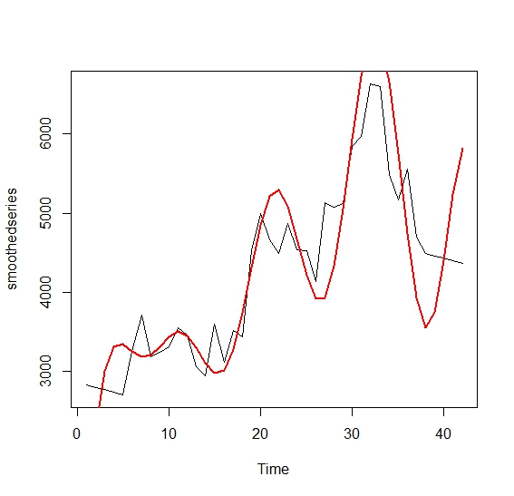
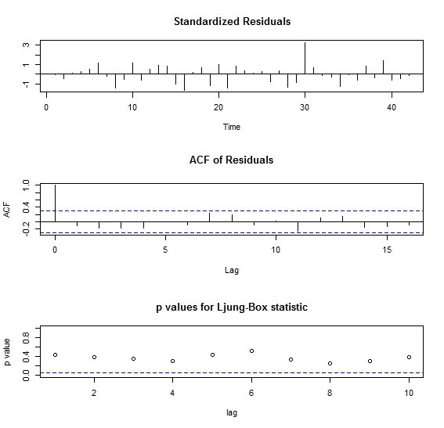
<Model Results/Plots> Smoothed series and Arma fit plots

Slide 7
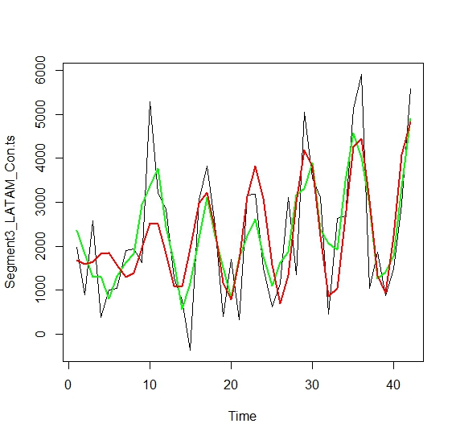
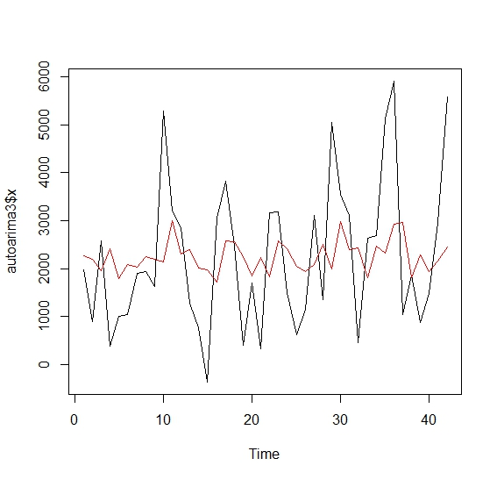
<Model Results/Plots> Market: Latin America Segment: Consumer

Slide 8
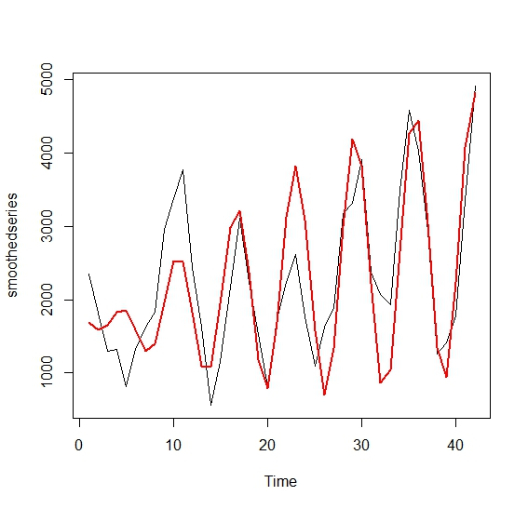
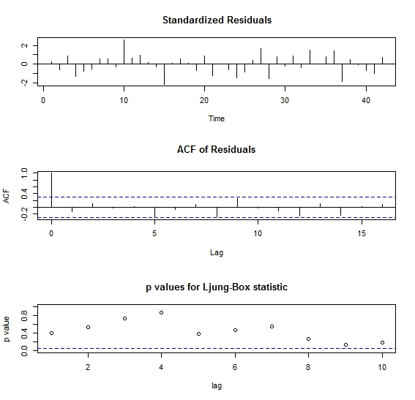
<Model Results/Plots> Smoothed series and Arma fit plots

Slide 9
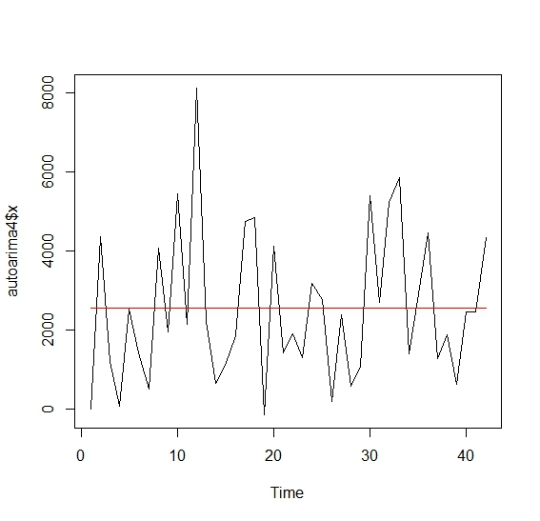
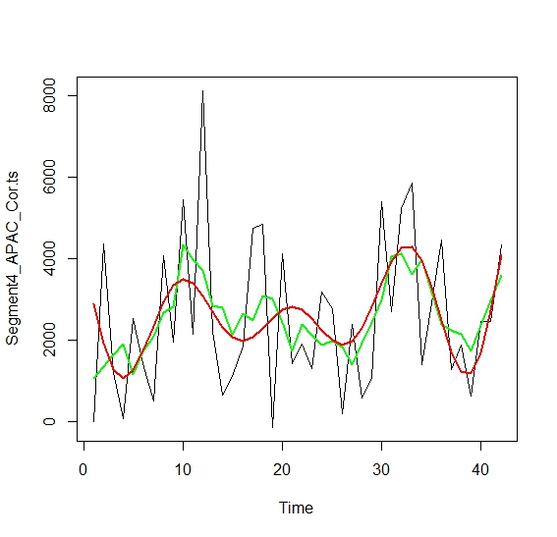
<Model Results/Plots> Market: Asia Pacific Segment: Corporate

Slide 10
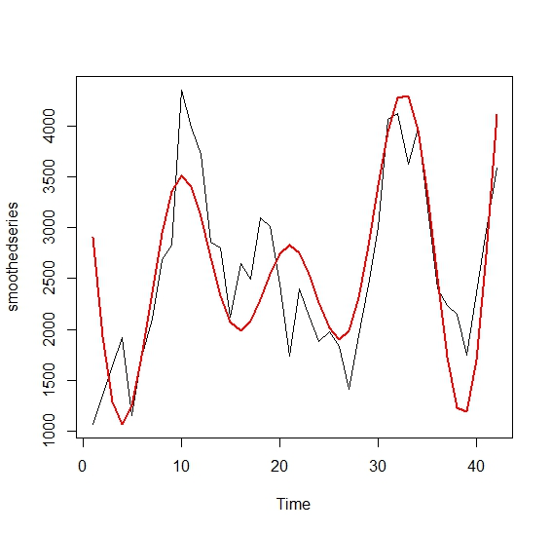
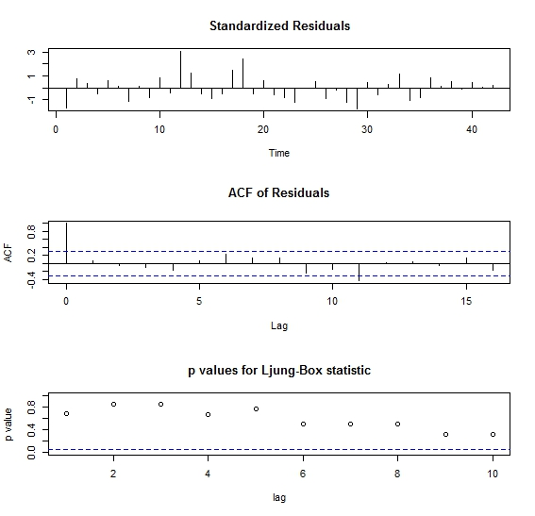
<Model Results/Plots> Smoothed series and Arma fit plots

Slide 11
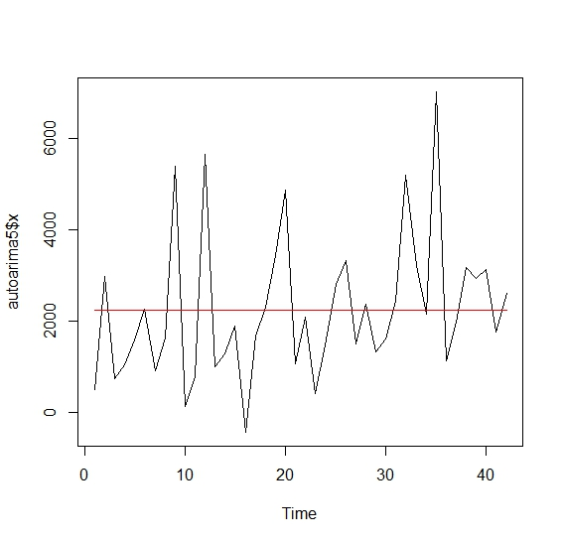
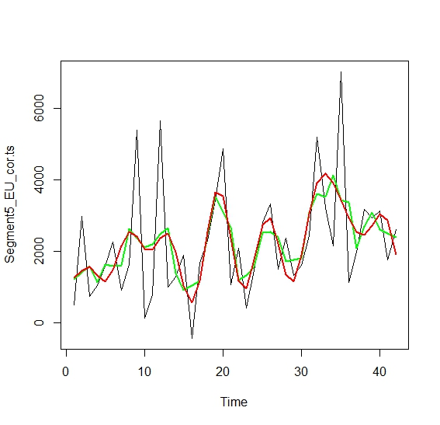
<Model Results/Plots> Market: Europe Segment: Corporate

Slide 12
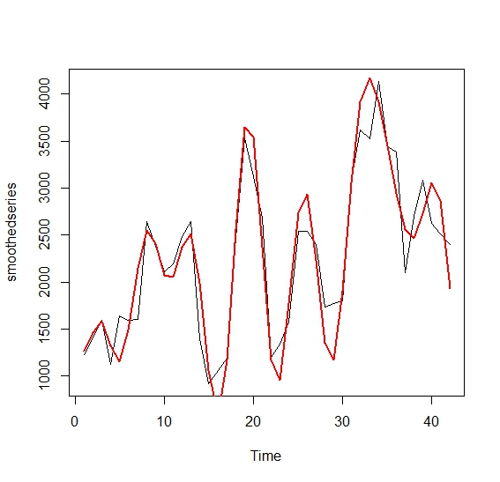
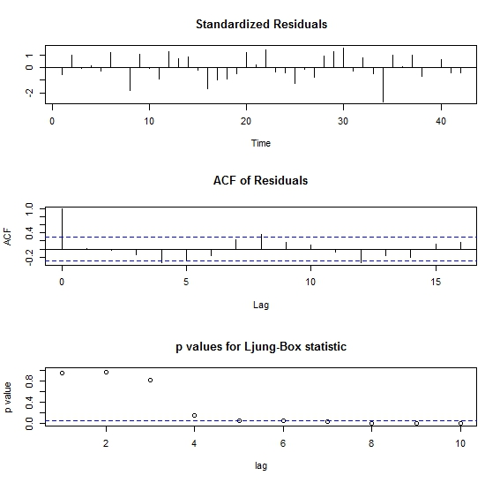
<Model Results/Plots> Smoothed series and Arma fit plots

Slide 13
<Conclusions>
By looking at all the 10 forecasted models in the R file we can observe the following:
Asia Pacific market in the consumer segment is likely to generate huge revenue over the course of next 6 months when compared to other markets and segments
Latin America market in the consumer segment is the next best market that is likely to generate more revenue over the course of next 6 months
Europe market in the corporate segment is the worst sector out of the 5 market/segments we considered that is likely to generate very less revenue over the next 6 months
Recommendation:
It is recommended that Global Mart should divert and re-route most of it’s resources to Asia Pacific and Latin America consumer markets to tap in the potential these have to generate most of the profits.

