Slide 1
Java Technology Platform
Overview
Notes:
Sun has provided Technology Platform for developing allocations which can run in any environment and fulfill all kind of business requirements.
This presentation will provide you overview of Java Technologies.
The contents in this presentation is gathered from Sun Microsystems website.
As sun is acquired by Oracle in 2010, now similar information can be obtained from Oracle site.

Slide 2
Big Picture
JRE
  JVM -----> Platform for Standalone application
  Web Container --→ Platform for Web application
  EJB Container --→ Platform for Enterprise application
  KVM -→ Platform for Micro Application
Java SE
  JDK
Java EE
  Application Server
  Web Server
Java ME
  CDC
  CLDC
Java FX
Notes:
JRE, JDK, Java EE, Java ME and Java FX are major elements of Java Technology.

Slide 3
JAVA SOFTWARES
JRE – for Desktop Users
Java SE – for desktop developers
Java EE – for developers building server-side applications
Java ME – for developers with a focus on devices of all kinds
Java FX - for web developers and designers to create dynamic applications for the next generation of web delivered content

Slide 4
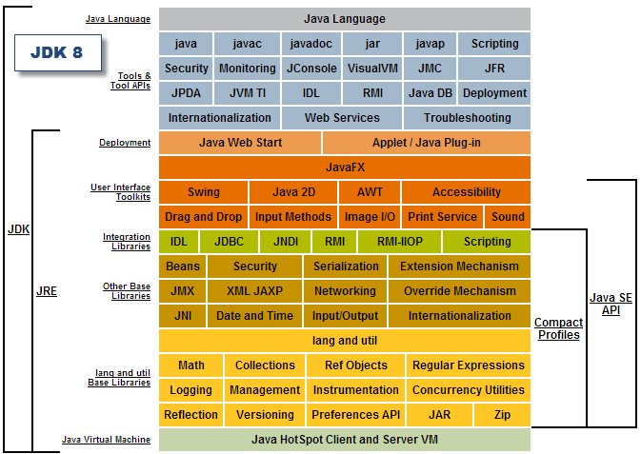

Slide 5
JAVA EE
Java EE APIs
Java EE Servers
Java EE Development Tools
Java EE Frameworks

Slide 6
JAVA EE 5
Web Application
  Servlet 2.5
  JSP 2.1
  JSTL 1.1
  JSF 1.2.3
Web Services
  JAX-WS 2.0
  JAXB 2.0
  WS Annotations
  SAAJ
  JAX-RPC
Enterprise Application
  EJB 3.0
  JCA 1.5
  JAF1.1
  Java Mail
  JTA

Slide 7
JAVA EE 6
Web Application
  Servlet 3.0
  JSP 2.2
  JSTL 1.2
  JSF 2.0
Web Services
  JAX-WS 2.2
  JAXB 2.2
  JAX-RPC 1.1
  JAX-RS 1.1
  JAXB 2.2
  JAXR 1.0
Enterprise Application
  EJB 3.1
  JCA 1.6
  JAF1.1
  Java Mail 1.4
  JTA 1.1
  JPA 2.0
  JMS 1.1
  Web Beans 1.0
  Dependency Injection for Java
  Bean Validation

Slide 8
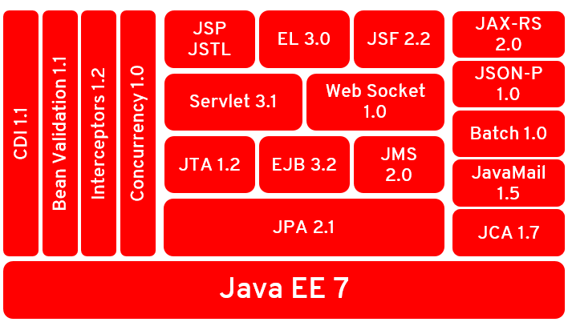
JAVA EE 7

Slide 9
JAVA EE Servers
Apache Tomcat
Sun Glassfish
BEA Weblogic (now part of Oracle)
IBM Websphere
JBoss

Slide 10
JAVA EE Development Tools
Eclipse
Netbeans
IBM RAD

Slide 11
JAVA EE Frameworks
Struts 2
Spring 3
JSF 2
Hibernate 3
iBatis 2 / myBatis 3
Wicket
Notes:
J2EE developers were facing lot of configuration and deployment issues while working with EJB.
This the origin for several lightweight container architecture aiming replacement of EJB.
Several third partly framework exists in the market and each one has there pros and cons.
You need to select one as per the requirement of application architecture.

Slide 12
JAVA ME
CLDC - Connected Limited Device Configuration
CDC - Connected Device Configuration
Java ME Platform for Converged Services
/java.sun.com/javame/technology/index.jsp
Notes:
Java Platform, Micro Edition (Java ME) is a collection of technologies and specifications to create a platform that fits the requirements for mobile devices such as consumer products, embedded devices, and advanced mobile devices. It is a collection of technologies and specifications that can be combined to create a complete Java runtime environment specifically to fit the requirements of a particular device

Slide 13
JAVA FX
JavaFX provides a productive development environment for web developers, mashup authors, and Java developers to quickly and easily build the next generation of rich internet applications (RIAs).
With JavaFX, designers and developers can collaborate on building high-impact RIAs. Designers gain a broad set of tools to complete the designer/developer workflow, and developers have a simple, declarative scripting language with the right set of tools.

Slide 14
Summary….
  Java FX
  Java Card
  Development Tools
  Java Frameworks
  JRE
  Java SE
  Java EE
    Servlet
    JSP
    EJB
    JSF
    Web Server
    Application Server
  Java ME
    CDC
    CLDC

