Slide 1
Java Programming – Language Fundamentals

Slide 2








Iconic Representations.......
Test your Memory
Can you Solve?
Objective
Coffee Break
Queries
Recap
Need more Info
Brainstorm

Slide 3
Objectives
At the end of this module you would be able to understand,
Language Fundamentals
Constants and Variables
Underscores in Numeric Literals(Java 7)
Data Types
Control Structures
Strings in switch statement (Java 7)
Command Line Arguments
Arrays
Classes and Objects
Access Specifiers
Enum
String Handling
Scanner Class
Notes:
Variables:
A variable is a location in your computer's memory(Random Access Memory (RAM)) in which you can store a value and from which you can later retrieve that value.
A variable must always be defined inside a Java class.
When you define a variable in Java, you must tell the compiler what kind of variable it is. (this is usually referred to as variable type).
Types of Variables :
Class Variable/Static variable
A java class variable is a field declared using the keyword static within a java class, or with or without the keyword static within a java interface declaration.
These variables are declared at the top level. They begins their life when first class loaded into memory and ends when class is unloaded. As they remain in memory till class exist, so these variables often called Class variables.
There only one copy of these variables exist
These variables are having highest scope that is they can be accessed from any method/ block in a class
When no explicit assignment made while declaration they are initialized to default values , depending on their type.

Slide 4
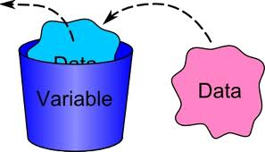
Language Fundamentals
Variables
Basic unit of storage in a Java program
Three types of variables:
Instance variables
Static variables
Local variables
Each variable type has different scope
Notes:
Variables:
A variable is a location in your computer's memory(Random Access Memory (RAM)) in which you can store a value and from which you can later retrieve that value.
A variable must always be defined inside a Java class.
When you define a variable in Java, you must tell the compiler what kind of variable it is. (this is usually referred to as variable type).
Types of Variables :
Class Variable/Static variable
A java class variable is a field declared using the keyword static within a java class, or with or without the keyword static within a java interface declaration.
These variables are declared at the top level. They begins their life when first class loaded into memory and ends when class is unloaded. As they remain in memory till class exist, so these variables often called Class variables.
There only one copy of these variables exist
These variables are having highest scope that is they can be accessed from any method/ block in a class
When no explicit assignment made while declaration they are initialized to default values , depending on their type.

Slide 5
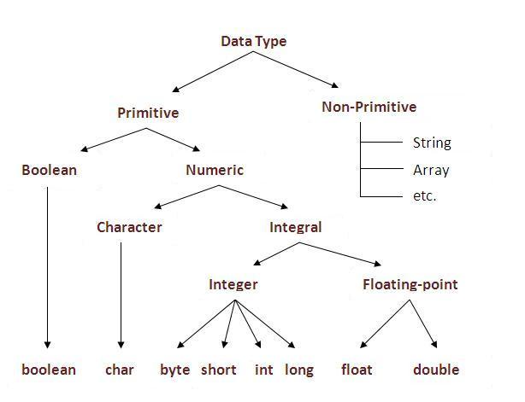
Language Fundamentals
Data Types
Classified into two
Primitive
Non-Primitive
Notes:
Data Types in Java:
Data type specifies the size and type of values that can be stored in an identifier. The Java language is rich in its data types. Different data types allow you to select the type appropriate to the needs of the application.
Java's types all have a set size regardless of platform, while C/C++'s data types only have a minimum number of bits, which causes some variation between platforms.
Data types in Java are classified into two types:
Primitive: Integer, Character, Boolean, and Floating Point.
Non-primitive : Classes, Interfaces, and Arrays.
Primitive Data Types:

Slide 6
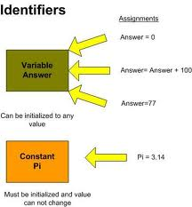
Language Fundamentals
Constants
Use the final keyword before the variable declaration and include an initial value for that variable
Eg:-
final float pi = 3.141592;
final boolean debug = false;
final int maxsize = 30000;
Notes:
Constants :-
There are several values in the real world which will never change.
A square will always have four sides,
PI to three decimal places will always be 3.142, and
a day will always have 24 hours.
These values remain constant. When writing a program it makes sense to represent them in the same way - as values that will not be modified once they have been assigned to a variable. These variables are known as constants.
This is done by adding the keyword modifier final:
final int NUMBER_OF_HOURS_IN_A_DAY = 24;
Note: as per the standard Java naming convention the variable name is mentioned in uppercase
Where to Declare Constants
As with normal variables you want to limit the scope of constants to where they are used.
If the value of the constant is only needed in a method then declare it there.

Slide 7
Underscores in Numeric Literals(Java 7)
Declaring numeric literals with underscores would have caused a compile error in any previous release of the language.
But in Java 7 numeric literals with underscore characters are allowed.
You can place any number of underscore(_) between digits of numeric literals.
This added feature improves the readability of the code.
For Example credit card number can be write as follows:
Long creditCardNumber=1234_5678_9012_3456L;

Slide 8
Underscores in Numeric Literals (Java 7)
You can place underscore between digits. But for placing underscore you need to be careful.
You can’t place underscore in the following places:
You can’t place it at the beginning or at the end of a number.
Adjacent to a decimal point in a floating point literal.
Before to an F or L suffix.
In positions where a string of digits is expected.

Slide 9
Underscores in Numeric Literals(Java 7)
Some of the valid example with different type of data type is given below:
long creditCardNumber = 1234_5678_9012_3456L;
long socialSecurityNumber = 999_99_9999L;
float pi = 3.14_15F;
long hexBytes = 0xFF_EC_DE_5E;
long hexWords = 0xCAFE_BABE;
long maxLong = 0x7fff_ffff_ffff_ffffL;

Slide 10

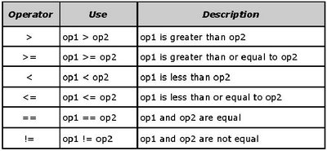
Language Fundamentals
Operators
Arithmetic operators:
+, - , * , / ,%
++, --
+=, -=, *= , /= , %=
Relational operators:
Notes:
Arithmetic Operators:
When an integer and a floating-point number are used as operands to a single arithmetic operation, the result is a floating point. The integer is implicitly converted to a floating-point number before the operation takes place
Relational Operators:
Relational Operators are used to check relation between two variables or numbers.
Relational Operators are Binary Operators.Relational Operators returns “Boolean” value .i.e it will return true or false.
Most of the relational operators are used in “If statement” and inside Looping statement in order to check truthness or falseness of condition.They acan also be used within an expression.
Note: Do not Use Relational Operator to Initialize Non-Boolean Variable
However we can use Relational Operators in Expression in which final result will be accumulated in boolean variable.
class boolDemo {
public static void main(String args[]) {
boolean num1 = 100 > 20; System.out.println(num1);
}
}

Slide 11
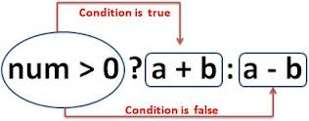
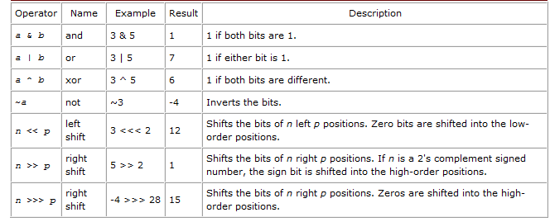
Language Fundamentals
Operators
Ternary Operator:
Bitwise operators:
Notes:
Conditional Operator:
Conditional Operator (?:)‏ is a ternary operator. It takes in three arguments that together form a conditional expression.
Syntax:
exp1?exp2:exp3 wherein exp1 - is a boolean expression whose result must either be true or false
Result:
If exp1 is true, exp2 is the value returned. If it is false, then exp3 is returned.
Bitwise Operators

Slide 12
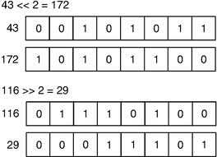
Language Fundamentals
Operators
Bitwise operators:
Notes:
Bitwise Operator:
Java's bitwise operators operate on individual bits of integer (int and long) values. If an operand is shorter than an int, it is promoted to int before doing the operations.
It helps to know how integers are represented in binary.
Common Uses of Bitwise Operators are:
Packing and Unpacking : common use of the bitwise operators (shifts with ands to extract values and ors to add values) is to work with multiple values that have been encoded in one int. Bit-fields are another way to do this.
For example, let's say you have the following integer variables: age (range 0-127), gender (range 0-1), height (range 0-128). These can be packed and unpacked into/from one short (two-byte integer) like this (or many similar variations).
Setting flag bits
Some library functions take an int that contains bits, each of which represents a true/false (boolean) value. This saves a lot of space and can be fast to process.
Shift left multiplies by 2; shift right divides by 2
On some older computers it was faster to use shift instead of multiply or divide.

Slide 13
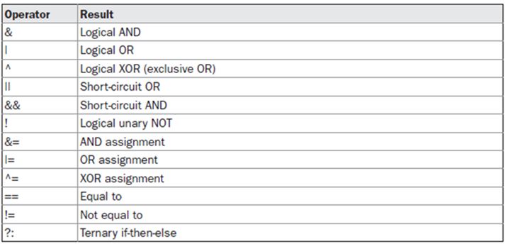
Language Fundamentals
Operators
Logical operators:
Notes:
Logical Operator:
Logical operators have one or two boolean operands that yield a boolean result.
There are six logical operators:
&& (logical AND)‏
& (boolean logical AND)‏
(logical OR)‏
(boolean logical inclusive OR)‏
-^ (boolean logical exclusive OR)‏
-! (logical NOT)‏
&&(logical) and &(boolean logical) AND
The basic difference between && and & operators :
&& supports short-circuit evaluations (or partial evaluations), while & doesn't.
Given an expression:exp1 && exp2
-&& will evaluate the expression exp1, and immediately return a false value is exp1 is false. -If exp1 is false, the operator never evaluates exp2 because the result of the operator will be false regardless of the value of exp2.
In contrast, the & operator always evaluates both exp1 and exp2 before returning an answer.

Slide 14
Language Fundamentals
Operators
Logical operators:
Notes:
(logical) and (boolean logical) inclusive OR
The basic difference between and I operators :
supports short-circuit evaluations (or partial evaluations), while doesn't.
Given an expression:exp1 exp2
will evaluate the expression exp1, and immediately return a true value is exp1 is true.If exp1 is true, the operator never evaluates exp2 because the result of the operator will be true regardless of the value of exp2.
In contrast, the operator always evaluates both exp1 and exp2 before returning an answer.
^ (boolean logical exclusive OR)
The result of an exclusive OR operation is TRUE, if and only if one operand is true and the other is false.
Note that both operands must always be evaluated in order to calculate the result of an exclusive OR.
! ( logical NOT)‏
The logical NOT takes in one argument, wherein that argument can be an expression, variable or constant.

Slide 15
Language Fundamentals
Control Statements
decision-making statements
If-then
If-then-else
switch
Iteration Statement
while
do…while
for
for (int i : 1 to n)
Java5
Notes:
Control Structures:
Control structure includes the looping control structure and conditional or branching control structure.
In a conditional or branching control structure, a portion of the program is executed once depending on what conditions occur in the code.
If –else
switch
In a looping control structure, series of statements are repeated
While
Do-while
For
Enhanced For loop:
Java 5 also introduced an advanced for syntax known as for-each.
It is designed specifically for iterating over collections of data, whether whose collections are arrays, or some predefined collection classes
Syntax:
for (Type element: collectionOfType) { // Do something with element }

Slide 16
Strings in switch statement (Java 7)
Prior to Java 7 the condition code in a switch statement had to be a Integer type (long types are not allowed) or enum values.
Java 7 allows programs to switch on a string.
The switch statement compares the passed string with each case label and execute the case block which have matched string.
The comparison of string in switch statement is case sensitive.
Example code is given in the next slide.

Slide 17
Arrays

Slide 18
Language Fundamentals
Arrays
Arrays are objects of class java.lang.reflect.Array
Can’t specify size when declaring array
int arr[3]; // not legal in Java!
int arr[]; // okay
int[] arr; // okay (same as previous line)
Arrays (as all objects) are dynamically allocated
int[] arr = new int[3];
Before allocation, array variable is null
Destroyed automatically by garbage collector. No delete operator
Shorthand to declare, allocate, and initialize
int[] arr = { 5, 10, 15, 20};

Slide 19
Language Fundamentals
Arrays(Contd..)
Java array (object) always knows its own length
int[] arr = {5, 20, 15, 10};
System.out.println(“Length is ” + arr.length);
Elements indexed from 0 to length-1, like C++
Raises exception for “ArrayIndexOutOfBounds”
Length is fixed when allocated; create new array and copy over to change length

Slide 20
Language Fundamentals
Arrays(Contd..)
Example:
class ArrayEx{
public static void main(String a[]){
int i, sum = 0;
int[] arr;
for (i=0; i < arr.length; i++)
sum += arr[i];
for(int i:arr){
System.out.println(i);
}

Slide 21
Language Fundamentals
Array as References
Arrays are objects, hence, are implemented as references (reference is a pointer in disguise)
int[] arr = {5, 20, 15, 10};
int[] b = arr;
b[0] = 3; // arr[0] also becomes 3!
Array copying (java.lang.System)
System.arraycopy(from, fromIndex, to, toindex, count);
int[] c;
System.arraycopy(arr, 0, c, 0, 4);
Array sorting (java.util.Arrays)
Arrays.sort(arr) //use a tuned QuickSort

Slide 22
Language Fundamentals
Arrays(Contd..)
Example:
public class ArrayRef {
public static void main( String[] args ) {
int [] a = {0, 1, 2, 3, 4};
int [] b = {10, 11, 12, 13, 14};
a = b;
b = new int[] { 20, 21, 22, 23, 24 };
for (int i=0; i<a.length && i<b.length; i++) {
System.out.println( a[i]+ ” ”+ b[i] );
}
}
}

Slide 23
Language Fundamentals
Multidimensional Arrays:
Java arrays are asymmetrical arrays
int[][] matrix = new int[5][10];
int[] firstRow = matrix[0]; //ref to 1st row
int[] secondRow = matrix[1]; //ref to 2nd row
int firstElem = matrix[0][0];
firstElem = firstRow[0];

Slide 24
Language Fundamentals
Arrays of objects too can be created
Example 1 :
Box Barr[] = new Box[3];
Barr[0] = new Box();
Barr[1] = new Box();
Barr[2] = new Box();
Example 2:
String[] Words = new String[2];
Words[0]=new String(“Mumbai”);
Words[1]=new String(“Pune”);

Slide 25
Language Fundamentals
Command-Line Arguments
Command line arguments allow the user to affect the operation of an application.
When invoking an application, the user types the command line arguments after the application name.
E.g. C:\> java Sort files
In the Java language, when you invoke an application, the runtime system passes the command line arguments to the application's main method via an array of Strings. Each String in the array contains one of the command line arguments

Slide 26
Language Fundamentals
Variable Arguments in a Function
with J2SE 5.0, we have the added convenience of using variable parameters, known less formally as varargs.
In general, a method can have at most one parameter that is a vararg, it must be the last parameter taken by the method, and it is denoted by the object type, a set of ellipses ( ... ), and the name of the variable.
E.g. public static void greetings(String... Names)

Slide 27
Classes and Objects

Slide 28
Language Fundamentals
Classes :
A class is nothing but a blueprint or a template for creating different objects which defines its properties and behaviors.
Java class objects exhibit the properties and behaviors defined by its class.
A class can contain fields and methods to describe the behavior of an object.
Methods are nothing but members of a class that provide a service for an object or perform some business logic.
Java fields and member functions names are case sensitive.

Slide 29
Language Fundamentals
Objects:
An object is an instance of a class created using a new operator.
The new operator returns a reference to a new instance of a class.
This reference can be assigned to a reference variable of the class.
The process of creating objects from a class is called instantiation. An object encapsulates state and behavior.
The phases of life of an Object are:
Creating Object
Using Object
Cleaning Up Unused Object

Slide 30
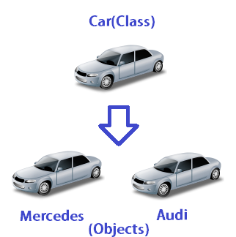
Language Fundamentals
Classes and Objects(Contd..)

Slide 31
Language Fundamentals
Objects(Contd..):
Creating Object
It includes Declaration, Instantiation and Initialization
Declaring an Object is just like variable declaration
The new operator instantiates a class by allocating memory for a new object of that type.
classes can provide one or more constructors to initialize a new object of that type.
Using Object
We can use an Object to
1. Manipulate or inspect its variables
2. Call Methods of that class.
Objects can refer to members using dot(.) operator.
Cleaning Up Unused Object
The Java runtime environment deletes objects when it determines that they are no longer being used. This process is called garbage collection.

Slide 32
Language Fundamentals
Classes and Objects(Contd..)
Object Instantiation
Rectangle r1=new Rectangle();
r1
Rectangle r2=r1;
length
Rectangle
Object
breadth
r2

Slide 33
Language Fundamentals
Classes and Objects
Example:
public class Cube {
int length = 10;
int breadth = 10;
int height = 10;
public int getVolume() {
return (length * breadth * height);
}
public static void main(String[] args) {
Cube cubeObj; // Creates a Cube Reference
cubeObj = new Cube(); // Creates an Object of Cube
System.out.println("Volume of Cube is : " + cubeObj.getVolume());
}
}

Slide 34
Language Fundamentals
Objects(Contd..):
Cleaning Up Unused Object
An object is eligible for garbage collection when there are no more references to that object. References that are held in a variable are naturally dropped when the variable goes out of scope. Or you can explicitly drop an object reference by setting the variable to null.
The Garbage Collector
The Java platform has a garbage collector that periodically frees the memory used by objects that are no longer needed.
The Java garbage collector is a mark-sweep garbage collector. A mark-sweep garbage collector scans dynamic memory areas for objects and marks those that are referenced. After all possible paths to objects are investigated, unmarked objects (unreferenced objects) are known to be garbage and are collected.
The garbage collector runs in a low-priority thread and runs either synchronously or asynchronously depending on the situation and the system on which Java is running.
It runs synchronously when the system runs out of memory or in response to a request from a Java program.
The Java garbage collector runs asynchronously when the system is idle

Slide 35
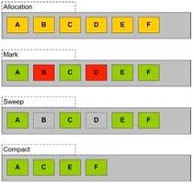
Language Fundamentals
Objects(Contd..)
Garbage Collector(Contd..)
Allocation
Mark
Sweep
Compact

Slide 36
Language Fundamentals
Objects(Contd..):
Cleaning Up Unused Object(Contd..)
Before an object gets garbage-collected, the garbage collector gives the object an opportunity to clean up after itself through a call to the object's finalize method. This process is known as finalization.
During finalization, an object may wish to free system resources such as files and sockets or to drop references to other objects so that they in turn become eligible for garbage collection.
The finalize method is a member of the Object class.
Syntax:
protected void finalize()
{
// finalization code here
}

Slide 37
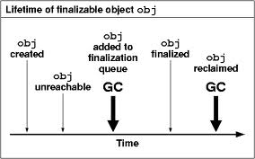
Language Fundamentals
Objects(Contd..):
Cleaning Up Unused Object(Contd..)

Slide 38
Language Fundamentals
Access Specifiers
Java allows you to control access to classes, methods, and fields via so-called access specifiers.
Java supports four access-specifiers
public
protected
default
private
public:
public classes, methods, and fields can be accessed from everywhere.
A file with Java source code can only contain one public class whose name must also match with the filename.
use public classes, methods, or fields only if you explicitly want to offer access to the entities.

Slide 39
Language Fundamentals
Access Specifiers
protected:
protected methods and fields can only be accessed within the same class to which the methods and fields belong, within its subclasses, and within classes of the same package, but not from anywhere else.
use the protected access level when it is appropriate for a class's subclasses to have access to the method or field, but not for unrelated classes.
Default
Default specifier If you do not set access to specific level
A class, method, or field will be accessible from inside the same package to which the class, method, or field belongs, but not from outside this package.
This access-level is convenient if you are creating packages.

Slide 40
Language Fundamentals
Access Specifiers(Contd..)
private
private methods and fields can only be accessed within the same class to which the methods and fields belong.
private methods and fields are not visible within subclasses and are not inherited by subclasses.
It is mostly used for encapsulation: data are hidden within the class and accessor methods are provided.

Slide 41
Language Fundamentals
Classes and Objects(Contd..)
Method Overloading
Method overloading results when two or more methods in the same class have the same name but different parameters.
Methods with the same name must differ in their types or number of parameters. This allows the compiler to match parameters and choose the correct method when a number of choices exist.
Changing just the return type is not enough to overload a method, and will be a compile-time error. They must have a different signature.
When no method matching the input parameters is found, the compiler attempts to convert the input parameters to types of greater precision. A match may then be found without error.
At compile time, the right implementation is chosen based on the signature of the method call
Like methods, constructors can also be overloaded.

Slide 42
Language Fundamentals
Classes and Objects
Types of variables.
Local variables .
variables defined inside methods, constructors or blocks are called local variables.
The variable will be declared and initialized within the method and the variable will be destroyed when the method has completed.
Instance variables .
Instance variables are variables within a class but outside any method.
These variables are instantiated when the class is loaded. Instance variables can be accessed from inside any method, constructor or blocks of that particular class.
Class variables .
Class variables are variables declared with in a class, outside any method, with the static keyword.
There would only be one copy of each class variable per class, regardless of how many objects are created from it.

Slide 43
Language Fundamentals
Classes and Objects(Contd..)
Types of variables.
Class variables .(Contd..)
Static variables are stored in static memory. It is rare to use static variables other than declared final and used as either public or private constants.
Static variables are created when the program starts and destroyed when the program stops.

Slide 44
Language Fundamentals
Nested Classes:
Class within another class
The scope of a nested class is bounded by the scope of its enclosing class
Nested classes are of two types:
Static
Non-static aka Inner Class
Nested classes should be used to reflect and enforce the relationship between two classes

Slide 45
Language Fundamentals
Nested Classes:
Class within another class
The scope of a nested class is bounded by the scope of its enclosing class
Nested classes are of two types:
Static
Non-static aka Inner Class
Nested classes should be used to reflect and enforce the relationship between two classes

Slide 46
Language Fundamentals
Nested Classes(Contd..):
Nested Classes
Static Nested Classes
Inner Nested Classes
Nested Class Declared with keyword “static”
Anonymous Inner Classes
Local Inner Classes
Class defined in method is “Local Inner Class”
Class doesn’t have a name

Slide 47
Language Fundamentals
Nested Classes:
Class within another class
The scope of a nested class is bounded by the scope of its enclosing class
Nested classes are of two types:
Static
Non-static aka Inner Class
Nested classes should be used to reflect and enforce the relationship between two classes

Slide 48
Language Fundamentals
Nested Classes(Contd..)
Inner Classes: They are categorized into two.
Anonymous Inner Classes:
These classes do not have a name
Are defined at the location they are instantiated using additional syntax with the new operator
Typically used to create objects “on the fly” in contexts such as return value of a method, an argument in a method call or in initialization of variables
Local Inner Class:
If an inner class has been defined within a code block (typically within the body of a method), then such an inner class is called a local inner class.
A local inner class is not a member of the enclosing class and hence it can not have any access specifier.
A local inner class will have access to all the members of the enclosing class and it'll have access to the local final variables in the scope it's defined.

Slide 49
Language Fundamentals
Superclass – Object
Cosmic super class
Ultimate ancestor – every class in Java implicitly extends Object
A variable of type Object can be used to refer to objects of any type
E.g.. Object obj = new Emp();
Methods in Object class are :
void finalize()
Class getClass()
String toString()
used when we need a string representation of an object.

Slide 50
Language Fundamentals
System Class
The System class is the class used to interact with any of the system resources
It can not be instantiated.
Contains a lot of methods and variables to handle system I/O.
Among the facilities provided by the System class are standard input, standard output, and error output streams.
Some of the methods in System class:
System.gc(): is a suggestion and not a command
It is not guaranteed to cause the garbage collector to collect everything
System.exit(0);

Slide 51
Enum

Slide 52
Language Fundamentals
Enum:
Enums are used primarily to handle a collection of logically grouped constants.
A field of enumerated types can only assigned the values which are present in the enumerated types.
They represent a finite and fixed set of values that are canonical but can also have behaviour.
The standard way to represent an enumerated type in earlier version of Java was the int Enum pattern.
For example:-
public static final int DAY_SUNDAY = 0;
public static final int DAY_MONDAY = 1;

Slide 53
Language Fundamentals
“ Do you see any challenges in that way of defining Enumerations ?“

Slide 54
Language Fundamentals
Enum (Contd..)
Problems with the earlier pattern:
Since a SUNDAY, MONDAY is just an int you can pass in any other int value where a days is required, or add two days together which makes no sense. This also means that int enums are not Type Safe.
Because int enums are compile-time constants, they are compiled into clients that use them. If a new constant is added between two existing constants or the order is changed, clients must be recompiled. If they are not, they will still run, but their behavior will be undefined.
Because they are just ints, if you print one out all you get is a number, which tells you nothing about what it represents, or even what type it is. It is uninformative
No support for iterating over the defined enumerated constants

Slide 55
Language Fundamentals
Enum(Contd..)
In Java5 we don’t need to define the constants. Instead use enum data type to store them directly.
Syntax:
public enum enumName {Value1,..........ValueN;}
Example:
import java.util.ArrayList; public class EnumsExamples { public enum Color {WHITE, BLACK, RED, YELLOW, BLUE} public static void main(String[] args) { System.out.println(Color.BLUE); } }

Slide 56
Language Fundamentals
Enum(Contd..):
Enum embedded inside a class.
Outside the enclosing class, elements are referenced as Outter.Color.RED, Outter.Color.BLUE, etc.
public class Outter { public enum Color {WHITE, BLACK, RED, YELLOW, BLUE} }
Enum that overrides toString method.
A semicolon after the last element is required to be able to compile it.
public enum Color {WHITE, BLACK, RED, YELLOW, BLUE; @Override public String toString() { String s = super.toString(); return s.substring(0, 1) + s.substring(1).toLowerCase(); }}

Slide 57
Language Fundamentals
Enum(Contd..)
Enum with additional fields and custom constructor.
Enum constructors must be either private or package default, and protected or public access modifier is not allowed.
When custom constructor is declared, all elements declaration must match that constructor.
public enum Color { WHITE(21), BLACK(22), RED(23), YELLOW(24), BLUE(25); private int code; private Color(int c) { code = c; } public int getCode() { return code; }
}

Slide 58
Language Fundamentals
Enum(Contd..)
Restrictions on Enum
Though enum types are full-fledged classes, the following are not allowed with enums:
enums cannot be subclassed
enums cannot have public constructor
enums are not allowed to be instantiated (using new)
enums cannot be cloned
All of these are enforced during compile-time.

Slide 59
String Handling

Slide 60
Language Fundamentals
String Handling:
Java implements strings as objects of type String.
A string is a sequence of characters. Unlike most of the other languages, Java treats a string as a single value rather than as an array of characters.
Java has two classes
String(immutable instance)
StringBuffer(mutable instance)
StringBuilder(similar to StringBuffer but unsynchronized – introduced in Java 1.5)

Slide 61
Language Fundamentals
String Handling(Contd..)
String Class
defined in the java.lang package
implements immutable character strings, which are read-only once the string object has been created and initialized.
When a change is made to a string, a new object is created and the old one is disused. This causes extraneous garbage collection if string modifier methods are used too often. The StringBuffer or StringBuilder class should be used instead of String objects in these cases.
String Constructors:
public String(String value)
public String()
public String(char[] value)
public String(char[] value, int startindex, int len)
public String(StringBuffer sbf)
public String(byte[] asciichars)
public String(byte[] asciiChars, int startindex, int len)

Slide 62

Question
String aName=“Syntel";
String bName="Syntel";
if (aName==bName){
System.out.println(‘True');
else
System.out.println(‘False');
}
“ What will be the output of the following? “

Slide 63
Language Fundamentals
String Handling(Contd..):
String Class(Contd..):
Note: Since strings are stored as a memory address, the == operator can't be used for comparisons. Use equals() and equalsIgnoreCase() to do comparisons.
Accessor methods:
length(),charAt(i), getBytes(), getChars(istart,iend,gtarget[],itargstart), split(string,delim), toCharArray(), valueOf(g,iradix), substring(iStart [,iEndIndex)]) [returns up to but not including iEndIndex]
Modifier methods:
substring()
concat()
replace()
trim()
toUpperCase()
toLowerCase()

Slide 64
Language Fundamentals
String Handling(Contd..):
String Class(Contd..):
String Comparison Methods
public boolean equals(Object str)
Returns true if string contents are same
public boolean equalsIgnoreCase(Object str)
public int compareTo(String str):
The compareTo() method is used in conditions where a Programmer wants to sort a list of strings in a predetermined order.
returns an int value as the result
Less than zero The invoking string is less than the argument string.
Zero The invoking string and the argument string are same.
Greater than zero The invoking string is greater than the argument string.
public int compareToIgnoreCase(String str)
public boolean regionMatches(int startindex, String str2, int startindex2, int len)
The regionMatches() method is used to check the equality of two string regions where the two string regions belong to two different strings.

Slide 65
Language Fundamentals
String Handling(Contd..):
String Class(Contd..):
String Comparison
public boolean startsWith(String prefix)
public boolean endsWith(String prefix)
String Search:
public int indexOf(int ch)
public int lastIndexOf(int ch)

Slide 66
Language Fundamentals
String Handling(Contd..):
StringBuffer Class:
allow manipulation of strings without creating a new object each time a manipulation occurs.
Accessor methods:
capacity(), charAt(i), length(), substring(iStart [,iEndIndex)])
Modifier methods:
append(),
delete(), deleteCharAt(),
ensureCapacity(),
getChars(),
insert(),
replace(),
reverse(),
setCharAt(),
setLength()

Slide 67
Language Fundamentals
String Handling(Contd..):
StringBuilder Class:
similar to StringBuffer ones but they are unsynchronized (ie. not for multithreaded applications).
They are also much faster
Accessor methods:
capacity(), length(), charAt(i), indexOf(g), lastIndexOf(g)
Modifier methods:
append(),
delete(),
insert(),
getChars(), setCharAt(),
substring(),
replace(),
reverse(),
trimToSize(g ),

Slide 68
Language Fundamentals
StringBuilder defString=new StringBuilder();
“ What will be the default size? “
By default it will set the size to 16 chars

Slide 69
Language Fundamentals
String Handling(Contd..)
String Tokenizer:
Defined in java.util package
a tokenizer function parses or breaks up the text into subunits called tokens based on specific delimiters or break characters.
Java also provides several tokenizer classes including
StringTokenizer (for strings) and
StreamTokenizer and Scanner (for streams and files).
StringTokenizer class objects may be created by one of three constructor methods depending on the parameters used.
The StringTokenizer methods are: int countTokens(), boolean hasMoreTokens() and String nextToken().

Slide 70
Wrapper Classes

Slide 71
Language Fundamentals
Wrapper Classes
Java is an object-oriented language and as said everything in java is an object. But what about the primitives?
Java allows you to include the primitives in the family of objects by using what are called wrapper classes.
There is a wrapper class for every primitive date type in Java. This class encapsulates a single value for the primitive data type. For instance the wrapper class for int is Integer, for float is Float, and so on.

Slide 72
Language Fundamentals
Wrapper Classes(Contd..):
It server two purposes:
To provide a mechanism to “wrap” primitive values in an object so that the primitives can be included in activities reserved for objects, like as being added to Collections, or returned from a method with an object return value.
To provide an assortment of utility functions for primitives. Most of these functions are related to various conversions: converting primitives to and from String objects, and converting primitives and String objects to and from different bases (or radix), such as binary, octal, and hexadecimal.

Slide 73
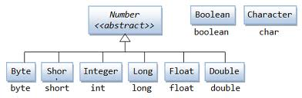
Language Fundamentals
Wrapper Classes:

Slide 74
Language Fundamentals
Wrapper Classes(Contd..):
Creating a Wrapper Class Object:
can be created in one of two ways:
by instantiating the wrapper class with the new operator or
E.g. boolean boo = false; Boolean wboo = new Boolean(boo);
float f = 12.34f; Float wfloat = new Float(f);
double d = 12.56d; Double wdouble = new Double(d);
by invoking a static method on the wrapper class.
using static valueOf() .Because it's a static method, it can be invoked directly on the class (without instantiating it), and will return the corresponding object that is wrapping what you passed in as an argument.
Integer i2 = Integer.valueOf("101011", 2); // converts 101011 to 43 and assigns the value 43 to the Integer object i2
Float f2 = Float.valueOf("3.14f"); // assigns 3.14 to the Float object f2

Slide 75
Language Fundamentals
Wrapper Class(Contd..)
Wrapper Class Utilities:
Once you store a primitive in a wrapper object, often you will want to retrieve the stored primitive at a later time. This can be done using one of these methods:
xxxValue()
xxx Parsexxx(String) method:
These methods throw a NumberFormatException if the String argument is not properly formed.
The difference between the two methods is:
parseXxx() returns the named primitive.
valueOf() returns a newly created wrapped object of the type that invoked the method.
toString()
toXxxString()
E.g. String s3 = Integer.toHexString(254);

Slide 76
Language Fundamentals
“ Why do we need a Wrapper Class? “

Slide 77
Scanner Classes

Slide 78
Language Fundamentals
Scanner Class
Introduced in Java 5.0 to make it easier to read basic data types from a character input source.
Defined in java.util package.
The scanner acts as a wrapper for the input source.
The constructor specifies the source of the characters that the Scanner will read.

Slide 79
Language Fundamentals
Scanner Class(Contd..):
First, you must create a Scanner object
To read from the keyboard (System.in), do:
Scanner scanner = new Scanner(System.in);
To read from a file, do:
File myFile = new File("myFileName.txt"); Scanner scanner = new Scanner(myFile);
You have to be prepared to handle a FileNotFound exception
You can even “read” from a String:
Scanner scanner = new Scanner(myString);
This can be handy for parsing a string
Note: When processing input, a scanner usually works with tokens. In the case of a scanner, tokens must be separated by "delimiters." By default, the delimiters are whitespace characters such as spaces and end-of-line markers, but you can change a Scanner's delimiters if you need to.

Slide 80
Language Fundamentals
Scanner Class(Contd..):
Using Scanner Class:
First, you should make sure there is something to scan
scanner.hasNext() → boolean
You wouldn’t use this when reading from the keyboard
You can read a line at a time
scanner.nextLine() → String
Or, you can read one “token” at a time
A token is any sequence of nonwhitespace characters
scanner.next () → String
Note: There are also methods to check for and return primitives directly

Slide 81
Language Fundamentals
Scanner Class(Contd..);
Scanning for Primitives:
If an attempt is made to read past the end of input, an exception of type NoSuchElementException is thrown.
Methods such as scanner.getInt() will throw an exception of type InputMismatchException if the next token in the input does not represent a value of the requested type
You can read in and convert text to primitives:
boolean b = sc.nextBoolean();
byte by = sc.nextByte();
short sh = sc.nextShort();
int i = sc.nextInt();
long l = sc.nextLong();
float f = sc.nextFloat();
double d = sc.nextDouble();
And test if you have something to read:
hasNextBoolean()
hasNextByte()
hasNextShort()
hasNextInt()
hasNextLong()
hasNextFloat()
hasNextDouble()

Slide 82
Language Fundamentals
Formatted Output
Java 5 has a printf method, similar to that of C
Each format code is % width code
Some format codes are s for strings, d for integers, f for floating point numbers
Example:
double pi = Math.PI;
System.out.printf("%8s %-8s %6d %-6d %8f %-8.2f :) \n“, "abc", "def", 123, 456, pi, pi);
System.out.printf("%8s %-8s %6d %-6d", "abcdef", "ghijkl", 12345, 6789);

Slide 83
Brainstorm

Slide 84
Queries

Slide 85
Recap
In this lesson, you have learnt:
Variables and Data Types
Working with Command-line arguments.
Fetching User Input using Scanner
Dealing with Arrays
String, StringBuffer and StringBuilder in Java
Access Specifier, Packages
Wrapper Class
Scanner Class

Slide 86
Quiz…
1) State True/False
A Java program has to be always enclosed in a class definition.
Answer :True. Java is completely Object-oriented so it has to be always enclosed in a class definition.
2) What would be the output of the following code snippet?
System.out.println("// Looks like a comment.");
Answer : //Looks like a comment.

Slide 87
Proceed to Day-2
Thank You

