Slide 1
Exception Handling

Slide 2

Objectives
To learn and understand
Exception and exception class hierarchy
Handling Exceptions.
Try with resource statement (Java 7)
Multiple Exception Catching (Java 7)
Creating User-defined Exceptions
Using Assertions to detect logical errors
Notes:
It should be mentioned to the participant that current version of Java is 1.5, although not covered as part of this training.

Slide 3
Exception Handling
What is an Exception?
An exception is a problem that arises during the execution of a program. An exception can occur for many different reasons, including the following:
A user has entered invalid data.
A file that needs to be opened cannot be found.
A network connection has been lost in the middle of communications, or the JVM has run out of memory.
Some of these exceptions are caused by user error, others by programmer error, and others by physical resources that have failed in some manner.
Cause normal program flow to be disrupted

Slide 4
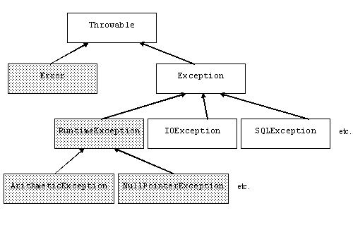
Exception Handling
Exception Class Hierarchy

Slide 5
Exception Handling
Exception Class Hierarchy(Contd..)
Throwable class
Root class of exception classes
Immediate subclasses
Error
Exception
Exception class
Exceptions indicate that a problem occurred but that the problem is not a serious systemic problem.
Conditions that user programs can reasonably deal with
Usually the result of some flaws in the user program code
Examples
Division by zero error
Array out-of-bounds error

Slide 6
Exception Handling
Exception Class Hierarchy(Contd..)
The subclasses of java.lang.Exception are divided in two categories :
Checked Exception and
Unchecked Exception.
Checked Exceptions:
Classes that extend Throwable class except RuntimeException and Error are Checked Exceptions. They are checked at compile-time by the Java compiler.
Compiler checks each method call and method declaration determines whether method throws checked exceptions.
If so, the compiler ensures checked exception caught or declared in throws clause.
If not caught or declared, compiler error occurs.
Examples:
ClassNotFoundException
IOException
FileNotFoundException

Slide 7
Exception Handling
Exception Class Hierarchy(Contd..)
Unchecked Exception:
The classes that extend RuntimeException are known as Unchecked Exceptions.
Unchecked exceptions are those exception objects which don't have to be explicitly caught. Whenever an unchecked exception occurs JVM will handle it automatically.
Compiler does not check code to see if exception caught or declared rather they are checked at run-time.
Examples:
NullPointerException
IndexOutOfBoundsException
ArrayIndexOutOfBoundsException

Slide 8
Exception Handling
Exception Class Hierarchy(Contd..)
Error class
Used by the Java run-time system to handle errors
occurring in the run-time environment
Generally beyond the control of user programs
This type of abnormal conditions are errors which can comes from external sources or agent.
The instances which are type of java.lang.Error cannot be recovered in java program. They have to be correct by external source.
Examples
out ofMemoryError
AssertionError
VirtualMachineError

Slide 9
Exception Handling
Exception Handling in java is done using try, catch, throw, throws, finally clause
try {
// statement that could throw an exception
}catch (<exception type> e) {
// statements that handle the exception
}catch (<exception type> e) { //e higher in hierarchy
// statements that handle the exception
}finally {
// release resources
}
//other statements
At most one catch block executes
finally block always executes once, whether there’s an error or not

Slide 10

Exception Handling
What is the problem with the following
code snippet?
class sampleDemo {
public static void main(String a[]) {
int d = 0;
int a = 10 /d;
System.out.println(“Rest of the code……………….”);
}
}

Slide 11
Exception Handling
Example: With Exception Handling
class exceptionDemo {
public static void main(String a[]) {
try {
int d = 0;
int a = 10 /d;
} catch(ArithmeticException ae) {
System.out.println(ae);
}
System.out.println(“Rest of the code……………….”);
}
}

Slide 12

Exception Handling
sampleDemo.java
exceptionDemo.java

Slide 13
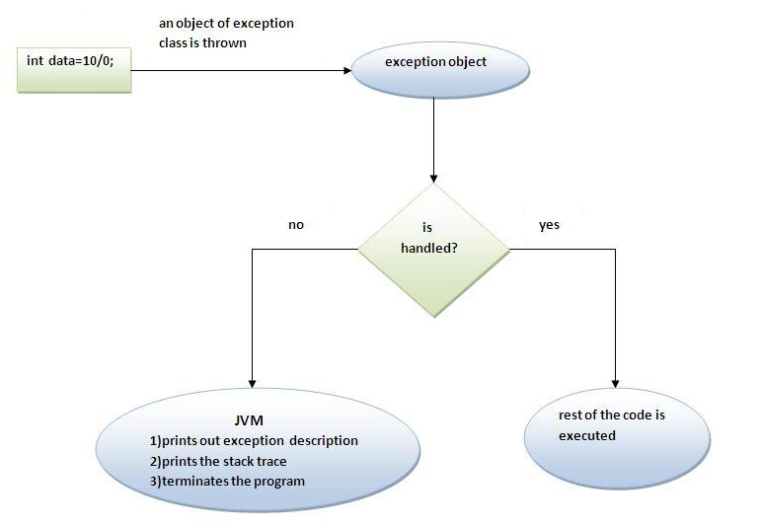
Exception Handling

Slide 14
Exception Handling
Why Exception Handling ?
Improves readability and maintainability
Error handling code is separated from the normal program
Adding more handlers requires more catch clauses without affecting the original program flow
Easy to say where the exception will be handled
Exceptions propagate the call stack at runtime
Caller can have its own error handling routines for some abnormal condition

Slide 15
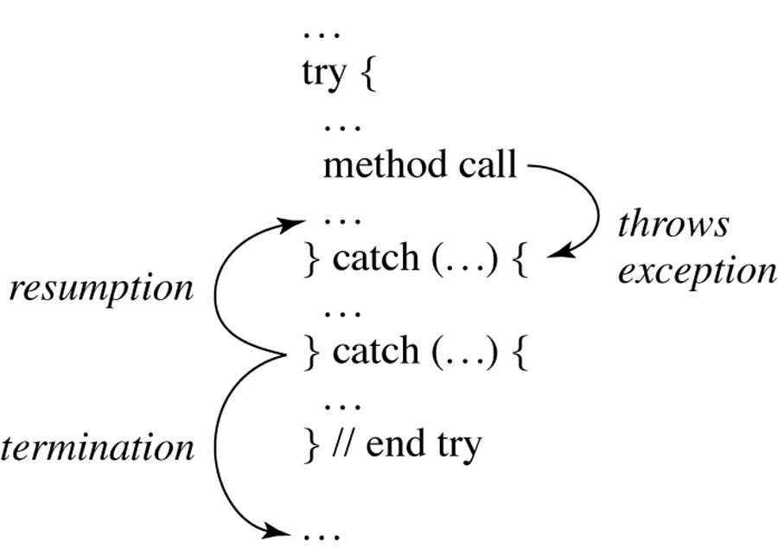
Exception Handling
Multiple Catch
It is possible that a statement might throw more than one kind of exception
We can list a sequence of catch blocks, one for each possible exception
There is an object hierarchy for exceptions - since the first one that matches is used and the others skipped, put a derived class first and its base class later or else it will result in a compiler error.

Slide 16
Try with resource statement (Java 7)
It is also known as Automatic Resource Management(ARM).
The try with resource statement contains declaration of one or more resources.
Prior to Java SE 7 resource object must be closed explicitly, when the resource use or work is finished.
After the release of Java SE 7 the try with resource statement handles it implicitly means it automatically closed the resource when it has no longer use to the class.
Example code is given the next slide.

Slide 17
Multiple Exception Catching (Java 7)
Java 7 introduced multi-catch functionality to catch multiple exception types using a single catch block.
In the pre Java 7 world, you would handle exceptions by writing separate catch blocks for different types of exceptions that occur in the try block.
Java 7 multi catch block provides you the flexibility to combine such catch blocks provided you have similar code to handle these exceptions.
Example code is given the next slide.

Slide 18
Exception Handling
Exception "thrown" here
Thrown exception matched against first set of exception handlers
Exception handler
If it fails to match, it is matched against next set of handlers, etc.
Exception handler
If exception matches none of handlers, program is abandoned

Slide 19
Exception Handling
Although try and catch provide a terrific mechanism for trapping and handling exceptions, the problem is
“how to clean up after an exception occurs”
Because execution transfers out of the try block as soon as an exception is thrown, the cleanup code cannot be put at the bottom of the try block and expect it to be executed if an exception occurs.

Slide 20
Exception Handling
Finally Clause
A finally block encloses code that is always executed at some point after the try block, whether an exception was thrown or not.
Even if there is a return statement in the try block, the finally block executes right after the return statement is encountered, and before the return executes
Will not execute if the application exits early from a try block via method System.exit

Slide 21
Exception Handling
Finally Clause(Contd..)
Example:
class demo {
public static void main(String a[]) {
try {
int d = 0;
int a = 42 /d;
} catch(ArithmeticException ae) {
System.out.println(ae);
}finally{
System.out.println(“Always Executed”);
}
}
}

Slide 22
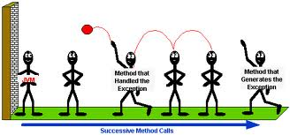
Exception Handling
Propagating an Exception
Before you can catch an exception, some code somewhere must throw one.
Any code can throw an exception: our code, code from a package written by someone else such as the packages that come with the Java platform, or the Java runtime environment. Regardless of what throws the exception, it’s always thrown with the throw statement.
Method that handled the exception
Method that generates the exception

Slide 23
Exception Handling
Propagating an Exception
Throw Clause:
You can throw an exception, either a newly instantiated one or an exception that you just caught, by using the throw keyword.
The throw statement requires a single argument: a throwable object.
Throwable objects are instances of any subclass of the Throwable class.

Slide 24
Exception Handling
Propagating an Exception(Contd..)
Example:
public int divideIntegers(int number, int divisor) {
try{
if(divisor==0)
throw new ArithmeticException(“divisor cannot be zero”);
else
return number/divisor;
}catch(ArithmeticException ae){ }

Slide 25
Exception Handling
Propagating an Exception(Contd..)
Preceding step
try block throw statement
unmatched catch
matching catch
unmatched catch
finally
next step

Slide 26
Question
Consider a scenario where you are making some general purpose class. This class may contain several methods that may be error prone. So in this case it’s better to declare them instead of handling.
“How will you declare an exception is thrown”

Slide 27
Exception Handling
If method is capable of throwing an exception or If a method does not handle a checked exception, then calling programs needs to be informed about it. This is done by throws
Throws Clause:
The throws keyword appears at the end of a method's signature followed by a comma separated list of Exceptions.
Throws clause is not commonly used for Exceptions of type Error, RuntimeException, or its subclasses

Slide 28
Exception Handling
Throws Clause(Contd..)
Example
public int divideIntegers(int number, int divisor) throws ArithmeticException{
if(divisor==0)
throw new ArithmeticException(“divisor cannot be zero”);
else
return number/divisor;
}
Now, wherever this method is used either handle the thrown exception or re throw them.
Re-throwing an exception is known as Chained exception.

Slide 29
Exception Handling
User-Defined Exception
You can create your own exceptions in Java. For creating user-defined exceptions we must ensure that:
All exceptions must be a child of Throwable.
If you want to write a checked exception we need to extend the Exception class.
If you want to write a runtime exception, you need to extend the RuntimeException class.

Slide 30
Exception Handling
User-Defined Exception
Example:
class AgeException extends Exception {
AgeException(String message) {
super(message);
}
}
A method that makes use of the above exception class:
public int setAge(int age) throws AgeException{
if (age<18)
throw new AgeException(“Age should be more than 18");
else
this.age=age;

Slide 31
Assertion

Slide 32
Assertions
An assertion is a Java statement in the program specifying whether the current state of the computation is as expected
Assertions can be used to assure program correctness and avoid logic errors.
Must form a boolean expression that
When evaluated to true nothing happens
The program state is ok
When evaluated to false throws AssertionError
Can be disabled during runtime without program modification or recompilation
Two forms
assert condition;
assert condition: expression;

Slide 33
Assertions
Example:
public class AssertionDemo {
public static void main(String[] args) {
int i; int sum = 0;
for (i = 0; i < 10; i++) {
sum += i;
}
assert i == 10;
assert sum > 10 && sum < 5 * 10 : "sum is " + sum;
}
}

Slide 34
Assertions
By default, the assertions are disabled at runtime. To enable it, use the switch –enableassertions, or –ea for short, as follows:
java –ea AssertionDemo
Assertions can be selectively enabled or disabled at class level or package level. The disable switch is –disableassertions or –da for short.
Example: The following command enables assertions in package package1 and disables assertions in class Class1.
java –ea:package1 –da:Class1 AssertionDemo

Slide 35
Assertions
Exception Handling Vs Assertions
Assertion should not be used to replace exception handling. Exception handling deals with unusual circumstances during program execution. Assertions are to assure the correctness of the program.
Exception handling addresses robustness and assertion addresses correctness.
Like exception handling, assertions are not used for normal tests, but for internal consistency and validity checks.
Assertions are checked at runtime and can be turned on or off at startup time.

Slide 36

Summary
Exception Handling :
It is done using try,catch, throw, throws, finally.
For normal execution:
try block executes, then finally block executes, then other statements execute
When an error is caught and the catch block throws an exception or returns:
try block is interrupted
catch block executes (until throw or return statement)
finally block executes
When error is caught and catch block doesn’t throw an exception or return:
try block is interrupted
catch block executes
finally block executes
other statements execute

Slide 37
Summary
Exception
When an error occurs that is not caught:
try block is interrupted
finally block executes
Assertions:
Checks for the correctness of the program
Can be enabled or disabled as per programmer’s choice.

Slide 38
Questions
What can be the possible cause of NoClassDefFoundError?
NoClassDefFoundError occurs when a class was found during compilation but could not be located in the classpath while executing the program.

Slide 39
Questions
How will you re-throw an exception which has been caught in a catch block?
Throw

Slide 40
Questions
Consider a scenario where you are using a third-party function that is specified to return a double value between 0 and 1, but we'd like to guarantee that is the case. How will you do it?
Using Assertions

Slide 41
THANK YOU

