Slide 1
Java Database Connectivity

Slide 2

Objective
To understand JDBC API
To know types of drivers
To implement database connectivity to different databases using JDBC
Notes:
It should be mentioned to the participant that current version of Java is 1.5, although not covered as part of this training.

Slide 3

Contents
What is JDBC
Architecture of JDBC
Types of Divers
Implementing JDBC
Fetching the MetaData
DataSource and Connection Pooling
Rowsets
Notes:
It should be mentioned to the participant that current version of Java is 1.5, although not covered as part of this training.

Slide 4
Java Database Connectivity
What is JDBC?
Defines how a java program can communicate with a database.
JavaSoft worked with D/B tool vendors to provide DBMS independent mechanism to write client side applications
The result is JDBC API
JDBC API is designed to allow developers to create database front ends without having to continually rewrite the code
An API that is D/B independent and uniform across databases
It has through a set of interface that are implemented by the driver.
Driver is responsible for converting a standard JDBC call to a native call.
JDBC API has two major packages
java.sql and
javax.sql.
This new JDBC API moves Java applications into the world of heavy-duty database computing.

Slide 5
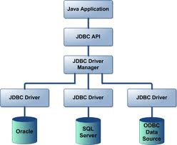
Java Database Connectivity
JDBC Architecture
JDBC architecture consist of different layers and drivers which are capable of working with any database

Slide 6
Java Database Connectivity
JDBC API supports both two-tier and three-tier models for database access
JAVA Application
Client GUI
Java Applet or HTML browser
JDBC
HTTP,RMI,CORBA
Application server (JAVA)
Propriety protocol
Business logic
Database server
JDBC
Propriety protocal
DBMS
DBMS
Two-tier JDBC
Three-tier JDBC

Slide 7
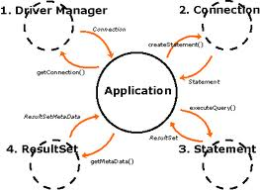
Java Database Connectivity
JDBC API
JDBC API consist of different classes and Interfaces to help interact with the Database.

Slide 8
Java Database Connectivity
JDBC API
JDBC has four primary pieces, used for each database access phase:
DriverManager:
the DriverManager class loads and configures a database driver on the database
Connection:
The Connection class performs confectioning and authentication to a database
Statement / PreparedStatement:
The Statement and PreparedStatement classes send SQL statements to the database engine for preprocessing and eventually execution
ResultSet:
the ResultSet class allows for the inspection of results from executions

Slide 9
Java Database Connectivity
JDBC API
Driver
Connection
ResultSet
Interfaces in java.sql
DatabaseMetaData
ResultSetMetaData
Statement
PreparedStatement
CallableStatement

Slide 10
Java Database Connectivity
JDBC Components
Driver Manager
Driver
Connection
PreparedStatement
Statement
CalllableStatement
ResultSet
ResultSet
ResultSet

Slide 11
Java Database Connectivity
Dealing with Databases
Steps Involved
Load or register the driver with Class.forName().
Establish Connection with the database with Connection Interface.
Create Statement objects for Queries.
Execute the statements which may or may not return ResultSet.
Manipulate the ResultSet.
Close the Statements and Connection objects.

Slide 12
Java Database Connectivity
Dealing with Databases(Contd..)
Step 1: Load or register the driver with Class.forName().
A JDBC driver implements the interfaces and classes used to connect to databases and send queries for a particular DBMS vendor.
Class.forName()throws ClassNotFoundException
- sun.jdbc.odbc.JdbcOdbcDriver
- jdbc.driver.oracle.OracleDriver
- jdbc:sqlserver://
For Example:
try {
Class.forName("sun.jdbc.odbc.JdbcOdbcDriver");
}catch(ClassNotFoundException e) {
System.out.println(“Exception : “ + e);
}

Slide 13
Java Database Connectivity
Dealing with Databases(Contd..):
Step 1: Load or register the driver with Class.forName()(Contd..).
Types of Drivers
:
:
Driver Type | Specification
Type I | Jdbc-Odbc Bridge Driver
Type II | Partly Java, partly native code implementing Vendor specific API
Type III | Pure Java driver requesting either to type I or II as another layer(Middleware)
Type IV | :Pure Java requesting directly to the database

Slide 14
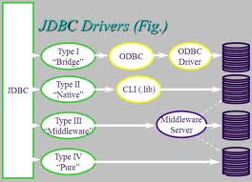
Java Database Connectivity
Dealing with Databases(Contd..):
Step 1: Loading the Driver(Contd..):
Types of Drivers

Slide 15
Java Database Connectivity
Dealing with Databases(Contd..):
Step 1: Load or register the driver with Class.forName()(Contd..).
Types of Drivers
JDBC-ODBC Bridge driver
The Type 1 driver translates all JDBC calls into ODBC calls and sends them to the ODBC driver. ODBC is a generic API.
The JDBC-ODBC Bridge driver is recommended only for experimental use or when no other alternative is available.
Advantage
The JDBC-ODBC Bridge allows access to almost any database, since the database's ODBC drivers are already available.
Disadvantages
1. Since the Bridge driver is not written fully in Java, Type 1 drivers are not portable.
2. A performance issue is seen as a JDBC call goes through the bridge to the ODBC driver, then to the database, and this applies even in the reverse process. They are the slowest of all driver types.
3. The client system requires the ODBC Installation to use the driver.
4. Not good for the Web.

Slide 16
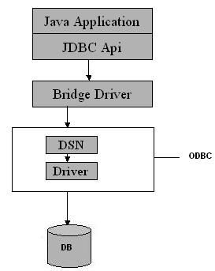
Java Database Connectivity
Dealing with Databases(Contd..):
Step 1: Loading the Driver(Contd..):
JDBC-ODBC Bridge driver

Slide 17
Java Database Connectivity
Dealing with Databases(Contd..):
Step 1: Loading the Driver(Contd..):
JDBC Driver :Native-API/partly Java driver
The distinctive characteristic of type 2 jdbc drivers are that Type 2 drivers convert JDBC calls into database-specific calls i.e. this driver is specific to a particular database.
Example: Oracle will have oracle native api.
Advantage
They offer better performance than the JDBC-ODBC Bridge as the layers of communication (tiers) are less and also it uses Native api which is Database specific.
Disadvantage
1. Native API must be installed in the Client System and hence cannot be used for the Internet.
2. It’s not written in Java Language which forms a portability issue.
3. If we change the Database we have to change the native api as it is specific to a database
4. 5. Usually not thread safe. And is mostly obsolete now.

Slide 18
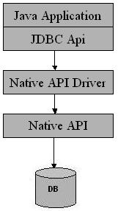
Java Database Connectivity
Dealing with Databases(Contd..):
Step 1: Loading the Driver(Contd..):
JDBC Driver :Native-API/partly Java driver

Slide 19
Java Database Connectivity
Dealing with Databases(Contd..):
Step 1: Loading the Driver(Contd..):
Type3 : All Java/Net-protocol driver
Type 3 database requests are passed through the network to the middle-tier server which then translates the request to the database. If the middle-tier server can in turn use Type1, Type 2 or Type 4 drivers.
Advantage
1. This driver is server-based, so there is no need for any vendor database library to be present on client machines.
2. This driver is fully written in Java and hence Portable. It is suitable for the web.
4. The net protocol can be designed to make the client JDBC driver very small and fast to load.
5. The type 3 driver typically provides support for features such as caching (connections, query results, and so on), load balancing, and advanced system administration such as logging and auditing.
6. This driver is very flexible allows access to multiple databases using one driver.
7. They are the most efficient amongst all driver types.

Slide 20
Java Database Connectivity
Dealing with Databases(Contd..):
Step 1: Loading the Driver(Contd..):
Type3 : All Java/Net-protocol driver(Contd..)
Disadvantage
It requires another server application to install and maintain.
Traversing the recordset may take longer, since the data comes through the backend server.

Slide 21
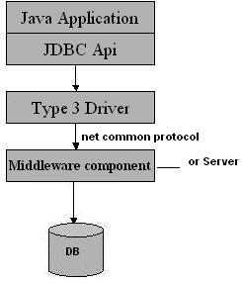
Java Database Connectivity
Dealing with Databases(Contd..):
Step 1: Loading the Driver(Contd..):
Type3 : All Java/Net-protocol driver(Contd..)

Slide 22
Java Database Connectivity
Dealing with Databases(Contd..):
Step 1: Loading the Driver(Contd..):
Type4: Native-protocol/all-Java driver
The Type 4 uses java networking libraries to communicate directly with the database server.
Advantage
1. They are completely written in Java to achieve platform independence and eliminate deployment administration issues. It is most suitable for the web.
2. Number of translation layers is very less i.e. type 4 JDBC drivers don't have to translate database requests to ODBC or a native connectivity interface or to pass the request on to another server, performance is typically quite good.
3. You don’t need to install special software on the client or server. Further, these drivers can be downloaded dynamically.
Disadvantage
With type 4 drivers, the user needs a different driver for each database.

Slide 23
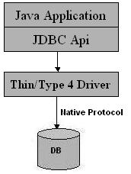
Java Database Connectivity
Dealing with Databases(Contd..):
Step 1: Loading the Driver(Contd..):
Type4: Native-protocol/all-Java driver:

Slide 24
Java Database Connectivity
Dealing with Databases(Contd..):
Step 2: Establish Connection with the database with Connection Interface.
A JDBC URL has the following syntax
String url= jdbc:<subprotocol>:<subname>
// for odbc
String url= “jdbc:odbc:employee” ;
// for jdbc – Oracle Driver
String url= “jdbc:oracle:thin:@tech:1521:ORCL” ;
Connection con = DriverManager.getConnection
(“url,"myLogin", "myPassword")
// for jdbc – SQL Driver jdbc:sqlserver://localhost;databaseName=biblio;integratedSecurity=true;

Slide 25
Java Database Connectivity
Dealing with Databases(Contd..):
Step 2: Establish Connection with the database with Connection Interface(Contd..)
DriverManager:
DriverManager is considered the backbone of JDBC architecture. It manages the JDBC drivers that are installed on the system.
Its getConnection() method is used to establish a connection to a database.
A jdbc Connection represents a session/connection with a specific database. Within the context of a Connection, SQL, PL/SQL statements are executed and results are returned.
An application can have one or more connections with a single database, or it can have many connections with different databases.
A Connection object provides metadata i.e. information about the database, tables, and fields. It also contains methods to deal with transactions.

Slide 26
Java Database Connectivity
Dealing with Databases(Contd..):
Step 3: Create Statement objects for Queries.
Once a connection is obtained we can interact with the database. Connection interface defines methods for interacting with the database via the established connection.
To execute SQL statements, you need to instantiate a Statement object from your connection object by using the createStatement() method.
Statement stmt = conn.createStatement();

Slide 27
Java Database Connectivity
Dealing with Databases(Contd..):
Step 3: Create Statement objects for Queries(Contd..).
Three kinds of Statements
Statement: Execute simple sql queries without parameters. Statement createStatement()
Prepared Statement: Execute precompiled sql queries with or without parameters. PreparedStatement prepareStatement(String sql)
Callable Statement: Execute a call to a database stored procedure. CallableStatement prepareCall(String sql)

Slide 28
Java Database Connectivity
Dealing with Databases(Contd..):
Step 4: Execute the statements which may or may not return ResultSet.
The Statement class has three methods for executing statements:
executeQuery(): For a SELECT statement, the method to use is executeQuery .
ResultSet executeQuery( String sql) throws SQLException
ResultSet rs = stmt.executeQuery("SELECT name, age FROM student");
executeUpdate(): For statements that create or modify tables, the method to use is executeUpdate. Note: Statements that create a table, alter a table, or drop a table are all examples of DDL statements and are executed with the method executeUpdate.

Slide 29
Java Database Connectivity
Dealing with Databases(Contd..):
Step 4: Execute the statements which may or may not return ResultSet.
ResultSet executeUpdate( ) throws SQLException
Statement stmt = con.createStatement();
stmt.executeUpdate("INSERT INTO student " + "VALUES (1, 'Smith', ' Bombay' , 20, 7646234 ) )";
execute() : executes an SQL statement that is written as String object.

Slide 30
Java Database Connectivity
Dealing with Databases(Contd..):
Step 5: Manipulate the ResultSet:
ResultSet provides access to a table of data generated by executing a Statement.
The table rows are retrieved in sequence. A ResultSet maintains a cursor pointing to its current row of data.
Retrieving data from Resultset
boolean next( ) throws SQLException
void close ( ) throws SQLException
XXX getXXX( int index ) throws SQLException

Slide 31
Java Database Connectivity
Dealing with Databases(Contd..):
Step 5: Manipulate the ResultSet(Contd..):
Example:
String query = " SELECT name, age FROM student ";
ResultSet rs = stmt.executeQuery(query);
while (rs.next()) {
String s = rs.getString("name");
BigDecimal n = rs.getBigDecimal("age");
System.out.println(s + " " + n);
}

Slide 32
Java Database Connectivity
Dealing with Databases(Contd..):
Step 6: Closing the Connections
close() is used with different interfaces
stmt.close()
conn.close()

Slide 33
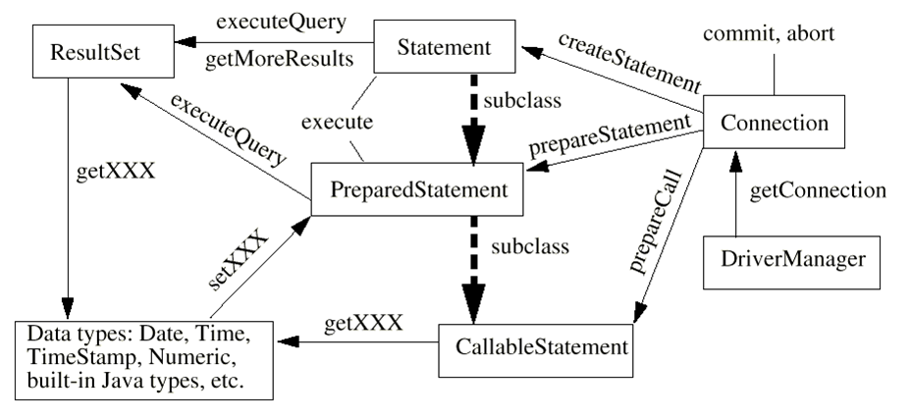
Java Database Connectivity
Dealing with Databases(Contd..):

Slide 34

Java Database Connectivity
AccessDemo.java
DerbyDemo.java
OracleDemo.java
OraDemoType4.java

Slide 35
Java Database Connectivity
Dealing with Databases(Contd..):
Transaction Management:
Transactions are not explicitly opened and closed, Instead, the connection has a state called AutoCommit mode
if AutoCommit is true, then every statement is automatically committed. Default case: true
Connection.setAutoCommit(boolean)
if AutoCommit is false, then every statement is added to an ongoing transaction
You must explicitly commit or rollback the transaction using
Connection.commit() and
Connection.rollback()

Slide 36
Java Database Connectivity
Dealing with Databases(Contd..):
Step 4: Using Prepared Statement..:
Example:
PreparedStatement prep = con.prepareStatement( "UPDATE"+
" course values set fees = ? WHERE c-id = ?");
prep.setInt(2, 2);
prep.setBigDecimal(1, 8000.00);
prep.executeUpdate ( );
prep.setInt(1, 4);
prep.setBigDecimal(2, 9000.00);prep.executeUpdate ( );

Slide 37
Java Database Connectivity
PreparedStat.java

Slide 38
Java Database Connectivity
Dealing with Databases(Contd..):
Step 4: Using Callable Statement..:
Example:
String sql=“execute getEmployes ? ”;
CallableStatement call=con.prepareCall(sql);
call.registerOutParameter(1,Types.INTEGER);
call.execute();
int val=call.getInt(1);
System.out.println(“There are ” +val + “ employees”);

Slide 39
Java Database Connectivity
CallableDemo.java

Slide 40
Java Database Connectivity
Dealing with Databases(Contd..):
Step 4: Using Transactions:
Example:
con.setAutoCommit(boolean commit)
con.commit()
con.rollback()
try {
con.setAutoCommit(false);
// perform transactions
con.commit()
con.setAutoCommit(true);
} catch (SQLException e) {
con .rollback() ;}

Slide 41
Java Database Connectivity
Transactions.java

Slide 42

Java Database Connectivity
We have used ResultSet to fetch the data and convert it into String or int and so on.
“But how can you know what is the datatype of the field being fetched ?“

Slide 43
Java Database Connectivity
ResultSet MetaData
The simple meaning of metadata is data about data.
There are two metadata available in the JDBC API –
ResultSetMetaData
DatabaseMetaData.
ResultSetMetaData:
It is used to make descriptive information about ResultSet object, like; number of columns, name of columns and datatype of columns.
It does not provide any information regarding database and how many rows are available in the ResultSet object. Whether ResultSet is read only, updatable or scrollable.
To create object of ResultSetMetadata by calling getMetaData() method from ResultSet object.

Slide 44
Java Database Connectivity
ResultSet MetaData(Contd..)
Syntax :
ResultSetMetaData rsmd=res.getMeataData();
// res is a valid object of ResultSet object
The following are common methods in ResultSetMetadata interface
int getColumnCount()
string getColumnName()
int getColumnType()
string getTableName()

Slide 45
Java Database Connectivity
ResultSetMetaDataDemo1.java

Slide 46
Java Database Connectivity
ResultSet MetaData
DatabaseMetaData:
This interface provide comprehensive information about the database. It contains the information about Database Management System (DBMS) and all the objects in the database, like; all the tables, cataloge name, view, stored procedure etc.
To create DatabaseMetaData object by calling getMetaData() from Connection interface.
Syntax:
DatabaseMetaData dmd=con.getMetaData();
// con is an object of Connection interface

Slide 47
Java Database Connectivity
Now that you have done a database interaction
“Do you find anything that can be improved over here ?“
“What will you do you want to fetch data from any other source?“
“Will it lead to manipulation of your code?“

Slide 48
Java Database Connectivity
DataSource and Connection Pooling
In a native SQL environment the most of the response time is used in creating and managing the connections in the database.
DataSource:
Introduced by JDBC 2.0 extension API
They are standard, general-use objects for specifying databases or other resources to use
It can reside on a remote server, or it can be on a local desktop machine
It can be thought of as a factory for connections to the particular data source that the DataSource instance represents
The DataSource interface is implemented by a driver vendor.

Slide 49
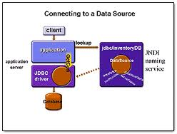
Java Database Connectivity
DataSource and Connection Pooling

Slide 50
Java Database Connectivity
DataSource and Connection Pooling
DataSource(Contd..):
There are three types of implementations:
Basic implementation -- produces a standard Connection object
Connection pooling implementation -- produces a Connection object that will automatically participate in connection pooling. This implementation works with a middle-tier connection pooling manager.
Distributed transaction implementation -- produces a Connection object that may be used for distributed transactions and almost always participates in connection pooling. This implementation works with a middle-tier transaction manager and almost always with a connection pooling manager.
A driver that is accessed via a DataSource object does not register itself with the DriverManager. Rather an object that implements the DataSource interface will typically be registered with a naming service based on the Java Naming and Directory (JNDI) API.

Slide 51
Java Database Connectivity
DataSource and Connection Pooling
DataSource(Contd..):
OracleDataSource ods = new OracleDataSource();
ods.setUser(" ");
ods.setPassword(" ");
ods.setDriverType(" ");
ods.setNetworkProtocol("tcp");
ods.setURL(" ");

Slide 52
Java Database Connectivity
DataSource and Connection Pooling
Connection Pooling:
There are many scenarios in software architecture where some type of object pooling is employed as a technique to improve application performance.
Object pooling is effective for two simple reasons.
First, the run time creation of new software objects is often more expensive in terms of performance and memory than the reuse of previously created objects.
Second, garbage collection is an expensive process so when we reduce the number of objects to clean up we generally reduce the garbage collection load.

Slide 53
Java Database Connectivity
Now that you have done a database interaction through DataSource
“Can we do Pooling in JDBC?”

Slide 54
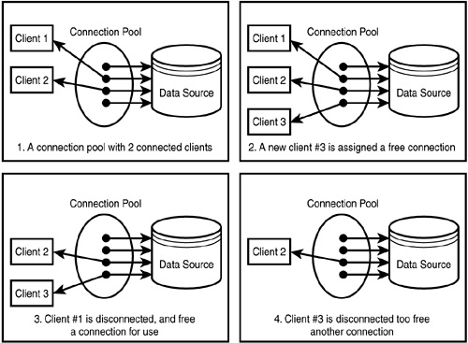
Java Database Connectivity
DataSource and Connection Pooling

Slide 55
Java Database Connectivity
Now that you have done a database interaction through DataSource
“How is it advantageous in JDBC?”
“Are there any overheads in creating a Connection Object?”

Slide 56
Java Database Connectivity
DataSource and Connection Pooling
Connection Pooling(Contd..):
JDBC connection pooling is conceptually similar to any other form of object pooling.
Database connections are often expensive to create because of the overhead of
establishing a network
connection and initializing a database connection session in the back end database.
connection session initialization often requires
time consuming processing to perform user authentication, establish transactional contexts and establish other aspects of the session that are required for subsequent database usage.
Managing all of its connection sessions can impose a major limiting factor on the scalability of the application.
Valuable database resources such as locks, memory, cursors, transaction logs, statement handles and temporary tables all tend to increase based on the number of concurrent connection sessions.

Slide 57
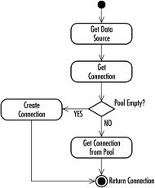
Java Database Connectivity
DataSource and Connection Pooling
Connection Pooling

Slide 58
Java Database Connectivity
DataSource and Connection Pooling
Connection Pooling(Contd..):
OracleDataSource ods = new OracleDataSource();
ods.setUser(" ");
ods.setPassword(" ");
ods.setDriverType(" ");
ods.setNetworkProtocol("tcp");
ods.setURL(" ");

Slide 59
Java Database Connectivity
DataSourceDemo.java

Slide 60
Java Database Connectivity
DriverManager Vs DataSource
Connection is Retained in the pool in DataSource
While directly creating a connection by calling DriverManager.getConnection(..) , you are creating a connection by yourself and when closing close() on it, the link to database is lost.
On the other hand we get a connection from a datasource, when you call the close() on it, it will not close the link to database, but will return to a connection pool where it can be reused by some other classes
It is always better to use a connection pool because creating connections are expensive. DataSource has its usability in the distributed computing environment, as it can be used with JNDI lookups
allows developers to implement a DataSource class to take advantage of features like connection pooling and distributed transactions

Slide 61
Java Database Connectivity
Rowsets
RowSets are a JDBC 2.0 extension to the java.sql.ResultSet interface.
Included within the package javax.sql.*
A RowSet object contains a set of rows from a result set or some other source of tabular data, like a file or spreadsheet.
Rowsets may have many different implementations to fill different needs. These implementations fall into two broad categories:
Connected RowSets
Disconnected. RowSets
Rowsets make it easy to send tabular data over a network.
They can also be used to provide scrollable result sets or updatable result sets when the underlying JDBC driver does not support them.

Slide 62
Java Database Connectivity
Rowsets
Disconnected RowSets:
It gets a connection to a data source in order to fill itself with data or to propagate changes in data back to the data source, but most of the time it does not have a connection open.
Does not need a JDBC driver or the full JDBC API, so its footprint is very small.
Is an ideal format for sending data over a network to a thin client.
It stores its data in memory. It needs to maintain metadata about the columns it contains and information about its internal state.
It also needs a facility for making connections, for executing commands, and for reading and writing data to and from the data source
Example: CachedRowSet:
a disconnected rowset that caches its data in memory;
not suitable for very large data sets, but an ideal way to provide thin Java clients, such as a Personal Digital Assistant (PDA) or Network Computer (NC), with tabular data

Slide 63
Java Database Connectivity
CachedRowSetDemo.java

Slide 64
Java Database Connectivity
Rowsets
Connected RowSets:
A connected rowset, by contrast, opens a connection and keeps it open for as long as the rowset is in use.
Example:
A JDBCRowSet class—a connected rowset that serves mainly as a thin wrapper around a ResultSet object to make a JDBC driver look like a JavaBeans component
A WebRowSet class—a connected rowset that uses the HTTP protocol internally to talk to a Java servlet that provides data access; used to make it possible for thin web clients to retrieve and possibly update a set of rows

Slide 65
Java Database Connectivity
JDBCRowSetDemo.java

Slide 66
Java Database Connectivity
“How does ResultSet differ from RowSet?”

Slide 67
Java Database Connectivity
ResultSet Vs Rowset
ResultSet | RowSet
A ResultSet maintains a connection to a database and because of that it can’t be serialized and also we cant pass the Resultset object from one class to other class across the network | RowSet is a disconnected, serializable version of a JDBC ResultSet and also it can be sent from one class to another across the network
Since the data is fetched directly from the database Connection there is problem even if the query returns a huge set of rows | Rowset keeps all the data from the query result in-memory. This is very in-efficient with queries that return huge data.
When using a ResultSet, we can requery the same column using getXX (...) method to retrieve the result as a different datum. | As the data from the resultset is preloaded into the Rowset, you cannot requery a particular column as a different datum.

Slide 68
Java Database Connectivity
“Do you forsee any limitations of RowSets?”

Slide 69
Java Database Connectivity
Rowsets
Limitations
As all the table rows are taken into memory, care should be taken with the query which retrieves the number of rows, as it will be very resourceful if huge set of rows is taken and the application will get very slow.
As rowsets will keep a connection to itself , hence the connection object will be kept at the client which make the client heavy. As it can modify data at the client side inconsistency may arise with the server containing actual data.

Slide 70

Summary
JDBC providers are prerequisites for data sources, which supply applications with the physical connections to a database.
Load the driver
use Class.forName otherwise
2. Define the Connection URL
jdbc:vendor:blah (vendor gives exact format)
3. Establish the Connection
DriverManager.getConnection
4. Create a Statement object
connection.createStatement
5. Execute a query
statement.executeQuery
6. Process the results
Loop using resultSet.next() and Call getString, getInt, etc.
7. Close the connection

Slide 71
Summary
RowSet is a new concept introduced in the JDBC specification. A RowSet object is designed to represent a container of tabular data from any data source.
A RowSet object is also a JavaBeans component. It is designed to combine functionalities of Connect, Statement and ResultSet objects into a single object.

Slide 72
Questions
“If we are using PreparedStatement the execution time will be less. “
Is it true?
Yes the statement is true. This is because PreparedStatement object contains SQL statement that has been precompiled. Thus, the DBMS does not have to recompile the SQL statement and prepare an execution plan - it simply runs the statement.

Slide 73
Questions
What Class.forName will do while loading drivers?
It is used to create an instance of a driver and register it with the Driver Manager. When you have loaded a driver, it is available for making a connection with a DBMS.

Slide 74
Questions
If you need a Statement object to execute many times Which of the Statement object will you prefer?
PreparedStatement.

Slide 75
Questions
Can we reuse a Statement or must we create a new one for each query?
Yes the Statement object be reused. We can use the same Statement for any number of queries.

Slide 76
Questions
What do you understand by connection timeout interval ?
Every database connection has the timeout interval set (depends on database configuration). This is the max inactivity interval for any connection. If not statement is executed within this time the underlying database would invalidate the connection.

Slide 77
THANK YOU

