Slide 1
Oracle SQL-DQL

Slide 2
Version Control and Revision History
 | Name | Date
Prepared By | Manisha Mane | 27-Jul-2018
Reviewed By | Nisha Mendonsa | 27-Jul-2018
Approved By | Gauresh Gaitonde | 27-Jul-2018
Version No. | Date | Section Affected | Highlight of Changes
1.0.0 | 23-Mar-2017 | All | Original Version.
2.0.0 | 27-Jul-2018 | None | Annual Review 2018. No changes made.

Slide 3










Iconic Representations.......
Coffee Break
Can you Solve?
FAQ
Test your Memory
Objective
Queries
Demo
Recap
Need more Info
Brainstorm

Slide 4
Objectives
SQL
Introduction to SQL
What is SQL
Connecting to SQL
Subsets of SQL
Data Query Language(DQL) – SELECT
ORDER BY
GROUP BY and HAVING
Aggregate Functions

Slide 5
Oracle SQL
Introduction to SQL

Slide 6
What is SQL?
Abbreviated as Structured Query Language.
It’s a special purpose programming language to manage the data in a RDBMS.
One of the first commercial languages for Relational Model
Described as a declarative language(4GL)

Slide 7
Subsets of SQL?
Some subsets of SQL are:
DQL (Data Query Language) : Querying the Data
DML (Data Manipulation Language) : Manipulating the Data
DDL (Data Definition Language) : Defining the structure to hold the data
TCL (Transaction Control Language) : Controlling the Transactions
DQL
DML
DDL
TCL
SELECT
INSERT
UPDATE
DELETE
MERGE
CREATE
ALTER
DROP
TRUNCATE
COMMIT
ROLLBACK
SAVEPOINT

Slide 8

Rules for writing SQL Statements
Many DBMS systems normally terminate SQL statements with a semi-colon character.
Character strings and date values are enclosed in single quotes
Character values are case-sensitive and date values are format sensitive.

Slide 9
Getting Connected to Oracle:
There are two modes to get connected in Oracle 10g XE
Command Line
To work with the SQL Command Line go to
GU I
Start -> Oracle 10g XE -> Run SQL Command Line
Start -> Oracle 10g XE -> Go to Database HomePage

Slide 10
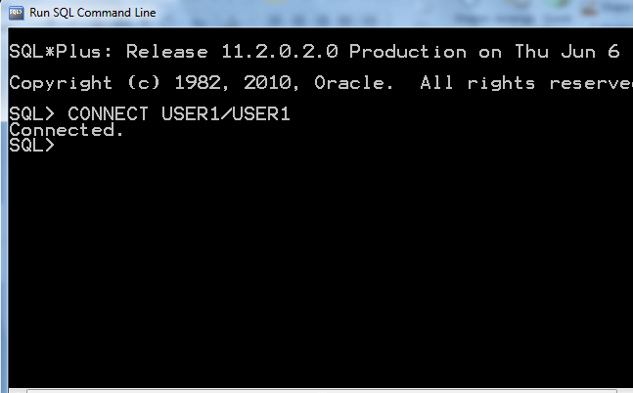
Writing a Query:
Command Line:
To Connect using a username and password the command is:
CONNECT <<username>> / <<password>>

Slide 11
Getting Connected to Oracle:
Command Line :Set of commands to start working with the CLI.
Command | Description
SQL > LIST | Lists the SQL Command in the Buffer
SQL > SAVE <<filename>> | Save the Contents of the Buffer to a file
CLEAR BUFFER | Flushes the buffer
SQL > GET <<filename>> | Load the contents of the file into memory
SQL > @filename or SQL > START <<filename>> | Load the contents of the file into the memory and execute the commands in the file.
SQL > RUN or SQL > / | Executes the commands in the buffer(RUN displays the contents of the buffer before execution)
SQL > SPO[OL ] <<filename|OFF|OUT>> | To store/print the queries and the Output.

Slide 12
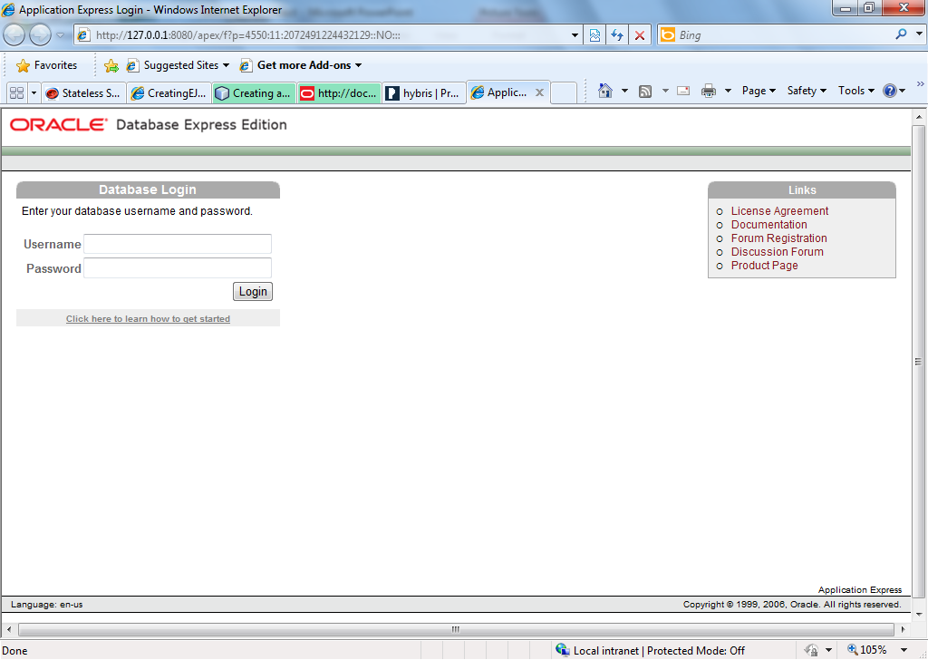
Writing a Query:
GUI Environment:
Specify the username and password

Slide 13
SQL
DQL – Data Query Language

Slide 14

DQL:
Data Query Language
Used to fetch records from Database.
DISTINCT : Selecting DISTINCT records from the set
WHERE : Filtering Records based on some criteria
GROUP BY : Grouping Records
HAVING BY : Applying condition on GROUPS
ORDER BY : Arranging in Ascending / Descending Order.
SELECT [DISTINCT ]column_list |*
FROM table-name [WHERE Clause] [GROUP BY clause] [HAVING clause] [ORDER BY clause];

Slide 15
DQL:
Fetching Records from the table
Expressions in SELECT Statement
‘ ||’ is the concatenation operator in Oracle
SELECT * FROM HR.Employees SELECT first_name,last_name,department_id
FROM Hr.Employees
SELECT DISTINCT job_id FROM HR.Employees
SELECT first_name||last_name “Emp Name”
FROM Hr.Employees
OR
SELECT first_name||last_name AS “Emp Name”
FROM Hr.Employees

Slide 16
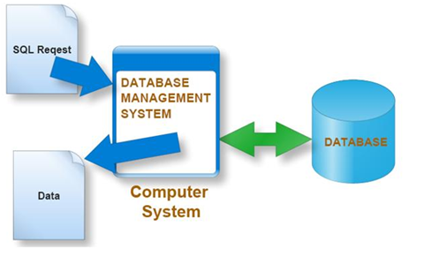
DQL:
Filtering Information using Where Condition
When filtering out String or Date data enclose the data in quotes
SELECT * FROM HR.Employees
WHERE Salary > 5000;
SELECT * FROM HR.Employees
WHERE job_id=‘HR_REP’;

Slide 17
DQL:
Logical Conditions (Contd..)
AND Operator : Returns TRUE if both component conditions are TRUE.
OR Operator : Returns TRUE if either component conditions are TRUE.
NOT Operator : Returns TRUE if the following condition is FALSE.
SELECT *
FROM HR.Employees
WHERE NOT (salary BETWEEN 1000 AND 2000);
SELECT *
FROM HR.Employees
WHERE first_name = 'SAMI‘ OR salary >= 1000;
SELECT *
FROM HR.Employees
WHERE first_name ='SAMI‘ AND salary=3000;

Slide 18
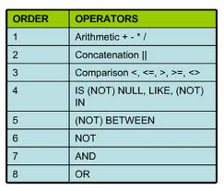
DQL:
Logical Conditions (Contd..)
Order of Precedence of Operators is as follows:

Slide 19
DQL:
Other Keywords:
IN
NOT IN : Equivalent to "!=ALL". Evaluates to FALSE if any member of the set is NULL..
SELECT *
FROM HR.Employees
WHERE deparmentid IN (10,20);
SELECT *
FROM HR.Employees
WHERE first_name NOT IN ('SCOTT', 'SMITH');

Slide 20
DQL:
NULL:
If a column is empty or no value has been inserted in it then it is called null.
NULL doesn’t mean 0 (Zero) or blank String “ “.
LIKE :
Used to search for a pattern
Wildcards like % and _ (Underscore) is used to match the pattern.
% Matches any number of characters
_ (underscore) matches a single character
SELECT * FROM HR.Employees
WHERE commission_pct IS NULL
SELECT * FROM HR.Employees
WHERE job_id LIKE ‘HR%’

Slide 21
DQL:
Sorting the Records:ORDER BY
Results fetched can be ordered in Ascending / Descending order using the ORDER BY Clause
Default order of arranging the Records is Ascending Order.
Specifying the Descending order can be done by adding the DESC Keyword.
More than one ordering criteria can also be enforced:
SELECT * FROM HR.Employees
ORDER BY department_id
SELECT * FROM HR.Employees
ORDER BY Salary DESC
SELECT * FROM HR.Employees
ORDER BY department_id ASC, Salary DESC

Slide 22
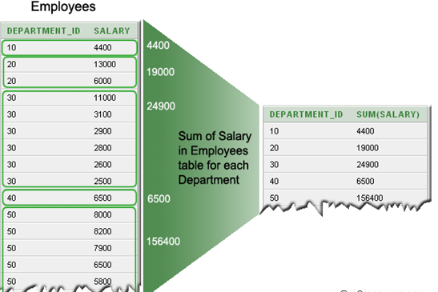
DQL:
GROUP BY :
Used to divide the rows in a table into smaller groups
The grouping can happen after retrieves the rows from a table.
The GROUP BY clause is rarely used without an aggregate function.

Slide 23
DQL:
GROUP BY : Aggregate Functions
COUNT()
SUM()
Other Aggregate Functions are : MIN,MAX,AVG,…
SELECT department_id "Department Code“,COUNT(*) "No of Employees"
FROM employees
GROUP BY department_id;
SELECT department_id, SUM(salary)
FROM employees
GROUP BY department_id;

Slide 24
DQL:
GROUP BY : Aggregate Functions
Grouping more than one column is also permissble
GROUP BY with HAVING Clause
Works with the GROUP BY clause to limit the results to groups that meet the criteria
SELECT department_id "Department Code", job_id,
SUM(salary) "Total Salary"
FROM employees
GROUP BY department_id,job_id;
SELECT department_id, count(*) "No. of Employee"
FROM employees
GROUP BY department_id
HAVING count(*) > 2;

Slide 25

SQL:
GROUP BY:
Rules for Grouping columns are:
If a select block does have a GROUP BY clause, any column specification specified in the SELECT clause must exclusively occur as a parameter of an aggregated function or in the list of columns given in the GROUP BY clause, or in both.
The result of an aggregation function always consists of one value for each group. The result of a column specification on which grouping is performed also always consists of one value per group. These results are compatible. In contrast, the result of a column specification on which no grouping is performed consists of a set of values. This would not be compatible with the results of the other expressions in the SELECT clause.

Slide 26
DQL:
GROUP BY :
Although every column included in the SELECT list must also be listed in a GROUP BY clause, this restriction doesn’t apply to number and string literals, constant expressions (expressions that do not use column values), and functions such as SYSDATE.
SELECT COUNT(employee_id), department_id, salary, SYSDATE, ‘String Literal’, 42*37 Expression
FROM Employee
GROUP BY department_id, salary
HAVING (COUNT(employee_id) > 1 OR salary < 100000)
ORDER BY department_id, salary DESC;

Slide 27
SQL:
GROUP BY:
Rules for Grouping columns are:
An expression that is used to form groups can also occur in the SELECT clause within a compound expression.
For SELECT statements with a GROUP BY clause: DISTINCT (if used outside an aggregation function) that is superfluous when the SELECT clause includes all the columns specified in the GROUP BY clause. The GROUP BY clause groups the rows in such a way that the columns on which they are grouped no longer contain duplicate values.
SELECT AMOUNT * 100 AS AMOUNT_IN_CENTS
FROM PENALTIES
GROUP BY AMOUNT

Slide 28
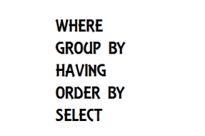
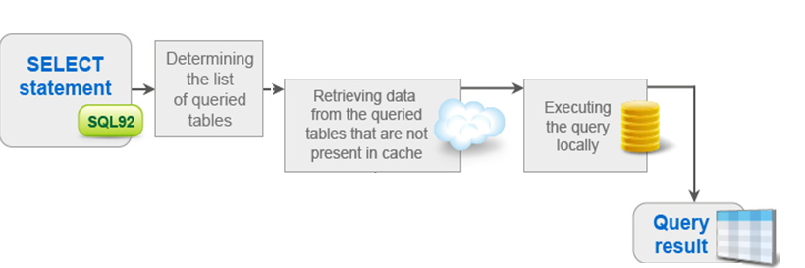
Execution Order
The Execution order of the various clauses in the SELECT Statement are as follows:

Slide 29
SQL
Single Row Functions

Slide 30
Single Row Functions:
Used for performing calculations on data, alter data formats for display, convert data types, etc.
Return a single result row for every row of a queried table or view.
Can appear in select lists, WHERE clauses, START WITH and CONNECT BY clauses, and HAVING clauses
They are categorized as
Numeric Functions
Character Function
Date Functions
Conversion
General Functions
Character
General
Single-row
functions
Number
Conversion
Date

Slide 31
Single Row Functions:
Numeric Function:
Some of the numeric functions are :
Numeric
Functions
ROUND
TRUNC
MOD
SIGN
POWER
SQRT
GREATEST
LEAST
SIN,COS,TAN
LOG
CEIL,FLOOR

Slide 32
Single Row Functions:
Numeric Function:
Function | Description
ABS | Returns the absolute of the value
FLOOR | Returns largest integer equal to or less than n.
CEIL | Returns smallest integer equal to or greater than n.
MOD | MOD returns the remainder of n2 divided by n1.
POWER | POWER returns n2 raised to the n1 power
ROUND | ROUND returns n rounded to integer places to the right of the decimal point. If you omit integer, then n is rounded to 0 places. The argument integer can be negative to round off digits left of the decimal point.

Slide 33
Single Row Functions:
Numeric Function:
Function | Description
SIGN | SIGN returns the sign of n. This function takes as an argument any numeric datatype, or any nonnumeric datatype that can be implicitly converted to NUMBER, and returns NUMBER. of NUMBER type, the sign is: -1 if n<0 0 if n=0 1 if n>0
SQRT | SQRT returns the square root of n.
TRUNC | The TRUNC (number) function returns n1 truncated to n2 decimal places. If n2 is omitted, then n1 is truncated to 0 places. n2 can be negative to truncate (make zero) n2 digits left of the decimal point.

Slide 34
Single Row Functions:
Numeric Functions :
Example :
Output
TRUNC : 44.4
ROUND : 44.5
CEIL : 45
FLOOR : 44
SELECT TRUNC(44.46,1),ROUND(44.46,1),CEIL(44.46),FLOOR(44.46)
FROM Dual;

Slide 35
Single Row Functions:
Character Function:
Some of the character functions are :
Character
functions
Case-manipulation
functions
Character-manipulation
functions
LOWER
UPPER
INITCAP
CONCAT
SUBSTR
LENGTH
INSTR
LPAD | RPAD
RTRIM|LTRIM|TRIM
REPLACE

Slide 36
Single Row Functions:
Character Functions :
Function | Description
CONCAT | Returns the concatenation of 2 strings. You can also use the || command for this
SUBSTR | Returns a part of the String
LENGTH | Returns the length of the String
TRIM|LTRIM|RTRIM | Removes the spaces from the Left or right or both sides of the String.
INSTR | Returns the position of a String within a String.
LPAD|RPAD | Add characters to the left/right of a string until a fixed number is reached

Slide 37
Single Row Functions:
Character Functions :
Function | Description
REPLACE | Replaces every occurrence of a search_string with a new string.
REVERSE | Reverses the characters of a String
UPPER|LOWER|INITCAP | Transform a string to all upper case or lower case or sentence case characters

Slide 38
Single Row Functions:
Character Functions :
Example : Display the data for those employees whose last names end with the character “n”.
SELECT employee_id, CONCAT(first_name, last_name) NAME,
LENGTH (last_name), INSTR(last_name, 'a') "Contains 'a'?"
FROM employees
WHERE SUBSTR(last_name, -1, 1) = 'n';

Slide 39
Single Row Functions:
Date Functions:
Some of the date functions are :
Date
Functions
SYSDATE
ADD_MONTHS
MONTHS_BETWEEN
NEXT_DAY
LAST_DAY
GREATEST
LEAST
ROUND

Slide 40
Single Row Functions:
Date Function:
Function | Description
SYSDATE | returns the current date and time in the default Oracle date format. The default format for the date returned is MM-DD-YY
MONTHS_BETWEEN | returns the months between two dates
LAST_DAY | returns the date of the last day of the month that contains date.
ROUND | Rounds of the date to the nearest month or year . Syntax: ROUND(date,’MONTH/YEAR’)
GREATEST and LEAST | Returns the GREATEST or LEAST dates out of the given set of dates.

Slide 41
Single Row Functions:
Date Functions :
Example : Display how many days are left in the current month
SELECT SYSDATE, LAST_DAY(SYSDATE) "Last", LAST_DAY(SYSDATE) - SYSDATE "Days Left“,
TO_CHAR(NEXT_DAY(sysdate,'MON'),'DD.MM.YYYY') "Next Monday from now“
FROM DUAL;

Slide 42
Single Row Functions:
Conversion Functions:
These are functions that help us to convert a value in one form to another form.
Some of the conversion functions are :
Conversion
Functions
TO_CHAR
TO_DATE
NVL
DECODE

Slide 43
Single Row Functions:
Conversion Function:
Function | Description
TO_CHAR | Converts Numeric and Date values to a character string value. It cannot be used for calculations since it is a string value.
TO_DATE | Converts a valid Numeric and Character values to a Date value. Date is formatted to the format specified by 'date_format'.
TO_NUMBER | Converts a character string containing digits to a number with the optional format model fmt.
NVL(x,y) | If 'x' is NULL, replace it with 'y'. 'x' and 'y' must be of the same datatype.

Slide 44
Single Row Functions:
Conversion Functions :
Example : Display how many days are left in the current month
SELECT TO_CHAR(hire_date, 'DD-MON-YYYY')
FROM EMPLOYEES;
SELECT TO_DATE('01-JAN-1985','DD-MON-YYYY')
FROM DUAL;
SELECT first_name, salary, commission_pct,
(salary*12)+NVL(commisson_pct,0)
FROM employees;

Slide 45
Single Row Functions:
Conversion Functions :
DECODE:
Decodes an expression in a way similar to the IF-THEN-ELSE logic used in various languages.
The DECODE function decodes expression after comparing it to each search value.
If the expression is the same as search, result is returned.
If the default value is omitted, a null value is retuned where a search value does not match any of the result values.
SELECT job_id, salary, DECODE(job_id,
'ANALYST' , sal*1.1,
'CLERK' , sal*1.15,
'MANAGER' , sal*1.20, salary) Increment
FROM employees ;

Slide 46
Recap
SQL is the stuctured Query Language used to query the data from the database.
Consists of some subsets as:
DQL - SELECT
DDL - CREATE, ALTER, DROP, TRUNCATE
DML - INSERT, UPDATE, DELETE
DQL Queries out the data from the database
WHERE CLAUSE : Specifies the criteria for selecting the results
ORDER BY : Sorts the Results fetched
GROUP BY : Helps in Grouping the Results and HAVING BY filters the grouped results
Aggregate Functions like COUNT,SUM,MAX,MIN and AVG are mostly used with GROUP BY Clause to enable data analysis.

Slide 47
Recap
Single- Row Functions
Single-row functions can be nested to any level. Single-row functions can manipulate the following
Character data:
LOWER, UPPER, INITCAP, CONCAT, SUBSTR, INSTR, LENGTH
Number data:
ROUND, TRUNC, MOD
Date data:
MONTHS_BETWEEN, ADD_MONTHS, NEXT_DAY, LAST_DAY, ROUND, TRUNC
Date values can also use arithmetic operators.
Conversion functions can convert character, date, and numeric values
TO_CHAR, TO_DATE, TO_NUMBER
SYSDATE and DUAL
SYSDATE is a date function that returns the current date and time. It is customary to select SYSDATE from a dummy table called DUAL.

