Slide 1
JQuery

Slide 2
Version Control and Revision History
 | Name | Date
Prepared By | Ranjeet Kaur Bhachu | 30-Jul-2018
Reviewed By | Nisha Mendonsa | 30-Jul-2018
Approved By | Gauresh Gaitonde | 30-Jul-2018
Version No. | Date | Section Affected | Highlight of Changes
1.0.0 | 23-Mar-2017 | All | Original Version.
2.0.0 | 30-Jul-2018 | None | Annual Review 2018. No changes made.

Slide 3
Objectives
After completing the session participants will able to
Develop and design Responsive Web Design using jQuery.
Apply different types of effects to the jQuery selectors using jQuery Events.
Create animation effects using jQuery.
Create web application using different types of manipulations like HTML,CSS and DOM manipulations.

Slide 4
What is JQuery

Slide 5
What is jQuery?
It is an alternate way to write java script code.
It is a JavaScript Library.
It greatly simplifies JavaScript programming.
It is easy to learn.
Some Features of jQuery
DOM manipulation & Event handling
AJAX Support
Animations
Lightweight & Cross Browser Support

Slide 6
Downloading jQuery Library
There are 2 ways of downloading jQuery library.
URL : https://jquery.com/download
CDN : https://code.jquery.com/jquery-1.12.4.min.js

Slide 7
JQuery Selectors

Slide 8
JQuery Selectors
This is used to find the elements or attributes from HTML Page
Basic syntax is: $(selector). jqueryfunction()
A $ sign to define/access jQuery
A (selector) to "query (or find)" HTML elements
A jQuery function() perform some action on the selected element(s)
Examples:
$(this).hide() - hides the current element.
$("p").hide() - hides all <p> elements.
$(".test").hide() - hides all elements with class="test".
$("#test").hide() - hides the element with id="test".
$("[href]").hide() - hides all elements with a href attribute
$("[href='default.htm']").hide() – hides all elements with a href attribute value equal to "default.htm"

Slide 9
JQuery Selectors
This is used to find the elements or attributes from HTML Page

Slide 10
JQuery Events

Slide 11
JQuery Events
Events methods are used to register behaviors to take effect when the user interacts with the browser.
Types of Event methods:
Method | Description
.blur( ) | Triggers the blur event of each matched element.
.change( ) | Triggers the change event of each matched element.
.click( ) | Triggers the click event of each matched element.
.dblclick( ) | Triggers the dblclick event of each matched element.
.focus( ) | Triggers the focus event of each matched element.
.keydown( ) | Triggers the keydown event of each matched element.
.mousedown( fn ) | Binds a function to the mousedown event of each matched element.
.mouseenter( fn ) | Bind a function to the mouseenter event of each matched element.
.submit( ) | Trigger the submit event of each matched element.

Slide 12
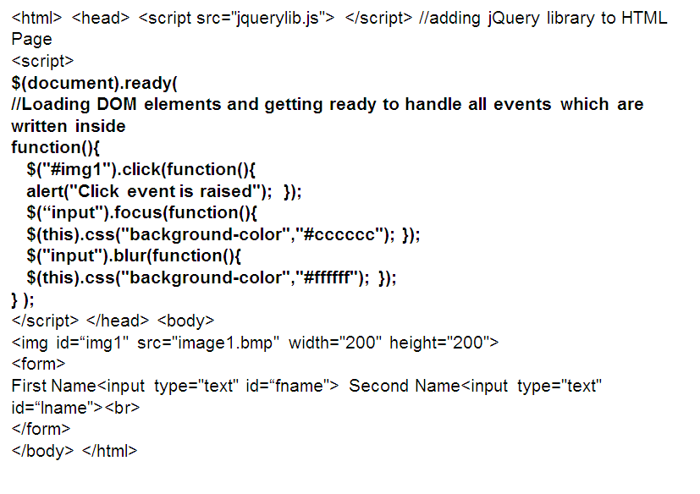
First Demo

Slide 13
JQuery Effects

Slide 14
JQuery Effects
There are several effects methods available in jQuery.
All the functions are overloaded.
Method | Description
.hide() | Hiding selected element
.hide(int) | Hiding selected element and passing seconds in arguments to complete the effect
.hide(string) | Hiding selected element and passing string value like slow
.show() | Showing selected element
.toggle() | hide and show selected element
.fadeIn() | Hiding selected element with fading effect
.fadeOut() | Showing selected element with fading effect
.fadeToggle() | hide and show selected element with fading effect
.slideUp() | Hiding selected element with sliding effect
.slideDown() | Showing selected element with sliding effect
.slideToggle() | hide and show selected element with sliding effect

Slide 15
Hide, Show, Toggle functions
<html>
<head> <script src="jquerylib.js"> </script>
<script>
$(document).ready(function(){
$("#h").click(function(){
$("img").hide(); });
$("#s").click(function(){
$("img").show(); });
$("#t").click(function(){
$("img").toggle(); });
});
</script>
</head> <body>
<center>
<img src="image4.jpg" width="200" height="200"><br>
<button id="s">Show</button><button id="h">Hide</button><button id="t">Toggle</button>
</center>
</body> </html>

Slide 16
Hide, Show, Toggle with integer arguments
<html>
<head> <script src="jquerylib.js"> </script>
<script>
$(document).ready(function(){
$("#h").click(function(){
$("img").hide(1000); });
$("#s").click(function(){
$("img").show(1000); });
$("#t").click(function(){
$("img").toggle(1000); });
});
</script> </head> <body>
<center>
<img src="image4.jpg" width="200" height="200"><br>
<button id="s">Show</button><button id="h">Hide</button><button id="t">Toggle</button>
</center>
</body> </html>

Slide 17
Hide, Show, Toggle with string arguments
<html>
<head> <script src="jquerylib.js"> </script>
<script>
$(document).ready(function(){
$("#h").click(function(){
$("img").hide(“slow”); });
$("#s").click(function(){
$("img").show(“slow”); });
$("#t").click(function(){
$("img").toggle(“slow”); });
});
</script>
</head> <body>
<center>
<img src="image4.jpg" width="200" height="200"><br>
<button id="s">Show</button><button id="h">Hide</button><button id="t">Toggle</button>
</center>
</body> </html>

Slide 18
FadeIn, fadeOut, fadeToggle functions
<html>
<head> <script src="jquerylib.js"> </script>
<script>
$(document).ready(function(){
$("#h").click(function(){
$("img").fadeIn(); });
$("#s").click(function(){
$("img").fadeOut(); });
$("#t").click(function(){
$("img").fadeToggle(); });
});
</script>
</head> <body>
<center>
<img src="image4.jpg" width="200" height="200"><br>
<button id="s">Show</button><button id="h">Hide</button><button id="t">Toggle</button>
</center>
</body> </html>

Slide 19
SlideUp, SlideDown, SlideToggle functions
<html>
<head> <script src="jquerylib.js"> </script>
<script>
$(document).ready(function(){
$("#h").click(function(){
$("img").slideUp(); });
$("#s").click(function(){
$("img").slideDown(); });
$("#t").click(function(){
$("img").slideToggle(); });
});
</script> </head>
<body>
<center>
<img src="image4.jpg" width="200" height="200"><br>
<button id="s">Show</button><button id="h">Hide</button><button id="t">Toggle</button>
</center>
</body> </html>

Slide 20
Animation Effects
Basic syntax:
$(selector).animate({params},speed,callback);
$(selector).stop(boolean,boolean);
<html> <head> <script src="jquerylib.js"> </script> <script>
$(document).ready(function(){
$("#b1").click(function(){
$("#d1").animate({left:'310px'},1000,function(){alert(‘completed’);});
$("#d1").animate({left:'9px'},1000,function(){alert(‘completed’);});
});
$("#b9").click(function(){
$("#d1").stop(); });
$("#b10").click(function(){
$("#d1").stop(true); });
$("#b11").click(function(){
$("#d1").stop(true,true); });
});

Slide 21
JQuery DOM

Slide 22
DOM Manipulation Functions
There are several DOM function available in jQuery.
Some functions are given below.
.text() | Sets or returns the text content of selected elements
.html() | Sets or returns the content of selected elements (including HTML markup)
.val() | Sets or returns the value of form fields
.append() | Inserts content at the end of the selected elements
.prepend() | Inserts content at the beginning of the selected elements
.after() | Inserts content after the selected elements
.before() | Inserts content before the selected elements
.remove() | Removes the selected element (and its child elements)
.empty() | Removes the child elements from the selected element

Slide 23
DOM Manipulation Demo
<html> <head> <script src="jquerylib.js"> </script> <script>
$(document).ready(function(){
$("#btn1").click(function(){
alert("Text: " + $("#test").text()); });
$("#btn2").click(function(){
alert("HTML: " + $("#test").html()); });
$("#btn3").click(function(){
alert("User Name: " + $("#t1").val()); });
});
</script></head>
<body>
<p id="test">This is some <b>bold</b> text in a paragraph.</p>
<form>
Enter User Name<input type="text" id="t1"/><br>
<button id="btn1">Show Text</button>
<button id="btn2">Show HTML</button>
<button id="btn3">Show Text Box Value</button>
</form></body>
</html>

Slide 24
CSS Manipulation Functions
There are several CSS functions available in jQuery.
Some functions are given below.
.addClass() | Adds one or more classes to the selected elements
.removeClass() | Removes one or more classes from the selected elements
.toggleClass() | Toggles between adding/removing classes from the selected elements
.css() | Sets or returns the style attribute

Slide 25
CSS Manipulation Demo
<html> <head> <script src="jquerylib.js"> </script> <script>
$(document).ready(function(){
$("#a1").click(function(){
$(“h1").addClass("style1"); });
$("#r1").click(function(){
$(“h1").removeClass("style1"); });
});
</script>
<style type="text/css">
.style1{
background-color: gray; font-size: xx-large; font-style: italic; text-align: center; color: blue; }
</style>
</head> <body>
<h1>jQuery Event Basics</h1>
<button id="a1">Add First Style</button> <button id="r1">Remove First Style</button>
</body> </html>

Slide 26
JQuery AJAX

Slide 27
JQuery Ajax method
AJAX – Asynchronous JavaScript and XML. It is loading data in the background and displaying it without reloading the whole page.
The jQuery ajax() method provides core functionality of Ajax in jQuery. It sends asynchronous HTTP requests to the server.
Syntax:
$.ajax(url)
$.ajax(url, [options])
Where,
url – string url to which data needs to be submitted or from where data needs to be retrieved.
options -- This is an optional parameter. It specifies configuration options for Ajax request. Options parameters can be specified using JSON format.

Slide 28
JQuery Ajax method contd…
The following table list all the options available for configuring Ajax request.
Options | Description
accepts | The content type sent in the request header that tells the server what kind of response it will accept in return
async | By default, all requests are sent asynchronously. Set it false to make it synchronous.
complete | A callback function to be executed when request finishes.
contentType | A string containing a type of content when sending MIME content to the server.Default is "application/x-www-form-urlencoded; charset=UTF-8"
statusCode | A JSON object containing numeric HTTP codes and functions to be called when the response has the corresponding code.
success | A callback function to be executed when Ajax request succeeds.
Timeout | A number value in milliseconds for the request timeout.
Type | A type of http request e.g. POST, PUT and GET. Default is GET.
beforeSend | A callback function to be executed before Ajax request is sent.
Cache | A boolean indicating browser cache. Default is true.
Username | A username to be used with XMLHttpRequest in response to an HTTP access authentication request.
Xhr | A callback for creating the XMLHttpRequest object.

Slide 29
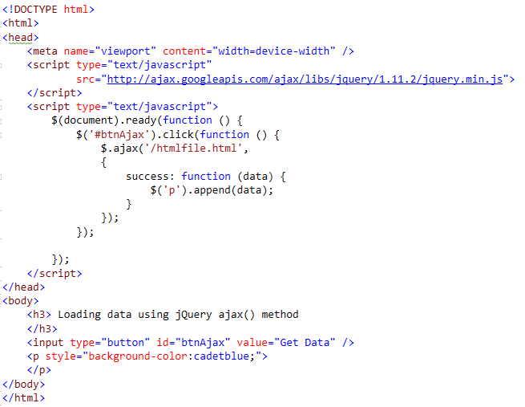
Asynchronous AJAX Request Demo – ajax method

Slide 30
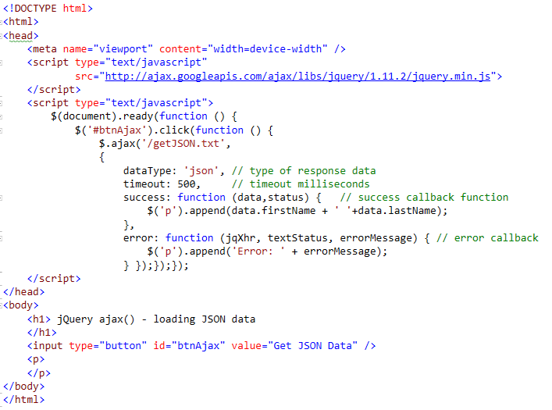
Asynchronous AJAX Request Demo – getting JSON data

