Slide 1
JavaScript

Slide 2
Version Control and Revision History
 | Name | Date
Prepared By | Ranjeet Kaur Bhachu | 30-Jul-2018
Reviewed By | Nisha Mendonsa | 30-Jul-2018
Approved By | Gauresh Gaitonde | 30-Jul-2018
Version No. | Date | Section Affected | Highlight of Changes
1.0.0 | 23-Mar-2017 | All | Original Version.
2.0.0 | 30-Jul-2018 | None | Annual Review 2018. No changes made.

Slide 3
Introduction to JavaScript
One of the three languages for web development
HTML
CSS
JavaScript (Works within other application (Browser)).
A JavaScript engine is a program or interpreter which executes JavaScript code.
JavaScript is not compiled but translated. The JavaScript Translator (embedded in browser) is responsible to translate the JavaScript code.

Slide 4
Introduction to JavaScript
JavaScript is a lightweight, interpreted programming language with object-oriented capabilities that allows you to build interactivity into otherwise static HTML pages.
The general-purpose core of the language has been embedded in Netscape, Internet Explorer, and other web browsers
JavaScript is:
JavaScript is a lightweight, interpreted programming language
Designed for creating network-centric applications
Complementary to and integrated with Java
Complementary to and integrated with HTML
Open and cross-platform

Slide 5
Client Side JavaScript
Client-side JavaScript is the most common form of the language. The script should be included in or referenced by an HTML document for the code to be interpreted by the browser.
It means that a web page need no longer be static HTML, but can include programs that interact with the user, control the browser, and dynamically create HTML content.
The JavaScript client-side mechanism features many advantages over traditional CGI server-side scripts. For example, you might use JavaScript to check if the user has entered a valid e-mail address in a form field.
The JavaScript code is executed when the user submits the form, and only if all the entries are valid they would be submitted to the Web Server.
JavaScript can be used to trap user-initiated events such as button clicks, link navigation, and other actions that the user explicitly or implicitly initiates.

Slide 6
Advantages
Less server interaction: You can validate user input before sending the page off to the server. This saves server traffic, which means less load on your server.
Immediate feedback to the visitors: They don't have to wait for a page reload to see if they have forgotten to enter something.
Increased interactivity: You can create interfaces that react when the user hovers over them with a mouse or activates them via the keyboard.
Richer interfaces: You can use JavaScript to include such items as drag-and-drop components and sliders to give a Rich Interface to your site visitors.

Slide 7
Disadvantages
We can not treat JavaScript as a full fledged programming language. It lacks the following important features:
Client-side JavaScript does not allow the reading or writing of files. This has been kept for security reason.
JavaScript can not be used for Networking applications because there is no such support available.
JavaScript doesn't have any multithreading or multiprocess capabilities.

Slide 8
JavaScript Syntax
The script tag takes two important attributes:
language: This attribute specifies what scripting language you are using. Typically, its value will be JavaScript
type: This attribute is what is now recommended to indicate the scripting language in use and its value should be set to "text/javascript".
<script language="javascript" type="text/javascript">
JavaScript is case sensitive language.
Comments can be single line or multiline
<!— Code //--> </script> | <noscript> JavaScript needed </noscript>

Slide 9
JavaScript Code
JavaScript code can be placed in the following three locations
Between the body tag
Between the head tag
In .js file (External JavaScript file)
It provides code re usability because single JavaScript file can be used in several html pages.
An external JavaScript file must be saved by .js extension.

Slide 10
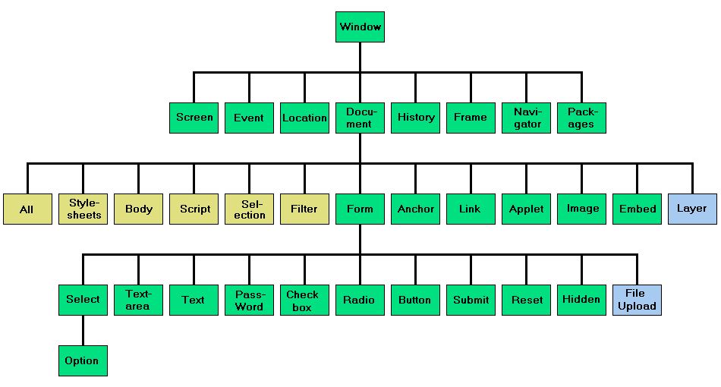
JavaScript Object Hierarchy (DOM)

Slide 11
JavaScript Functions
A function is a group of reusable code which can be called anywhere in a program. This eliminates the need of writing same code again and again.
Like any other advance programming language, JavaScript also supports all the features necessary to write modular code using functions.
JavaScript also allows us to create user defined functions apart from predefined functions

Slide 12
JavaScript Variables
JavaScript allows three primitive data types:
Numbers: e.g.. 100, 120.20 etc.
Strings of text e.g. “Hello World" etc.
Boolean e.g. true or false.
Undefined : represents undefined value
Null: represents null – no value
In addition to these primitive data types, JavaScript supports a composite data type known as object (Reference type).
JavaScript is untyped language.
JavaScript Variable Scope
Global Variables: A global variable has global scope which means it is defined everywhere in your JavaScript code.
Local Variables: A local variable will be visible only within a function where it is defined. Function parameters are always local to that function.

Slide 13
JavaScript Operators
JavaScript language supports following type of operators.
Arithmetic Operators
Comparison Operators
Logical (or Relational) Operators
Assignment Operators
Miscellaneous Opeartor
Conditional (or ternary) Operators (?:)
typeof operator

Slide 14
JavaScript Operators
var keyword is used to create any type of variable. Based on the value assigned the type of the variable is inferred.
JavaScript is a dynamically typed language. JavaScript data types are converted automatically as needed during script execution.
Operator +
When + operator is used with 2 numbers, JavaScript adds those numbers
When + operator is used with 2 strings, JavaScript concatenates those strings
When + operator is used with a string and a number, JavaScript converts the numeric value to a string and performs concatenation.
When – operator is used, numeric value is not converted into string

Slide 15
JavaScript Programming Constructs
JavaScript language supports following type of Constructs.
Conditional
If else
Nested if else
Switch case
Iterative or Looping
for
For…in
While
Do…while

Slide 16
JavaScript Events
JavaScript's interaction with HTML is handled through events that occur when the user or browser manipulates a page.
Developers can use these events to execute JavaScript coded responses, which cause buttons to close windows, messages to be displayed to users, data to be validated, and virtually any other type of response imaginable to occur.
Events are a part of the Document Object Model (DOM) and every HTML element have a certain set of events which can trigger JavaScript Code.

Slide 17
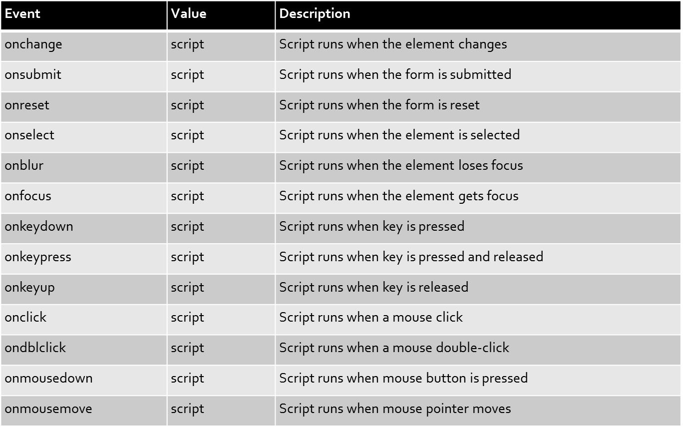
JavaScript Events

Slide 18
JavaScript Dialog Boxes
JavaScript supports three important types of dialog boxes. These dialog boxes can be used to raise and alert, or to get confirmation on any input or to have a kind of input from the users.
Alert Dialog Box
alert()
Confirmation Dialog Box
confirm()
Prompt Dialog Box
prompt()

Slide 19
JavaScript Page Redirect
<head>
<script type="text/javascript">
<!--
window.location="http://www.newlocation.com";
//-->
</script>
</head>
function Redirect()
{
window.location="http://www.newlocation.com";
}
document.write("You will be redirected to main page in 10 sec.");
setTimeout('Redirect()', 10000);

Slide 20
JavaScript Objects
Array
An object that represents a collection of similar type of elements.
Three ways of creating an array
By array literal
var courses=["Java", "JavaScript", "VBScript", ".NET", "Testing"];
By creating instance of array directly
var names = new Array();
names[0]="Emp1";
names[1]="Emp2";
names[2]="Emp3";
By using an Array Constructor
var emp=new Array(1,2,3);

Slide 21
JavaScript Objects
String
String is an object that represents a sequence of characters.
Two ways of creating a String
By String literal
By String Object (new keyword)
var str=new String(“”);
String functions
Functions | Functions
charAt(index) | toLowerCase()
concat(str) | toUpperCase()
indexOf(str) | slice(beginIndex, endIndex)
lastIndexOf(str) | trim()

Slide 22
JavaScript Objects
Date
Date object can be used to get year, month and day.
Date Constructors
Date()
Date(dateString)
Date(year, month, day, hours, minutes, seconds, milliseconds)

Slide 23
JavaScript Objects
Date Functions
Function | Description
getFullYear() | returns the year in 4 digit e.g. 2015. It is a new method and suggested than getYear() which is now deprecated.
getMonth() | returns the month in 2 digit from 0 to 11. So it is better to use getMonth()+1 in your code.
getDate() | returns the date in 1 or 2 digit from 1 to 31.
getDay() | returns the day of week in 1 digit from 0 to 6.
getHours() | returns all the elements having the given name value.
getMinutes() | returns all the elements having the given class name.
getSeconds() | returns all the elements having the given class name.
getMilliseconds() | returns all the elements having the given tag name.

Slide 24
JavaScript Objects
Math
Math object provides several constants and methods to perform mathematical operation.
It doesn’t have constructor.
Functions
Math.sqrt(n)
Math.random()
Math.pow(m,n)
Math.floor(n)
Math.ceil(n)
Math.round(n)
Math.abs(n)

Slide 25
Browser Objects
Window
Represents window in a browser. Automatically created by browser.
History
Represents an array of URLs visited by the user.
Navigator
Used for browser detection.
Screen
Used to get information of browser screen

Slide 26
Regular Expressions
A regular expression is an object that describes a pattern of characters. Used to perform pattern-matching and "search-and-replace" functions on text.
Methods used in regular expressions
Method | Description
exec | A RegExp method that executes a search for a match in a string. It returns an array of information or null on a mismatch.
test | A RegExp method that tests for a match in a string. It returns true or false.
match | A String method that executes a search for a match in a string. It returns an array of information or null on a mismatch.
search | A String method that tests for a match in a string. It returns the index of the match, or -1 if the search fails.
replace | A String method that executes a search for a match in a string, and replaces the matched substring with a replacement substring.
split | A String method that uses a regular expression or a fixed string to break a string into an array of substrings.

Slide 27
Regular Expressions cont.….
Modifiers: Modifiers are used to perform case-insensitive and global searches
Modifier | Description
i | Perform case-insensitive matching
g | Perform a global match (find all matches rather than stopping after the first match)
m | Perform multiline matching
Brackets: Brackets are used to find a range of characters
Expression | Description
[abc] | Find any character between the brackets
[^abc] | Find any character NOT between the brackets
[0-9] | Find any character between the brackets (any digit)
[^0-9] | Find any character NOT between the brackets (any non-digit)
(x|y) | Find any of the alternatives specified

Slide 28
Regular Expressions cont.….
Quantifiers:
Quantifier | Description
n+ | Matches any string that contains at least one n
n* | Matches any string that contains zero or more occurrences of n
n? | Matches any string that contains zero or one occurrences of n
n{X} | Matches any string that contains a sequence of X n's
n{X,Y} | Matches any string that contains a sequence of X to Y n's
n{X,} | Matches any string that contains a sequence of at least X n's
n$ | Matches any string with n at the end of it
^n | Matches any string with n at the beginning of it
?=n | Matches any string that is followed by a specific string n
?!n | Matches any string that is not followed by a specific string n

Slide 29
Regular Expressions cont.….
Metacharacters:
Metacharacter | Description
* | Find a single character, except newline or line terminator
\w | Find a word character
\W | Find a non-word character
\d | Find a digit
\D | Find a non-digit character
\s | Find a whitespace character
\S | Find a non-whitespace character
\b | Find a match at the beginning/end of a word
\B | Find a match not at the beginning/end of a word

Slide 30
Regular Expressions cont.….
Metacharacters:
Metacharacter | Description
\0 | Find a NUL character
\n | Find a new line character
\f | Find a form feed character
\r | Find a carriage return character
\t | Find a tab character
\v | Find a vertical tab character
\xxx | Find the character specified by an octal number xxx
\xdd | Find the character specified by a hexadecimal number dd
\uxxxx | Find the Unicode character specified by a hexadecimal number xxxx

