Slide 1
Introduction to Database

Slide 2

Objectives
The objective of this session is to make participants understand the Database Concepts and enable to design the Database Schema
Database Fundamentals
Database Views and Users
Data Models
Normalization

Slide 3
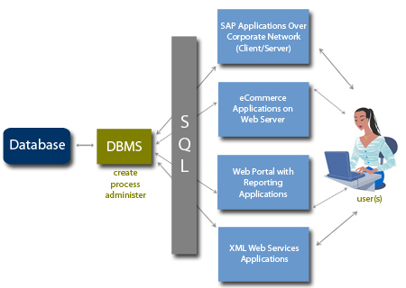
Introduction to Database
DB - A set of inter-related data
MS - A software that manages the data
SCHEMA - A set of tables and relationships, which meet a specific need

Slide 4
Characteristics of DBMS
Control of Data Redundancy
Same data is stored at number of places
DBMS helps in removing redundancies by providing means of integration.
Sharing of Data
DBMS allow many applications to share the data with user.
Maintenance of Integrity
Refers to the correctness, consistency and interrelationship of data with respect to the application, which uses the data.

Slide 5
Characteristics of DBMS
Support for Transaction Control and Recovery
DBMS ensures that updates take place physically after a logical transaction is complete.
Data Independence
In DBMS, the application programs are transparent to the physical organization and access techniques.
Availability of Productivity Tools
Tools like query language, screen and report painter and other 4GL tools are available.

Slide 6
Characteristics of DBMS
Control over Security
DBMS provide tools by which the DBA can ensure security of the database.
Hardware Independence
Most DBMS are available across hardware platforms and operating systems.

Slide 7
Database Applications – DBMS
Applications where we use Database Management Systems are:
Telecom
Industry
Banking System
Education Sector
Online Shopping

Slide 8
DBMS over file system
Advantage of DBMS system:
No redundant data – Redundancy removed by data normalization
Data Consistency and Integrity – data normalization takes care of it too
Secure – Each user has a different set of access
Privacy – Limited access
Easy access to data
Easy recovery
Flexible
Disadvantages of DBMS
DBMS implementation cost is high compared to the file system
Complexity: Database systems are complex to understand
Performance: Database systems are generic, making them suitable for various applications. However this feature affect their performance for some applications

Slide 9
Levels of Abstraction
Physical level:
This is the lowest level of data abstraction. It describes how data is actually stored in database. You can get the complex data structure details at this level.
Logical level:
This is the middle level of 3-level data abstraction architecture. It describes what data is stored in database.
View level:
Highest level of data abstraction. This level describes the user interaction with database system.

Slide 10
Instance and schema
Definition of schema:
Design of a database is called the schema. Schema is of three types: Physical schema, logical schema and view schema.
The design of a database at physical level is called physical schema, how the data stored in blocks of storage is described at this level.
Design of database at logical level is called logical schema, programmers and database administrators work at this level, at this level data can be described as certain types of data records gets stored in data structures
Design of database at view level is called view schema. This generally describes end user interaction with database systems.
Definition of instance:
The data stored in database at a particular moment of time is called instance of database. Database schema defines the variable declarations in tables that belong to a particular database; the value of these variables at a moment of time is called the instance of that database.

Slide 11
Data models in DBMS
Data Model:
is a logical structure of Database. It describes the design of database to reflect entities, attributes, relationship among data, constrains etc.
Types of Data Models:
Object based logical Models – Describe data at the conceptual and view levels.
E-R Model
Object oriented Model
Record based logical Models:
Like Object based model, they also describe data at the conceptual and view levels. These models specify logical structure of database with records, fields and attributes.
Hierarchical Model
Network Model
Relational Model

Slide 12
E-R model in DBMS
ER model:
is a systematic way of describing and defining a business process. An ER model is typically implemented as a database. The main components of E-R model are: entity set and relationship set.
Rectangle: Represents Entity sets.
Ellipses: Attributes
Diamonds: Relationship Set
Lines: They link attributes to Entity Sets and Entity sets to Relationship Set
Double Ellipses: Multivalued Attributes
Dashed Ellipses: Derived Attributes
Double Rectangles: Weak Entity Sets
Double Lines: Total participation of an entity in a relationship set

Slide 13
The Relational Model
Relational Model:
developed out of the work done by Dr. E. F. Codd at IBM in the late 1960s who was looking for ways to solve the problems with the existing models.
At the core of the relational model is the concept of a table (also called a relation) in which all data is stored.
Each table is made up of records (horizontal rows also known as tuples) and fields (vertical columns also known as attributes).
Examples of RDBMS are Oracle, Informix, and Sybase.

Slide 14
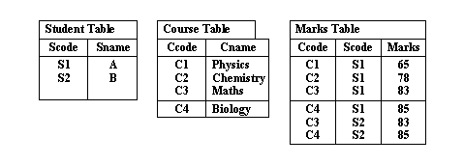
The Relational Model
Because of lack of linkages relational model is easier to understand and implement.

Slide 15
Possibilities in Relational Model
INSERT
Inserting a course record or student record poses no problems because tables are separate
DELETE
Deleting any record affects only a particular table
UPDATE
Update can be done only to a particular table

Slide 16
Properties of Relational Data Structures
Tables must satisfy the following properties to be classified as relational.
Entries of attributes are single valued
Entries of attribute are of the same kind.
No two rows are identical
The order of attributes is unimportant
The order of rows is unimportant
Every column can be uniquely identified.

Slide 17
Data Integrity
Data integrity is the assurance that data is consistent, correct, and accessible
Entity Integrity:
This is concerned with the concept of primary keys. The rule states that every table must have its own primary key and that each has to be unique and not null.
Referential Integrity:
This is the concept of foreign keys. The rule states that the foreign key value can be in two states. The first state is that the foreign key value would refer to a primary key value of another table, or it can be null. Being null could simply mean that there are no relationships, or that the relationship is unknown.
Domain Integrity:
This states that all columns in a relational database are in a defined domain.

Slide 18
Types of keys in DBMS
Data integrity is the assurance that data is consistent, correct, and accessible
Primary Key – A primary is a column or set of columns together in a table that uniquely identifies tuples (rows) in that table.
Super Key – A super key is a set of one of more columns (attributes) to uniquely identify rows in a table.
Candidate Key – A super key with no redundant attribute is known as candidate key
Alternate Key – Out of all candidate keys, only one gets selected as primary key, remaining keys are known as alternate or secondary keys.
Composite Key – A key that consists of more than one attribute to uniquely identify rows (also known as records & tuples) in a table is called composite key.
Foreign Key – Foreign keys are the columns of a table that points to the primary key of another table. They act as a cross-reference between tables.

Slide 19
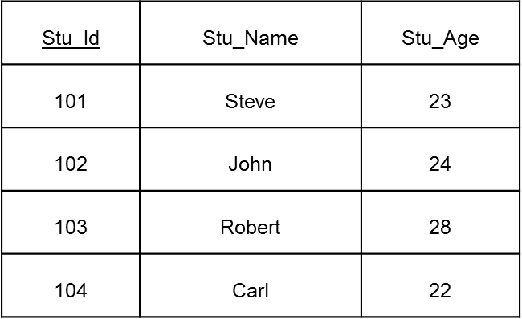
Primary Key
A primary is a column or set of columns in a table that uniquely identifies tuples (rows) in that table.
We denote the primary key by underlining the column name.
A Table should have one primary key.
The value of primary key should be unique for each row of the table. Primary key column cannot contain duplicate values.
Primary key column should not contain nulls.
Primary keys are not necessarily to be a single column; more than one column can also be a primary key for a table is called composite.

Slide 20
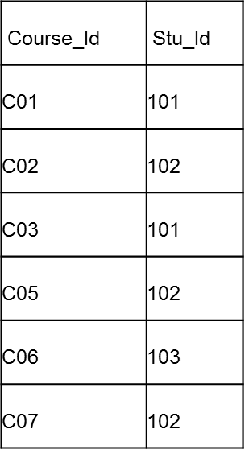
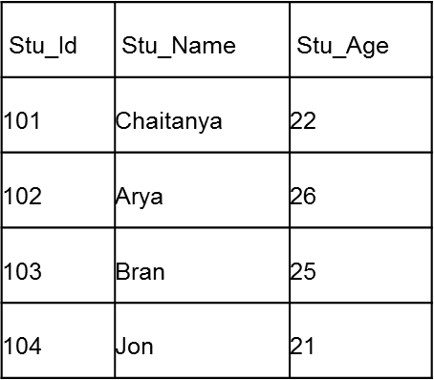
Foreign key
A primary is a column or set of columns in a table that uniquely identifies tuples (rows) in that table.
Practically, the foreign key has nothing to do with the primary key tag of another table, if it points to a unique column (not necessarily a primary key) of another table then too, it would be a foreign key. So, a correct definition of foreign key would be: Foreign keys are the columns of a table that points to the candidate key of another table.
105

Slide 21
Composite key
A key that consists of more than one attribute to uniquely identify rows (also known as records & tuples) in a table is called composite key. It is also known as compound key.
cust_Id | order_Id | product_code | product_count
C01 | O001 | P007 | 23
C02 | O123 | P007 | 19
C02 | O123 | P230 | 82
C01 | O001 | P890 | 42
Key in above table: {cust_id, order_id}
This is a composite key as it consists of more than one attribute.

Slide 22
Cardinality in DBMS
Context of Data Models:
In terms of data modeling, cardinality refers to the relationship between two tables. They can be of four types:
One to One – A single row of table 1 associates with single row of table 2
One to Many – A single row of table 1 associates with more than one rows of table 2
Many to One – Many rows of table 1 associate with a single row of table 2
Many to Many – Many rows of table 1 associate with many rows of table 2

Slide 23
ACID properties in DBMS
Atomicity: This property ensures that either all the operations of a transaction reflect in database or none.
Consistency: The execution of transaction should take place in isolation (that means no other transaction should run concurrently when there is a transaction already running).
Isolation: For every pair of transactions, one transaction should start execution only when the other finished execution.
Durability: Once a transaction completes successfully, the changes it has made into the database should be permanent even if there is a system failure.

Slide 24
Normalization

Slide 25
Normalization
Is a technique for designing relational database tables
Minimize duplication of information
Safeguard the database against certain types of problems
Process of efficiently organizing data in a database
Goals of the normalization process:
Reduces the amount of space a database consumed
Ensures that data is logically stored.

Slide 26
Problems with Un normalized Database
can suffer from logical inconsistencies of various types and from anomalies involving data operations.
UPDATE ANOMALY
INSERTION ANOMALY
DELETION ANOMALY

Slide 27
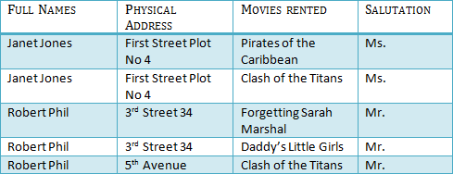
First Normal Form (1NF)
I NF:
Eliminate Repeating Groups - Make a separate table for each set of related attributes, and give each table a primary key.
1NF requires that the values in each column of a table are atomic. By atomic we mean that there are no sets of values within a column.
A table is in first normal form (1NF) if and only if it faithfully represents a relation.

Slide 28
Second Normal Form (2NF)
2 NF:
Is based on the concept of Full Functional Dependency.
A relation R is in 2NF if and only if it is in 1NF and every non-key attribute is fully functionally dependent on the primary key of the relation R.
A table in 1NF is also in 2NF form if the values in every column are functionally or transitively dependent on the complete primary key
For every relation with a single data item making up the primary key, this rule should always be true. For those with the composite key examine every column and ask whether its value depends on the whole of the composite key or just some part of it
Remove those that depend only on part of the key to a new relation with that part as the primary key

Slide 29

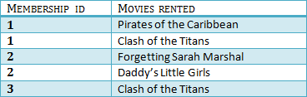
Example of 2NF form
The below two tables demonstrate 2NF.

Slide 30
Third Normal Form(3NF)
3 NF:
Eliminate Columns Not Dependent On Key - If attributes do not contribute to a description of the key, remove them to a separate table
3nF is based on the concept of transitive dependency.
A relation R is in 3NF if and only if it is in 2NF and every non-key attribute is nontransitively dependent on the primary key of the relation R.

Slide 31
The criteria for third normal form (3NF)
3 NF Rules :
A relation in the second normal form is also in the third normal form, if the values in every non - key column are not transitively dependent on the primary key
Examine every non - key column and question its relationship with every other non - key column
If there is a transitive dependency remove both the columns to a new relation

Slide 32

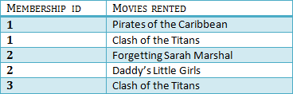

Example of Third Normal form
The below two tables demonstrate 3NF.

Slide 33
BENEFITS OF NORMALIZATION
BENEFITS:
Greater overall database organization
Reduction of redundant data
Data consistency within the database
A much more flexible database design
A better handle on database security

Slide 34
DRAWBACKS OF NORMALIZATION
Reduced database performance
The acceptance of reduced performance requires the knowledge that when a query or transaction request is sent to the database
Requires much more CPU, memory, and I/O to process transactions and database queries

Slide 35
Summary
RDBMS are primary used for storing transactional data.
E-R Model is prepared to map the business system to database.
Normalization is the process of refining the table schema.

