Slide 1

Angular JS

Slide 2
Objectives
After completing the session participants will able to
Develop a single page application (SPA).
Apply different types of filters for web application.

Slide 3
Angular JS
Overview

Slide 4
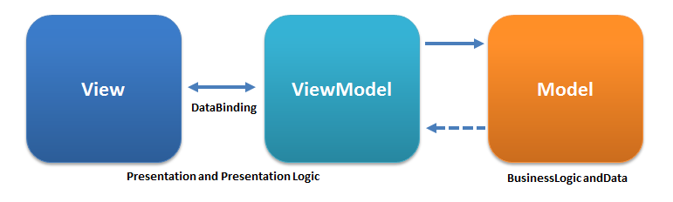
What is Angular JS?
Full-featured JavaScript SPA (Single Page Application) framework
open source client-side JavaScript framework
built and maintained by Google
extends HTML DOM with using Directives and binds data to HTML using expressions
MVC/MVVM Framework

Slide 5
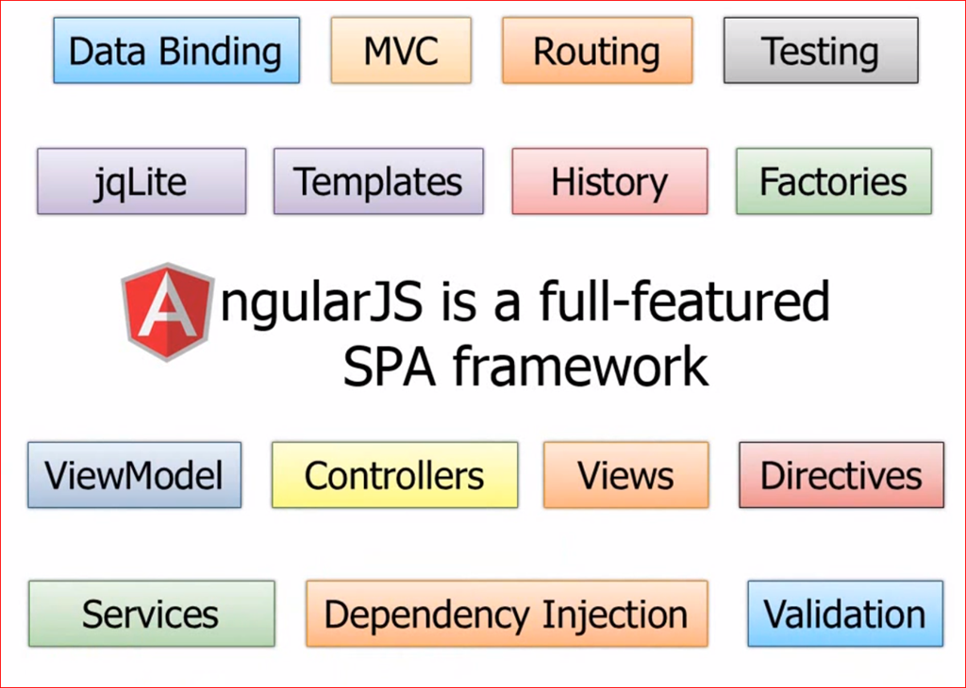
Angular JS Big Picture
Notes:
Overview
▪Angular JS Terminologies:
▪View: In AngularJS, Views arelike Document Object Model (DOM) and are used todisplay the data.
▪Controller:Controllers are JavaScript constructor functions that are used to control the AngularJS applications. Application logic can be placed in controller.
▪Scope: Scope is an Application Object($scope), which alludes to the Application Model. It acts as a glue between Controller and View for execution of expressions.
▪Services:AngularJS services has several built-in objects like$httpand services can be utilized to arrange the code crosswise over theapplication.
▪Filters:Filters can be used in controllers, services, expressions and directives with pipe character (|) to format the value of expressions and display it to the user.
▪Directives:Directives are used to extend theHTML DOMwith new attributes. They have the prefixng-. Own directives ( custom directives ) can be created like controllers and services.
▪Templates:Templates are written in HTML that contains specific AngularJS directives and expressions. More templates can be combined with the information from the controller and forms a single page application. For examplesingle.html.
▪Dependency Injection: AngularJS has come up with a dependency sub-system that helps the developers toeasily develop, analyze and test the applications.

Slide 6
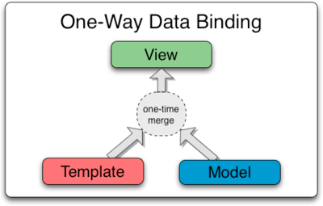
One Way Data Binding
View (UI part) does not automatically updates when there is a change in the data model and we need to write custom code to make it updated every time
Its not a synchronization processes.
A data binding can be specified in two different ways:
•with curly braces:{{expression}}
•with the ng-bind directive:ng-bind= “varName”

Slide 7
Angular JS
Data Binding

Slide 8
One way data binding code snippet
<!DOCTYPE html>
<html>
<head>
<title>Example for get fullnameusing AngularJS</title>
</head>
<body ng-app="“ ng-init=“firstname=‘Angular’;lastname=‘JS’;”>
<h1>Example for get fullnameusing AngularJS</h1>
<p>Fullname: {{ firstname+ ' ' + lastname}}</p>
<p>Fullname:
<span ng-bind=“firstname”></span> + ' ' + <span ng-bind=“lastname”></span> </p>
<script src="http://ajax.googleapis.com/ajax/libs/angularjs/1.4.1/angular.min.js">
</script>
</body>
</html>
Data Binding

Slide 9
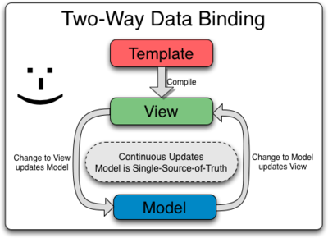
Two way data binding
2-Way Data Binding, when a model variable is bound to a HTML element that can both change and display the value of the variable
•ng-model directive to bind a model variable to the HTML element that can not only display its value, but also change it

Slide 10
Two way data binding code snippet
<!DOCTYPE html>
<html>
<head>
<title>Example for get fullnameusing AngularJS</title>
</head>
<body ng-app="">
<h1>Example for get fullnameusing AngularJS</h1>
<form name="Application" action="#">
Firstname: <input type="text" name="firstname" id="firstname" ng-model="firstname">
Lastname: <input type="text" name="lastname" id="lastname" ng-model="lastname">
<br>
</form>
<p>Fullname: {{ firstname+ ' ' + lastname}}</p>
<script src="http://ajax.googleapis.com/ajax/libs/angularjs/1.4.1/angular.min.js">
</script>
</body>
</html>

Slide 11
Angular JS
Directives

Slide 12
Directives
Are an extension over the HTML elements and that allow you to extend the HTML elements behavior by adding special attribute prefix ng-.
They are markers (such as attributes, tags, and class names) that tell Angular JS to attach a given behavior to a DOM element (or transform it, replace it, etc.)
Some angular directives are:
‒ ng-app: Bootstrapping your app and defining its scope.
‒ ng-controller: Defines which controller will be in charge of your view.
‒ ng-repeat: Allows for looping through collections.
‒ ng-init: This directive is used to initialize values to variables used in application.
‒ ng-model: This directive is used to bind values of input controls to application data.

Slide 13
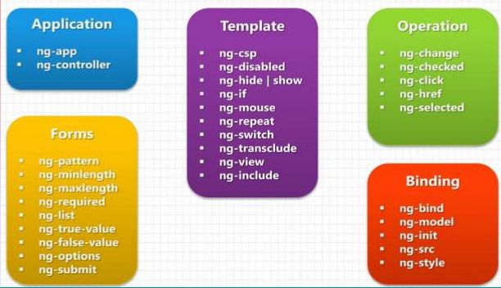
Directives

Slide 14
Directives
Some angular directives are:
‒ ng-app: Bootstrapping your app and defining its scope.
‒ ng-controller: Defines which controller will be in charge of your view.
‒ ng-repeat: Allows for looping through collections.
‒ ng-init: This directive is used to initialize values to variables used in application.
‒ ng-model: This directive is used to bind values of input controls to application data.

Slide 15
Directives
ng-app
Used to define starting point of application and it will act as root element for application
Will identify which part of HTML needs to use for angularjs app
Once Angular JS framework initialized it will check if html contains ng-app directive or not in case if it found it will compile that respective html template
If we define ng-app in root element either <html> or <body> of html document then it will control complete html DOM elements

Slide 16
Directives
ng-app
Used to define starting point of application and it will act as root element for application
Will identify which part of HTML needs to use for angularjs app
Once Angular JS framework initialized it will check if html contains ng-app directive or not in case if it found it will compile that respective html template
If we define ng-app in root element either <html> or <body> of html document then it will control complete html DOM elements

Slide 17
Directives
ng-init:
Used to initialize application data during starting of application.
used to define local variable with value and we can use that variable value in application wherever we required.
Can declare multiple values with ng-init directive(separated by ;)
ng-model:
used to get value of input controls like textbox, label, etc and bind that value to application data.
Can declare multiple values with ng-model directive.

Slide 18
Code Snippet: ng-app, ng-init and ng-model directives
<html >
<head>
<title> AngularJsDirective example </title>
<script src="http://ajax.googleapis.com/ajax/libs/angularjs/1.4.8/angular.min.js"></script>
</head>
<body>
<div ng-app="" ng-init="multiple=12;number1=0">
Get <input type="text" ng-model="number1" /> Multiple of 12
<p>Result : {{number1 * multiple}}</p>
</div>
</body>
</html>

Slide 19
Angular JS
Filters

Slide 20
Filters
Filters are used to change the appearance of an expressions by formatting while displaying it to users.
A concepts that work with separation of record based on column and we will apply filters to expressions and directives by using the pipe ( | ) character.
We can also apply filters to result of another filter(also called chaining of filters).
We can also format expressions by applying filters with arguments

Slide 21
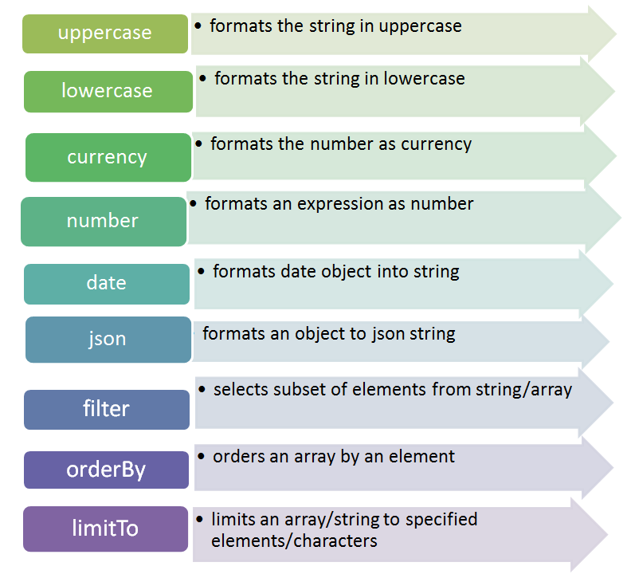
Filters Types

Slide 22
Lowercase and Uppercase Filters Demo
<script>
varapp = angular.module("AngularlowercaseApp", []);
app.controller("lowercasectrl", function ($scope) {
$scope.clients= [{
name: "Amex", location: "Phoenix"},
{name: "DTNA", location: "Portland"},
{name: "Scripps", location:"California"},
{name: "Magellan", location: "Richmond“ }];
});
</script>
</head>
<body ng-app="AngularlowercaseApp">
<h2>AngularJS LowerCaseFilter Example</h2>
<div ng-controller="lowercasectrl">
<ulng-repeat="client in clients ">
<li>{{client.name | lowercase }}</li>
<li>{{client.name | uppercase }}</li>
</ul>
</div>
</body>

Slide 23
Number Filter
Used to format the number and convert it as string or text.
Can show number with decimal values and also define limit to show number of decimal values.
<script>
varapp = angular.module("AngularnumberApp", []);
app.controller("numberctrl", function ($scope) {
$scope.sampleval= 98765.13547584;
});
</script>
</head>
<body ng-app="AngularnumberApp">
<div ng-controller="numberctrl">
Enter Number: <input type="text" ng-model="sampleval" /><br/><br/>
Default Number expression:{{sampleval| number}}<br/><br/>
Number with Decimal Value: {{sampleval| number:4}} <br/><br/>
Number with Zero Decimals:{{sampleval| number:0}}
</div>
</body>

Slide 24
Currency Filter
Used to format number as a currency(by default dollar ($) symbol).
<script>
varapp = angular.module("AngularcurrencyApp", []);
app.controller("currencyctrl", function ($scope) {
$scope.sampleval= 55783.1483784;
});</script>
</head><body ng-app="AngularcurrencyApp">
<h2>AngularJS Currency Filter Example</h2>
<div ng-controller="currencyctrl">
Enter Number: <input type="text" ng-model="sampleval" /><br/><br/>
Default Currency expression:{{sampleval| currency}}<br/><br/>
Currency with Custom Value: {{sampleval| currency : "USD$"}} <br/><br/>
Currency with Zero Decimals: {{sampleval| currency : "USD$" : 0}}
Currency with Custom Value: {{sampleval| currency : "INR"}} <br/><br/>
Currency with Custom Value: {{sampleval| currency : "GBP"}} <br/><br/>
</div>
</body>

Slide 25
Date Filter
Used to convert date to string based on required format.
<script>
varapp = angular.module("AngulardateApp", []);
app.controller("datectrl", function ($scope) {
$scope.sampledate= new Date();
});
</script>
</head>
<body ng-app="AngulardateApp">
<div ng-controller="datectrl">
Enter Number: <input type="text" ng-model="sampledate" style="width:400px" /><br/><br/>
Date with short expression:{{sampledate| date:"short" }}<br/><br/>
Date with mediumDateexpression: {{sampledate| date : "mediumDate"}} <br/><br/>
Date with yyyy-mm-ddhh:mm:ssexpression: {{sampledate| date : "yyyy-mm-ddhh:mm:ss" : 0}} <br/><br/>
Date with yyyy-mm-ddhh:mm:ssexpression: {{sampledate| date : "dd/mm/yyyy'at' hh:mma" : 0}}
</div>
</body>

Slide 26
Order by Filter
used to sort array elements (like Java script objects, strings, list objects) either in ascending or descending order based on our requirement
<script>
varapp = angular.module("AngularOrderByApp", []);
app.controller("orderbyctrl", function ($scope) {
$scope.clients= [{name: "Amex", location: "Phoenix"}, {name: "DTNA", location: "Portland" },
{name: "Scripps", location:"California" }, {name: "Magellan", location: "Richmond" }];
});
</script>
<body ng-app="AngularOrderByApp">
<div ng-controller="orderbyctrl">
<p>OrderByName in Ascending Order</p>
<ulng-repeat="client in clients | orderBy: 'name'"> <li>{{client.name}}</li> </ul>
<p>OrderByName in Descending Order</p>
<ulng-repeat="client in clients | orderBy: 'name' : true"> <li>{{client.name}}</li> </ul>
</div>

Slide 27
Filter
used get filtered subset of items from array items list based on user input filter key text .
<script>
varapp = angular.module("AngularfilterApp", []);
app.controller("filterctrl", function ($scope) {
$scope.clients= [{name: "Amex", location: "Phoenix"},
{name: "DTNA", location: "Portland" },{name: "Scripps", location:"California" },
{name: "Magellan", location: "Richmond" }];
});
</script>
</head>
<body ng-app="AngularfilterApp">
<div ng-controller="filterctrl">Enter Name to Filter:<input ng-model="searchtxt" type="text" placeholder="Flterkey">
<table><tr><th>Name</th><th>Location</th></tr>
<trng-repeat="client in clients | filter : searchtxt">
<td>{{client.name}}</td><td>{{client.location}}</td>
</tr></table>
</div>
</body>

Slide 28
Limit To Filter
used to get new array or string with a specified number of elements.
<script>
varapp = angular.module("AngularfilterApp", []);
app.controller("filterctrl", function ($scope) {
$scope.arr= [220, 130, 413, 52, 111, 24, 6]
$scope.str= "www.syntelinc.com";
});
</script>
</head>
<body ng-app="AngularfilterApp">
<h2>AngularJS LimittoFilter Example</h2>
<div ng-controller="filterctrl">
Default Array : {{arr}}<br/><br/>
LimitToGet Elements from Beginning:{{arr| limitTo: 3}}<br/><br/>
LimitToGet Elements from Ending:{{arr| limitTo: -3}}<br/><br/>
Get Elements from String : {{str| limitTo: 4}}
</div>
</body>

Slide 29
Angular JS
Controllers

Slide 30
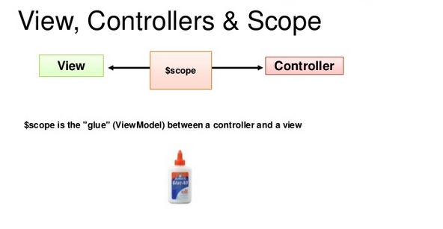
Controllers
Controllers are nothing but plain java script functions which are bound to particular scope.

Slide 31
Controller Demo
<div ng-controller="SimpleController">
<input type="text" ng-model="fname"></input>
<input type="text" ng-model="lname"></input>
{{fname}}
{{lname}}
{{getFullName()}}
</div>
<script>
function SimpleController($scope)
{
$scope.fname=‘John';
$scope.lname=‘Patrick';
$scope.getFullname=function()
{
return $scope.fname+" ~ "+$scope.lname;
}
}
</script>

Slide 32
Angular JS
Modules

Slide 33
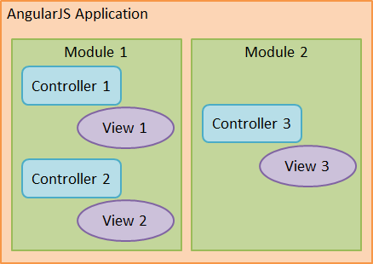
Modules
A module is a collection of services, directives, controllers, filters, and configuration information.
An Angular JS module defines an application.
The module is a container for the different parts of an application.
The module is a container for the application controllers.
Controllers always belong to a module.
You can create a controller using modules.

Slide 34
Creating a module
A module is created by using the AngularJS function angular.module
<div ng-app="myApp">...</div> <script> var app = angular.module("myApp", []); </script>
The "myApp" parameter refers to an HTML element in which the application will run.

Slide 35
Module Demo
<!DOCTYPE html>
<html ng-app="demoApp">
<head>
<script src="angular.min.js"></script>
</head>
<body>
<div ng-controller="NameController">
First Name: <input type="text" ng-model="firstName"><br>
Last Name: <input type="text" ng-model="lastName"><br>
<br>
Full Name: {{firstName + " " + lastName}}
</div>
<script>
var app = angular.module("demoApp", []);
app.controller("NameController", function($scope) {
$scope.firstName = “John";
$scope.lastName = “Rinkesh";
});
</script>
</body>
</html>

Slide 36
Angular JS
Services

Slide 37
Services
Angular JS provides a $http service for reading data and remote servers. It is used to retrieve the desired records from a server.
Angular JS requires data in JSON format.
Once the data is ready, $http gets the data form server.

Slide 38
Services Demo
<!DOCTYPE html>
<html>
<head>
<title>Angular JS Includes</title>
<style>
table, th , td {
border: 1px solid grey;
border-collapse: collapse;
padding: 5px;
}
table tr:nth-child(odd) {
background-color: #f2f2f2;
}
table tr:nth-child(even) {
background-color: #ffffff;
}
</style>
</head>

Slide 39
Services Demo
<body>
<h2>AngularJS Sample Application</h2>
<div ng-app = "" ng-controller = "employeeController">
<table>
<tr>
<th>Name</th>
<th>Age</th>
<th>Salary</th>
</tr>
<tr ng-repeat = "employee in employees">
<td>{{ employee.Name }}</td>
<td>{{ employee.Age }}</td>
<td>{{ employee.Salary }}</td>
</tr>
</table>
</div>

Slide 40
Services Demo
<script>
function employeeController($scope,$http) {
var url = "data.txt";
$http.get(url).success( function(response) {
$scope.employees = response;
});
}
</script>
</body>
</html>

Slide 41
Services Demo
"data.txt" (employee's data in JSON format)
{
"Name" : “Rajat",
"Age" : 20,
"Salary" : "22000"
},
{
"Name" : “Rinkesh",
"Age" : 45,
"Salary" : "67000"
},
{
"Name" : “Ramij",
"Age" : 21,
"Salary" : "55000"
}

