Slide 1
MEAN STACK

Slide 2
Version Control and Revision History
 | Name | Date
Prepared By | Pradeep Chinchole | 01-Aug-2018
Reviewed By | Nisha Mendonsa | 01-Aug-2018
Approved By | Gauresh Gaitonde | 01-Aug-2018
Version No. | Date | Affected Sections | Highlights
1.0.0 | 01-Aug-2018 | All | Original Version

Slide 3
MongoDB

Slide 4
Databases Types
Relational Database (Oracle , MySQL)
Analytical OLAP ( Cognos , MicroStrategy )
Key-Value Stores ( Berkley BB, Dyanmo DB)
Column Family (Cassandra , Hbase )
Graph Store ( Stardog, Bigdata triple store)
Document Store (MONGO-DB)

Slide 5
What is MongoDB?
Scalable High-Performance Open-source, Document-orientated database.
Built for Speed
Rich Document based queries for Easy readability.
Full Index Support for High Performance.
Replication and Failover for High Availability.
Auto Sharding for Easy Scalability.
Map / Reduce for Aggregation.

Slide 6
Why use MongoDB?
SQL was invented in the 70’s to store data.
MongoDB stores documents (or) objects.
Now-a-days, everyone works with objects (Python/Ruby/Java/etc.)
And we need Databases to persist our objects. Then why not store objects directly ?
Embedded documents and arrays reduce need for joins. No Joins.

Slide 7
What is MongoDB great for?
RDBMS replacement for Web Applications.
Is a Semi-structured or unstructured Content Management.
Real-time Analytics & High-Speed Logging.
Caching and High Scalability
Web 2.0, Media, Gaming
HealthCare, Finance, Telecom, Government

Slide 8
Not great for?
Highly Transactional Applications.
Problems requiring SQL

Slide 9









Some Companies using MongoDB

Slide 10

Creating local environment for MongoDB

Slide 11
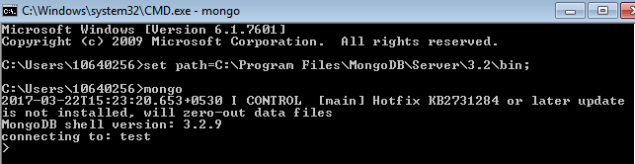
Mongo Client

Slide 12
How to import database ?
mongoimport –d database_name –c collection_name -–type type –-file path of your database –headerline;

Slide 13

Database
When I say
Think
Database
Made up of Multiple Collections.

Slide 14
Collection
When I say
Think
Table
Schema-less, and contains Documents.
Indexable by one/more keys.
Capped Collections: Fixed size, older records get dropped after reaching the limit.

Slide 15
Document
When I say
Think
Record/Row
Stored in a Collection.
Can have _id key – works like Primary keys in MySQL.
Document storage in BSON (Binary form of JSON).

Slide 16
The createCollection() Method
In MongoDB, you don't need to create collection. MongoDB creates collection automatically, when you insert some document.
MongoDB db.createCollection(name, options) is used to create collection.
Example
    use test
    switched to db test
    >db.createCollection("mycollection") { "ok" : 1 }

Slide 17
MongoDB
You can check the created collection by using the command show collections.
Syntax:show collections
To Check current database
Syntax: db
To See all Databases
Syntax:show dbs
To remove Collection
Syntax:db.emp.remove({})

Slide 18
The dropDatabase() Method
MongoDB db.dropDatabase() command is used to drop a existing database.
Syntax: db.dropDatabase()
This will delete the selected database. If you have not selected any database, then it will delete default 'test' database.

Slide 19
Insert
To insert data into MongoDB collection, you need to use MongoDB' s insert().
In the inserted document, if we don't specify the _id parameter, then MongoDB assigns a unique ObjectID for this document.
E.g.. db.collection_name.insert({“name”:”Radhika”,”salary”:20000,”city”:”Mumbai”});
db.collection_name.insert({“_id”:1,“name”:”Radhika”,”salary”:20000,”city”:”Mumbai”});

Slide 20
Projection
Projection means selecting only the necessary data rather than selecting whole of the data of a document. If a document has 5 fields and you need to show only 3, then select only 3 fields from them.
db.COLLECTION_NAME.find();
db.COLLECTION_NAME.find().pretty();
db.COLLECTION_NAME.find({},{KEY:1});
db.COLLECTION_NAME.find({},{_id:0,KEY:1});
Where clause – Equality {<key>:<value>}
Less Than {<key>:{$lt:<value>}}
Not Equals {<key>:{$ne:<value>}}

Slide 21
Update()
MongoDB's update() methods are used to update document into a collection. This method updates the values in the existing document while the save() method replaces the existing document with the document passed in save() method.
SYNTAX
db.COLLECTION_NAME.update(SELECTION_CRITERIA, UPDATED_DATA)
For multi rows, syntax is {multi:true});

Slide 22
Where Clause Equivalents
Equality ---→ {<key>:<value>}
E.g.. db.mycol.find({“name":“lnt"}).pretty()
Less Than --→ {<key>:{$lt:<value>}}
E.g.. db.mycol.find({"likes":{$lt:50}}).pretty()
Less Than Equals --→ {<key>:{$lte:<value>}}
Eg.db.mycol.find({"likes":{$lte:50}}).pretty()
Greater Than --→ {<key>:{$gt:<value>}}
E.g.. db.mycol.find({“id":{$gt:50}}).pretty()
Greater Than Equals --→ {<key>:{$gte:<value>}}
E.g.. db.mycol.find({“id":{$gte:50}}).pretty()
Not Equals --→ {<key>:{$ne:<value>}}
E.g.. db.mycol.find({“id":{$ne:50}}).pretty()

Slide 23
OR
The $or operator performs a logical OR operation on an array of two or more <expressions> and selects the documents that satisfy at least one of the <expressions>.
Syntax :
db.mycol.find( { $or: [ {key1: value1}, {key2:value2} ] } ).pretty()

Slide 24
Pattern Matching
These queries are used to find a particular pattern of string from the data.
Pattern can be matched from beginning, end or from the middle.
^ is used to match the pattern in the beginning.
$ is used to match the pattern from the end.
Problem Statement:
Write a MongoDB query to find the records where employee name starts with ‘A’.
Query: db.employee.find({firstName:/^A./},{firstName:1});
Output: { “firstName” : “Anthony” }
{ “firstName” : “Andy” }
Problem Statement:
Write a MongoDB query to find the records where employee name ends with ‘a’.
Query: db.employee.find({ename:/.a$/},{firstName:1});
Output: { "firstName" : "Pamela" }

Slide 25
Limit()
limit() is used to display only n number of documents from the retrieved data.
This function accepts one number type argument, which is the number of documents that you want to display.
limit() is only used to display n number of documents but all the documents matching the conditions in the find() will be retrieved by the query.
Syntax: db.collection.find().limit(n);
Problem Statement
Write a MongoDB query to display only first 5 records from the employee collection.
Query: db.employee.find().limit(5);
Output: { "firstName" : "Diane" }
{ }
{ "firstName" : "Jeff" }
{ "firstName" : "William" }
{ }

Slide 26
SKIP()
skip() is used to skip n number of documents from the retrieved data.
This function accepts one number type argument, which is the number of documents that you want to skip.
skip() is only used to skip n number of documents but all the documents matching the conditions in the find() will be retrieved by the query.
Syntax: db.collection.find().skip(n);
Problem Statement
Write a MongoDB query to display all documents after 5th document from employee collection.
Query: db.employee.find().skip(5);
Output: { "firstName" : "Anthony" }
{ "firstName" : "Leslie" }
{ "firstName" : "Leslie" }

Slide 27
SORTING
To sort documents in MongoDB, you need to use sort() method.
The method accepts a document containing a list of fields along with their sorting order.
To specify sorting order 1 and -1 are used.
    1 is used for ascending order
    -1 is used for descending order.

Slide 28
SORTING(Ascending)
Problem Statement:
Sort data based on salary in ascending order
QUERY: .find().sort({"Salary":1});
OUTPUT: { "_id" : ObjectId("58ca36621e64b28fee64b7bc"),"id" : 1111, "firstName" : "hitesh", "lastName" : "milani","dept" : "HRD", "City" : "Nashik"}
QUERY:

Slide 29
SORTING(Descending)
Problem Statement:
Sort data based on salary in descending order.
QUERY:
> db.class.find().sort({"Salary":-1});
OUTPUT:
{ "_id" : ObjectId("58ca0fc21e64b28fee64b7b9"), "id" : 1625, "firstName" : "Yoshimi","mname" : "V","lastName" : "Kato","dept" : "Planning","email" : "ykato@classicmodelcars.com","Salary" : 200000, "City" : "Nashik"}

Slide 30
remove()
MongoDB's remove() method is used to remove a document from the collection. remove() method accepts two parameters. One is deletion criteria and second is justOne flag.
Syntax: db.collection_name.remove(deletion_criteria,justOne);
deletion criteria − (Optional) deletion criteria according to documents will be removed.
justOne − (Optional) if set to true or 1, then remove only one document.

Slide 31
MongoDB
Problem Statement:
Remove all records from collection where id=1111.
QUERY:
> db.class.remove({"id":1111});
This will show:
WriteResult({ "nRemoved" : 1 })

Slide 32
Aggregate
Aggregation operations group values from multiple documents together, and can perform a variety of operations on the grouped data to return a single result.
In SQL count(*) and with group by is an equivalent of mongodb aggregation
Basic Syntax:
>db.COLLECTION_NAME.aggregate(AGGREGATE_OPERATION)

Slide 33
Aggregate(SUM)
Problem Statement:
calculate sum of salary of employees in each department .
QUERY:
>db.class.aggregate([{$group:{"_id":"$dept",Salary:{$sum:"$Salary"}}}]);
OUTPUT:
{ "_id" : "HRD", "Salary" : 125000 }
{ "_id" : "Sales", "Salary" : 215200 }

Slide 34
Aggregate(MAX)
Problem Statement:
calculate maximum of salary of employee in each department .
QUERY:
>db.class.aggregate([{$group:{"_id":"$dept",Salary:{$max:"$Salary"}}}]);
OUTPUT:
{ "_id" : "HRD", "Salary" : 50000 }
{ "_id" : "Sales", "Salary" : 110000 }

Slide 35
Aggregate(MIN)
Problem Statement:
calculate minimum of salary of employee in each department .
QUERY:
>db.class.aggregate([{$group:{"_id":"$dept",Salary:{$min:"$Salary"}}}]);
OUTPUT:
{ "_id" : "HRD", "Salary" : 15000 }
{ "_id" : "Sales", "Salary" : 5000 }
{ "_id" : "Design", "Salary" : 19000 }

Slide 36
Aggregate(AVG)
Problem Statement:
calculate average of salary of employee in each department .
QUERY:
>db.class.aggregate([{$group:{"_id":"$dept",Salary:{$avg:"$Salary"}}}]);
OUTPUT:
{ "_id" : "HRD", "Salary" : 31250 }
{ "_id" : "Sales", "Salary" : 53800 }
{ "_id" : "Design", "Salary" : 19000 }

Slide 37
$Concat(Aggregation)
Concatenates strings and returns the concatenated string.
Query:
db.emp.aggregate([{$project:{Name:{$concat:["$firstName","$lastName"]}}}])
Output:
{ "_id" : ObjectId("58ca103e98279e48184196f8"),
"Name" : "WilliamPatterson" }

Slide 38
$toUpper and $toLower
toUpper.
Converts a string to uppercase, returns the result.
toLower.
Converts a string to lowercase, returns the result

Slide 39
db.emp.aggregate([{$project:{Name:{$toUpper:{$concat:["$firstName","-","$lasName"]}}}}]);
output: { "_id" : ObjectId("58ca103e98279e48184196f8"),
"Name" : "WILLIAM PATTERSON“}
db.emp.aggregate([{$project:{Name:{$toLower:{$concat:["$firstName","-","$lasName"]}}}}]);
output: { "_id" : ObjectId("58ca103e98279e48184196f8"),
"Name" : “William patterson“}

Slide 40
AND
In the find() method, if you pass multiple keys by separating them by ‘,’ then MongoDB treats it as AND condition.
Joins query clauses with a logical AND returns all documents that match the conditions of both clauses

Slide 41
Syntax of AND:
Basic Syntax of AND –
db.mycol.find(
{
$and: [
{key1: value1}, {key2:value2}
]
} ).pretty()

Slide 42
Q. Find the details of person working in Pune having salary 5000
db.emp.find({$and:[{“City:”Pune”},{Salary:5000}]}).count()
Output- 2
Q. Find details of person having salary 5000 working in sales department
db.emp.find({$and:[{Salary: 5000},{“dept":“Sales"}]}).count().pretty();
Output-1

Slide 43
In and Not In
The $in operator is used to retrieve documents from the collection after checking whether the value of a specific column is matching the values, specified in an array or not.
The $nin operator is used to retrieve documents from the collection except that, it matches documents for which the specified field does not have any value in the specified array.

Slide 44
Problem Statement:
Find records from emp collection having salary within specified values [5000,45000,38000]
Query:db.emp.find({“Salary" : { $in : [5000,45000,38000]}})
Output-
"Salary" : 5000,
"City" : "Pune"
"Salary" : 38000,
"City" : "Jalgaon“

Slide 45
Problem Statement:
Find records from emp collection having salary within specified values [5000,45000,38000]
Query: db.emp.find({Salary : { $nin : [5000,45000,38000]}}).pretty()
Output-
"Salary" : 150000,
"City" : "Nashik“
"Salary" : 10400,
"City" : "Jalgaon"

Slide 46
DISTINCT
Finds the distinct values for a specified field across a single collection and returns the results in an array

Slide 47
Problem Statement:
Find distinct values for all dept in inventory collection
Query: db.emp.distinct( "dept" )
Output-
“Admin”
“HRD”
“Purchase”
“Production”

Slide 48
Count
Returns the count of documents that would match a find() query.
The db.collection.count() method does not perform find() operation but instead counts and returns the number of results that match a query.

Slide 49
Problem Statement:
Count number of records in emp collection
Query: db.emp.count()
Output: 20
Problem Statement:
Count number of records in Jalgaon city
Query: db.emp.find({"City":"Jalgaon"}).count()
Output: 15

Slide 50
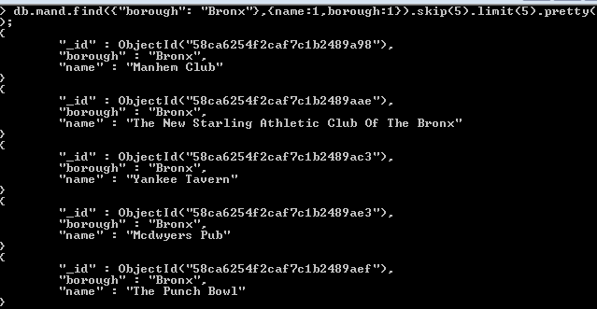
Write a MongoDB query to display the next 5 restaurants after skipping first 5 which are in the borough Bronx.

Slide 51
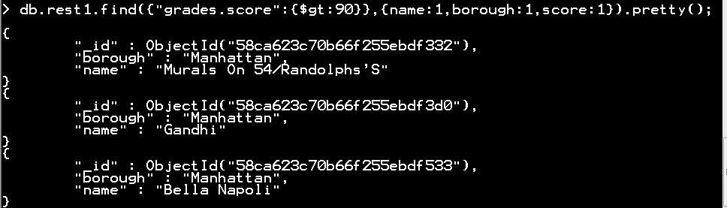
Write a MongoDB query to find the restaurants who achieved a score more than 90.

Slide 52
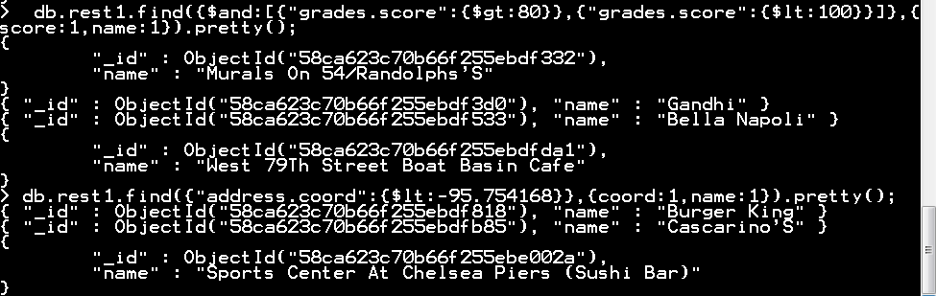
Write a MongoDB query to find the restaurants which locate in latitude value less than -95.754168.

Slide 53
Problem Statement:
Write a MongoDB query to find the restaurants which do not prepare any cuisine of 'American ' and achieved a grade point 'A' not belongs to the borough Brooklyn. The document must be displayed according to the cuisine in descending order.
Query:
db.rst.find({$and:[{"cuisine":{$ne:"American "}},{"grades.grade":"A"},{"borough":{$ne:"Brooklyn"}}]},{_id:0,cuisine:1,name:1}).sort({cuisine:-1})

Slide 54
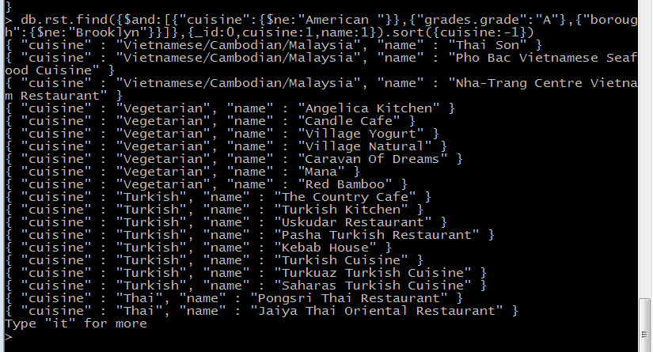

Slide 55
Write a MongoDB query to find the restaurants which belong to the borough Bronx and prepared either American or Chinese dish.
MongoDB query:
db.rst.find({$and:[{borough:"Bronx"},{cuisine:{$in:["American ","Chinese "]}}]}).pretty()

Slide 56
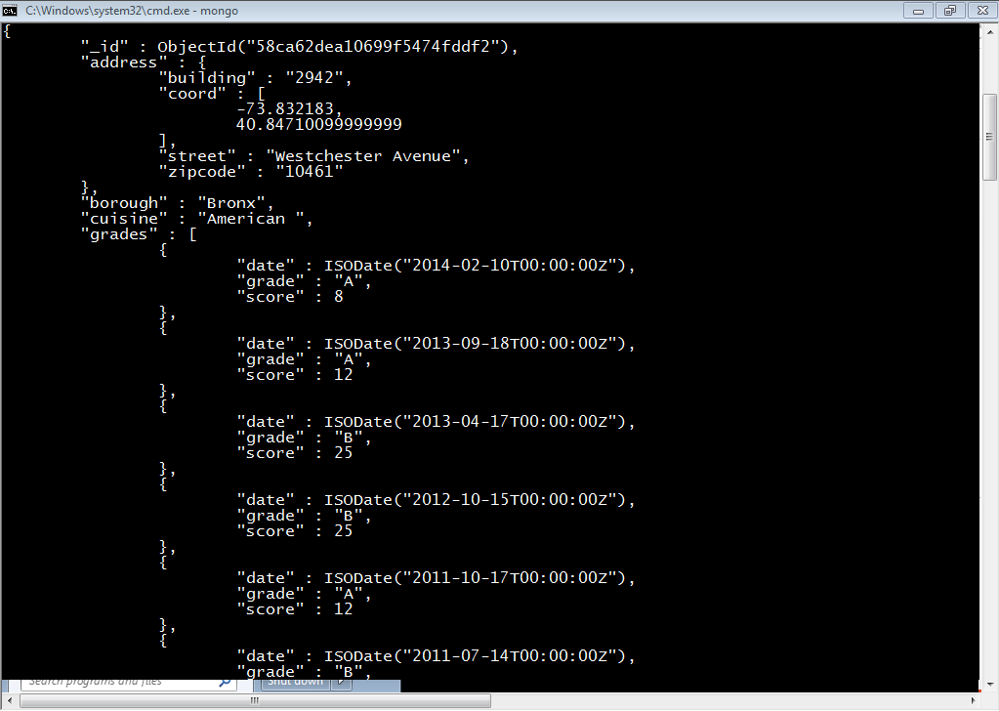
OUTPUT:

Slide 57
Write a MongoDB query to find the restaurant Id, name, borough and cuisine for those restaurants which achieved a score which is not more than 10.
MongoDB query:
db.rst.find({"grades.score":{$lte:10}},{_id:0,restaurant_id:1,name:1,cuisine:1,borough:1}).pretty()

Slide 58
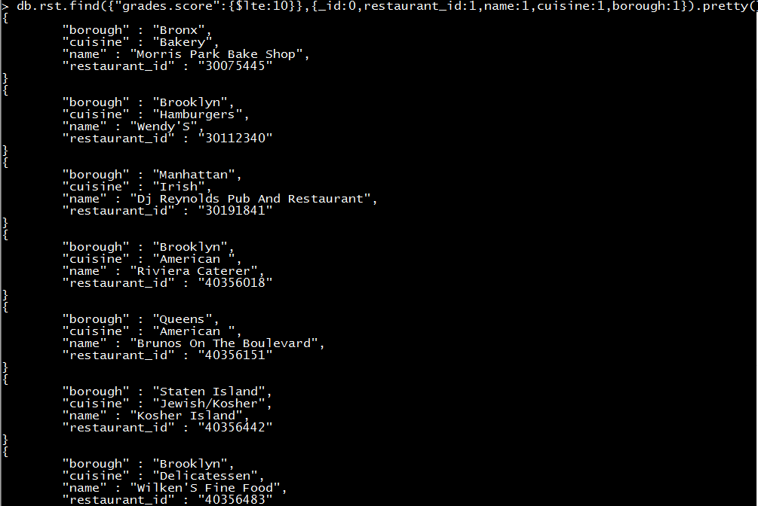
OUTPUT:

Slide 59
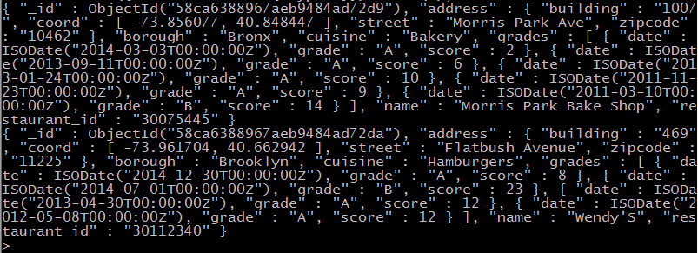
Problem Statement:
Select all documents in the restaurants collection where the coord field value is Double.
Query:
> db.res.find({"address.coord":{$type:1}}).limit(2);
Output:

Slide 60
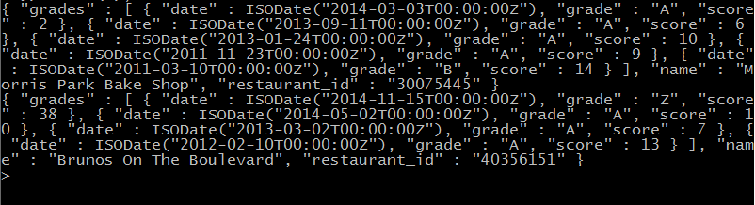
Problem Statement:
Select the restaurant Id, name and grades for those restaurants which returns 0 as a remainder after dividing the score by 7.
Query:
> db.res.find({"grades.score":{$mod:[7,0]}},{_id:0,restaurant_id:1,name:1,grades
:1}).limit(2);
Output:

Slide 61
Node JS

Slide 62
What is Node.js?
Node.js is an open source, cross-platform runtime environment for developing server-side and networking applications.
Node.js also provides a rich library of various JavaScript modules
It simplifies the development of web applications using Node.js to a great extent.
Node.js = Runtime Environment + JavaScript Library

Slide 63
Why Node.js a choice…?
Asynchronous and Event Driven
Very Fast
Single Threaded but Highly Scalable
No Buffering

Slide 64





Who uses Node.js

Slide 65
Where or where not to Use Node.js?
Where:-
I/O bound Applications
Data Streaming Applications
Data Intensive Real-time Applications (DIRT)
JSON APIs based Applications
Single Page Applications
Where not:-
It is not advisable to use Node.js for CPU intensive applications.

Slide 66
Local Environment Setup
BASIC REQUIREMENTS:
(a) Text Editor
(b) the Node.js binary installable.
Download specific MSI (Microsoft installer)
Node.js distribution in.
The installer should set the
directory in Window's PATH environment variable
C:\Program Files\nodejs
C:\Program Files\nodejs\bin

Slide 67
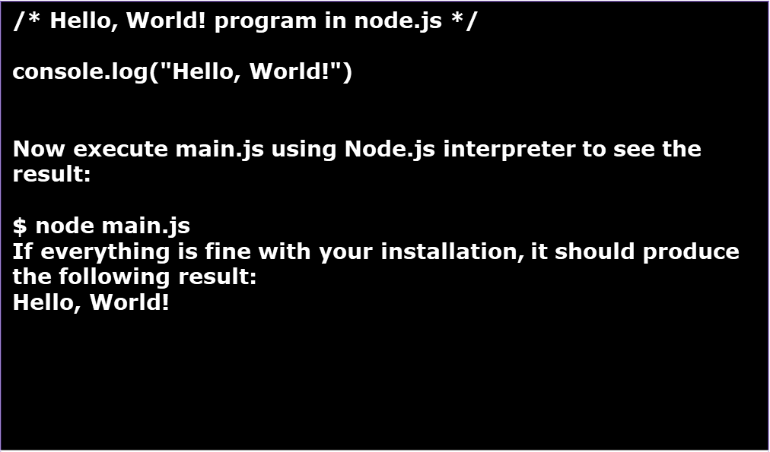
Verify Installation: Executing a File
Main.js

Slide 68
First Application using Node.js
Components of nodes.js:
1. Import required modules
2. Create server
3. Read request and return response

Slide 69
REPL Terminal
Node.js or Node comes bundled with a REPL environment. It performs the following tasks:
● Read - Reads user's input, parses the input into JavaScript data-structure, and stores in memory.
● Eval - Takes and evaluates the data structure.
● Print - Prints the result.
● Loop - Loops the above command until the user presses ctrl-c twice.

Slide 70
NODE PACKAGE MANAGER(NPM)
Easy for JavaScript developers to share the code and for other developers to reuse that code.
Package/Module
Package.json contain metadata of package
Installing Node.js :
-NPM comes bundled with Node.js installables after v0.6.3 version.
-to check version of NPM:
>$ npm –version
-Update command for NPM:
> npm install npm -g

Slide 71
Installing NPM Package
Types of installing NPM :
1) Locally:
If you want to depend on package from your own module install locally, is npm install's default behavior.
Syntax :
Can be imported using require() in Node application directly.
c:\> npm install <module name>

Slide 72
Working with NPM
2) Globally
Installing npm packages globally:
To download packages globally, you simply use the command
Updating global packages:
To update global packages, you can use
Ex:-npm update -g jshow
Uninstalling global packages
Global packages can be uninstalled with
> npm install -g <package>
npm update -g <package>
npm uninstall -g <package>

Slide 73
Using a package.json
The best way to manage locally installed npm packages is to create a package.json file.
A package.json file affords you a lot of great things:
1.It serves as documentation for what packages your project depends on.
2.It allows you to specify the versions of a package that your project can use using semantic versioning rules.
3.Makes your build reproducible which means that its way easier to share with other developers.

Slide 74
Minimum Requirements:
-As a bare minimum, a package.json must have:
•"name"
◦all lowercase
◦one word, no spaces
◦dashes and underscores allowed
•"version"
◦in the form of x.x.x
◦follows semver spec
We can also have:
•description: •main •scripts •keywords •author •license •bugs •homepage

Slide 75
Callback Concept
What is Callback?
Callback is an asynchronous equivalent for a function.
A callback function is called at the completion of a given task. Node makes heavy use of callbacks.
All the APIs of Node are written in such a way that they support callbacks.

Slide 76
Event-Driven Programming
Node.js uses events heavily and it is also one of the reasons why
Node.js is pretty fast compared to other similar technologies.
As soon as Node starts its server, it simply initiates its variables, declares functions, and then simply waits for the event to occur.
In an event-driven application, there is generally a main loop that listens for events, and then triggers a callback function when one of those events is detected.

Slide 77
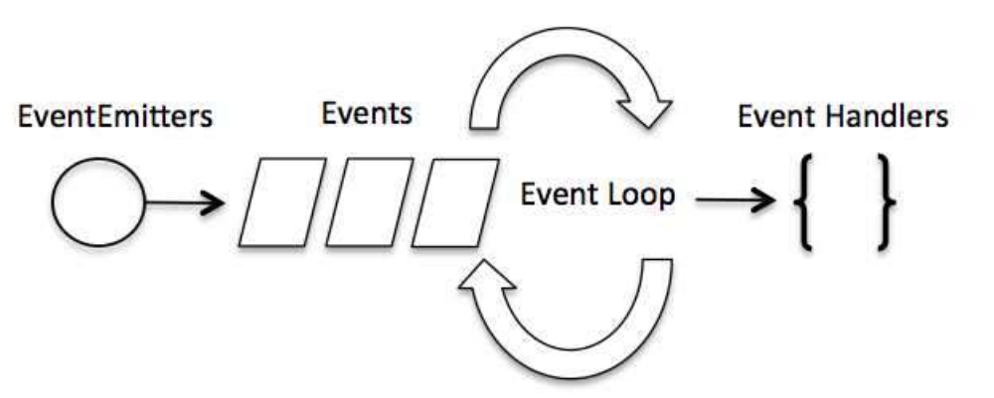
Event-Driven Process

Slide 78
Open a File
Syntax
Following is the syntax of the method to open a file in asynchronous mode:
fs.open(path, flags[, mode], callback)
Parameters
• path - This is the string having file name including path
.
• flags - Flags indicate the behavior of the file to be opened. All possible values have been mentioned below.
• mode - It sets the file mode (permission and sticky bits), but only if the file was created. It defaults to 0666, readable and writeable.
• callback - This is the callback function which gets two arguments (err, fd).

Slide 79
Reading & writing to a File
Syntax(reading from a file)
fs.read(fd, buffer, offset, length, position, callback)
This method will use file descriptor to read the file.
Syntax(writing to a file)
fs.writeFile(filename, data[, options], callback)
This method will overwrite the file if the file already exists.

Slide 80
Closing and deleting a file
Closing a File
Syntax
fs.close(fd, callback)
Delete a File
Syntax
fs.unlink(path, callback)

Slide 81
What are Streams?
Streams are objects that let you read data from a source or write data to a destination in continuous fashion.
In Node.js, there are four types of streams:
Readable - Stream which is used for read operation.
Writable - Stream which is used for write operation.
Duplex - Stream which can be used for both read and write operation.
Transform - A type of duplex stream where the output is computed based on input.

Slide 82
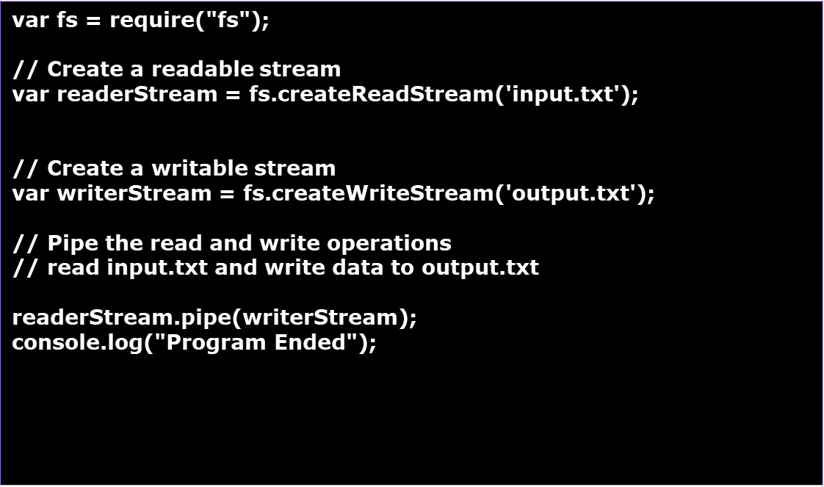
Piping the Streams
Create a js file named main.js with the following code:

Slide 83
Global Objects
Node.js global objects are global in nature and they are available in all modules. We do not need to include these objects in our application, rather we can use them directly.
These objects are modules, functions, strings and object itself.
__filename
__dirname
setTimeout(cb, ms)
clearTimeout (t)
setInterval(cb, ms)

Slide 84
Console Object
Node.js console is a global object and is used to print different levels of messages to stdout and stderr
Console Methods
console.log([data][, ...])
console.info([data][, ...])
console.error([data][, ...])
console.warn([data][, ...])

Slide 85
Utility Modules
There are several utility modules available in Node.js module library. These modules are
very common and are frequently used while developing any Node-based application.
OS Module
Path Module
Net Module
DNS Module
Domain Module

Slide 86
Express JS

Slide 87
What’s EXPRESS..???
Express is a flexible Node.js web application framework that provides a set of features for web and mobile applications.
It is specifically designed for building single-page, multi-page, and hybrid web applications.
It is an open source framework developed and maintained by the Node.js foundation.
It is a fast and asynchronous in nature.

Slide 88
Environment
To get started with developing using the Express framework, you need to have Node and npm(node package manager) installed.
If you don’t already have these, install node on your local system.
Before you start using Express framework, confirm that node and npm are installed on your local machine using the following commands :
  node --version
  npm --version

Slide 89
Features of Express framework
It is a middleware to respond to HTTP Requests.
It defines a routing table which is used to perform different actions based on HTTP method and URL.
It allows to dynamically render HTML Pages based on passing arguments to templates.

Slide 90
MEAN Stack
MEAN is a free and open-source JavaScript software stack for building dynamic web sites and web applications which has the following components:
  MongoDB - The standard NoSQL database
  Express.js - The default web applications framework
  Angular.js - The JavaScript MVC framework used for web applications
  Node.js - Framework used for scalable server-side and networking applications.

Slide 91
MEAN Stack
Express.js is the “E” in the MEAN software stack, where it runs alongside the MongoDB database, the Node.js environment, and the AngularJS/Angular front-end framework.
The MEAN stack is entirely JavaScript-powered, because of Node.js, the JS development environment that gives JavaScript back-end functionality.

Slide 92
Request & Response
Express application uses a function whose parameters are
request and response objects.
Request Object - The request object represents the HTTP request and has properties for the request query string, parameters, body, HTTP headers, and so on.
Response Object - The response object represents the HTTP response that an Express app sends when it gets an HTTP request.

Slide 93
HTTP Methods
The Express.js framework makes it very easy to develop an application which can be used to handle multiple types of requests like the GET, PUT, POST and DELETE requests.
  GET: The GET method is used to retrieve information from the given server using a given URI. Requests using GET should only retrieve data and should have no other effect on the data.
  POST: A POST request is used to send data to the server, for example, customer information, file upload, etc. using HTML forms.
  PUT: Replaces all current representations of the target resource with the uploaded content.
  DELETE: Removes all current representations of the target resource given by a URI.

Slide 94
Routing
Routing refers for determining the way in which an application responds to a client request to a particular endpoint.
For example, a client can make following http request using various URL's such as the one's shown below;
    http://localhost:3000/Books
    http://localhost:3000/Students
In the above example,
If a GET request is made for the first URL, then the response should ideally be a list of books.
If the GET request is made for the second URL, then the response should ideally be a list of Students.
So based on the URL which is accessed, a different functionality on the web server will be invoked and accordingly the response will be sent to the client. This is the concept of routing.

Slide 95
Angular 5

Slide 96
What is Angular?
Angular is a platform that makes it easy to build applications with the web.
Angular combines declarative templates, dependency injection, end to end tooling, and integrated best practices to solve development challenges.
Angular empowers developers to build applications that live on the web, mobile, or the desktop

Slide 97
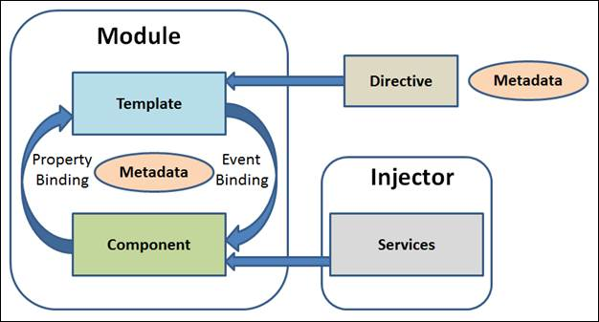
Angular Architecture

Slide 98
The main building blocks of Angular
Module
Component
Metadata
Template
Data Binding
Pipes
Service
Directive
Dependency Injection

Slide 99
Module
Module is the block of code which is designed to perform a single task.
We can export the module in form of class.
Angular applications have one or more modules.
Every Angular application must have at least one module.
If Angular application contains only one module, it is referring as root module.
Every Angular application has one root module and many more featured modules.

Slide 100
Module
Angular module is a class which is decorated with @NgModule.
NgModule takes a single metadata object and its properties describe the module. Following are the important properties of NgModule.
exports - It is the subset of declarations which would be used in the component template of other module.
imports - imports other modules
providers - It is a creator of services. They can be accessible in all the parts of the application.
bootstrap - The root module has to set the bootstrap property. It is used to host all other views.
declarations - It declare the view class that belong to current module. There are three type of view classes supported by Angular components, directives, and pipes.

Slide 101
Module Example
import { NgModule } from '@angular/core';
import { BrowserModule } from '@angular/platform-browser';
import { AppComponent } from './app.component';
@NgModule({
imports: [ BrowserModule ],
declarations: [ AppComponent ],
providers:[]
bootstrap: [ AppComponent ]
})
export class AppModule {
}

Slide 102
Component
The component is class with the template that deals with the View of application and it’s containing the core logic for the page.
We can compare it with the Controller in Angular 1.x.
We need to write the application logic inside the class which is used by the View.
The component class interacts with the View through Methods and Properties of API.
Angular creates and updates the required component and destroys the unused component as the user moves through an application.

Slide 103
Component Example
import { Component } from '@angular/core';
@Component({
selector: 'test-app',
template: '<h1>This is my First Angular Application</h1>' +
'<br/>' +
'<input #txtName type = "text" (keyup)="0" />' +
'<br/> ' +
'<p>You have Enter: {{txtName.value}}</p>'
})
export class AppComponent {
}

Slide 104
Metadata
Metadata is the way of defining the processing of a class.
In Typescript, we can define metadata by using decorator.
For example, if we define any component in Angular application, we need to tell Angular that this is the component, by using metadata of the class (using @Component decorator).

Slide 105
Metadata Example
  @Component({
  selector: 'test-app',
  template: '<h1>This is my First Angular 2 Application</h1>' +
  '<br/>' +
  '<input #txtName type = "text" (keyup)="0" />' +
  '<br/> ' +
  '<p>You have Enter: {{txtName.value}}</p>'
  })
The decorator @Component is used to configure the object to create the component and its View. The selector is creating the instance of the component. In the above example code, if Angular finds <test-app> tag in HTML, it replaces it with the template defined in component.

Slide 106
Template
The template is the component View that tells Angular how to display the component.
It looks like normal HTML.
Templates include data bindings as well as other components and directives

Slide 107
Data Binding
It Enables data to flow from the component to template and vice-versa
There are four type of binding supported by Angular 2 application,
Interpolation - It displays the component value within the HTML tags which is also referred as Expression in Angular 1.x.
Property Binding - It passes the value of property from the parent to the property of the child.
Event Binding - It fires the event when we click on the components method name.
Two-way Binding - It is an important form that combines event and property binding in single notation by using ngModel directive.

Slide 108
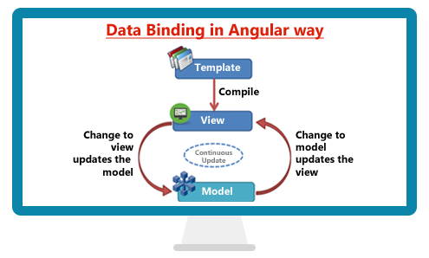
Two way Data Binding

Slide 109
Pipes
Angular pipes are used to format sort or search the data
Below are the Angular built-in pipes
    lowercase
    Uppercase
    titlecase
    number
    currency
    date
    json
    slice
    async

Slide 110
Service
It is Type Script class decorated with @Injectable which is used to perform a specific task.
It includes the function, values, or any other feature required by the application.
Typical examples of services are logging service, data service, message service etc. There is no base class for service.
Service Example:
  import { Injectable } from '@angular/core';
  @Injectable()
  export class LoggingService {
  }

Slide 111
Directive
Directives are one of the most important components of AngularJS application.
They are extended HTML attributes.
These are the markers on the DOM element which provides some special behavior to DOM elements and tell AngularJS' s HTML compiler to attach.
It is class with directive metadata.
To create directive, we have to apply @Directive decorator on attached metadata to the class.
There are three types of directives
    Component Directive Ex. <router-outlet>
    Structural Directive Ex. *ngFor,*ngIf, *ngSwitchCase
    Attribute Directive Ex. ngStyle, ngClass,ngSwitch

Slide 112
Dependency Injection
Dependency Injection is a software design pattern in which objects are passed as dependencies.
It helps us remove the hard coded dependencies, and makes dependencies configurable.
Using Dependency Injection, we can make components maintainable, reusable, and testable.
Point to remember about Dependency Injection,
To use DI for a service, we register it as a provider in one of two ways:
    when bootstrapping the application,
    or in the component metadata

Slide 113
Dependency Injection Example
import { Component } from '@angular/core';
import { LoggingService } from ’./logging.service.ts';
@Component({
selector: 'test-app',
template: ‘Hello World' ,
providers:[LoggingService]
})
export class AppComponent {
constructor(private ls:LoggingService) //Dependency Injection
{}
}

Slide 114
Angular JS vs Angular
Angular JS (1.6) | Angular ( 6)
1. It's not developed by keeping mobile development mind | 1.Anular is developed for mobile development
2. Base language Is JavaScript | 2.Base language Type Script (Object Oriented Version of Java Script)
3.Controller | 3.Components and Templates
4.Filters | 4.Pipes
5.Routing is function based | 5.Routing is JSON based
6.Directives :ng-if ng-repeat | 6.Directives : *ngIf *ngFor
7.Angular JS development is easy | 7.Angular development is complicated as Type Script is not a browser understandable code.

