Slide 1
Servlets

Slide 2
Version Control and Revision History
 | Name | Date
Prepared By | Manisha Mane | 05-Jul-2019
Reviewed By | Pradeep Chinchole | 09-Jul-2019
Approved By | Nisha Mendonsa | 12-Jul-2019
Version No. | Date | Section Affected | Highlight of Changes
1.0.0 | 12-Jul-2019 | All | Original Version

Slide 3
Objectives
Introduction to Servlets
Introduction
HTTP Basics
Servlets
Servlet Architecture and Life-Cycle
HTTP Vs Generic Servlet
JEE Container
Information from Servlets
Fetching Server Information
Fetching Client Information
Setting/Fetching Initial Parameters
Setting/Fetching Application Parameters

Slide 4
Introduction To Web
Web Pages
Static Pages - They are created using HTML,CSS, and Applet.
Dynamic Pages - They are created with the help of scripting languages
Scripting Languages
Client Side - They are created using Java script, VB Script. They are used to perform Ajax, field validations, and event handling executed on client machine (Web Browser)
Server Side - They are created using Servlet, JSP, ASP. They are used to perform Business and DAO actions executed on the server machine (Web Server)

Slide 5
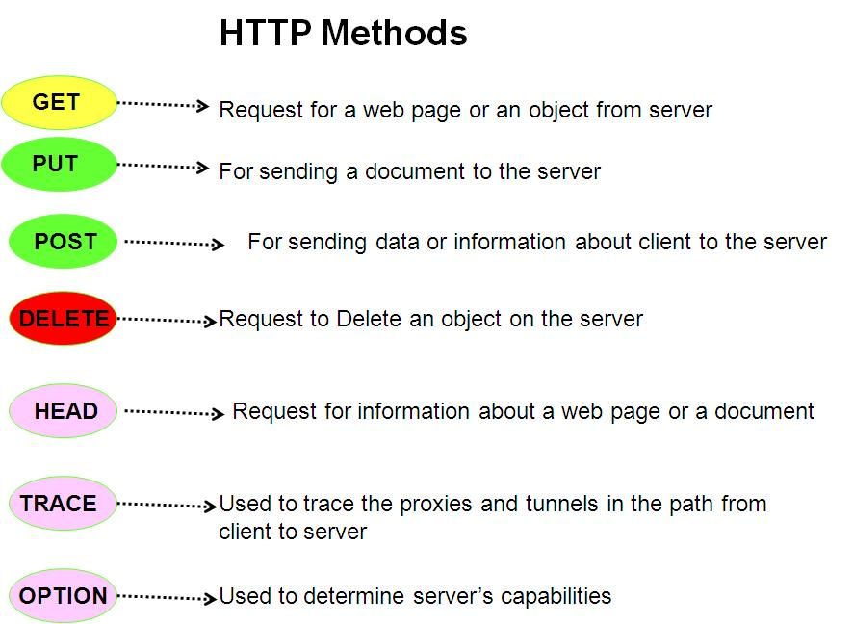
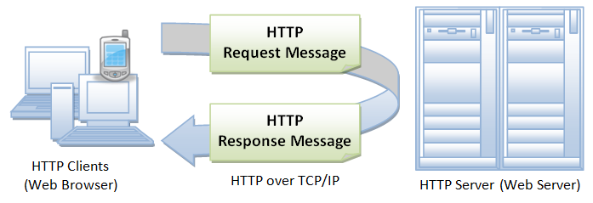
HTTP Basics
HTTP Basics:
HTTP is a request-response oriented protocol.
An HTTP request consists of a request method, a URI, header fields, and a body (which can be empty).
An HTTP response contains a result code, header fields, and a body.
The recognized request methods are GET, HEAD, PUT, POST, DELETE, OPTIONS, and TRACE.
Notes:
Applets :
They run on the client side in web browsers, or for writing Internet applications.
Applets are small programs that are downloaded into a Java Enabled Web Browser, like Netscape Navigator or Microsoft Internet Explorer.
The browser will execute the applet on the client’s machine. The downloaded applet has very limited access to the client machine’s file system and network capabilities.
The Servlet API brings the power of Java to your servers,too.
JavaTM Servlet technology provides web developers with a simple, consistent mechanism for extending the functionality of a web server and for accessing existing business systems.
A servlet can almost be thought of as an applet that runs on the server side.
Servlets are protocol- and platform-independent server side components, which dynamically extend Java enabled servers. They provide a general framework for services built using the request-response paradigm.
Servlets run inside servers. They are Java application components which are downloaded, on demand.

Slide 6
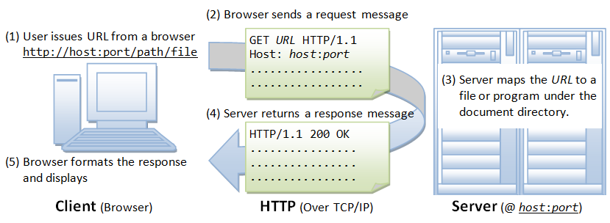
HTTP Basics
Notes:
Applets :
They run on the client side in web browsers, or for writing Internet applications.
Applets are small programs that are downloaded into a Java Enabled Web Browser, like Netscape Navigator or Microsoft Internet Explorer.
The browser will execute the applet on the client’s machine. The downloaded applet has very limited access to the client machine’s file system and network capabilities.
The Servlet API brings the power of Java to your servers,too.
JavaTM Servlet technology provides web developers with a simple, consistent mechanism for extending the functionality of a web server and for accessing existing business systems.
A servlet can almost be thought of as an applet that runs on the server side.
Servlets are protocol- and platform-independent server side components, which dynamically extend Java enabled servers. They provide a general framework for services built using the request-response paradigm.
Servlets run inside servers. They are Java application components which are downloaded, on demand.

Slide 7
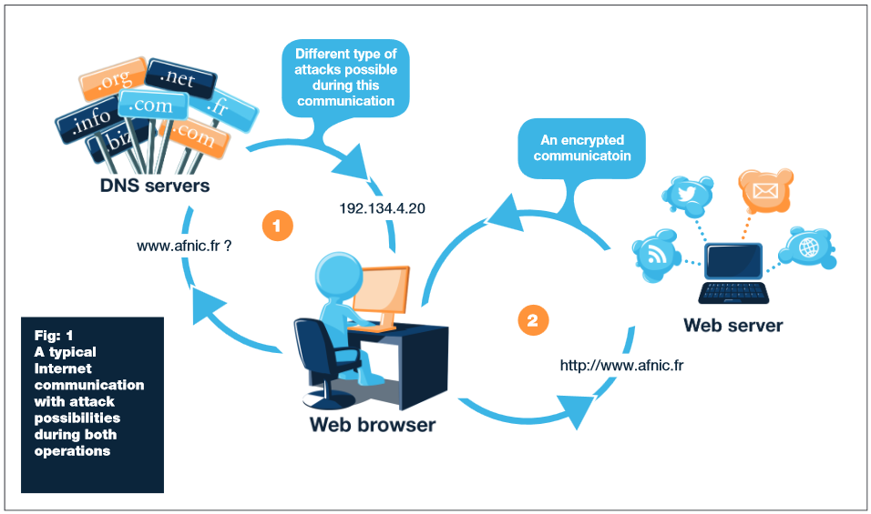
Web Browser and Web Server
Notes:
Applets :
They run on the client side in web browsers, or for writing Internet applications.
Applets are small programs that are downloaded into a Java Enabled Web Browser, like Netscape Navigator or Microsoft Internet Explorer.
The browser will execute the applet on the client’s machine. The downloaded applet has very limited access to the client machine’s file system and network capabilities.
The Servlet API brings the power of Java to your servers,too.
JavaTM Servlet technology provides web developers with a simple, consistent mechanism for extending the functionality of a web server and for accessing existing business systems.
A servlet can almost be thought of as an applet that runs on the server side.
Servlets are protocol- and platform-independent server side components, which dynamically extend Java enabled servers. They provide a general framework for services built using the request-response paradigm.
Servlets run inside servers. They are Java application components which are downloaded, on demand.

Slide 8
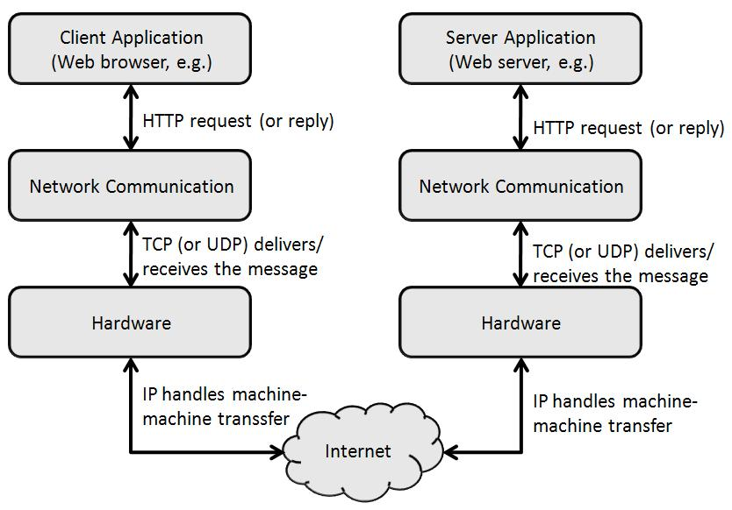
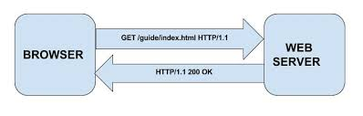
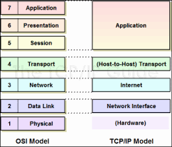
Network layers and Communication
Notes:
Applets :
They run on the client side in web browsers, or for writing Internet applications.
Applets are small programs that are downloaded into a Java Enabled Web Browser, like Netscape Navigator or Microsoft Internet Explorer.
The browser will execute the applet on the client’s machine. The downloaded applet has very limited access to the client machine’s file system and network capabilities.
The Servlet API brings the power of Java to your servers,too.
JavaTM Servlet technology provides web developers with a simple, consistent mechanism for extending the functionality of a web server and for accessing existing business systems.
A servlet can almost be thought of as an applet that runs on the server side.
Servlets are protocol- and platform-independent server side components, which dynamically extend Java enabled servers. They provide a general framework for services built using the request-response paradigm.
Servlets run inside servers. They are Java application components which are downloaded, on demand.

Slide 9
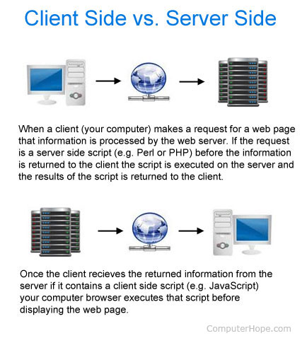
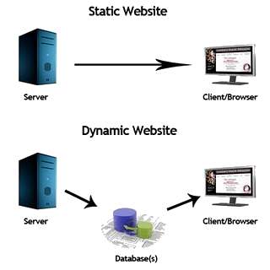
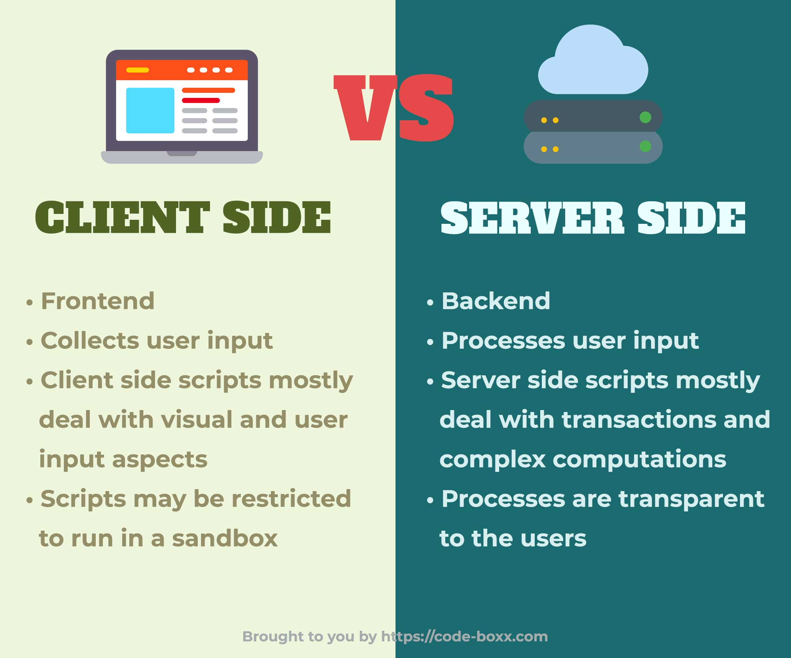
Client Script Vs. Server Script

Slide 10
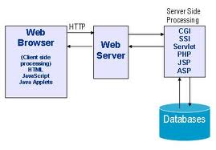
Server Side Scripting Languages
The server – side technologies for generating dynamic pages are:
Common Gateway Interface (CGI)
Active Server Pages (ASP)
Java Servlets
Java Server Pages (JSP)
Distributed Components-Based Technology ( CORBA, DCOM, EJB, RMI, … )

Slide 11

Applets in Server side
Can I use Applets to do server-side programming ?
Applets run on client-side (on the client's JVM (via a Browser Plug-in)).
Big applets require long download time
Applets do not have access to all the system resources
Server-side Java solves problems that applets faces
Code executed on the server side and only the results sent to client
Servlets can access legacy applications and data sources
Notes:
Applets :
They run on the client side in web browsers, or for writing Internet applications.
Applets are small programs that are downloaded into a Java Enabled Web Browser, like Netscape Navigator or Microsoft Internet Explorer.
The browser will execute the applet on the client’s machine. The downloaded applet has very limited access to the client machine’s file system and network capabilities.
The Servlet API brings the power of Java to your servers,too.
JavaTM Servlet technology provides web developers with a simple, consistent mechanism for extending the functionality of a web server and for accessing existing business systems.
A servlet can almost be thought of as an applet that runs on the server side.
Servlets are protocol- and platform-independent server side components, which dynamically extend Java enabled servers. They provide a general framework for services built using the request-response paradigm.
Servlets run inside servers. They are Java application components which are downloaded, on demand.

Slide 12
Introduction CGI
Common Gateway Interface (CGI)
Provides the ability to generate HTML pages dynamically.
Limitations with CGI:
Response time is high, the creation of an OS Shell is an heavy weight activity
CGI is not scalable
Not always secure or object-oriented
No separation of presentation and business logic
Scripting languages are often platform-dependent
Perl 1
Browser 1
Web
Server
Perl 2
Browser 2
Browser N
Perl N
Notes:
Applets :
They run on the client side in web browsers, or for writing Internet applications.
Applets are small programs that are downloaded into a Java Enabled Web Browser, like Netscape Navigator or Microsoft Internet Explorer.
The browser will execute the applet on the client’s machine. The downloaded applet has very limited access to the client machine’s file system and network capabilities.
The Servlet API brings the power of Java to your servers,too.
JavaTM Servlet technology provides web developers with a simple, consistent mechanism for extending the functionality of a web server and for accessing existing business systems.
A servlet can almost be thought of as an applet that runs on the server side.
Servlets are protocol- and platform-independent server side components, which dynamically extend Java enabled servers. They provide a general framework for services built using the request-response paradigm.
Servlets run inside servers. They are Java application components which are downloaded, on demand.

Slide 13
Introduction To Servlets
Servlet:
A servlet is a java program that extends an application hosted on a web server.
Handles the HTTP request-response process.
Dynamically generate html pages in response to requests
May also send data in other forms like XML or serialized Java objects
Run in a servlet container and have access to services that the container provides
Client of the servlet can be: Browser,Applet,Java Application,etc….
It is available and runs on all major web and application servers.
HTTP Request
Servlet
Container
Servlet
Browser
HTTP
Server
HTTP Response
Static
Content
Notes:
Applets :
They run on the client side in web browsers, or for writing Internet applications.
Applets are small programs that are downloaded into a Java Enabled Web Browser, like Netscape Navigator or Microsoft Internet Explorer.
The browser will execute the applet on the client’s machine. The downloaded applet has very limited access to the client machine’s file system and network capabilities.
The Servlet API brings the power of Java to your servers,too.
JavaTM Servlet technology provides web developers with a simple, consistent mechanism for extending the functionality of a web server and for accessing existing business systems.
A servlet can almost be thought of as an applet that runs on the server side.
Servlets are protocol- and platform-independent server side components, which dynamically extend Java enabled servers. They provide a general framework for services built using the request-response paradigm.
Servlets run inside servers. They are Java application components which are downloaded, on demand.

Slide 14
Servlets Vs CGI
Servlets over CGI:
Request is run in a separate thread, so faster than CGIs
Scalable, can serve many more requests,
Robust and Object Oriented.
Can be written in Java Programming language.
Platform independent.
Access to Logging Capabilities.
Error handling and Security.
Servlet
Browser 1
Web
Server
Browser 2
Browser N
Notes:
Applets :
They run on the client side in web browsers, or for writing Internet applications.
Applets are small programs that are downloaded into a Java Enabled Web Browser, like Netscape Navigator or Microsoft Internet Explorer.
The browser will execute the applet on the client’s machine. The downloaded applet has very limited access to the client machine’s file system and network capabilities.
The Servlet API brings the power of Java to your servers,too.
JavaTM Servlet technology provides web developers with a simple, consistent mechanism for extending the functionality of a web server and for accessing existing business systems.
A servlet can almost be thought of as an applet that runs on the server side.
Servlets are protocol- and platform-independent server side components, which dynamically extend Java enabled servers. They provide a general framework for services built using the request-response paradigm.
Servlets run inside servers. They are Java application components which are downloaded, on demand.

Slide 15
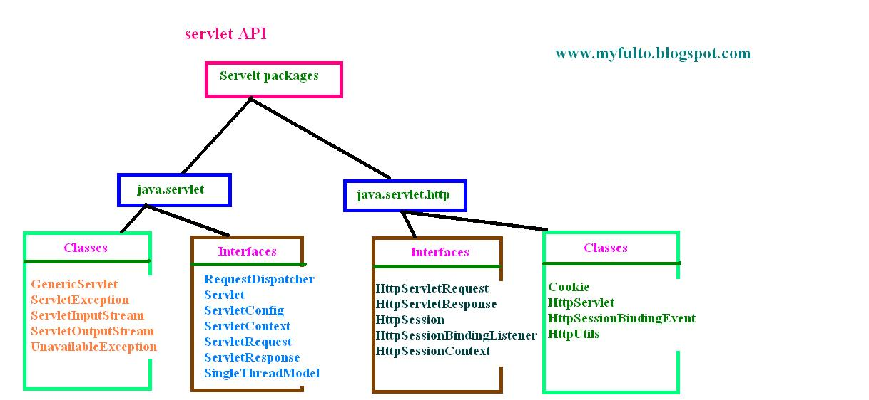

Servlet API
Notes:
Applets :
They run on the client side in web browsers, or for writing Internet applications.
Applets are small programs that are downloaded into a Java Enabled Web Browser, like Netscape Navigator or Microsoft Internet Explorer.
The browser will execute the applet on the client’s machine. The downloaded applet has very limited access to the client machine’s file system and network capabilities.
The Servlet API brings the power of Java to your servers,too.
JavaTM Servlet technology provides web developers with a simple, consistent mechanism for extending the functionality of a web server and for accessing existing business systems.
A servlet can almost be thought of as an applet that runs on the server side.
Servlets are protocol- and platform-independent server side components, which dynamically extend Java enabled servers. They provide a general framework for services built using the request-response paradigm.
Servlets run inside servers. They are Java application components which are downloaded, on demand.

Slide 16
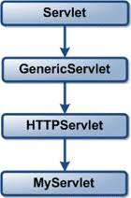
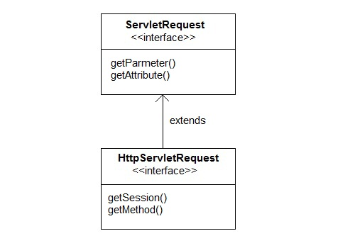
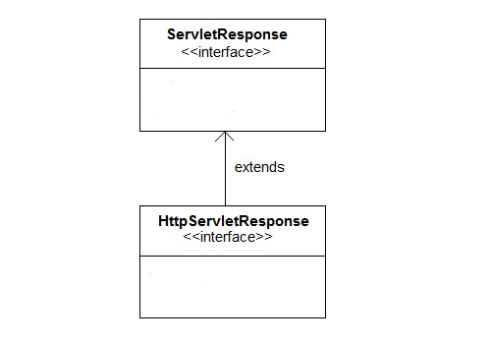
Servlet API
Servlet API:
Servlet API is specified in two packages,
javax.servlet and
javax.servlet.http
Notes:
Applets :
They run on the client side in web browsers, or for writing Internet applications.
Applets are small programs that are downloaded into a Java Enabled Web Browser, like Netscape Navigator or Microsoft Internet Explorer.
The browser will execute the applet on the client’s machine. The downloaded applet has very limited access to the client machine’s file system and network capabilities.
The Servlet API brings the power of Java to your servers,too.
JavaTM Servlet technology provides web developers with a simple, consistent mechanism for extending the functionality of a web server and for accessing existing business systems.
A servlet can almost be thought of as an applet that runs on the server side.
Servlets are protocol- and platform-independent server side components, which dynamically extend Java enabled servers. They provide a general framework for services built using the request-response paradigm.
Servlets run inside servers. They are Java application components which are downloaded, on demand.

Slide 17
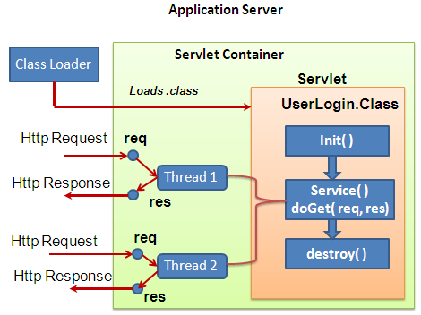
Life Cycle of Servlet
Notes:
Applets :
They run on the client side in web browsers, or for writing Internet applications.
Applets are small programs that are downloaded into a Java Enabled Web Browser, like Netscape Navigator or Microsoft Internet Explorer.
The browser will execute the applet on the client’s machine. The downloaded applet has very limited access to the client machine’s file system and network capabilities.
The Servlet API brings the power of Java to your servers,too.
JavaTM Servlet technology provides web developers with a simple, consistent mechanism for extending the functionality of a web server and for accessing existing business systems.
A servlet can almost be thought of as an applet that runs on the server side.
Servlets are protocol- and platform-independent server side components, which dynamically extend Java enabled servers. They provide a general framework for services built using the request-response paradigm.
Servlets run inside servers. They are Java application components which are downloaded, on demand.

Slide 18
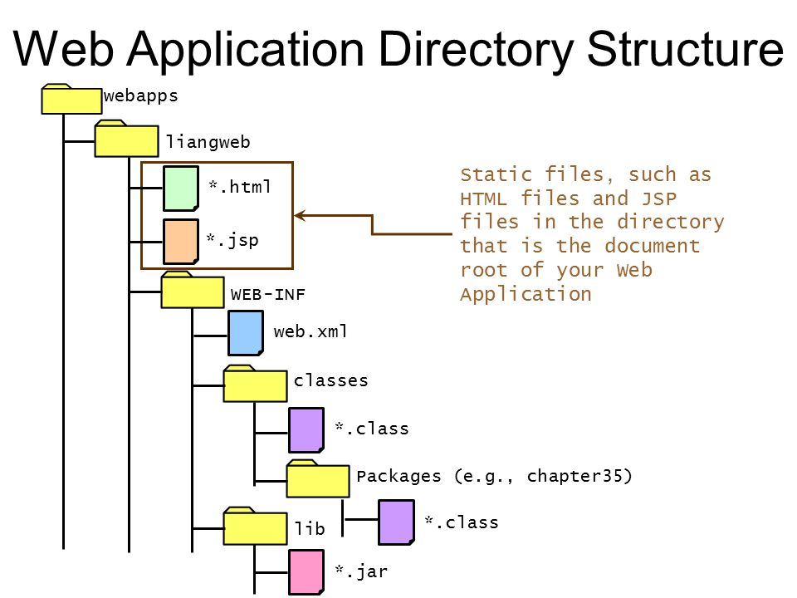
File Structure in Tomcat Server
Notes:
Applets :
They run on the client side in web browsers, or for writing Internet applications.
Applets are small programs that are downloaded into a Java Enabled Web Browser, like Netscape Navigator or Microsoft Internet Explorer.
The browser will execute the applet on the client’s machine. The downloaded applet has very limited access to the client machine’s file system and network capabilities.
The Servlet API brings the power of Java to your servers,too.
JavaTM Servlet technology provides web developers with a simple, consistent mechanism for extending the functionality of a web server and for accessing existing business systems.
A servlet can almost be thought of as an applet that runs on the server side.
Servlets are protocol- and platform-independent server side components, which dynamically extend Java enabled servers. They provide a general framework for services built using the request-response paradigm.
Servlets run inside servers. They are Java application components which are downloaded, on demand.

Slide 19
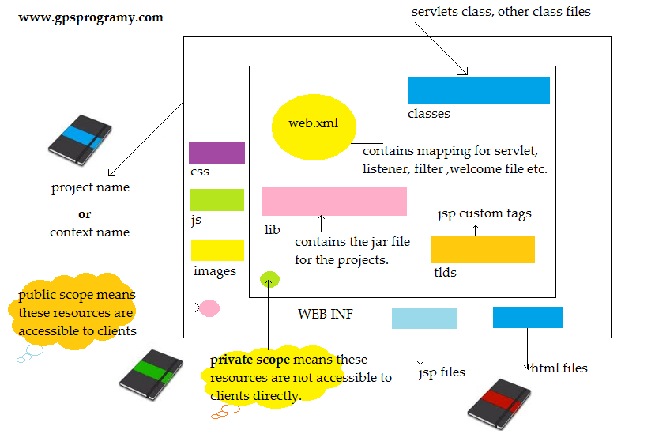

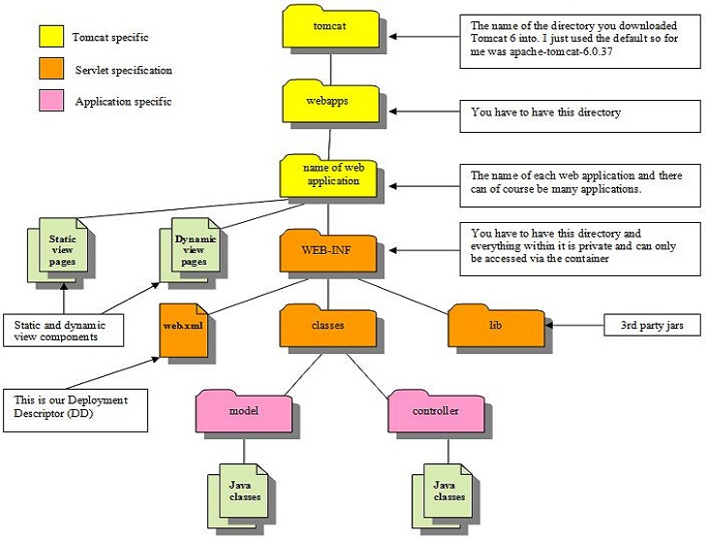
File Structure in Tomcat Server
Notes:
Applets :
They run on the client side in web browsers, or for writing Internet applications.
Applets are small programs that are downloaded into a Java Enabled Web Browser, like Netscape Navigator or Microsoft Internet Explorer.
The browser will execute the applet on the client’s machine. The downloaded applet has very limited access to the client machine’s file system and network capabilities.
The Servlet API brings the power of Java to your servers,too.
JavaTM Servlet technology provides web developers with a simple, consistent mechanism for extending the functionality of a web server and for accessing existing business systems.
A servlet can almost be thought of as an applet that runs on the server side.
Servlets are protocol- and platform-independent server side components, which dynamically extend Java enabled servers. They provide a general framework for services built using the request-response paradigm.
Servlets run inside servers. They are Java application components which are downloaded, on demand.

Slide 20
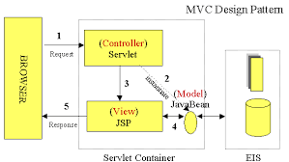
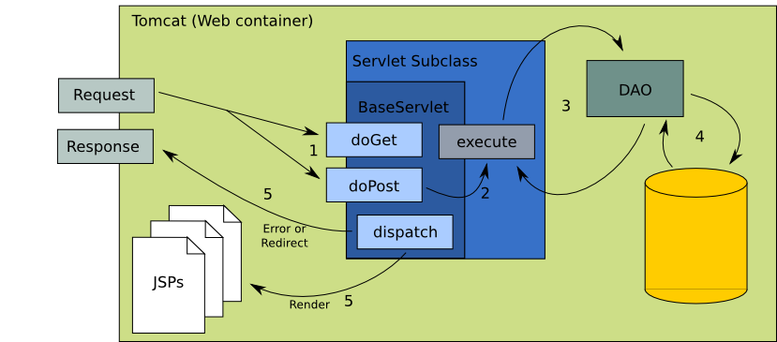
MVC and Servlet Execution
Notes:
Applets :
They run on the client side in web browsers, or for writing Internet applications.
Applets are small programs that are downloaded into a Java Enabled Web Browser, like Netscape Navigator or Microsoft Internet Explorer.
The browser will execute the applet on the client’s machine. The downloaded applet has very limited access to the client machine’s file system and network capabilities.
The Servlet API brings the power of Java to your servers,too.
JavaTM Servlet technology provides web developers with a simple, consistent mechanism for extending the functionality of a web server and for accessing existing business systems.
A servlet can almost be thought of as an applet that runs on the server side.
Servlets are protocol- and platform-independent server side components, which dynamically extend Java enabled servers. They provide a general framework for services built using the request-response paradigm.
Servlets run inside servers. They are Java application components which are downloaded, on demand.

Slide 21
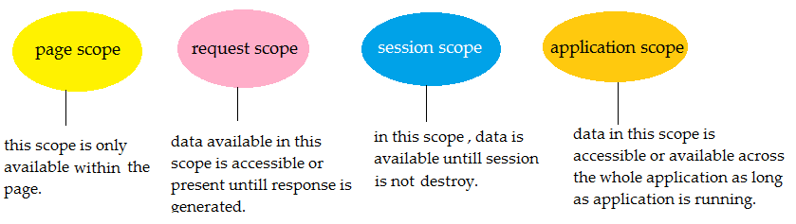
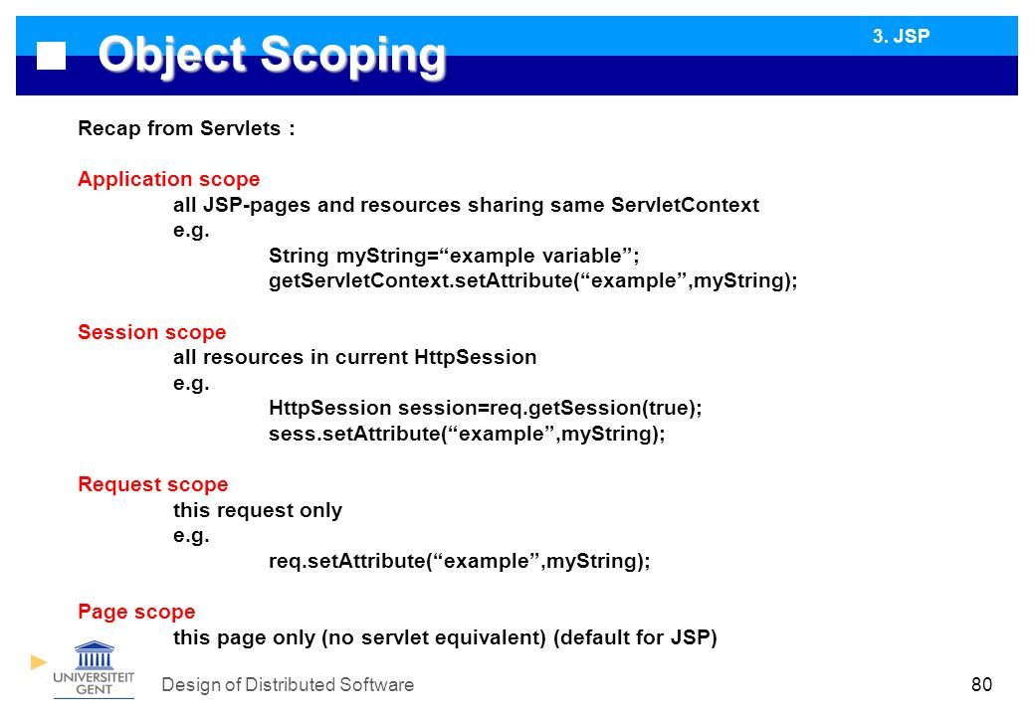
Scope Objects
Notes:
Applets :
They run on the client side in web browsers, or for writing Internet applications.
Applets are small programs that are downloaded into a Java Enabled Web Browser, like Netscape Navigator or Microsoft Internet Explorer.
The browser will execute the applet on the client’s machine. The downloaded applet has very limited access to the client machine’s file system and network capabilities.
The Servlet API brings the power of Java to your servers,too.
JavaTM Servlet technology provides web developers with a simple, consistent mechanism for extending the functionality of a web server and for accessing existing business systems.
A servlet can almost be thought of as an applet that runs on the server side.
Servlets are protocol- and platform-independent server side components, which dynamically extend Java enabled servers. They provide a general framework for services built using the request-response paradigm.
Servlets run inside servers. They are Java application components which are downloaded, on demand.

Slide 22
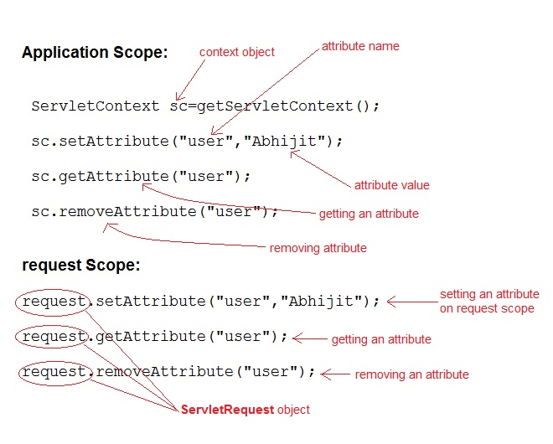
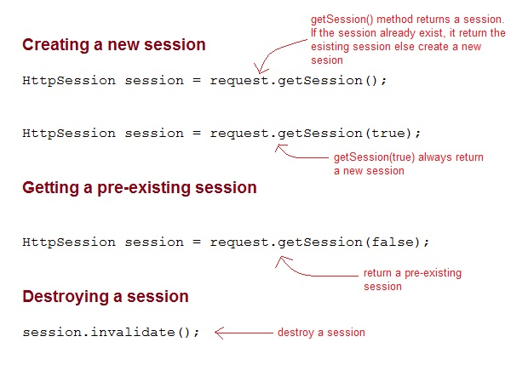
Accessing Scope Objects
Notes:
Applets :
They run on the client side in web browsers, or for writing Internet applications.
Applets are small programs that are downloaded into a Java Enabled Web Browser, like Netscape Navigator or Microsoft Internet Explorer.
The browser will execute the applet on the client’s machine. The downloaded applet has very limited access to the client machine’s file system and network capabilities.
The Servlet API brings the power of Java to your servers,too.
JavaTM Servlet technology provides web developers with a simple, consistent mechanism for extending the functionality of a web server and for accessing existing business systems.
A servlet can almost be thought of as an applet that runs on the server side.
Servlets are protocol- and platform-independent server side components, which dynamically extend Java enabled servers. They provide a general framework for services built using the request-response paradigm.
Servlets run inside servers. They are Java application components which are downloaded, on demand.

Slide 23
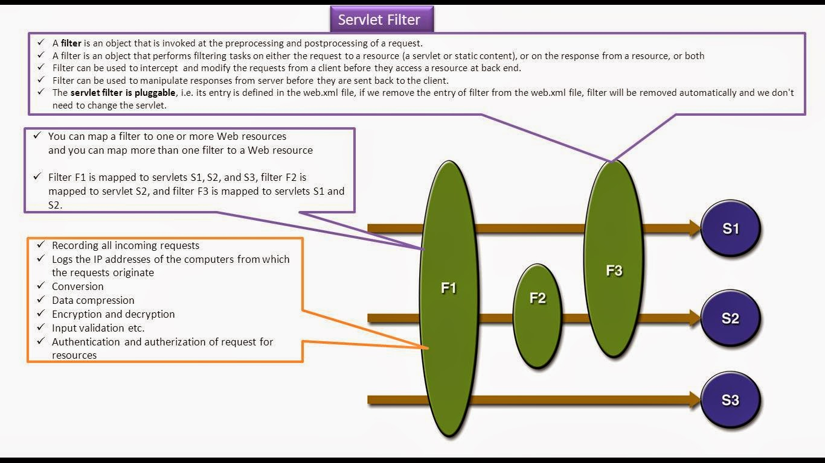
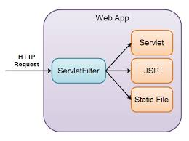
Filter
Notes:
Applets :
They run on the client side in web browsers, or for writing Internet applications.
Applets are small programs that are downloaded into a Java Enabled Web Browser, like Netscape Navigator or Microsoft Internet Explorer.
The browser will execute the applet on the client’s machine. The downloaded applet has very limited access to the client machine’s file system and network capabilities.
The Servlet API brings the power of Java to your servers,too.
JavaTM Servlet technology provides web developers with a simple, consistent mechanism for extending the functionality of a web server and for accessing existing business systems.
A servlet can almost be thought of as an applet that runs on the server side.
Servlets are protocol- and platform-independent server side components, which dynamically extend Java enabled servers. They provide a general framework for services built using the request-response paradigm.
Servlets run inside servers. They are Java application components which are downloaded, on demand.

Slide 24
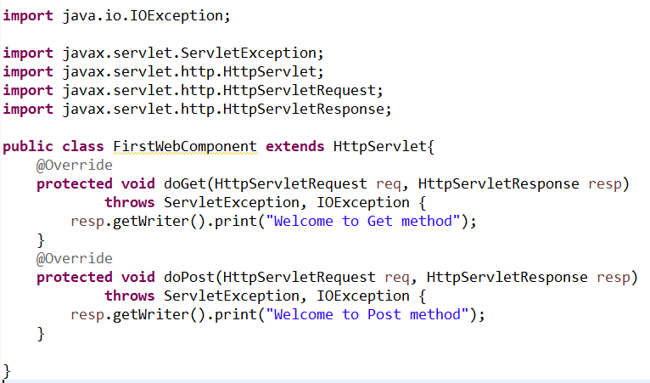
Creating Servlet Class
It should extend HttpServlet
Should Implement the doGet() or doPost() method
Both methods accept two parameters HttpServletRequest HttpServletResponse
Obtain the writer from the response object to write the response and Close the writer
Notes:
Applets :
They run on the client side in web browsers, or for writing Internet applications.
Applets are small programs that are downloaded into a Java Enabled Web Browser, like Netscape Navigator or Microsoft Internet Explorer.
The browser will execute the applet on the client’s machine. The downloaded applet has very limited access to the client machine’s file system and network capabilities.
The Servlet API brings the power of Java to your servers,too.
JavaTM Servlet technology provides web developers with a simple, consistent mechanism for extending the functionality of a web server and for accessing existing business systems.
A servlet can almost be thought of as an applet that runs on the server side.
Servlets are protocol- and platform-independent server side components, which dynamically extend Java enabled servers. They provide a general framework for services built using the request-response paradigm.
Servlets run inside servers. They are Java application components which are downloaded, on demand.

Slide 25
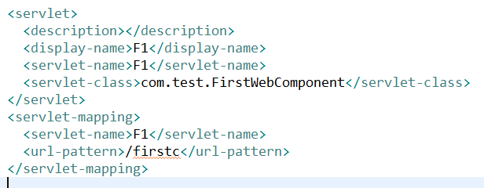
Deployment Descriptor
contains the basic and most important information that is required to deploy a web application (Servlet) .
Without this, the web server would not know, which requests to consider as requests to access this servlet.
Notes:
Applets :
They run on the client side in web browsers, or for writing Internet applications.
Applets are small programs that are downloaded into a Java Enabled Web Browser, like Netscape Navigator or Microsoft Internet Explorer.
The browser will execute the applet on the client’s machine. The downloaded applet has very limited access to the client machine’s file system and network capabilities.
The Servlet API brings the power of Java to your servers,too.
JavaTM Servlet technology provides web developers with a simple, consistent mechanism for extending the functionality of a web server and for accessing existing business systems.
A servlet can almost be thought of as an applet that runs on the server side.
Servlets are protocol- and platform-independent server side components, which dynamically extend Java enabled servers. They provide a general framework for services built using the request-response paradigm.
Servlets run inside servers. They are Java application components which are downloaded, on demand.

Slide 26
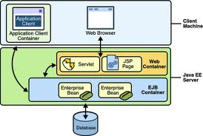
Java EE containers
provide a runtime environment for components that include security, concurrency, life-cycle management, transaction, deployment, and other services.
They can be classified as:
Web containers: Host web components like Servlets and JSP. For example: Tomcat , Sun’s Java Web Server
Application containers: Host business components for developing enterprise-based applications.
For example: BEA System’s Weblogic, IBM’s Websphere Application Server, Redhat’s Jboss.
Notes:
Applets :
They run on the client side in web browsers, or for writing Internet applications.
Applets are small programs that are downloaded into a Java Enabled Web Browser, like Netscape Navigator or Microsoft Internet Explorer.
The browser will execute the applet on the client’s machine. The downloaded applet has very limited access to the client machine’s file system and network capabilities.
The Servlet API brings the power of Java to your servers,too.
JavaTM Servlet technology provides web developers with a simple, consistent mechanism for extending the functionality of a web server and for accessing existing business systems.
A servlet can almost be thought of as an applet that runs on the server side.
Servlets are protocol- and platform-independent server side components, which dynamically extend Java enabled servers. They provide a general framework for services built using the request-response paradigm.
Servlets run inside servers. They are Java application components which are downloaded, on demand.

Slide 27
Introduction To Servlets
Setting Initial Parameters:
Setting parameters in <init-param> in web.xml
<servlet>
<servlet-name>myServlet</servlet-name>
<servlet-class>ServletClass</servlet-class>
<init-param>
<param-name>organization</param-name> <param-value>paramValue</param-value>
</init-param>
</servlet>
Notes:
Initialization Parameters:
Rather than having Server initialize a servlet when the first request is made for it, you can first configure server to initialize a servlet when the server starts. You do this by specifying the servlet class in the load-on-startup element in the J2EE standard Web Application deployment descriptor, web.xml.
The order in which resources within a Web application are initialized is as follows:
ServletContextListeners—the contextCreated() callback for ServletContextListeners registered for this Web application.
ServletFilters init() method.
Servlet init() method, marked as load-on-startup in web.xml.
You can pass parameters to an HTTP servlet during initialization by defining these parameters in the Web Application containing the servlet. You can use these parameters to pass values to your servlet every time the servlet is initialized without having to rewrite the servlet. The init parameters are specified in web.xml as shown above, using the <init-param> tags.

Slide 28
Introduction To Servlets
Initializing a Servlet :
Accessing Initial Parameters
String ServletConfig.getInitParameter(): It is used to get access to servlet’s init parameters:
Enumeration getInitParameterNames (): It is used to examine all init parameters.
public void init(ServletConfig config ) throws ServletException {
super.init(config);
String greet =getInitParameter(“userName”);
}
Enumeration params = getInitParameterNames();
while (params.hasMoreElements()) {
String name = (String) params.nextElement();
out.println(name + ": " + getInitParameter(name)); }
Notes:
Each init-param element defines one initial parameter and must contain a parameter name and value specified by children param-name and param-value elements, respectively. A Servlet may have as many initial parameters as needed, and initial parameter information for a specific Servlet should be specified within the servlet element for that particular Servlet.
Each registered servlet can have specific initialization (init) parameters associated with it. These are available to the servlet at any time. They are often used in the init() method to set initial or default values for a servlet or to customize the servlet’s behavior in some way. Settings of initialization parameters are server specific.
Fetching Initialization Parameters:
It is the ServletConfig that contains the initialization parameters. A reference to this object can be retrieved by calling the getServletConfig() method. The ServletConfig object provides the following methods for accessing initial parameters:
getInitParameter(String name) The getInitParameter() returns a String object that contains the value of the named initialization parameter or null if the parameter does not exist.

Slide 29
Introduction To Servlets
4 Methods to access the information
public String ServletRequest.getServerName() : returns the host name of the server to which the request was sent.
public String ServletRequest.getServerPort() : returns the port number to which the request was sent
public String ServletContext.getServerInfo() : returns the name and version of the server software as: JBossWeb/2.0.1.GA.
public String ServletRequest.getAttribute( String name) : returns the value of the named server attribute as an Object or null if the attribute does not exist. The attributes are server dependent.
Enumeration getInitParameterNames (): It is used to examine all init parameters.
Notes:
Retreiving Information about Servlet
Many a times, you may want to know about the environment in which a web application is running.
You may need to find out about the server that is executing your servlets or who is the client that is sending request.
You may also need information about the requests that the application is handling.
We shall now see a number of methods that provide this information to servlets.

Slide 30
Introduction To Servlets
Information about Client :
A servlet has the ability to find out about the client machine and for pages requiring authentication, about the actual user.
This information can be used for logging access data, associating information with individual users, or restricting access to certain clients.
Methods are:
Information about client machine:
public String ServletRequest.getRemoteAddr(): retrieves the IP
public String ServletRequest.getRemoteHost(): retrieves the hostname
Information about User:
public String HttpServletRequest.getRemoteUser(): It returns the login of the user, if the user has been authenticated, or null if not.
Enumeration getInitParameterNames (): It is used to examine all init parameters.
Notes:
Retreiving Information about Client
The hostname and IP Address of the client requesting the servlet can be obtained using the HttpRequest object.
getRemoteAddr(): Returns the internet address of the client sending the request. When the client address is unknown, returns an empty string.
getRemoteHost(): Returns the host name of the client sending the request. If the name is unknown, returns an empty string. The fully qualified domain name (e.g. "xyzws.com") of the client that made the request. The IP address is returned if this cannot be determined.
The information comes from the socket that connects the server to the client, so the remote address and hostname may be that of a proxy server. An example remote address might be “192.26.80.1320” while an example of remote host might be “dist.engr.com”.
getRemoteUser () of the HttpServletRequest gives the username of the client. With the remote user’s name, a servlet can save information about each client. Over the long term, it can remember each individual’s preferences. For the short tern, it can remember the series of pages viewed by the client and use them to add a sense of state to a stateless HTTP protocol. A simple servlet that uses getRemoteUser() can greet its clients by name and remember when each last logged in.

Slide 31
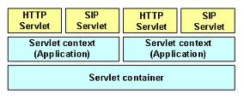
Introduction To Servlets
Servlet Context:
Implemented by the servlet container for all servlet to communicate with its servlet container
It returns the current context of a web application running in a particular JVM.
Notes:
Servlet Context
ServletContext is a interface which helps us to communicate with the servlet container. There is only one Servlet Context for the entire web application and the components of the web application can share it.
It is an object that contains meta informaton about your web application
Web application initialization:
First of all the web container reads the deployment descriptor file and then creates a name/value pair for each <context-param> tag.
After creating the name/value pair it creates a new instance of ServletContext.
Its the responsibility of the Container to give the reference of the ServletContext to the context init parameters.
The servlet and jsp which are part of the same web application can have the access of the ServletContext.

Slide 32
Introduction To Servlets
Servlet Context:
Implemented by the servlet container for all servlet to communicate with its servlet container
It returns the current context of a web application running in a particular JVM.
Notes:
Servlet Context (Contd..)
ServletContext is implemented by the servlet container for all servlet to communicate with its servlet container, for example, to get the MIME type of a file, to get dispatch requests, or to write to a log file. That is to get detail about its execution environment.
It is applicable only within a single Java Virtual Machine. If a web applicationa is distributed between multiple JVM this will not work. For understanding, this is like a application global variable mechanism for a single web application deployed in only one JVM.
The ServletContext object is contained within the ServletConfig object. That is, the ServletContext can be accessed using the ServletConfig object within a servlet.
The ServletContext data is global to all users and all resources within the web application, and it is because of the scope that the ServletContext is also often referred to as the application context. Basically, it’s a scope that is global to the given web application. Furthermore, the ServletContext can contain name-value pairs in the form of both Strings and Object types.

Slide 33
Introduction To Servlets
Application Level Parameters:
Setting Parameters:
Setting parameters in <context-param> in web.xml
These parameters will be available to all the servlets within the applications
<web-app>
<context-param>
<param-name>dbString</param-name>
<param-value>Data Source=xxx;User=user1; Password=user1;
</param-value>
</context-param>
…………………
</web-app>
Notes:
Setting Application –level parameters:
The attributes stored in the ServletContext are available to all servlets in your application, and between requests and sessions. That means, that the attributes are available to all visitors of the web application. Session attributes are just available to a single user.
The ServletContext attributes are still stored in the memory of the servlet container. That means that the same problems exists as does with the session attributes, in server clusters.
Fetching Context Parameters
We need to use ServletContext (javax.servlet.ServletContext) to fetch the required value:

Slide 34
Introduction To Servlets
Application Level Parameters:
Accessing Parameters
String ServletConfig.getInitParameter(): It is used to get access to servlet’s init parameters:
public void doGet(HttpServletRequest request, HttpServletResponse response) throws ServletException , IOException { try { response.setContentType("text/plain"); PrintWriter out = response.getWriter(); ServletContext application = config.getServletContext(); String attribute = application.getAttribute(“dbString");
}
Notes:
ServletConfig Vs ServletContext:

Slide 35

Recap
We have learnt about :
Role of Servlets in web application design
Basic Servlet Architecture
HTTP Basics
Servlet LifeCycle
Elements of a Web Application
Developing Servlets
Initializing Servlets
Getting Information about the Server, Client and User

