Slide 1
Inter Servlet Communication

Slide 2
Version Control and Revision History
 | Name | Date
Prepared By | Manisha Mane | 05-Jul-2019
Reviewed By | Pradeep Chinchole | 09-Jul-2019
Approved By | Nisha Mendonsa | 12-Jul-2019
Version No. | Date | Section Affected | Highlight of Changes
1.0.0 | 12-Jul-2019 | All | Original Version

Slide 3

Objective
To understand how servlets communicate with each other and how to access resources of the Web Server and communicate with other kinds of active resources

Slide 4

Contents
Inter Servlet Communication
ServletContext
Servlet Chaining
Sharing Information
Interacting with Database

Slide 5
Inter-Servlet Communication
Inter Servlet Communication:
Servlets are not alone in a Web Server.
To help manage an application, you will sometimes need to set and get information that all of the servlets share.
Servlets running together in the same server have several ways to communicate with each other.
It can happen in the following ways:
By storing & retrieving data from shared scopes like session and application(servlet context).
Servlet Chaining :Request Dispatching
By using forwards & redirects.
Normally used when you have a decision making servlet which forwards/redirects you to some other servlets depending on various conditions.
HTTP Redirect
Notes:
Inter-servlet communication can happen in the following ways: 1. By storing & retrieving data from shared scopes like session and application(servlet context). 2. By Request Dispatching: using forwards & redirects.
3. HTTP Redirect
4. Servlet Chaining
Method 1:
If you have 2 servlets. In one servlet you do some calculation and store the data in session scope, for example bill for all the items in the user's shopping cart. Then you forward the request to another servlet which takes care of presenting the data to the user for confirmation before completing the order. This is just one scenario. There could be many more examples where you would need to store data in a shared scope in one servlet and retrieve it in another servlet.
Method 2:
You would use this method, for example when you have a decision making servlet which forwards/redirects you to some other servlets depending on various conditions. For example, in the case of a shopping cart servlet, after the user confirms the order, if the order is successfully saved in the database, you redirect to a success page, otherwise to a failure page that shows the appropriate status.

Slide 6
Inter-Servlet Communication
Why use Inter-servlet Communication?
Direct Server Manipulation:
gain access to the other currently loaded servlets through ServletContext object and perform some task on them
Servlet Reuse
reuse another's abilities to perform a task
Servlet Collaboration
sharing state information among servlets
Notes:
Why Servlets Need to Communicate?
There are three major reasons to use interservlet communication:
1.) Direct servlet manipulation :
A servlet can gain access to the other currently loaded servlets and perform some task on each. The servlet could, for example, periodically ask every servlet to write its state to disk to protect against server crashes.
2.) Servlet reuse :
One servlet can use another's abilities to perform a task.
3.) Servlet collaboration
The most common, situation involves two or more servlets sharing state information. For example, a set of servlets managing an online store could share the store's product inventory count. Session tracking is a special case of servlet collaboration.

Slide 7
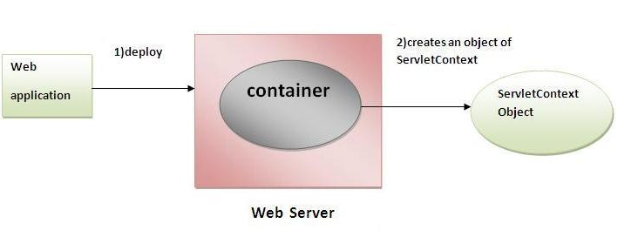
Inter-Servlet Communication
What is Servlet Context?
An interface which helps us to communicate with the servlet container. It is an object that contains meta information about web application.
There is only one ServletContext for the entire web application and the components of the web application can share it.
Using ServletContext we can
access context parameters set in the web.xml file,
forward the request to other servlets, and
store application wide parameters in the ServletContext.
Notes:
What is Servlet Context?
Each servlet runs within some sort of environment. This environment describes various parameters associated with the servlet environment, such as the document root and any mappings that may exist. This is known as the ServletContext.
A servlet belongs to only one ServletContext and the server's Web administrator controls this.
A Web application includes many parts. It is more than just one servlet or JSP. Numerous JSPs and one or more Servlets and other supporting java classes together form the web application. To help manage an application, you will sometimes need to set and get information that all of the servlets share together, which we will refer to as context-wide.
The ServletContext can store objects on behalf of servlets running within its context. There are methods that allow a servlet to add and remove objects and to determine what the objects are that are stored. These objects can be retrieved and modified by other servlets running within the context.

Slide 8
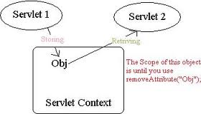
Inter-Servlet Communication
The <co
What is ServletContext(Contd..):
We can access the ServletContext object from the
getServletContext() of ServletConfig interface
getServletContext() of Generic Servlet Class.
getSession().getServletContext() of HttpRequest Class
ntext-param> element in <web-app> is used to define initialization parameter in the application-scope
Notes:
For E.g., if you want a single name using which you can refer to the application, you can set it in the servlet context and have it shared across all instances that use the application. Methods in the Servlet Context :Apart from setting and getting custom attributes used for our application, the context also contains various methods that we can use to retrieve specific information about the application and other aspects. They are: • getAttributeNames() - Returns an Enumeration object containing the attribute names available within this servlet context. • getContext(String uripath) - Returns a ServletContext object that corresponds to a specified URL on the server. • getInitParameter(String name) - Returns a string containing the value of the named context-wide initialization parameter, or null if the parameter does not exist. • getInitParameterNames() - Returns the names of the context's initialization parameters as an Enumeration of string objects, or an empty Enumeration if the context has no initialization parameters. • getMajorVersion() - Returns the major version as an int that this Servlet Container supports. • getMimeType(java.lang.String file) - Returns the MIME type as a string of the specified file, or null if the MIME type is not known. • getMinorVersion() - Returns the minor version as an int of the Servlet API that this Servlet Container supports.

Slide 9

Inter-Servlet Communication
Notes:
• getNamedDispatcher(String name) Returns a RequestDispatcher object that acts as a wrapper for the named servlet. • getRealPath(String path) - Returns a string containing the real path for a given virtual path. • getRequestDispatcher(String path) Returns a RequestDispatcher object that acts as a wrapper for the resource located at the given path. • getResource(String path) - Returns a URL to the resource that is mapped to a specified path. • getResourceAsStream(String path) - Returns the resource located at the named path as an InputStream object. • getServerInfo() Returns the name and version as a String of the Servlet Container on which the servlet is running.

Slide 10

Inter-Servlet Communication
Servlet Chaining:
It a process in which you pass the output of one servlet as the input to other. These servlets should be running in the same server.
Servlet allows us to invoke more than one servlet in sequence when the URL is opened with a common servlet.
Achieved using RequestDispatcher in 2 ways
Include
Forward
A Servlet can either hand off a request to a different resource or include the response which is created by that resource in its own response.
Notes:
Servlet Chaining:
Servlet Chaining is when output of one servlet act as a input to another servlet and at last request is sent to the browser and final output is achieved. When you use servlet chaining, you delegate the responsibility of generating the response to the next servlet in the chain.
User provides request to the first servlet present in the chain. The first servlet uses the form fields present in the request. The first servlet can transfer the request to another servlet with the execution control. The second servlet can use the request, as it is available to itself. This process can be repeated for any number of sevlets. The last servlet present in the chain provides response to the user. All servlet present before the last servlet remains invisible to the user.
In Servlets/JSPs, there are two ways to achieve servlet chaining using javax.servlet.RequestDispatcher:
Include:
Forward

Slide 11
Inter-Servlet Communication
Servlet Chaining(Contd..):
The RequestDispatcher Interface dispatches the request to another resource or includes the content of another resource.
Fetching the Request Dispatcher :
2 Ways to fetch the RequestDispatcher
ServletContext.getRequestDispatcher(String resource)
ServletRequest.getRequestDispatcher(String resource)
Example:
RequestDispatcher dispatcher = getServletContext().getRequestDispatcher(“/myApp/myServlet");
RequestDispatcher dispatcher = request.getRequestDispatcher(“myServlet");
Note: ServletRequest.getRequestDispatcher can take a relative URL. ServletContext.getRequestDispatcher cannot
Notes:
RequestDispatcher Interface This interface is present in the javax.servlet package and contains only following two methods :
forward(ServletRequest request, ServletResponse response) : Forwards a request to another resource on the same server. That resource can be a Servlet, JSP page or a simple HTML page.
include(ServletRequest request, ServletResponse response) : Works like a server-side include ( SSI ) and includes the response from the given resource ( Servlet, JSP page, HTML page ) within the caller response.
How to get a reference to RequestDispatcher Interface ? In order to use forward() or include() methods we discussed above we will have to get a reference to RequestDispatcher interface. There are two ways you can do this :
ServletContext.getRequestDispatcher(String resource)
ServletRequest.getRequestDispatcher(String resource)
They both do the same thing, but impose slightly different constraints on the argument path. For the ServletRequest, it looks for the resource in the same webapp to which the invoking servlet belongs and the pathname specified can be relative to invoking servlet. For the ServletContext, the pathname must begin with '/' and is interpreted relative to the root of the webapp.

Slide 12
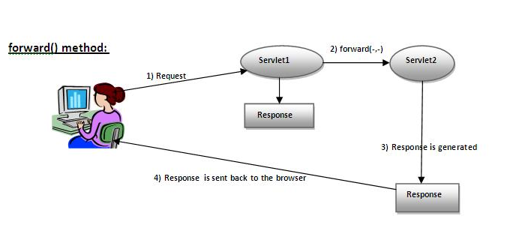
Inter-Servlet Communication
Servlet Chaining(Contd..) : RequestDispatcher.forward()
public void forward(ServletRequest request, ServletResponse response) throws ServletException, java.io.IOException
The response of Servlet2 is sent to client but response of Servlet1 is not displayed to the client
Notes:
Example:
// req is HttpServletRequest object
RequestDispatcher rd; rd = req.getRequestDispatcher("pathToServlet");
rd.forward(req, res);
Or you can use ServletContext's getRequestDispatcher(String resource) to do the same.
RequestDispatcher rd;
rd = getServletContext().getRequestDispatcher(“/pathToServlet");
rd.forward(req, res);

Slide 13
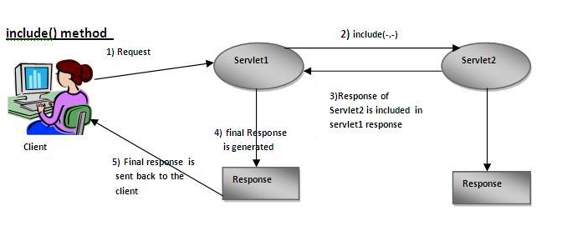
Inter-Servlet Communication
Servlet Chaining(Contd..) : RequestDispatcher.include()
public void redirect(ServletRequest request, ServletResponse response) throws ServletException, java.io.IOException
The response of Servlet2 included in the response of Servlet1 that is sent to the client
Notes:
Including a Response:
This is a process to provide response to the user by including response of other pages into the response of first servlet. The user provides request of first servlet, the first servlet can transfer the request with execution control to another servlet or page. The second servlet or page can use the request available from the first servlet. The second servlet provides response and execution control to the first servlet. The first servlet provides response to the user by including response of the second page or servlet. This process can be repeated for any number of servlet. The user fills like getting response of only one page.

Slide 14
Inter-Servlet Communication
ServletCommunication (Execute login.html with username as user1 and password as Syntel123)

Slide 15
Inter-Servlet Communication
response.sendRedirect() | RequestDispatcher.forward()
works with absolute URLs | can use only relative URLs with forward()
To pass the data we have to set the data in session or by appending the data to the URL that will be passed as argument to this method | we can pass data to the forwarded jsp/servlet
The sendRedirect is not transparent to the user, if request is sendRedirect then its visible in your browser (redirect at client side). | The forward() request is transparent to the user. It is done at server side and it is not visible to user.
network round trip to the server and back is required. | The forward() method is faster than using sendRedirect as no network round trip to the server and back is required.
Notes:
HTTP RedirectHTTP allows servers to redirect a client request to a different location. Although, this will usually result in another network round trip, it has some useful applications:
A web application may use redirection to navigate between parts of the application.
If content has moved to a different URL or domain name, redirection can be used to avoid breaking old URLs or bookmarks.
It is possible to convert a POST request to a GET request using redirection.
A client can be directed to use its local cache for content that has not changed.
Too use sendRedirect or getRequestDispatcher()
When you want to preserve the current request/response objects and transfer them to another resource WITHIN the context, you must use getRequestDispatcher or getNamedDispatcher.
If you want to dispatch to resources OUTSIDE the context, then you must use sendRedirect. In this case you won't be sending the original request/response objects, but you will be sending a header asking to the browser to issue a request to the new URL.
If you don't need to preserve the request/response objects, you can use either.

Slide 16
Inter-Servlet Communication
Sharing information:
Collaborating Web components share information via objects maintained as attributes of four scope objects.
These attributes are accessed with the [get|set]Attribute methods of the class representing the scope
Scope | Class | Accessible From
Web Context | javax.servlet.ServletContext | Web components within a Web context
session | javax.servlet.http.HttpSession | Web components handling a request that belongs to the session
request | javax.servlet.ServletRequest | Web components handling the request

Slide 17
Inter-Servlet Communication
Interacting with Database:
A servlet can access database using JDBC API
Optionally we can also access a database from a servlet using Datasource(<database>) configuration for the database in web.xml.
The DataSource is obtained using the jndi-name specified when configuring the database resource
<database jndi-name="jdbc/HogwartsStore"/>
<driver>
<type>org.postgresql.Driver</type> <url>jdbc:postgresql://127.0.0.1:5432/hogwarts_store</url> <user>web</user>
<password>i19web</password>
</driver>
</database>

Slide 18
Summary
A Servlet can make a request to an active resource on the web server just like a client can (by requesting a URL).
Passive server resources (e.g. static HTML pages which are stored in local files) are not accessed using the ServletContext .getResource(String path) returns a URL object for a resource specified by a local URI (e.g. "/" for the server's document root) which can be used to examine the resource.
Servlet API can sharie named objects between all the Servlets in a Servlet context by binding the objects to the ServletContext.
The ServletContext object of a Servlet with a known local URI can be retrieved with the method public ServletContext getContext(String uripath) of the Servlet's own ServletContext. This method returns null if there is no Servlet for the specified path or if this Servlet is not allowed to get the ServletContext for the specified path due to security restrictions.

