Slide 1
Web Services Implementation

Slide 2
Version Control and Revision History
 | Name | Date
Prepared By | Manisha Mane | 05-Jul-2019
Reviewed By | Pradeep Chinchole | 09-Jul-2019
Approved By | Nisha Mendonsa | 12-Jul-2019
Version No. | Date | Section Affected | Highlight of Changes
1.0.0 | 12-Jul-2019 | All | Original Version

Slide 3
Agenda
Introduction
Variable Declaration
Constants
Arrays
Conditional and Looping Statements
Shell Scripting
Dictionary Objects
Functions
File Handling
Database Handling
Working with XML & Excel

Slide 4
Objectives
Step by step implementing Web Service
Create web service Endpoint interface
Create web service Endpoint Implementation
Create end point publisher
Creating web service client.
Java Web Service Client via wsimport tool
Tracing SOAP Traffic
Wsgen tool

Slide 5
RPC/Document Style of Web-Service
In document style, the SOAP message is sent as a single document whereas in the RPC style, the SOAP body may contain several elements.
The document style is loosely coupled whereas the RPC is tightly coupled.
In the document style, the client sends the service parameters in simple XML format whereas in the RPC style the parameters are sent as discrete of values.
The Document/Literal style loses the operation name in the SOAP message whereas the RPC/literal style keeps the operation name in the SOAP message.
In the Document/Literal style, messages can always be validated using any XML validator whereas in the RPC/literal style, the transferred data is difficult to validate by the SOAP message.

Slide 6
JAX_WS RPC Style
JAX-WS is bundled with JDK 1.6, which makes Java web service development easier to develop.
Create a SOAP-based RPC style web service endpoint by using JAX-WS.
Create a Java web service client manually.
Create a Java web service client via wsimport tool.
Create a Ruby web service client.
Java Web Service Client via wsimport tool
Tracing SOAP Traffic
RPC/Document Style of Web-Service
Generating Support Files

Slide 7
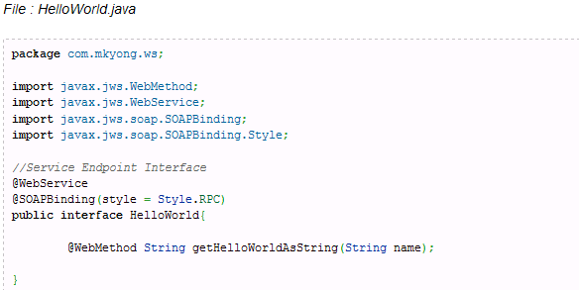
JAX-WS Web Service End Point
Create a Web Service Endpoint Interface

Slide 8
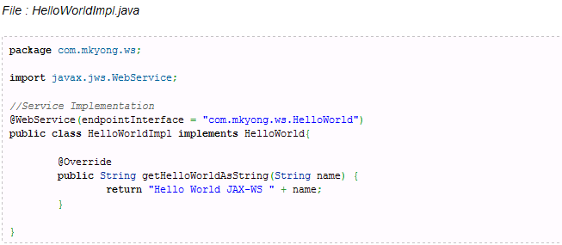
JAX-WS Web Service End Point
2.Create a Web Service Endpoint Implementation

Slide 9
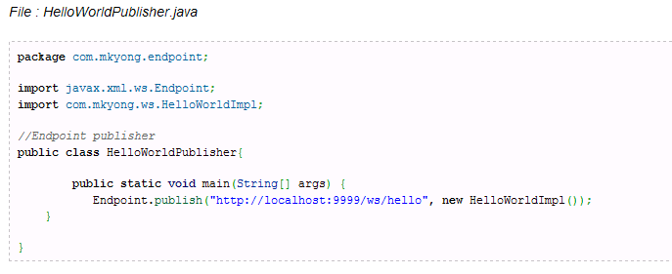
JAX-WS Web Service End Point
3. Create a Endpoint Publisher

Slide 10
JAX-WS Web Service
Run the endpoint publisher, and your “hello world web Service” is deployed in URL
“http://localhost:9999/ws/hello“.

Slide 11
Testing of - JAX-WS Web Service
4. You can test the deployed web service by accessing the generated WSDL (Web Service Definition Language) document via this URL “http://localhost:9999/ws/hello?wsdl” .

Slide 12
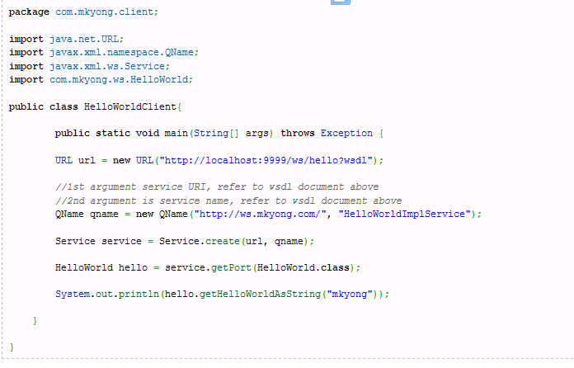
Java Web Service Client
1. Without tool, you can create a Java web service client like this :

Slide 13
Java Web Service Client
2. Java Web Service Client via wsimport tool
We can use “wsimport” tool to parse the published wsdl file, and generate necessary client files (stub) to access the published web service.
wsimport” command.
wsimport -keep http://localhost:9999/ws/hello?wsdl
It will generate necessary client files, which is depends on the provided wsdl file. In this case, it will generate one interface and one service implementation file.
Contd . . .

Slide 14
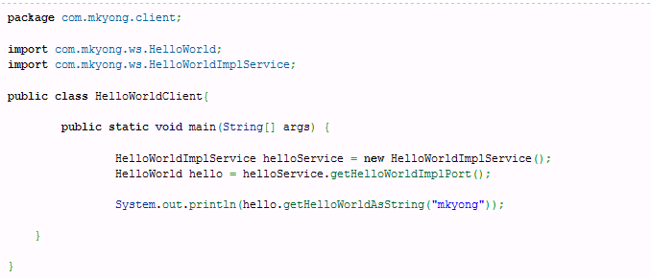
Java Web Service Client
2. Java Web Service Client via wsimport tool
Now, create a Java web service client which depends on the above generated files.

Slide 15
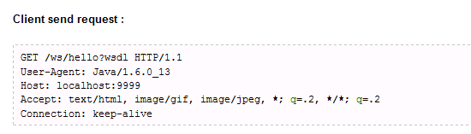
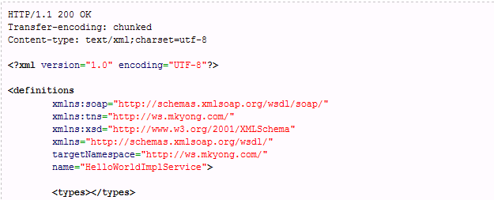
Tracing SOAP Traffic
Request a WSDL file : First, client send a wsdl request to service endpoint, see HTTP traffic below :
Server send response : WSDL File . . . . In XML format

Slide 16
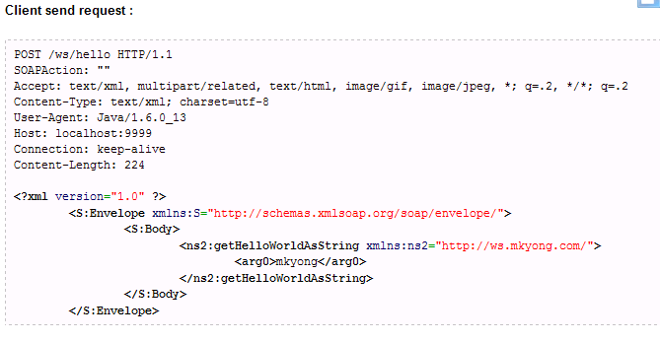
Tracing SOAP Traffic
2. hello.getHelloWorldAsString()
A second call, client put method invoke request in SOAP envelope and send it to service endpoint. At the service endpoint, call the requested method and put the result in a SOAP envelope and send it back to client.

Slide 17
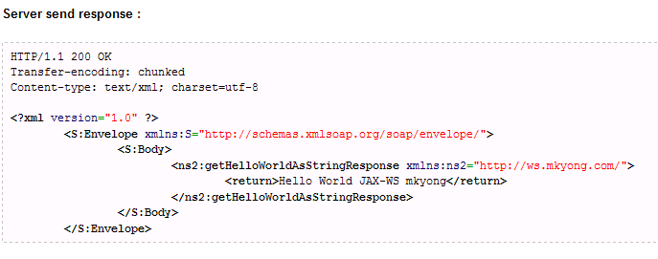
Tracing SOAP Traffic

Slide 18
Generating Support Files
wsgen -cp . SOAP_handlers.ServerInfo
Demo Files

Slide 19
Summary
Understood different styles of webservice.
Creating and consuming web services.
Generating web service artifacts using wsgen and wsimport tool.
Tracing SOAP messages using TCPMON tool.

Slide 20
Quiz
Difference between wsgen & wsimport.
Difference between Document style and RPC style.
Generally how many files does wsimport utility generates?

