Slide 1
xBRiD FrameWork

Slide 2
Basically JUnit is an open source unit testing tool and used to test small/large units of code. To run the JUnit test you don’t have to create class object or define main method. JUnit provide assertion library which is used to evaluate the test result. Annotations of JUnit are used to run the test method. JUnit is also used to run the Automation suite having multiple test cases.
Adding JUnit library in Java project
First we will learn how to add JUnit library in your Java project:
Step #1: Right click on Java project->Build Path->Configure Build path
Step #2: Click Libraries->Add Library
Step #3: Click on Junit.
Step #4: Select Junit4->Finish
Step #5: Click OK.

Slide 3
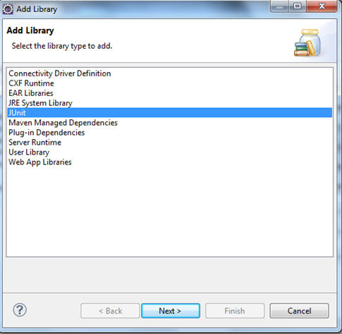
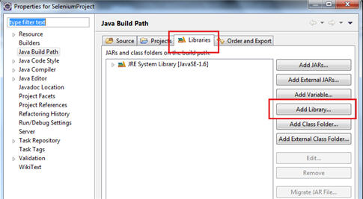
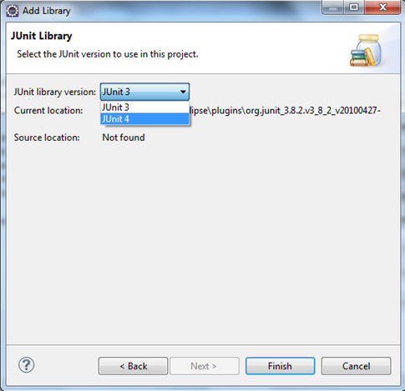
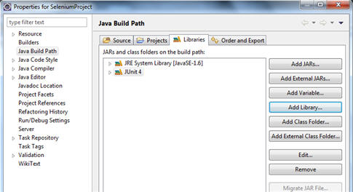

Slide 4
JUNIT – Annotations can be used based on the need.
@Test: The Test annotation tells JUnit that the public void method to which it is attached can be run as a test case. - See more at: http://java2novice.com/junit-examples/junit-annotations/#sthash.hDNn1Dwp.dpuf
@Before: When writing tests, it is common to find that several tests need similar objects created before they can run. - See more at: http://java2novice.com/junit-examples/junit-annotations/#sthash.hDNn1Dwp.dpuf
@After: If you allocate external resources in a Before method you need to release them after the test runs. - See more at: http://java2novice.com/junit-examples/junit-annotations/#sthash.hDNn1Dwp.dpuf

Slide 5
TestNG
TestNG is an advance framework designed in a way to leverage the benefits by both the developers and testers. For people already using JUnit, TestNG would seem no different with some advance features. With the commencement of the frameworks, JUnit gained an enormous popularity across the Java applications, Java developers and Java testers, with remarkably increasing the code quality.

Slide 6
Features of TestNG
Support for annotations
Support for parameterization
Advance execution methodology that do not require test suites to be created
Support for Data Driven Testing using Dataproviders
Enables user to set execution priorities for the test methods
Supports threat safe environment when executing multiple threads
Readily supports integration with various tools and plug-ins like build tools (Ant, Maven etc.), Integrated Development Environment (Eclipse).
Facilitates user with effective means of Report Generation using ReportNG

Slide 7
TestNG versus JUnit
There are various advantages that make TestNG superior to JUnit. Some of them are:
Advance and easy annotations
Execution patterns can be set
Concurrent execution of test scripts
Test case dependencies can be set

Slide 8
TestNG Installation in Eclipse
Follow the below steps to TestNG Download and installation on eclipse:
Step 1: Launch eclipse IDE -> Click on the Help option within the menu -> Select “Eclipse Marketplace..” option within the dropdown.
Step 2: Enter the keyword “TestNG” in the search textbox and click on “Go” button as shown below.
Step 3: As soon as the user clicks on the “Go” button, the results matching to the search string would be displayed. Now user can click on the Install button to install TestNG.
Step 4: As soon as the user clicks on the Install button, the user is prompted with a window to confirm the installation. Click on “Confirm” button.
Step 5: In the next step, the application would prompt you to accept the license and then click on the “Finish” button.
Step 6: The installation is initiated now and the progress can be seen as following:

Slide 9
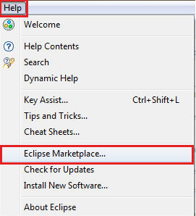
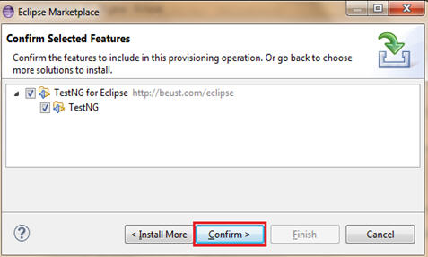
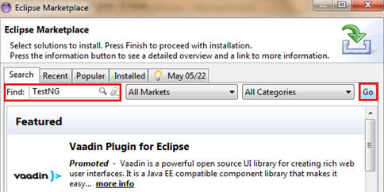
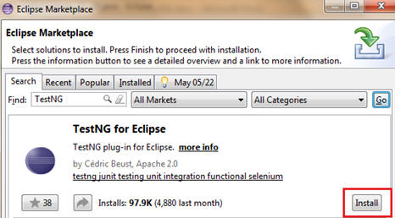
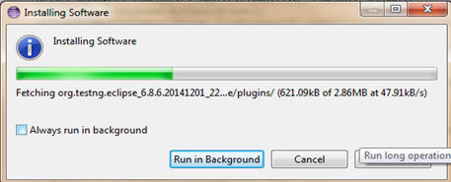

Slide 10
Test NG AnnotationDescription
@BeforeSuite
The annotated method will be run only once before all tests in this suite have run.
@AfterSuite
The annotated method will be run only once after all tests in this suite have run.
@BeforeClass
The annotated method will be run only once before the first test method in the current class is invoked.
@AfterClass
The annotated method will be run only once after all the test methods in the current class have run.
@BeforeTest
The annotated method will be run before any test method belonging to the classes inside the <test> tag is run.

Slide 11
@AfterTest
The annotated method will be run after all the test methods belonging to the classes inside the <test> tag have run.
@BeforeGroups
The list of groups that this configuration method will run before. This method is guaranteed to run shortly before the first test method that belongs to any of these groups is invoked.
@AfterGroups
The list of groups that this configuration method will run after. This method is guaranteed to run shortly after the last test method that belongs to any of these groups is invoked.

Slide 12
@BeforeMethod
The annotated method will be run before each test method.
@AfterMethod
The annotated method will be run after each test method.
@DataProvider
Marks a method as supplying data for a test method. The annotated method must return an Object[ ][ ], where each Object[ ] can be assigned the parameter list of the test method. The @Test method that wants to receive data from this DataProvider needs to use a dataProvider name equals to the name of this annotation.

Slide 13
@Factory
Marks a method as a factory that returns objects that will be used by TestNG as Test classes. The method must return Object[ ].
@Listeners
Defines listeners on a test class.
@Parameters
Describes how to pass parameters to a @Test method.
@Test
Marks a class or a method as a part of the test.

