Slide 1

UNIX Commands

Slide 2
Objectives
After completing the session participants will able to
Create a file and directory related utilities.
Apply and provide permissions to file related utilities and filter based utilities.

Slide 3
UNIX Commands
What is UNIX?

Slide 4
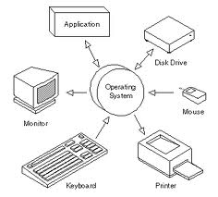
What is UNIX?
Unix:
UNIX is an operating system
Open-source
It is a stable, multi-user, multi-tasking system for servers, desktops and laptops.
Notes:
History of Unix
The Unix operating system found its beginnings in MULTICS, which stands for Multiplexed Operating and Computing System.
The MULTICS project began in the mid 1960s as a joint effort by General Electric, Massachusetts Institute for Technology and Bell Laboratories. In 1969 Bell Laboratories pulled out of the project.
One of Bell Laboratories people involved in the project was Ken Thompson. He liked the potential MULTICS had, but felt it was too complex and that the same thing could be done in simpler way.
In 1969 he wrote the first version of Unix, called UNICS. UNICS stood for Uniplexed Operating and Computing System. Although the operating system has changed, the name stuck and was eventually shortened to Unix.
Ken Thompson teamed up with Dennis Ritchie, who wrote the first C compiler. In 1973 they rewrote the Unix kernel in C. The following year a version of Unix known as the Fifth Edition was first licensed to universities.
The Seventh Edition, released in 1978, served as a dividing point for two divergent lines of Unix development. These two branches are known as SVR4 (System V) and BSD.

Slide 5
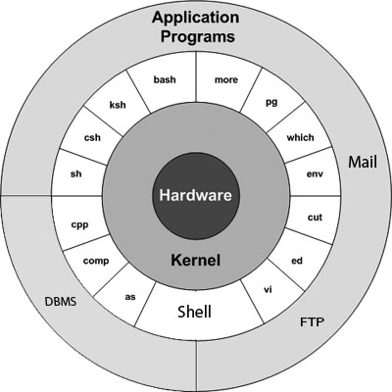
Block Diagram of Unix OS
Notes:
Block Diagram of Unix OS:
Unix is made up of three components
The kernel, which schedules tasks and manages storage
The shell, which connects and interprets users’ commands, calls programs from memory, and passes it on to the kernel for execution.
The tools and applications that offer additional functionality to the operating system
Kernel:
The kernel of Unix is the heart of the operating system. It allocates time and memory to programs and handles the filestructure and communication between the different parts of the computer system such as the keyboard and the screen.
As an illustration of the way that the shell and the kernel work together, suppose a user types rm myfile .The shell searches the filestore for the file containing the program rm, and then requests the kernel, through system calls, to execute the program rm on myfile. When the process rm myfile has finished running, the shell then returns the UNIX prompt to the user, indicating that it is waiting for further commands.
The kernel provides the file system, CPU scheduling, memory management, and other operating-system functions through system calls.
Shell
The shell is an interface between the user and the Unix kernel.
When a user logs in, the login program checks the username and password, and then starts another program called the shell.
The shell is a command line interpreter (CLI). It interprets the commands the user types in and arranges for them to be carried out. The commands are themselves programs: when they terminate, the shell gives the user another prompt
There are a variety of shells available for the various Unix systems. The expert user can customise their own shell and users can use different shells on the same machine.

Slide 6
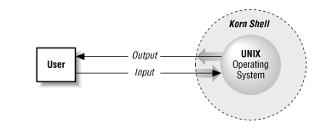
Block Diagram of Unix OS
Shell
It’s a text based command line driven program
Provides an Interface to the unix OS
Primary function is to read the commands and pass it on the kernel for execution.
Notes:
The shell and kernel work together like this:
a user types cat somefile to display a file;
the shell finds the program cat;
the shell instructs the kernel to run the program cat on somefile;
When the program finishes the kernel passes control back to the shell and displays the Unix prompt.
Types of Shell:
There are a number of different shells for Unix. People can become very attached to the shell they prefer. Popular shells include
sh - the bourne shell (The first shell )
bash - the bourne again shell
csh - the c shell
ksh - the Korn shell (strangely, not named for the band)
zsh - the z shell
Programs:
Programs are not part of the operating system as such, but they are logical sequences of commands, developed for implementing specific tasks. They usually include application software running at the user end.
UNIX provides several hundred utility programs, often referred to as commands.
Accomplish universal functions
editing
file maintenance
printing
sorting
programming support
online info
etc.
Modular: single functions can be grouped to perform more complex tasks.

Slide 7
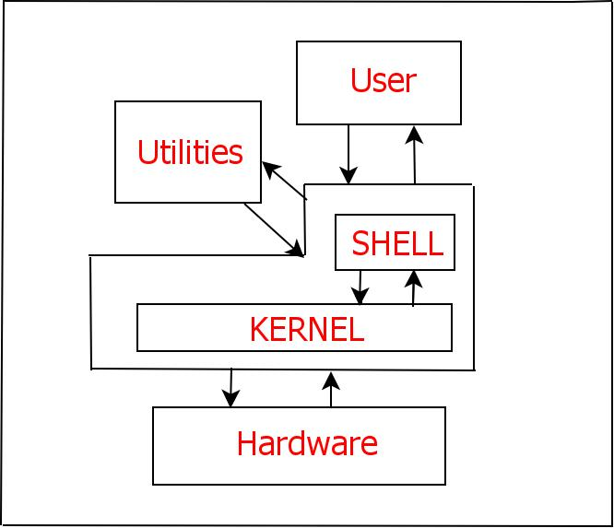
Features of Unix
Features of Unix:
Multi-user
Multi-tasking
Portability
Communication
Files in Unix
Security
Notes:
Multi-User Operating Systems
A multi-user operating system allows more than one user to share the same computer system at the same time. It does this by time-slicing the computer processor at regular intervals between the various users.
This switching between user programs is done by part of the kernel. To switch from one program to another requires,
a regular timed interrupt event (provided by a clock)
saving the interrupted programs state and data
restoring the next programs state and data
running that program till the next timed interrupt occurs
Main system memory is divided into portions for the operating system and user programs.
As you can see in the above diagram, the kernel space is kept separate from user programs.

Slide 8
Features of Unix
Features of Unix:
Multi-user
Multi-tasking
Notes:
In UNIX systems, each user is presented with a shell. This is a program which displays the users prompt, handles user input and displays output on the terminal. The shell program provides a mechanism for customizing each user's setup requirements, and storing this information for re-use (in a file called .profile).
When the UNIX system starts up, it also starts a system process which monitors the state of each terminal input line. Whenever a user logs in and their password is validated the UNIX system associates the shell program with that terminal.
Multi-Tasking Capability
It is capable of carrying out more than one job at the same time. It allows user to type in a program in its editor while it simultaneously executes some other commands like sort, copy a huge file.
The later job is performed in the background while in the foreground uses the editor or takes a directory listing or anything else.
OS/2 and Windows 95 are examples of multi-tasking single-user operating system. UNIX is an example of a multi-tasking multi-user operating system.
A multi-user system is also a multi-tasking system. This means that a user can run more than one program at once, using key selection to switch between them. Multiple users access the system by connecting to points known as terminals.
Multi-tasking systems support foreground and background tasks. A foreground task is one that the user interacts directly with using the keyboard and screen. A background task is one that runs in the background (it does not have access to the keyboard). Background tasks are usually used for printing or backups.
The role of the operating system is to keep track of all the programs, allocating resources like disks, memory and printer queues as required.
Portability:
UNIX uses a high-level language that is easy to comprehend, modify and transfer to other machines, which means you can change language codes according to the requirements of new hardware on your computer.
Therefore, have the flexibility to choose any hardware, modify the UNIX codes accordingly and use UNIX across multiple architectures.
Communication:
UNIX supports two major types of communication: 1. Communication between different terminals connected to the same computer. 2. Communication between users of the one computer at the specific location to the users of another type and size of a computer located elsewhere. The two computers may be located in different offices or different countries or continents. These types of communication is achieved by a mail system based on wide area and may be connected through telephone lines or satellite.
Files in Unix:
They are stored on disk in a hierarchical file system, with a single top location throughout the system (root, or "/"), with both files and directories, subdirectories, sub-subdirectories, and so on below it.
With few exceptions, devices and some types of communications between processes are managed and visible as files or pseudo-files within the file system hierarchy.
This is known as everything is a file. However, Linus Torvalds states that this is inaccurate and may be better rephrased as "everything is a stream of bytes".
Security:
Unix has 3 inherent provisions for protecting data.
Assign passwords and login name to users area.
Provide read, write and execute permission to each file.
Encrypt files into an unreadable format, and decrypting the file is also possible.

Slide 9
UNIX Commands
General UNIX Utilities

Slide 10
General UNIX Utilities
Unix Utilities:
Common Utilities
date | Display system date and time
cal | Print the calendar
man | Display reference manual pages
whatis | One – line description about a command
apropos | Search for a command
which | Displays the location of executables
echo | Display the contents on the Standard Output file
more | Browse or page through file
lpr | Sends file to printer
clear | clears the screen and puts cursor at beginning of first line
tty | Display the terminal number
Notes:
Common Utilites
cal:
cal command will print the calander on current month by default.
For example if you want to print calander of august of 1965. The command is.
% cal 8 1965
man:
Manual command.
% man man
This is help command, and will explains you about online manual pages you can also use man in conjunction with any command to learn more about that command
% man -k pattern
This command will search for the pattern in given command.
echo:
The echo command echoes its arguments. Here are some examples:
% echo this
this
% echo $EDITOR
/usr/local/bin/emacs
% echo $PRINTER
b129lab1
Things like PRINTER are so-called environment variables. This one stores the name of the default printer --- the one that print jobs will go to unless you take some action to change things.
The dollar sign before an environment variable is needed to get the value in the variable.
more:
More command will display a page at a time and then wait for input which is spacebar.
For example if you have a file which is 500 lines and you want to read it all. So you can use
% more filename
tty:
Tty command will display your terminal.
Syntax is: tty options
-l : will print the synchronous line number.
-s : will return only the codes: 0 (a terminal), 1 (not a terminal), 2 (invalid options).

Slide 11
General UNIX Utilities
Unix Utilities:
Common Utilities
Who | Displays the list of users logged to the unix server at a given instance
Who am I | Displays the details of the user who is logged in
Uname | Displays the hostname of the user
Logname | Displays the logname/hostname of the user

Slide 12
UNIX Commands
Directory related & File Handling Utilities

Slide 13

Directory related and File Handling Utilities
Unix Utilities:
Directory Related Utilities
cd | Change Directory
pwd | Present Working Directory
mkdir | Create a directory
rmdir | Remove a Directory
File Handling Utilities
touch | Create an empty file
cat | Create,append and view the contents of a file
ls | Listing all the files and directories
mv | Move a file
Notes:
Directory Related Commands
cd:
UNIX cd command is used to change the directory to require one .you can use cd with argument as name of the directory you wishes to enter.
syntax : cd [directory name]
Example:
To change the directory to /tmp directory. :cd /tmp
To change the current directory to user’s home directory : cd
To change the directory to previous directory used: cd –
To change the directory to users home directory (as cd with no arguments) :cd ~
To change the directory to parent directory or go backwards to one directory :cd ..
pwd:
Gives the absolute path from the root directory.Actually it gives present working directory
UNIX operating system stores environmental variables OLDPWD and PWD corresponds to pwd command :
PWD variable stores current working directory
OLDPWD variable stores previous working directory
mkdir:
mkdir command creates a single directories or multiple directories.
Syntax : mkdir [options] directories
options with examples:
-m : set permission mode for the new directory like chmod.
mkdir -m 777 newdir
-p no error if parent directory not existing, and creates sub-directories at once
mkdir –p newdir/sub1/sub2/sub3
To create mutiple directories at once
mkdir newdir1 newdir2 newdir3

Slide 14
File Handling Utilities
Unix Utilities:
File Handling Utilities
rm | Remove a file
cp | Copy a file
wc | Count the number of words,lines and characters in agiven file
file | Displays the type of file
chmod | Change the permissions of the file
chown | Change the owner of the file
chgrp | Change the group of the file
cmp | Compares the file character by character and stops the comparison when the first difference id found.
diff | Compares the files and also provides suggestions to make the two files copies of each other
Notes:
File Handling Utilites
touch :
Creates an empty file
cat :
It reads one or more files and prints the contents of the files to standard output.
Some operators when used with cat enables us to create / append a file
> used to create new file.
>> used to append to an existing file or create a file if file not exists
syntax : cat [options] [files]
Options:
-n : number all output lines
-b : number nonblank output lines
-e : $ is printed at the end of each line
-s : Suppress more than one single blank line
-v : Display control characters and nonprinting characters

Slide 15
UNIX Commands
Filtering Utilities

Slide 16
Filtering Utilities
Filtering Utilities in Unix will enable us to filter out the data.
Filtering Utilities
Head/tail | Used to filter out rows of data
cut | Used to filter out columns of data
paste | Paste out the filtered columns/ files
sort | Arranges the data in ascending/Descending order
Notes:
File Handling Utilites
touch :
Creates an empty file
cat :
It reads one or more files and prints the contents of the files to standard output.
Some operators when used with cat enables us to create / append a file
> used to create new file.
>> used to append to an existing file or create a file if file not exists
syntax : cat [options] [files]
Options:
-n : number all output lines
-b : number nonblank output lines
-e : $ is printed at the end of each line
-s : Suppress more than one single blank line
-v : Display control characters and nonprinting characters

Slide 17
Filtering Utilities
Filtering Utilities in Unix will enable us to filter out the data.
Filtering Utilities
uniq | Fetches out unique and duplicated data
grep | Search for data in Unix file/files
Notes:
File Handling Utilites
touch :
Creates an empty file
cat :
It reads one or more files and prints the contents of the files to standard output.
Some operators when used with cat enables us to create / append a file
> used to create new file.
>> used to append to an existing file or create a file if file not exists
syntax : cat [options] [files]
Options:
-n : number all output lines
-b : number nonblank output lines
-e : $ is printed at the end of each line
-s : Suppress more than one single blank line
-v : Display control characters and nonprinting characters

