Slide 1
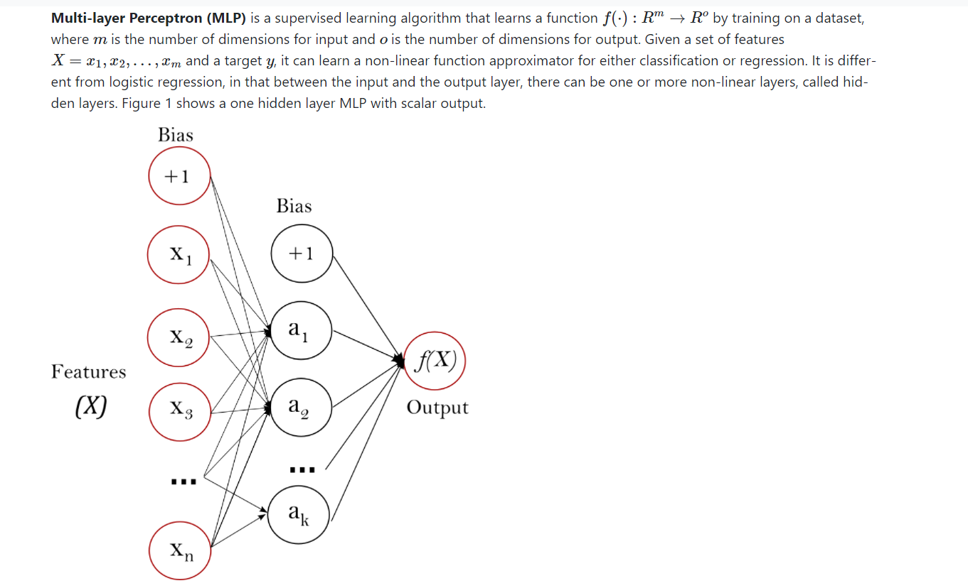
Algorithm

Slide 2
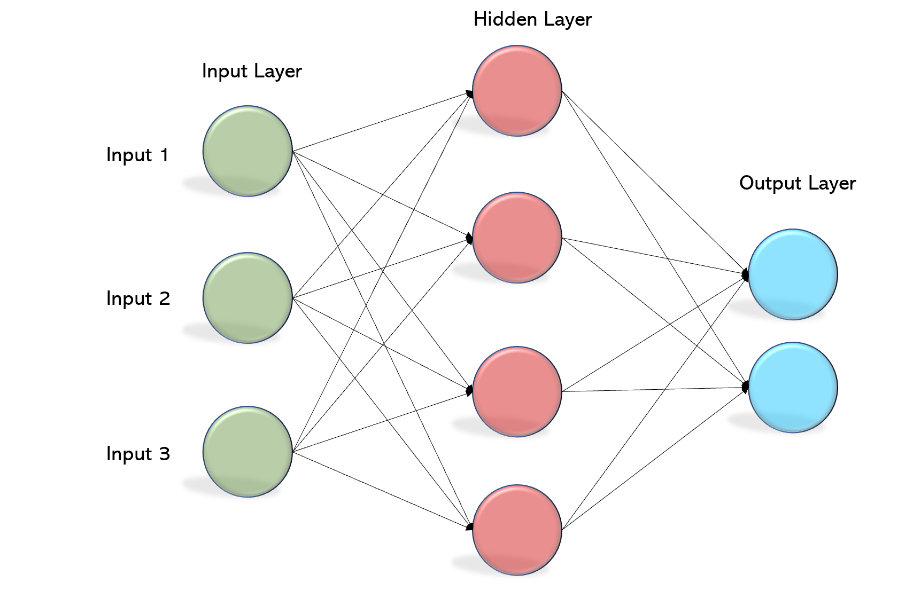
Algorithm - Layers

Slide 3
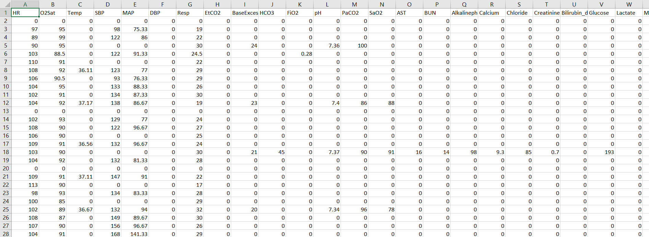
Dataset

Slide 4
Main Parameters
HR : Heart Rate
O2SAT : Oxygen Saturation
TEMP : Body Temperature
SBP : Spontaneous bacterial peritonitis
MAP : mean arterial pressure
RSP : Respiration Rate
Age, Gender & ICU spent time

Slide 5
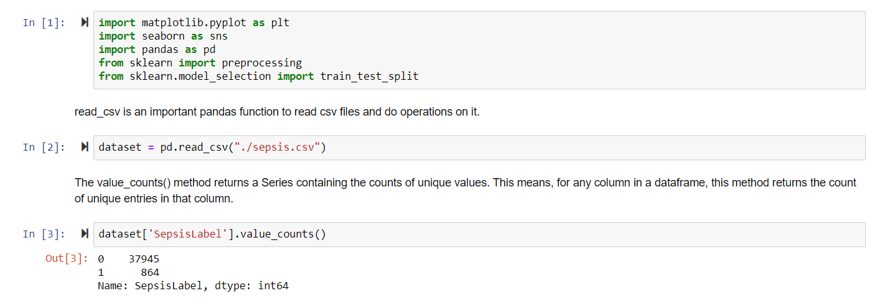
Importing the needed libraries and dataset

Slide 6
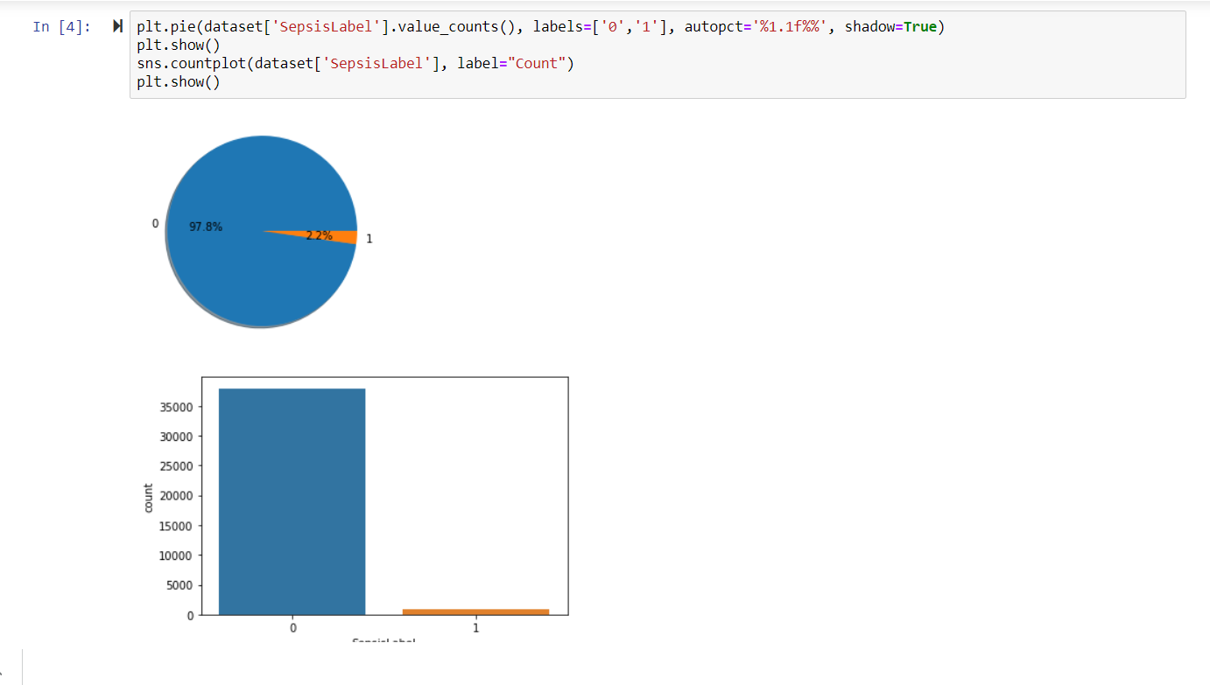
Preparing the dataset

Slide 7
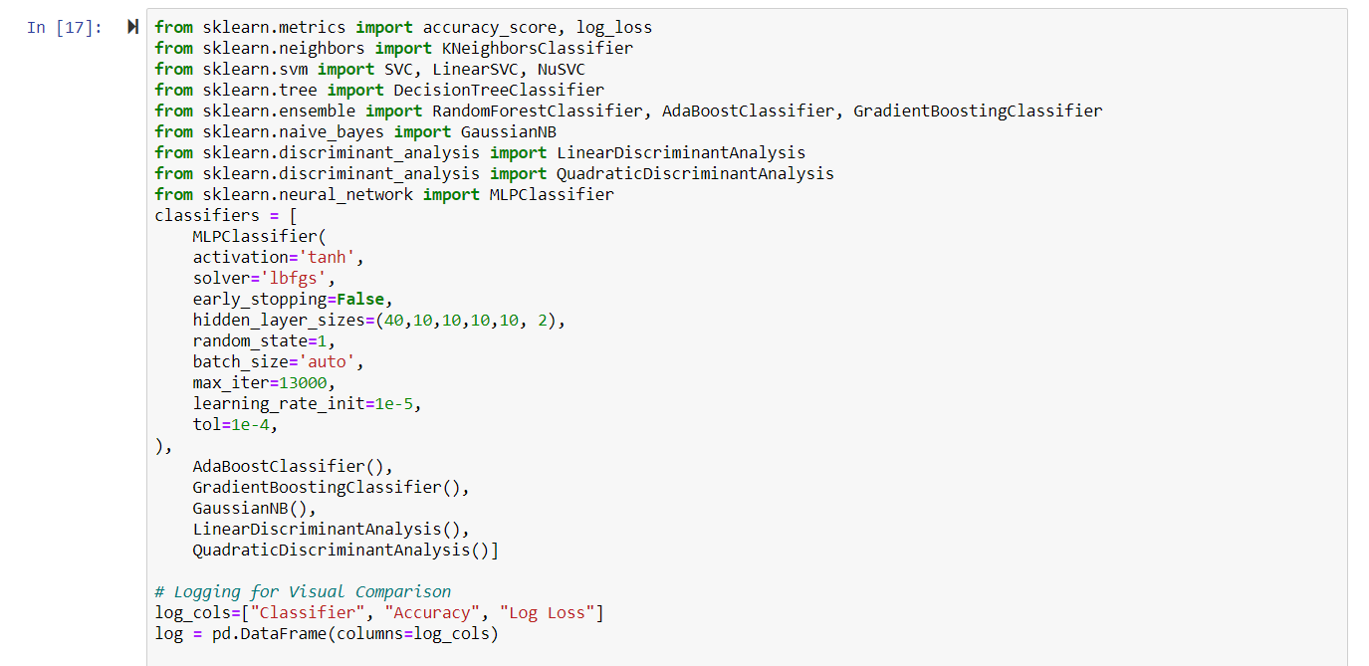
Preparing the classifier

Slide 8
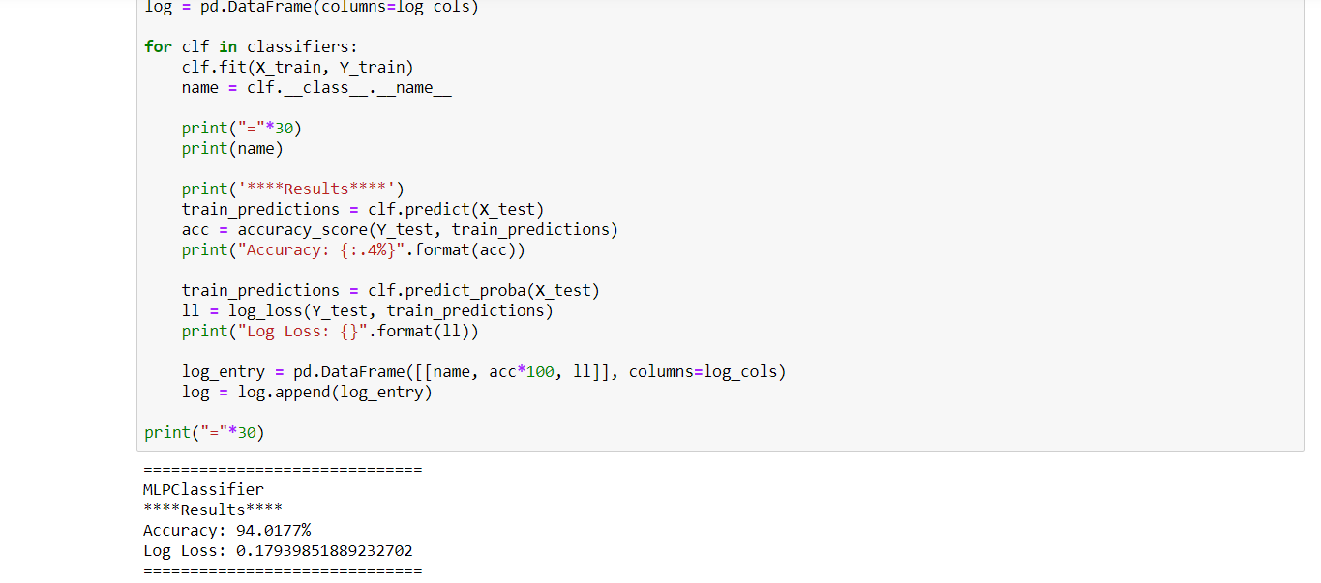
Running the classifier on the Dataset

