Slide 1
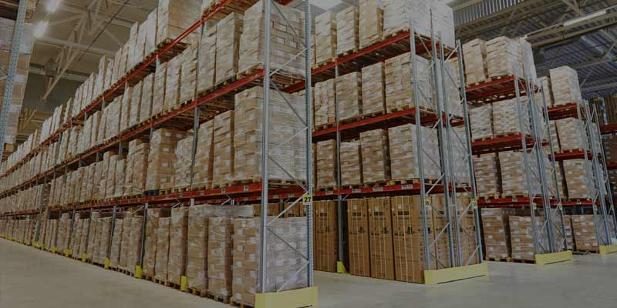
INVENTORY MANAGEMENT SYSTEM
(STOCK OF GOODS)
K.VISHNUVARDHAN
176323

Slide 2

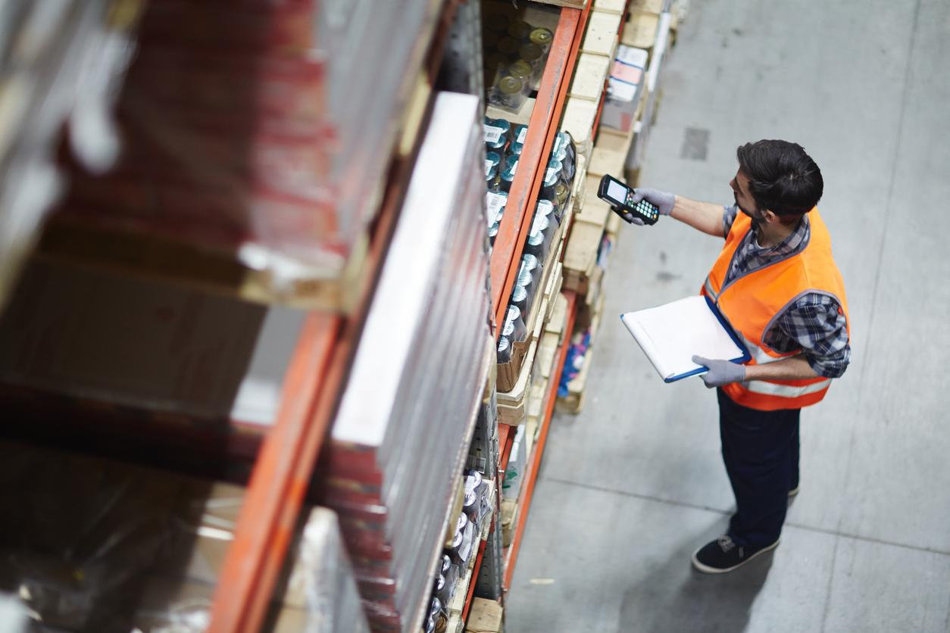
Problem statement:
How much additional inventory to order or produce?
When to order or produce it?
Proposed solution:
We propose Inventory management to ensure availability
of stock that minimizes investment costs.
It is prevention of spoilage,leakage,wastage of materials
and improving material handling.
It serves distribution between Production and distribution process.

Slide 3
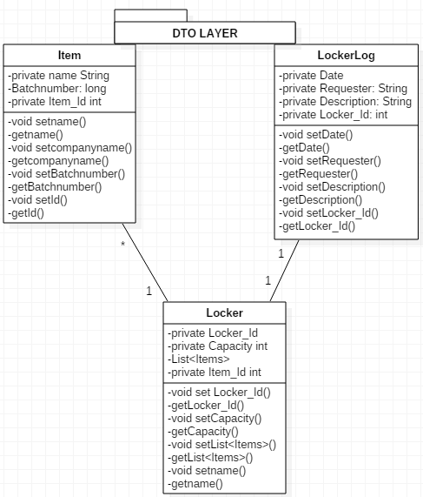
Pojo class:

Slide 4
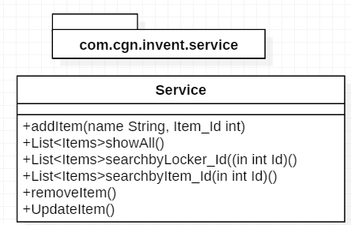
SERVICE LAYER

Slide 5
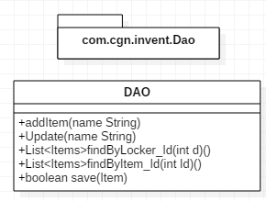
REPOSITORY LAYER:

Slide 6


