Slide 1
Title:Statement_showing_area_of_high_yielding_variety_plantations
Name: Vishnu Vardhan Reddy
Email: nvishnuvardhanrv@gmail.com
Github:https://github.com/Vishnuvardhan110602/
DataAnalyticsProjects
LinkedIn:www.linkedin.com/in/vishnu-vardhan-reddy-a73b35283

Slide 2
Dataset Description
The dataset contains 499 records across 7 columns, tracking land extent for Kumta, Kundapur, Puttur, and Moodabidri divisions from 1992 to 2490. It includes a serial number, year, and total land extent, with some missing values. On average, each division records 125 hectares, ranging from 5 to 653 hectares, while total land extent varies between 14 and 1615.5 hectares. This dataset helps analyze historical land distribution trends.

Slide 3
Data Processing Steps
The dataset was loaded using Pandas, and an initial analysis was performed:
Displaying dataset info and first 5 rows. Checking for missing values.
Missing values in numeric columns were filled using median values. This ensured that the dataset was complete and ready for further analysis.

Slide 4
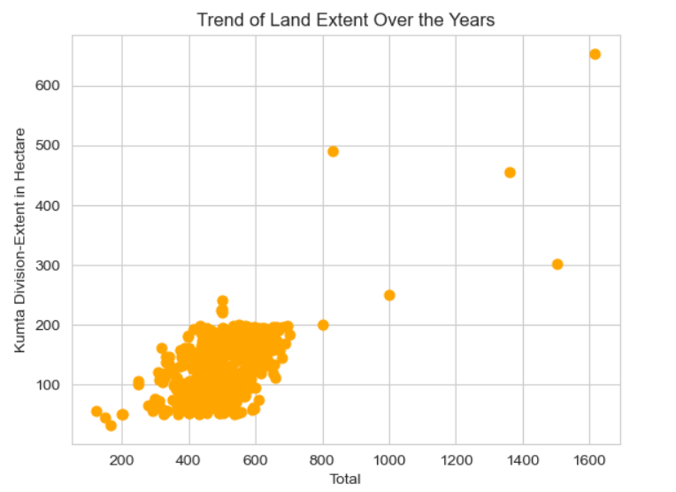
scatter plot of Kumta Division-Extent in Hectare with orange color

Slide 5
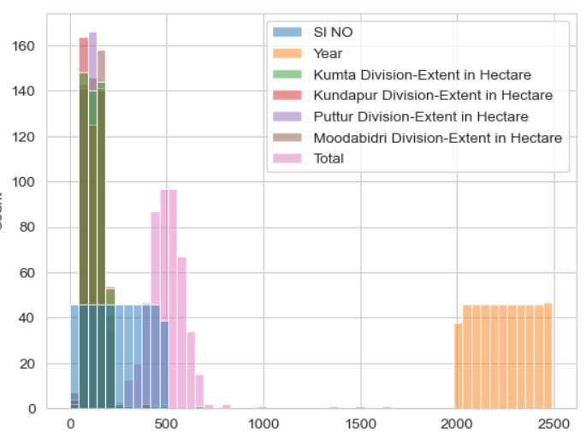
Histplot with all columns in seaborn with

Slide 6
Key Data Insights:
From the analysis:
Land extent varies significantly across years and divisions. Missing values were filled to maintain dataset integrity.
The dataset provides useful insights into land usage trends over centuries.Further visualizations can highlight patterns in land distribution.

Slide 7
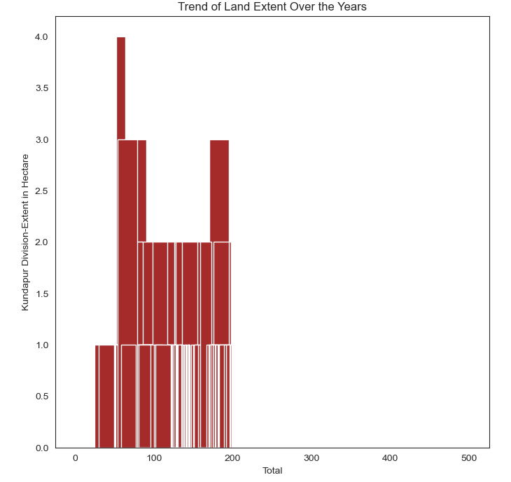
hist plot of Kundapur Division-Extent in Hectare in Hectare with brown color

Slide 8
Conclusion & Future Work
The dataset offers valuable insights into historical land distribution.
Future work could include:
Advanced visualization techniques. Predictive modeling to forecast land use changes.
Correlation analysis with environmental factors. This study lays the groundwork for further in-depth analysis.

