Slide 1
DevOps
Introduction

Slide 2
DevOps Engineer Skills in the market
Communication and Collaboration
Soft Skills and Noble Thought
Understanding of Relevant Tools
Security Skills
Automation Skills
Coding and Scripting
Cloud Skills
Testing Skills
Customer-Focused Approach
Proactiveness

Slide 3
Needed Skills - 1
1) Communication and Collaboration
Given its basic nature, communication and collaboration are very crucial to succeed in DevOps competition. These two are very important to breaking down the siloes between Dev and Ops teams, aligning teams’ goals to business objectives and implement DevOps culture cross-functionally.
2) Soft Skills and Noble Thought
It’s not enough if you are just good at coding and automation. DevOps needs a different you, who is also good at soft skills, self-motivation, flexibility and learning. DevOps professionals should be the doers as well as listeners.
They should be clear about the fact that DevOps transformation involves stakeholder discussions, awareness about business goals, assessment and identification of improvement areas, all driven by collaboration.
3) Understanding of Relevant Tools
DevOps success purely depends on the toolset it involves during different phases of its implementation. It’s hard to even count the number of tools that DevOps brought in. But the significance in making DevOps success is something to be discussed in detail.

Slide 4
Needed Skills - 2
4) Security Skills
The rate of risks often matches with the speed of deployment that DevOps facilitates. Given this constraint, security at the end or as a separate process in the traditional method might not work. This is where DevSecOps proves to be an advantage integrating security with SDLC right from the start.
So, DevSecOps skillset will definitely be an added advantage to success as a DevOps professional.
5) Automation Skills
Being called as a DevOps engineer will require a good command over automation, the heart of DevOps process. A DevOps engineer should be capable of automating the entire DevOps pipeline, including CI/CD cycles, app performance monitoring, infrastructure and configurations, among others.
DevOps automation skillset is closely linked to ability in knowledge about DevOps toolset, coding and scripting.
6) Coding and Scripting
Coding and scripting are two important skillset that DevOps engineer should possess. Python, Ruby, Python, Java, Javascript, PHP, Bash, Shell and Node.js are among the most recommended programming/scripting languages.

Slide 5
Needed Skills - 3
7) Cloud Skills
Cloud and DevOps are always together. The efficiency of one is directly dependent on and influenced by the other. While DevOps methodology drives a process, cloud enables that process by providing it with necessary platform to perform test, deploy and release code.
Cloud enables DevOps automation with required CI/CD toolset and also facilitates a resource monitoring mechanism.
8) Testing Skills
Testing stands crucial to DevOps success. DevOps automation pipeline will need tests that run well without fail. This is important for the success of continuous testing, where the automated tests are executed.
9) Customer-Focused Approach
Customer satisfaction is the end goal of any successful DevOps process. Given this factor, DevOps professionals should ensure every function they perform should be in line with business objectives and delivery value to the end-user.
In the process, they will need to collaborate with stakeholders such as developers, testers, project managers and organization’s thought leadership, towards a common goal.
10) Proactiveness
Overall, DevOps engineers/pros will need the proactiveness and passion towards work, which directly reflects in performance and productivity. Moreover, staying updated with relevant technologies, new tools, and more are part of your process.

Slide 6
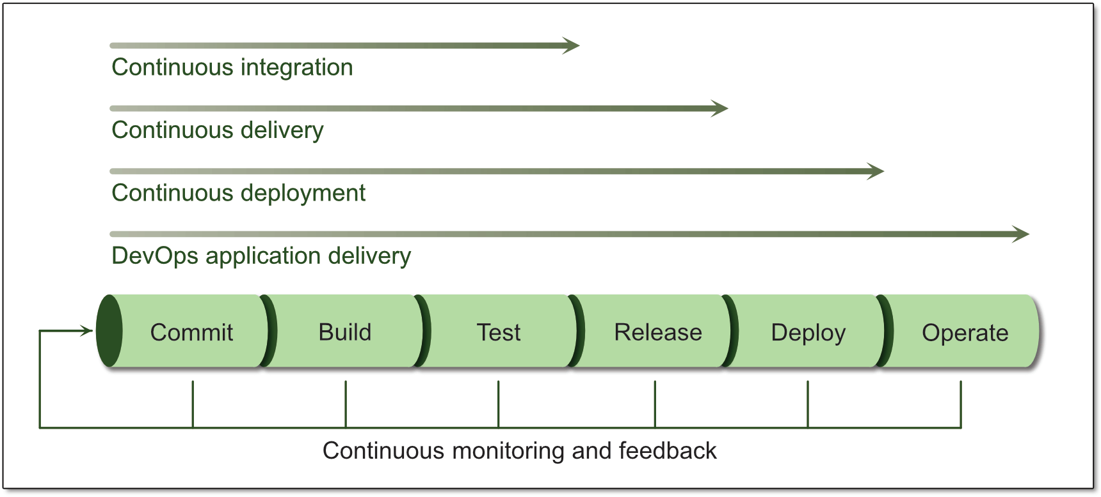
DevOps Delivery Pipeline

Slide 7
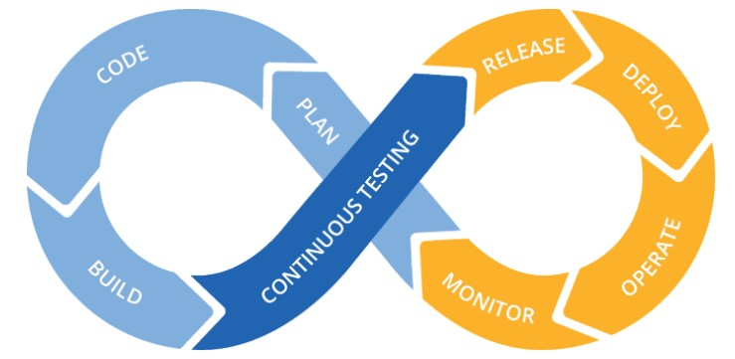
DevOps Delivery Pipeline

Slide 8
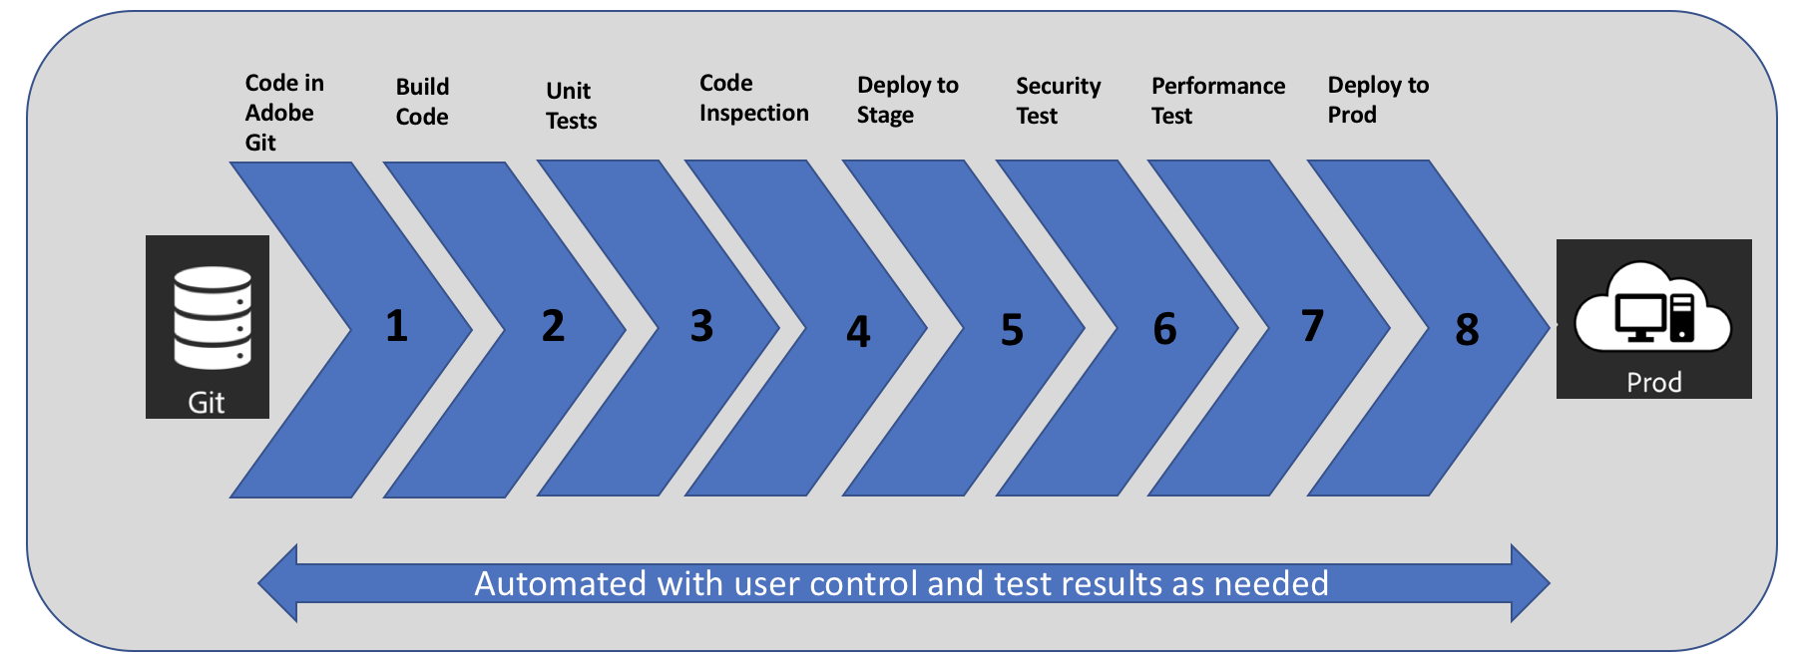
Typical DevOps Delivery Pipeline

Slide 9
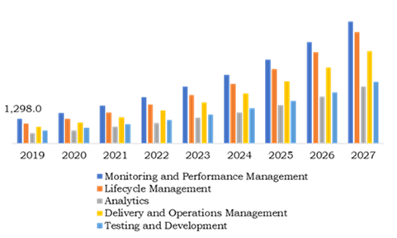
Market trend of DevOps

Slide 10
DevOps Technical Challenges
Adopting DevOps culture
Test Automation Strategy
Too much focus on tools
Ownership on Deployments and Releases
Adopting to Changes (Resistance to change)
Continuous learning process

Slide 11
DevOps Roadmap
Reference –
https://roadmap.sh/devops
https://blog.hubspot.com/website/devops-roadmap

Slide 12
