Slide 1
Document Intelligence Platform
Intelligent Document Extraction, Validation & API Platform
AI Engineer Internship — Technical Case Study Submission

Slide 2
Problem & Objective
The problem
Financial teams receive invoices & statements as native/scanned PDF, JPG or PNG in inconsistent layouts — manual extraction is slow and error-prone.
The objective
Build & deploy a reusable Document Intelligence service that extracts all available fields, validates key financial relationships, and exposes results via a dashboard and REST API.
Documents in scope
• Invoices
• Balance Sheets
• Profit & Loss Statements
• Cash Flow Statements

Slide 3
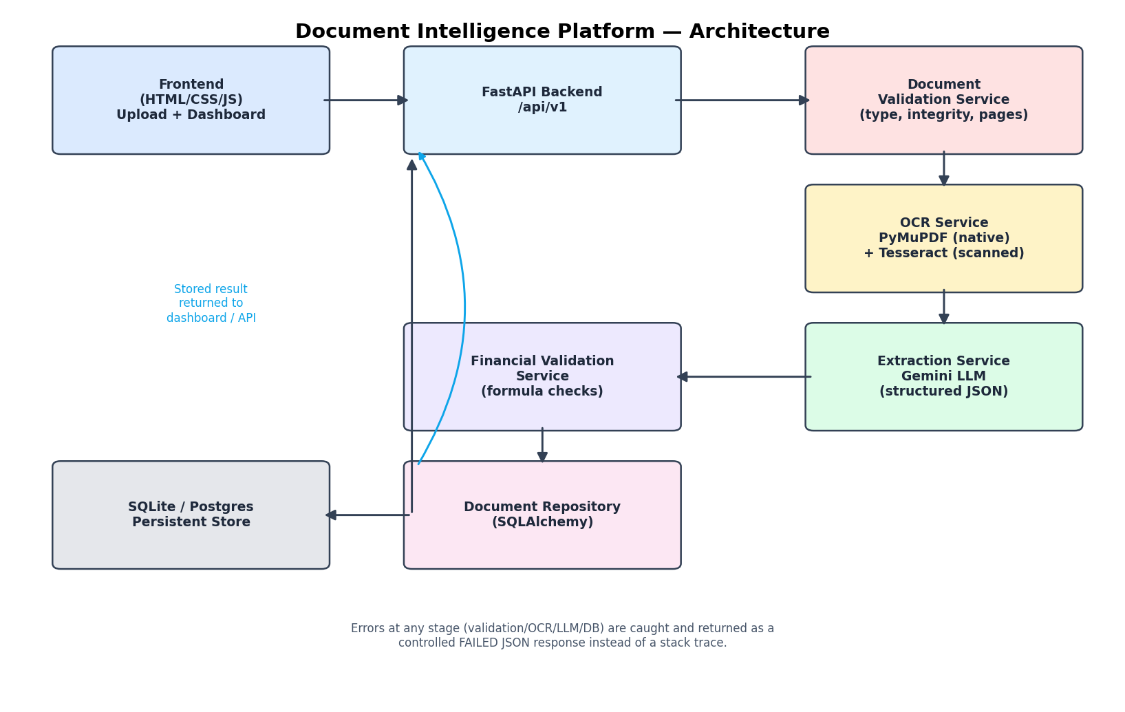
Architecture
Upload → Validate → OCR → AI Extraction → Financial Validation → Store → Dashboard/API

Slide 4
Technology Stack
Concern
Choice
Why
API framework
FastAPI
Async, auto Swagger/OpenAPI docs, Pydantic validation
Frontend
HTML/CSS + vanilla JS (Jinja2)
Single deployable service, meets brief's frontend requirement
Native PDF text
PyMuPDF
Fast, accurate embedded-text extraction
OCR
Tesseract (pytesseract)
Free, offline, no API key needed
AI extraction
Google Gemini (structured JSON)
Generous free tier, native JSON mode
Database
SQLite (Postgres-ready)
Zero-setup persistence, swappable via DATABASE_URL
Deployment
Docker on Render
One image; free tier; Tesseract baked in

Slide 5
REST API Design
Swagger/OpenAPI docs available at /docs on the deployed environment
POST
/api/v1/documents/process
Upload & process a PDF/JPG/PNG
GET
/api/v1/documents/{document_name}
Latest structured result by document name
GET
/api/v1/documents
List processed documents (dashboard feed)
GET
/api/v1/health
Health check

Slide 6
Extraction & Financial Validation
Extraction
ALL meaningful fields extracted, not a fixed list
Missing values → null, never invented
Evidence: source_text + page_number per field
Validation
Formula, inputs, calculated vs reported value, variance
PASS / FAIL / NOT_APPLICABLE — never assumes missing fields
Tolerance: max(abs 1.0, 1% of reported value)
"invoice_total_check"
formula: subtotal + tax − discount
calculated_value: 13125.00
reported_value: 13125.00
variance: 0.00
status: PASS

Slide 7
Testing & Deliverables
Testing
All 4 document types processed end-to-end
Scanned/image-based document included
Unsupported file & missing-field scenarios included
pytest: file validation, financial calc, API flow (14 tests, all passing)
Deliverables
Public GitHub repo (backend, frontend, tests, docs)
Deployed frontend + API + Swagger URLs
README (setup, architecture, API, limitations)
Architecture diagram + sample JSON outputs

Slide 8
Known Limitations & Production Roadmap
Known limitations
Multi-period statements validated as a single period, not per-year
Document type is user-selected, not auto-classified (per brief)
OCR quality varies on low-resolution/skewed scans
For production
Async processing queue instead of synchronous requests
Per-period structured extraction & validation
Managed Postgres + object storage + auth/rate-limiting

