Slide 1
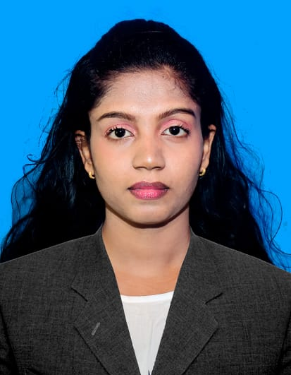

IT21188886 Shangeetha J
Body & Skin-Based Fashion Recommendation with Explainable Insights
BSc(Hons) Information Technology Specializing in Information Technology
IT21188886 | Shangeetha J | 25-26J-302
1
05/01/2026

Slide 2
Introduction
Body & Skin-Based Fashion Recommendation with Explainable Insights
Online fashion shopping faces high return rates (~30% globally) due to poor fit and color mismatch.
Users often don’t know their own body type or which colors suit them, leading to dissatisfaction.
This component: a web-based application that detects body shape + skin colour and provides personalized outfit recommendations with explainable reasoning.

Slide 3
Research Problem
Body & Skin-Based Fashion Recommendation with Explainable Insights
Existing systems:
Focus on body silhouette only.
Focus on skin tone only.
Provide black-box recommendations with no explanation.
Users lack confidence in recommendations.

Slide 4
Research Gap
Body & Skin-Based Fashion Recommendation with Explainable Insights
No system combines body shape + skin colour for fashion recommendations.
Lack of Explainable AI layer to justify recommendations.
Existing datasets are biased towards Western body types and skin tones.

Slide 5
Research Question:
Body & Skin-Based Fashion Recommendation with Explainable Insights
Can a hybrid AI system combining body shape and skin colour analysis provide explainable, personalized fashion recommendations , improving user satisfaction and trust?

Slide 6
Design Excellence / Contribution
Body & Skin-Based Fashion Recommendation with Explainable Insights
Lightweight ML models (CPU-friendly)
Separate models for:
Body Shape
Skin Tone
Outfit Recommendation
Modular API design → scalable

Slide 7
Body & Skin-Based Fashion Recommendation with Explainable Insights
Technologies USED
Computer Vision
MediaPipe (Pose + Segmentation)
Body landmark detection (shoulders, waist, hips)
Used to calculate SHR & WHR ratios
Machine Learning
LightGBM
Body shape classification
Outfit recommendation models
Custom CNN (TensorFlow / Keras)
Skin tone classification from images
Backend & Deployment
FastAPI
REST API for ML inference
Programming Language
Python 3.10 / 3.12
IT21188886 | Shangeetha J | 25-26J-302
7
05/01/2026

Slide 8
Body & Skin-Based Fashion Recommendation with Explainable Insights
Application of Specialization-Based Knowledge
ALGORITHMS USED & WHY
Body Shape Prediction
Algorithm: LightGBM (Multiclass Classification)
Input: SHR, WHR ratios
Why Used:
Designed for structured numerical data
Fast and lightweight
Provides confidence probabilities
Suitable for real-time API deployment
IT21188886 | Shangeetha J | 25-26J-302
8
05/01/2026

Slide 9
Body & Skin-Based Fashion Recommendation with Explainable Insights
Skin Tone Classification
Algorithm: Custom Convolutional Neural Network (CNN)
Input: RGB skin images
Why Used:
CNNs are optimal for image-based tasks
Automatically learn color and texture patterns
Robust to lighting variations
Validation Accuracy: 74.67%
IT21188886 | Shangeetha J | 25-26J-302
9
05/01/2026

Slide 10
Body & Skin-Based Fashion Recommendation with Explainable Insights
Outfit Recommendation
Algorithm: LightGBM (Multiple Multiclass Models)
Input: Body Shape, Skin Tone
Outputs:
Tops, Bottoms, Dresses
Saree Style
Recommended Colors
Why Used:
Efficient handling of categorical features
Avoids rule-based logic
Easily extendable
IT21188886 | Shangeetha J | 25-26J-302
10
05/01/2026

Slide 11
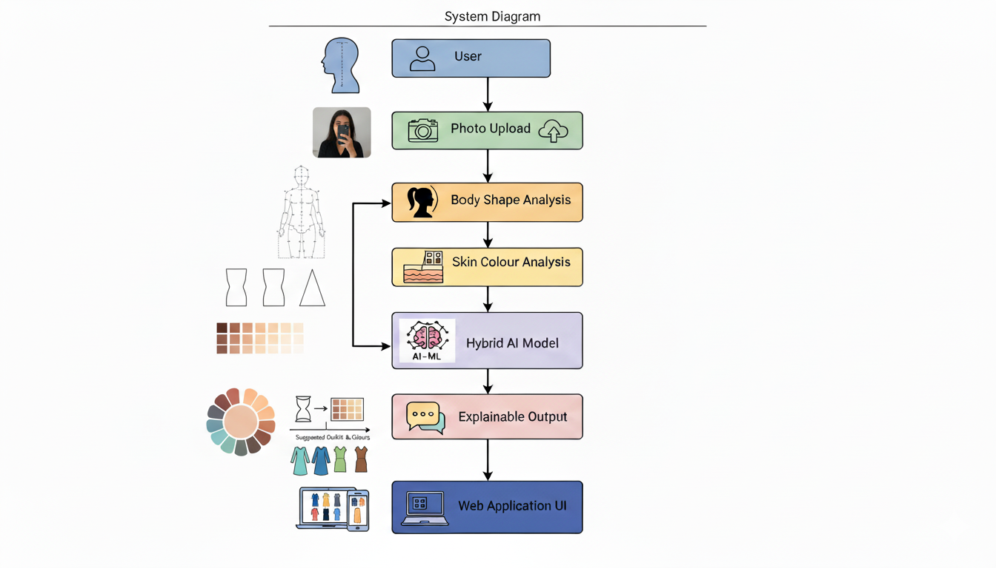
Implementation Details
Body & Skin-Based Fashion Recommendation with Explainable Insights
SYSTEM OVERVIEW
IT21188886 | Shangeetha J | 25-26J-302
11
05/01/2026

Slide 12
How to use in a real-world scenario
Body & Skin-Based Fashion Recommendation with Explainable Insights
User uploads photos → front and optional side view.
System analyzes body shape → calculates key ratios, landmarks.
System classifies skin colour → normalizes lighting, identifies tone.
Hybrid AI engine generates recommendations → outfit types, colours, accessories.
Explainable output is shown → Your body type is pear; A-line skirts balance proportions; medium skin tone pairs well with jewel tones like emerald.
IT21188886 | Shangeetha J | 25-26J-302
12
05/01/2026

Slide 13

IT22269270 | Thivvijavearl T.S
Event Theme Based Outfit Matching
Information Technology
IT22269270 | Thivvijavearl T.S | 25-26J-302

Slide 14
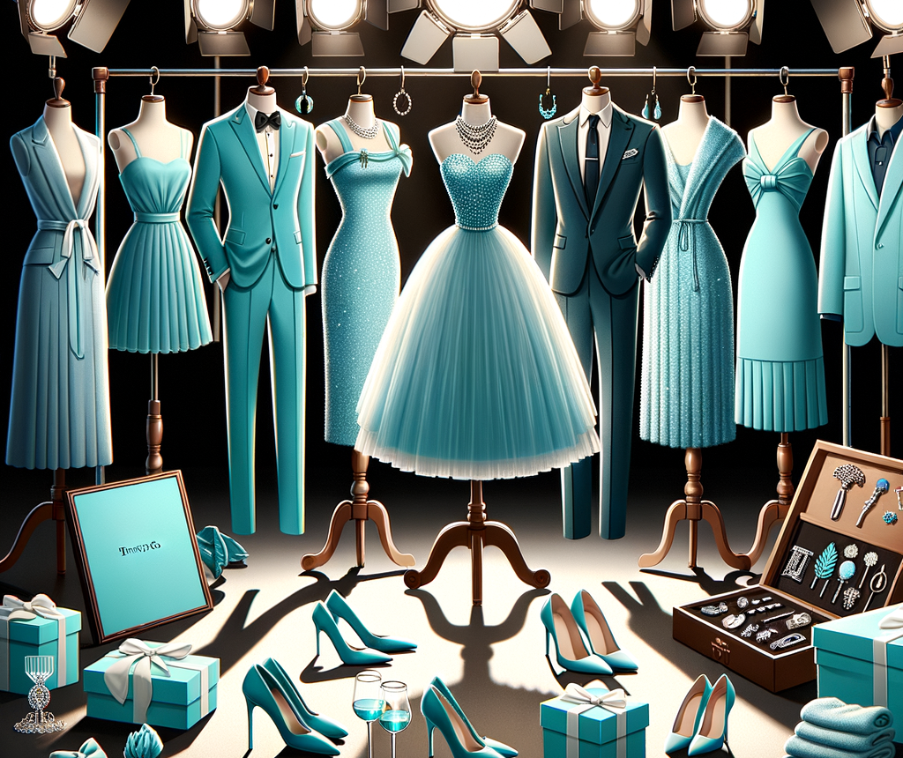
Event Theme Based Outfit Matching
Problem
Wearing theme mismatch outfits for events.
Solution
AI based event theme outfit recommendation.
Event decoration color and theme analysis using image processing.
Matching outfit color and style suggestions based on detected theme.
IT22269270 | Thivvijavearl T.S | 25-26J-302

Slide 15
Event Theme Based Outfit Matching
User Feedback
Design Excellence / Contribution
Designed a user centered interface for event theme–based outfit selection.
Ensured smooth data flow from event image input to outfit recommendation output.
Applied responsive UI design for consistent use across desktop and mobile devices.
Integrated real time visual feedback during image upload and analysis.
Optimized system performance for quick and accurate outfit predictions.
Improved the design iteratively using user feedback from prototype testing.
Enhanced result presentation with clear outfit suggestions and color explanations.
Category | Feedback
Usability | Easy to use interface with simple event image upload and clear outfit suggestions.
Prediction Output | Outfit color recommendations are clear and easy to understand
Performance | Fast response when analyzing event decoration images.
Improvements | More outfit style options and better mobile screen layout.
IT22269270 | Thivvijavearl T.S | 25-26J-302

Slide 16
Event Theme Based Outfit Matching
How the Solution Addresses the Sub-Problem / Prototype
Users upload an image of the event decoration or theme in real time.
The system analyzes visual features such as dominant colors, patterns, and textures.
AI/ML model predicts suitable outfit colors and styles that match the detected theme.
Visualizes recommended outfits and provides clear style suggestions to the user.
User Requirements Addressed
Simple and intuitive interface for uploading event images and viewing suggestions.
Fast and accurate outfit recommendation based on decoration theme analysis.
Supports multiple color and style options relevant to different event themes.
Real-time suggestions for matching outfits to avoid mismatched clothing choices.
IT22269270 | Thivvijavearl T.S | 25-26J-302

Slide 17

IT22066848 | ABIRAJH A
Digital wardrobe
B.Sc. (Hons) Degree in Information Technology, Specializing in information Technology​​
Abirajh A |
25-26J-302
1

Slide 18
Digital Wardrobe
Problem Definition / Knowledge Gap
People struggle to plan daily outfits efficiently, often repeating the same clothes and ignoring weather conditions.
Our Solution
weather-aware outfit recommendations
personalized, context-aware digital wardrobe systems
group or couple outfit coordination
Trip Planner
Abirajh A |
25-26J-302

Slide 19
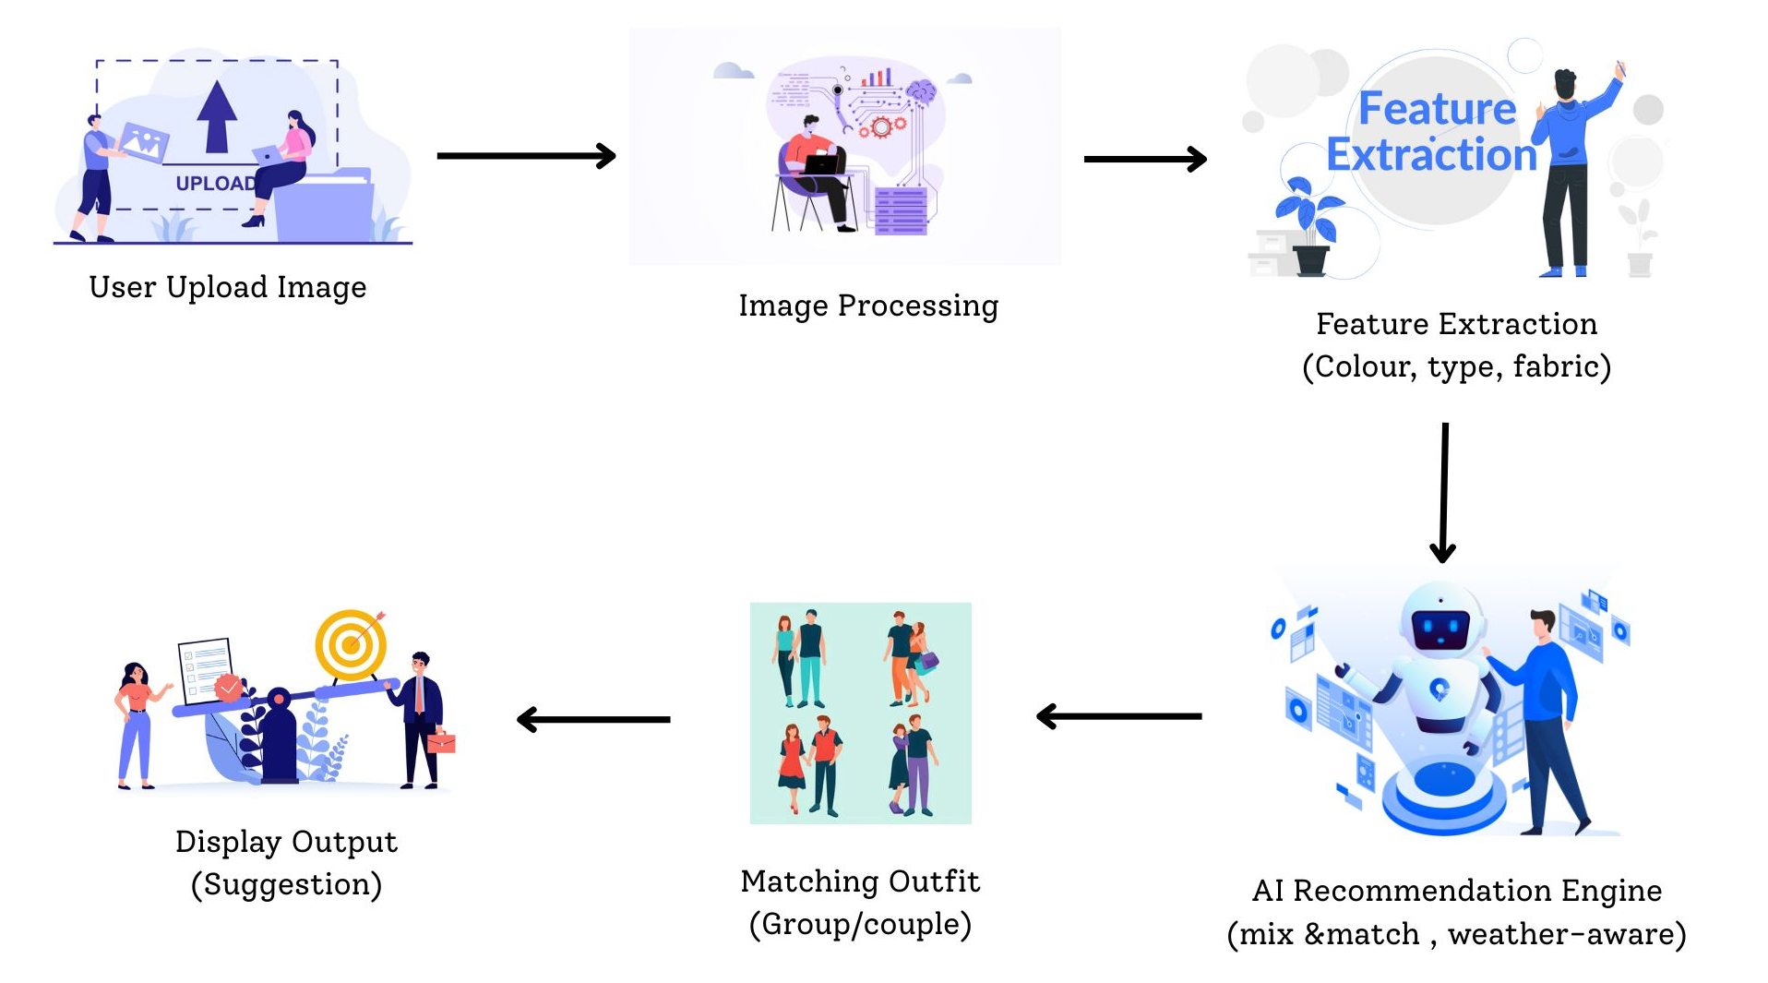
Digital wardrobe
Abirajh A |
25-26J-302

Slide 20
Digital Wardrobe
Prototype Evaluation & User Feedback
More outfit style options and better mobile screen layout.
More Dress type detection
.
Design Excellence / Contribution
Applied responsive UI design for consistent use across desktop and mobile devices.
Integrated real time visual feedback during image upload and analysis.
Optimized system performance for quick and accurate outfit predictions.
Abirajh A |
25-26J-302

Slide 21

IT22208194 | VISHNUYAN.T
Accessory Recommendation & Customization System
Specialization: Information Technology
IT22208194 | T.Vishnuyan | 25-26J-302

Slide 22
Accessory Recommendation & Customization System
Problem Definition / Knowledge Gap
Lack of accessory specific recommendations: Existing systems focus on clothing, neglecting accessories.
No user-driven customization with visuals: Current platforms rarely allow users to design custom accessories or provide visual previews, limiting personalization.
User Requirements addressed by the solution
User wants realistic necklace recommendations, not just text.
User expects neckline-appropriate necklace placement.
User prefers fashion-accurate and visually appealing outputs.
The system generates high-quality images quickly and automatically.
T.VISHNUYAN
25-26J-302

Slide 23
Accessory Recommendation & Customization System
Design Excellence/Contribution
Image Upload & Preprocessing User uploads a dress image, which is resized and prepared for analysis.
Feature Detection Skin tone and neckline are detected using EfficientNet, and dress color is extracted using K-Means.
Prompt Generation Detected features are combined to generate a custom SDXL text prompt.
Necklace Image Generation ComfyUI with the SDXL diffusion model generates a realistic necklace image.
Storage & Output The result is stored using FAISS and displayed to the user.
User Feedback on Prototype
Users found the generated necklace images realistic and visually appealing.
Users preferred image-based recommendations over text suggestions.
Users suggested adding manual customization options (size, length, material).
T.VISHNUYAN
25-26J-302

Slide 24
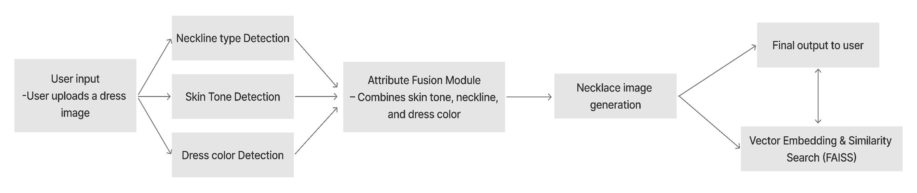
Accessory Recommendation & Customization System
System Diagram
T.VISHNUYAN
25-26J-302

Slide 25
Thank You

