Slide 1
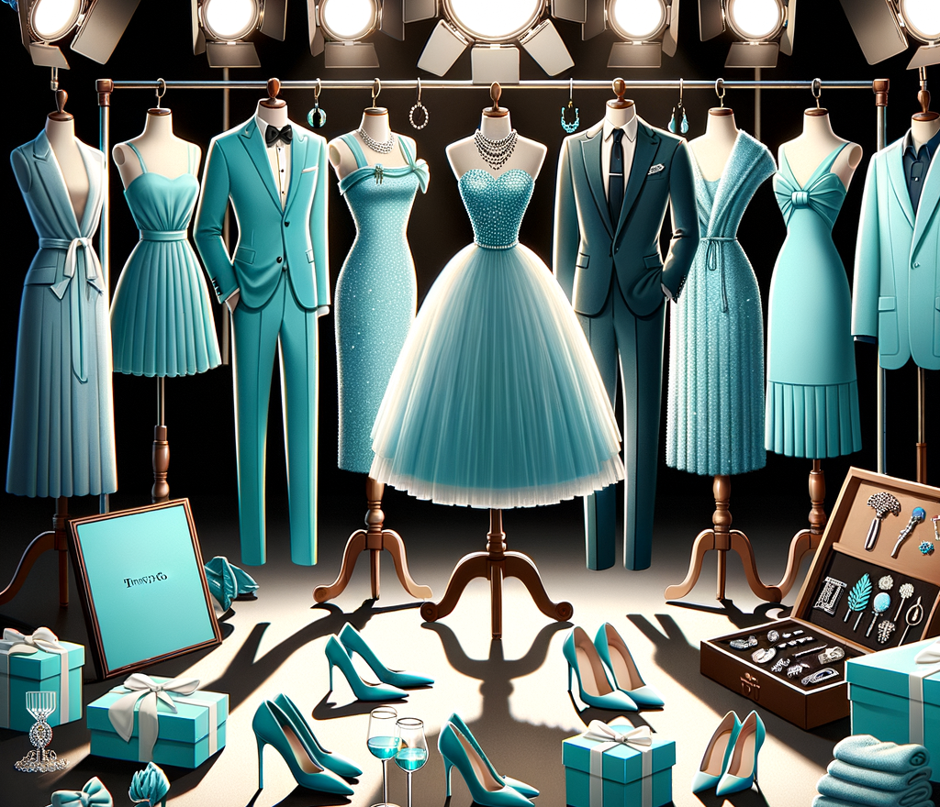
StyleMate AI-Powered Personal Fashion Assistant
Project ID – 25-26J-302

Slide 2

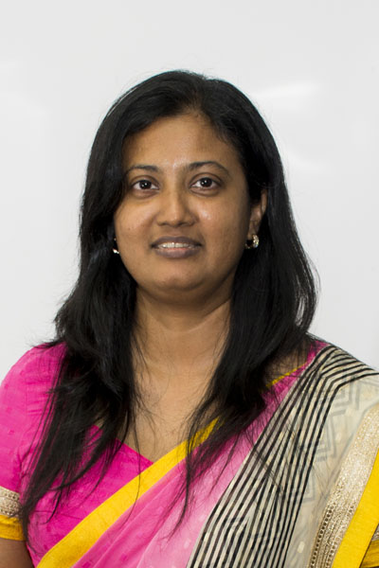
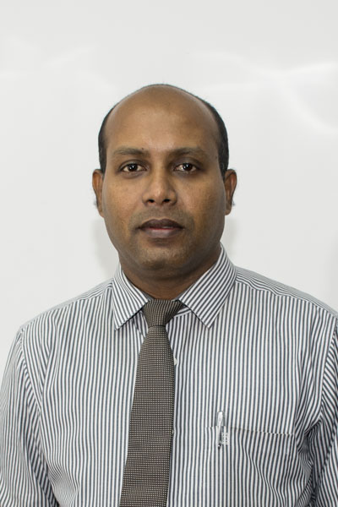

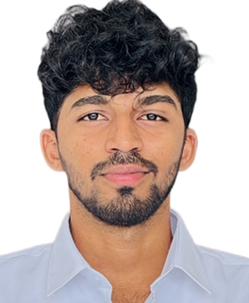
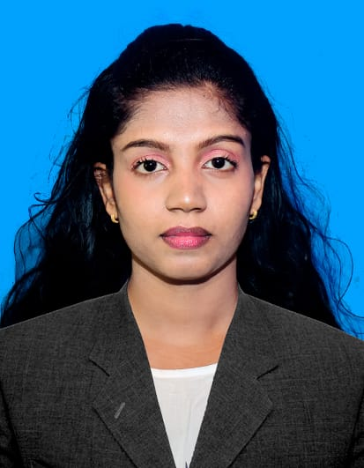

Team
Ms. Anjalie Gamage
Supervisor
Prof. Samantha Rajapaksha
CO-Supervisor
Shangeetha J
Vishnuyan T
Abirajh A
Thivvijavearl T.S

Slide 3






PP2 Feedback Response
Detailed Comments
Actions Taken
Improve accuracy of lower wear suggestions
Improve recommendations based on skin tone and styling
Improve image-based feature detection
Enhanced recommendation model using better dataset labeling and feature extraction across clothing categories.
Integrated skin tone analysis with outfit matching logic for better personalization.
Optimized image processing techniques for better extraction of body features and visual attributes.
Improve output accuracy based on prompts
Suggest accessories (e.g., necklaces) based on outfit
Validate dataset and system outputs
Refined prompt processing logic to correctly distinguish between casual, formal, and other styles.
Added accessory recommendation module aligned with wardrobe and outfit context
Updated the dataset. (Now using Kaggle dataset.)

Slide 4
Problem Statement
Context
Fashion decision-making is a daily challenge for many individuals when selecting suitable clothing for different occasions.
Observed issue
Difficulty selecting outfits that match body shape and skin tone
Lack of guidance for choosing appropriate outfits for events
Difficulty selecting matching accessories
Inefficient wardrobe planning and clothing organization
Why it matters
These issues lead to time-consuming decision making, poor outfit coordination, and inefficient wardrobe usage.

Slide 5
Design Excellence Over Existing Solutions
Combines Computer Vision + AI Recommendation System
Performs:
Body feature detection
Skin tone analysis
Generates:
Upper wear suggestions
Lower wear suggestions
Accessory recommendations
Supports prompt-based outfit generation (casual, formal, etc.)
Integrates wardrobe-aware recommendations
Provides end-to-end personalized styling solution
Focuses on:
Accuracy
Personalization
Real-world usability

Slide 6

IT21188886 Shangeetha J
Body & Skin-Based Fashion Recommendation with Explainable Insights
BSc(Hons) Information Technology Specializing in Information Technology

Slide 7
Body & Skin-Based Fashion Recommendation with Explainable Insights
Brief Description:
Generates outfit recommendations using:
Body shape
Skin tone
Uses Explainable AI (XAI) to provide reasoning behind suggestions.
Key Responsibilities:
Analyze user features (body shape + skin tone).
Recommend suitable outfits (upper & lower).
Provide explanations (e.g., color suitability, fit reasoning).
Key Contributions:
Improved accuracy of outfit recommendations.
Integrated XAI for transparency and user trust.
Enhanced lower wear selection based on visual features.
Technical Challenge:
Extracting accurate skin tone from full-body images caused pixel distortion.
Solution:
Optimized image input handling to maintain feature accuracy.
Focused on improving reliability over single-image constraint.

Slide 8

IT22066848 | ABIRAJH A
Digital wardrobe
B.Sc. (Hons) Degree in Information Technology, Specializing in information Technology​​

Slide 9
Digital Wardrobe
Brief Description:
Stores and manages user’s clothing items digitally
Key Responsibilities:
Upload and categorize wardrobe items
Maintain clothing database
Enable reuse of existing outfits
Contribution:
Supports personalized recommendations
Reduces unnecessary clothing suggestions
Improves real-world usability of the system

Slide 10

IT22208194 | VISHNUYAN.T
Accessory Recommendation & Customization System
B.Sc. (Hons) Degree in Information Technology, Specializing in information Technology​​

Slide 11
Accessory Recommendation & Customization System
Brief Description:
Suggest accessories (e.g., necklaces, jewelry)
Based on outfit neckline and styling context
Key Responsibilities:
Match accessories with outfit type and color
Use wardrobe data for better suggestions
Ensure styling consistency
Contribution:
Completes the overall look
Enhances personalization and user experience

Slide 12

IT22269270 | Thivvijavearl T.S
Event Theme Based Outfit Matching
B.Sc. (Hons) Degree in Information Technology, Specializing in information Technology​​

Slide 13
Event Theme Based Outfit Matching
Brief Description:
Analyzes event decoration images to extract dominant colors and recommend suitable outfits based on event theme and occasion.
Key Responsibilities:
Accept and process event decoration image uploads
Extract dominant colors using computer vision techniques
Apply color theory rules for color matching
Incorporate occasion-based filtering (wedding, party, corporate, etc.)
Generate outfit recommendations for men and women
Contribution:
Introduces environment-aware fashion recommendation
Improves visual compatibility between outfit and event theme
Enhances decision-making for users in real-world events
Bridges computer vision with fashion intelligence

Slide 14
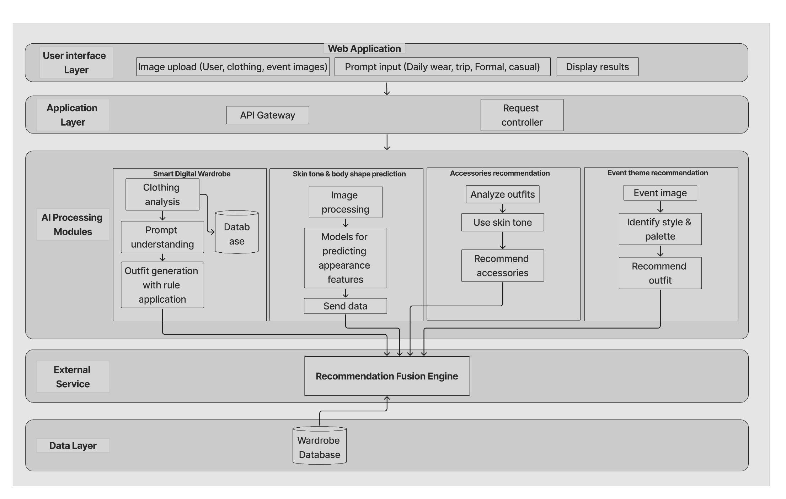
System Architecture & Integration

Slide 15
Q&A

Slide 16
THANK YOU

