Slide 1


Advanced Data Visualization Tool

Slide 2


Team Members
SHANMUGAPRIYA . S
VISHRUDHA . N
SASHITIKA . R

Slide 3

Abstract
The advanced data visualization tool is a software application designed to transform complex datasets into intuitive, interactive visual representations. It aims to empower users—ranging from business analysts to data scientists—to extract actionable insights from their data without needing deep expertise in data science or programming. By integrating real-time data processing, predictive analytics, and customizable visualization options, this tool enhances decision-making processes across various industries. The tool is designed to be user-friendly yet powerful, providing a wide range of features that cater to the diverse needs of modern data-driven organizations.

Slide 4
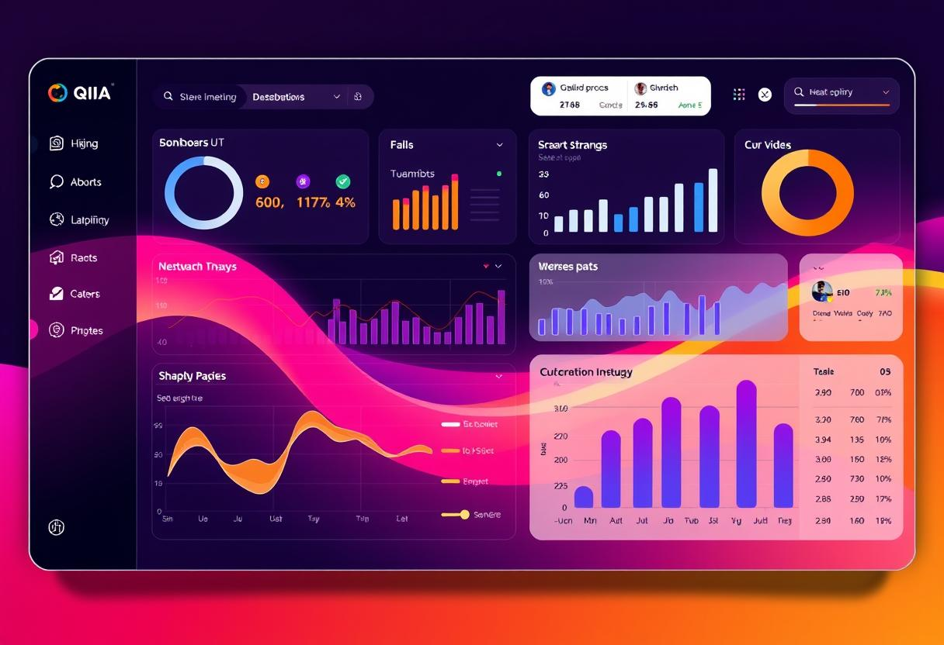
Introduction
Advanced Data Visualization tools are specialized software that transforms complex data into interactive and insightful visual formats. They go beyond basic charts, offering features like 3D visualizations, real-time data updates, and customizable dashboards. These tools help users identify patterns, trends, and insights within large datasets, making them essential in data-driven fields like business intelligence and analytics.
.

Slide 5

Existing Method
1
Limited Visualization Options
2
Difficulty Extracting Insights
Traditional data visualization tools often provide a limited set of chart types, restricting the ability to effectively communicate complex information.
Existing methods can be time-consuming and require significant technical expertise to uncover meaningful insights from data.
3
Siloed Approach
Lack of collaboration and data sharing hinders cross-functional teams from making informed, data-driven decisions.

Slide 6





Proposed Method
Data Integration
Advanced Analytics
Seamlessly connect to a variety of data sources, including databases, spreadsheets, and real-time feeds.
Leverage machine learning and AI-powered algorithms to uncover hidden patterns and insights.
Collaborative Insights
Customizable Visualizations
Empower teams to work together, share insights, and make informed, data-driven decisions.
Create and customize a wide range of interactive data visualizations to effectively communicate complex information.

Slide 7
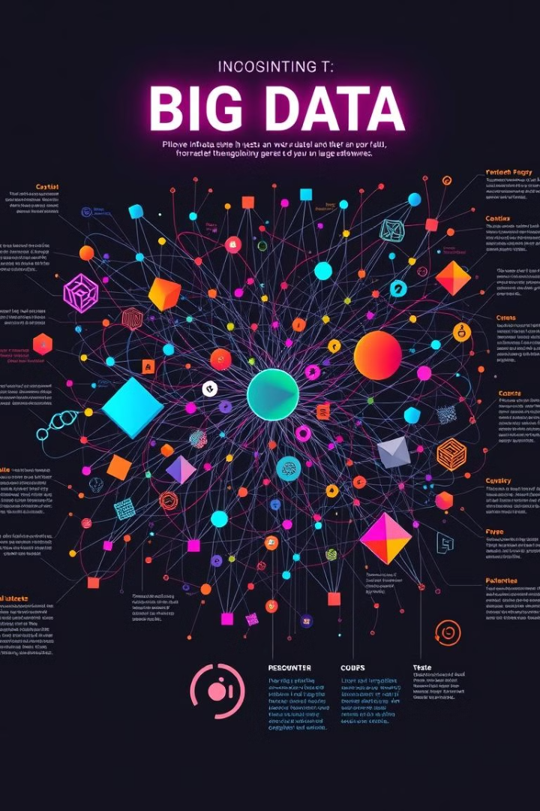



Problem Definition
Overwhelming Complexity
Large and intricate datasets become difficult to understand using basic charts and tables, leading to information overload.
Limited Visualization Capabilities
Existing tools often lack the flexibility and customization options needed to effectively communicate data-driven stories.
Inefficient Communication
Presenting data in simple, non-interactive formats can lead to misinterpretation and poor communication of key findings.

Slide 8

Solution
Comprehensive Data Integration
Powerful Analytics Capabilities
Seamlessly connect to a wide range of data sources, enabling a holistic view of the organization's data ecosystem.
Leverage advanced algorithms and machine learning to uncover hidden insights and patterns within the data.
Intuitive Visualization Builder
Collaborative Workspace
Facilitate real-time collaboration, data sharing, and collective decision-making across teams and departments.
Empower users to create and customize a diverse range of interactive data visualizations with ease.

Slide 9
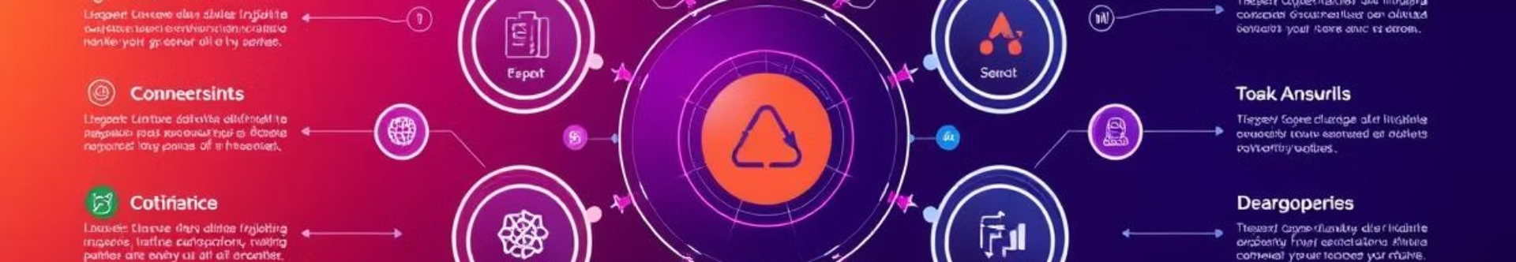
Modules
Data Connector
Seamlessly integrate data from various sources, including databases, spreadsheets, and real-time feeds.
Analytics Engine
Leverage advanced algorithms and machine learning to uncover hidden patterns and insights.
Visualization Builder
Empower users to create and customize a wide range of interactive data visualizations.
Collaboration Hub
Enable real-time collaboration, data sharing, and collective decision-making across teams.

Slide 10

Thank you
We hope this presentation has provided you with a comprehensive understanding of our advanced data visualization tool and its powerful capabilities. Please feel free to reach out if you have any further questions.
Any query ?

