Slide 1

SAMSUNG PRISM
Generative AI
Hackathon
3rd Edition 2026 – 27
Theme ID - 1 (Agentic Code Intelligence)
Team Name - Doomed
College Name - SRMIST Kattankulathur
Member Name & Email 1- Vishrut Goel, vg9532@srmist.edu.in
Member Name & Email 2- Mansi Dabbiru, md3808@srmist.edu.in
Submission Github link - https://github.com/Vishrut-10-Goel/Sam

Slide 2
Theme
Theme 1: Agentic Code Intelligence.
Given a library of code and a natural-language query, rank the code snippets by relevance.
Retrieval only. No answer generation, no explanation of results.
Thousands of snippets, and they keep getting longer. Too much for an LLM context window, and retrieval has to be faster than generation.
Must run on CPU, with minimal GPU use.
Three goals:
  P0: retrieval accuracy, scored on CoIR AppsRetrieval (NDCG@10, MRR)
  P1: retrieval across versions. Rebuild indexes and caches for any change, in reasonable time
  Bonus: evolutionary retrieval. Search every version at once, where near-identical snippets are hard to rank

Slide 3
Existing Solutions & Gaps
IDE and grep search match letters, not meaning. Search "send email" and code called dispatchNotification is invisible.
Pasting the codebase into an LLM: it does not fit in any context window, and LLMs are slow on long text. Retrieval is meant to be the fast first stage.
Generic sentence embeddings are weak on code. We measured all-MiniLM-L6-v2 at NDCG@10 0.066, where the right answer usually was not in the top ten.
Static indexes go stale. A full rebuild of a 654-file repo takes 43 minutes, and redoing that for three edited files is wasted work.
Nothing searches history. "Which release introduced this?" has no answer.
A stale index fails silently and returns line numbers that have since moved.

Slide 4
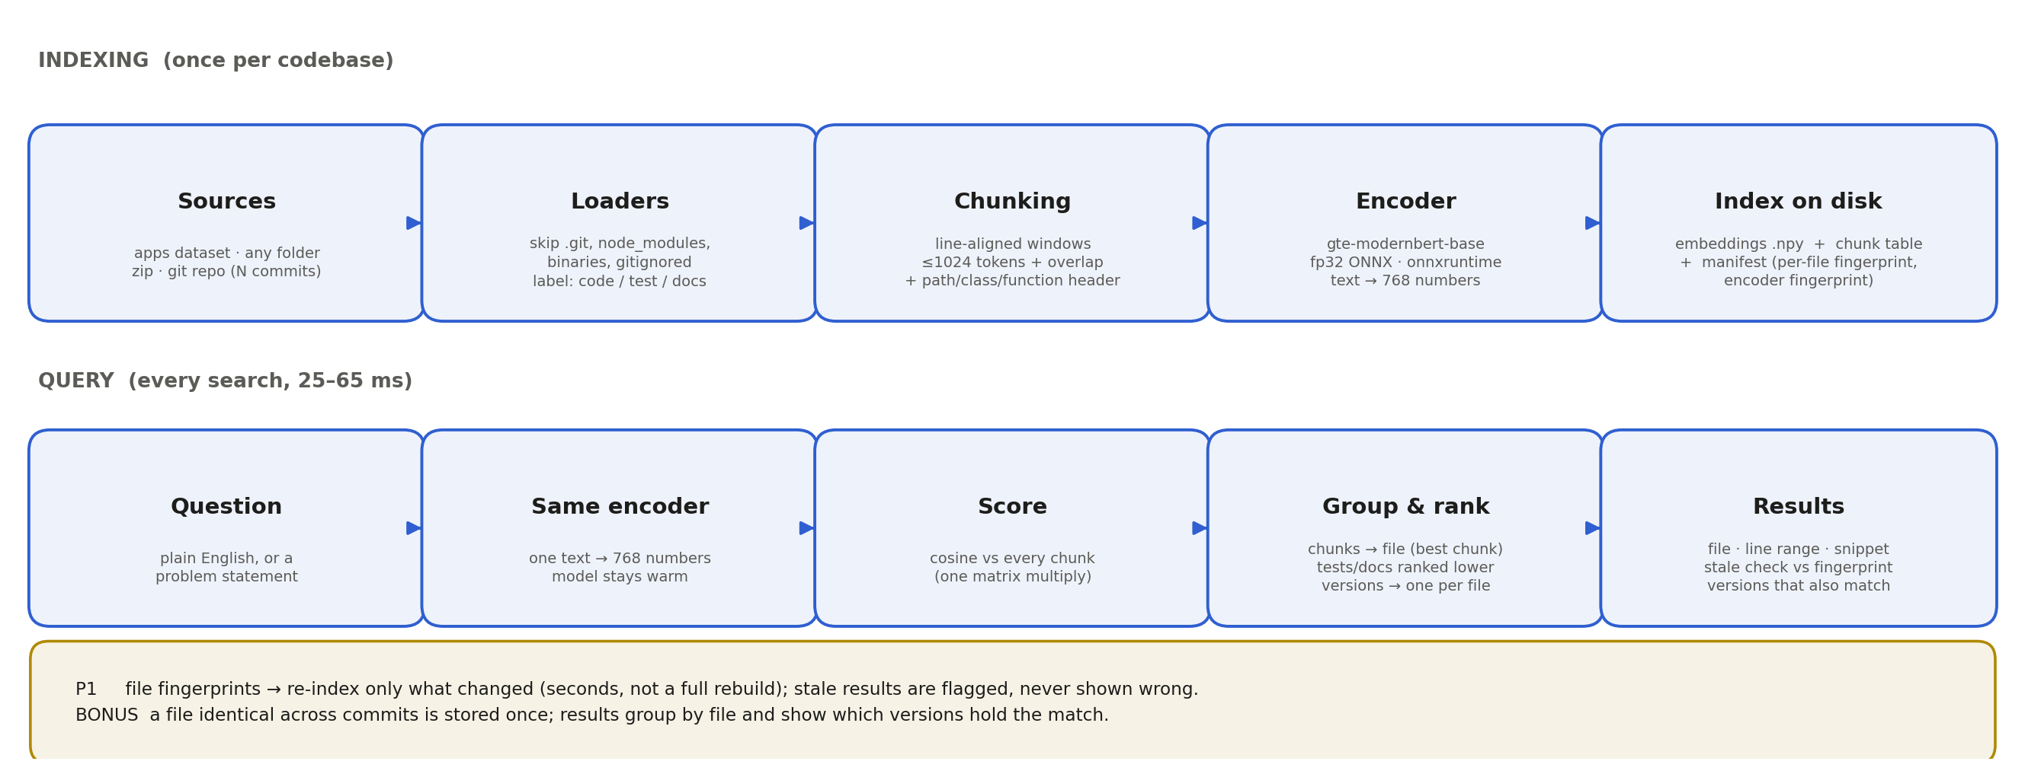
Our Solutions & Architecture Diagram
Lodestone. Two stages: indexing is slow and runs once, querying is milliseconds and runs constantly.

Slide 5
Demo & Product Walkthrough
Everything runs in one browser page. No terminal. The server keeps the model loaded and searches return in 25-65 ms.
Index any source: a folder on disk, a zip upload, or N commits of a git repository.
P0: paste a programming problem against the 8,765-solution benchmark corpus and the correct solution comes back first.
Generality: the same engine on the requests library, 120 files. "how do I configure retries" returns adapters.py, with the snippet opening on max_retries.
P1: edit a file and the result is flagged stale instead of shown wrong. One click re-indexes only the file that changed.
Bonus: six releases of requests in one index. Each result is one file and shows which versions hold the matching code.
Demo video: https://drive.google.com/file/d/1Q7Fo2h1sU-zAU98qJM5UCKXENwmgg-t8/view?usp=sharing

Slide 6
Tools and tech stack used
Model: Alibaba-NLP/gte-modernbert-base, 768 dimensions, CLS pooling. Chosen after measuring three candidates.
Runtime: fp32 ONNX through onnxruntime, CPU only. 78 minutes against 97 for PyTorch on a full pass, with identical accuracy.
Maths: NumPy. Cosine similarity over normalised vectors is one matrix multiply.
Chunking: line-aligned windows under 1,024 tokens with a path, class and function header. Optional AST chunking for Python.
Storage: .npy embedding matrix, JSONL chunk table, JSON manifest. Atomic writes, checksummed. No database.
Web: FastAPI with plain HTML, CSS and JavaScript. No framework, no build step.
Evaluation: MTEB 2.21.8, as the problem statement specifies. Metrics also reimplemented and checked against pytrec_eval.
Packaging: Docker, plus GitHub Actions that builds and runs the system on every push.

Slide 7
Impact & Use case
Onboarding: find the code that does X without knowing what it is called.
Bug fixing and feature work: go straight to the right block instead of reading directory trees.
First stage of a RAG pipeline. Hands an LLM only the snippets it needs, which is the role the problem statement describes.
Code archaeology: which release introduced this behaviour. The versioned index answers it directly.
CPU only, so a laptop or a cheap VM is enough. No GPU budget, no external API, nothing leaves the machine.
Indexing cost grows with the codebase. Query cost does not: 8,765 documents still answer in milliseconds.

Slide 8
Innovation highlights, results and limitations
Results on CoIR AppsRetrieval, 3,765 queries against 8,765 solutions, CPU only:
  NDCG@10 0.57545, MRR@10 0.52798, Recall@10 0.727, against a baseline of 0.0660 and 0.0558
  Our own pipeline reproduces the MTEB score exactly, so it can be checked rather than taken on trust
What worked:
  Context headers. Every chunk carries its file path and enclosing class or function, so a file named depth.py holds the concept even when the code never says it
  File-kind ranking. Docs and tests are prose, like questions, so they outranked real implementations. Down-weighting them moved top-1 from 5/10 to 8/10
  Fingerprints. The index knows when it is out of date and says so
Limitations:
  0.575 is an AppsRetrieval number and does not transfer unchanged to other codebases
  8/10 is optimistic. The penalty was chosen after seeing those ten questions, and ten is a small sample
  A first index of a large repo is slow: 43 minutes for 654 files. Re-indexing a change is seconds

Slide 9
What’s next
Hybrid retrieval. Blend BM25 keyword scores with embedding scores. Embeddings are weak on exact terms like gzip or timeout, so this is the cheapest win left.
Query preprocessing. Expand the question before searching. "Too many links deep" never meets "depth"; rephrased by hand, the right file goes from rank 126 to rank 3.
tree-sitter, so AST chunking works beyond Python.
Faster first index. The main weakness now. Smaller structure-aware chunks and parallel embedding should cut the 43 minutes.
More labelled questions. Ten per repository catches large effects, not small ones.

Slide 10
Brownie points slide( differentiation)
Three improvements were built, measured and rejected: cross-encoder re-ranking (0.621 against a 0.674 baseline), pseudo-relevance feedback (0.57536 against 0.57545) and AST chunking (a tie). Reports and raw numbers are in the repo.
For every real-codebase test the correct answers were written down and committed before any search ran, so grading could not drift generous.
Tests caught three bugs that would have produced wrong results with no error: fp16 weights loading on CPU, MTEB's whitespace handling (3,687 of 8,765 documents differed) and line-ending conversion breaking an index checksum.
GitHub Actions builds the Docker image and runs the whole system offline on every push, evaluation included.
The brief assumed multi-pass retrieval would be needed. We tested it, measured that it hurt on this task, and wrote down why.
P0, P1 and the bonus are all delivered, each with a report and raw data in the repo.

Slide 11
Checklist- Updated on Public GitHub
Working prototype code — public or shared GitHub repo (Y/N): Y, github.com/Vishrut-10-Goel/Sam
README with reproducible setup instructions (Y/N): Y
Demo video, max 5 minutes (YouTube or Drive link): https://drive.google.com/file/d/1Q7Fo2h1sU-zAU98qJM5UCKXENwmgg-t8/view?usp=sharing
Presentation file (PPT or PDF) (Y/N): Y

Slide 12
Thank you
Organised by the Language AI Team and the PRISM Team, Samsung R&D Institute India
Notes:
Closing slide. Add the Google Form URL and a contact email before sharing. Edition 2 organising team for reference: Language AI - Sourabh Tiwari, Gaurav, Sanjeeth Pothireddy, Gorang Maniar; PRISM - Binny Lakra, Prakhar Chandrakar, Vishu Kumar; Kick-off and mentors - Giridhar Jakki, Deepraj Prabhakar Patkar (Language AI), Srimanu Prasad Nagaraju, Ashish Kumar (Tech Strategy).

