Slide 1
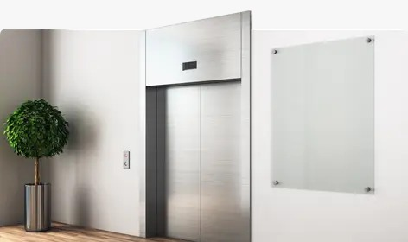
Elevator
System Simulation

Slide 2
Team members
Priyanka Bhati (2213102)
Rashika N (2213104)
Sachin Yadav (2213105)
Vishawjeet Jyoti (2213103)

Slide 3
The Elevator Problem
To Simulate the working of an Elevator in C++ programming language using the Object oriented approach.
Output:
Simulation helps us in identifying the working behaviour of a system before actually deploying it, so that required changes (if any) can be applied to the system before the deployment.

Slide 4
Working of an Elevator:
Listen for the calls.
Reach to a destination floor.
Take the input from Rider and follow a sequence for
reaching the floors.
Should take intermediate requests in the same direction.
Should not allow more people than the capacity.
Should not go out of bound of the number of floors.
Open the door only when the Elevator has stopped.
Close the door before departing.

Slide 5
Main Components:
Rider: The caller of the elevator at a floor. Guides the elevator to reach a destination. Basically acts like a controller of elevator’s next movement.
Building: The main block which contains everything, i.e. the Elevator, floors, and the riders. Responsible for the smooth functioning of the elevator. Hence, can be thought of as the central controller of all the elevators.
Elevator: The elevator itself. Contains riders in it and moves up and down the floors accordingly.
Floor: The floors of the building are also important as it contains information regarding the number of people waiting for the elevator.

Slide 6
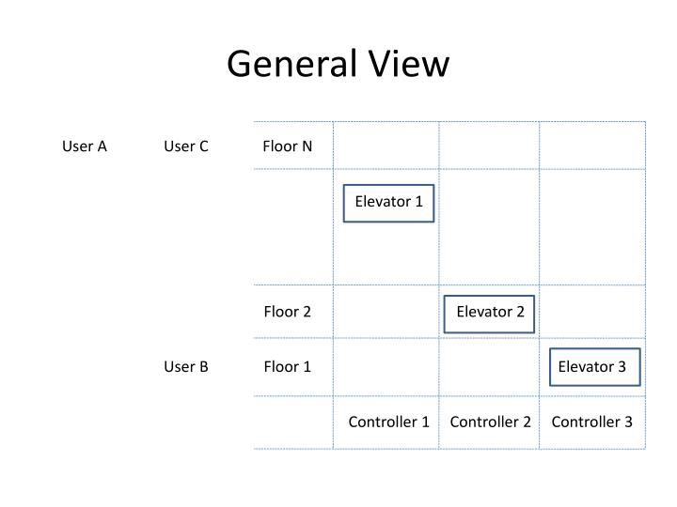

Slide 7
Component View
The Object of Building class will call the step() function every second and pass the number of arrivals of riders in that second.
The step() method is responsible for assigning the To- and From- floors to each of the passed riders randomly by calling the getDifferentFloors() method, which takes three arguments, the first one is the maximum number of floors in the building, and the second and third arguments are passed by reference and stores the To- and From- floors. The step() method is also the controller method of the elevators and controls how the elevators move.

Slide 8
Floor has :
Name
Location of the floor
Vector for up riders
Vector for down riders
The removeUpRiders() and the removeDownRiders() functions takes an integer value which tells the space which is available inside the elevator to hold enough number of riders, and then removes that many riders from the rider list of that floor, signifying that those riders have entered the elevator and are not waiting any longer.

Slide 9
Functions of the Floor class:
getLocation(): Will return the location of “this” floor.
hasRidersWaiting():Will return true or false based on whether there are riders waiting on that floor or not.
hasUpRiders(): Will return true if there are riders who are wanting to go to the upper floor.
hasDownRiders(): Will return true if there are riders who wants to go to the lower floors.
getUpRidersCount(): Will return the number of riders in upRiders vector.
getDownRidersCount(): Will return the number of riders in downRiders vector.
ifPreferredDirectionUp(): Returns true if:
All the riders at a floor are upRiders. (or)
The rider with lowest Id is a up-rider.
Otherwise returns false.

Slide 10
Functions of the Floor class:
addNewRider(): Takes a reference of a rider object and adds it to the upRider or the downRider vector depending on the floor that it wants to go.
removeUpRider(): Removes up rider from the floor, indicating that they have entered the elevator. It returns the deleted riders to the calling function, where those riders can be added into the elevator using the add rider method of the elevator class.
removeDownRider(): Same as above, except that it removes the Down riders.

Slide 11
Rider contains:
RiderID
A pointer to a floor where the rider wants to go.
A method getDestination() is defined in the rider class which returns the reference of a Floor object which contains the information regarding the destination of the rider. This function is used to set the destination of the elevator in the step() function.

Slide 12
Elevator class:
The Elevator class contains:
Direction of the elevator:
IDLE=0
UP=1
DOWN=2
Capacity: Number of people that the elevator can handle at a time.
Speed: Speed of the elevator in inches per second.
Pointer of Floor type: The pointer toFloor points to the next destination of the Elevator.
Location: The current location of the elevator in inches from the ground floor.
Status of Door: Whether a door is open or not. It takes one second for a door to open and one for it to close.
Elevator moves when it has riders.

Slide 13
Functions of the Elevator class:
hasRiders(): Returns true if there are riders in the elevator.
getRiderCount(): Returns the count of the riders.
getCapacity(): Returns the total capacity that it can handle.
getAvailableSpace(): returns the availabale space in the elevator.
moveUP(): Moves the elevator to the up direction.
moveDown(): Moves the elevator to the down direction.
setDestination(): Is used to set the destination of the elevator, it takes a constant pointer to a floor which is the destination floor.
getDestination(): It returns the destination of the elevator. It returns a reference of a floor object which can then call the functions defined on it for getting the Floor name.
hasADestination(): returns true if toFloor is not equal to 0.
removeRidersforDestinationFloor(): This method removes the riders which has arrived at their destination floor. It returns a vector of Rider which contains the Riders who have exited the elevator at a floor.
addRiders(): This function adds the riders to the elevator, it takes a vector of riders by reference.

Slide 14
Functions of the Elevator class:
setDestinationBasedonRiders(): This method is used to set the next destination of the elevator. It loops over all the riders that are present in the Elevator and finds the rider with the closest destination floor and then sets the destination of the elevator to that floor.
isNearDestination(): Since the elevator also has a speed factor, hence we are checking if the elevator is near to it’s destination. If it is near to it’s destination then we will call the method movetoDestinationFloor().
moveToDestinationFloor(): It sets the location of the elevator to the floor pointed by toFloor pointer.

Slide 15
Building class:
The Elevator class contains:
Time
Vector of Floors: To store the information regarding the floors of the building.
Vector of elevators: To store the information regarding the elevators of the building and operating them.

Slide 16
Functions of the Building class:
Step(): It takes integer value which is the number of riders that have arrived at the current second and then sets their origin and destination floor by calling the getDifferentFloors() method. It also loops over the elevators to check their state, i.e. if the elevator’s door is open or closed. If the door is opened, it means that elevator has arrived at some floor, and it will check if the number of riders is more than 0 or not, if it’s 0, then it will set the state of the Elevator as Idle, otherwise it will close the door.
getFloorCount(): Returns the count of the floors.
getElevatorCount(): returns the count of the elevators.

Slide 17
Simulation:
We are running the simulation for a total of 600 seconds, with a break after each 20 second.
For the simulation part, we generate the number of arrivals for each second and pass it as a parameter to the step function of the building object. After which it is handled by the step() function.
OUTPUT:
Simulation of Elevator system.

Slide 18
Thank You!

