Slide 1
Group : Cluster 555
Course Name: CSE 623 Machine Learning
Identify abnormal driving behavior using spatio-temporal analysis
[UAV videos]
AU2240041 Sarthak Siddhpura
AU2240177 Ritu Patel
AU2240182 Vishv Boda
AU2240183 Moin Vinchhi
AU2240239 Vrunda Patel

Slide 2
Problem Statement
There is an assumption that drivers behave similarly in the same patch of road, but it is not necessary that all drivers follow similar behavior.
In this project, students will identify abnormal driving behavior. You can use trajectories dataset and then develop a binary classifier which classifies a given trajectory into a “normal” or “abnormal” behavior based on spatial and temporal features.

Slide 3
Literature Survey
Paper Title | Authors | Algorithm and Methodology Used | Key Contribution
Vision-based investigation of road traffic and violations at urban roundabout in India using UAV video | Yagnik M Bhavsar et al. | Zone-based detection with image processing and rule-based classification | Used UAV video to analyze traffic violations at roundabouts, focusing on zone-based detection.
Driver Profile and Driving Pattern Recognition for Road Safety Assessment | Dimitrios I. Tselentis and Eleonora Papadimitriou | Statistical analysis and clustering (e.g., k-Means, hierarchical clustering) | Developed methods to recognize driving patterns for safety, using trajectory analysis.
Driving Style Classification using Deep Temporal Clustering with Enhanced Explainability | Yuxiang Feng et al. | Deep learning-based temporal clustering with convolutional neural networks (CNNs) and explainability techniques | Employed deep temporal clustering to classify driving styles with explainable features.
Traffic Pattern Modeling, Trajectory Classification and Vehicle Tracking within Urban Intersections | Cheng-En Wu et al. | Spatial-temporal modeling with Kalman filtering and pattern recognition techniques | Modeled traffic patterns and classified trajectories at intersections using spatial data.
Trajectory Data Classification: A Review | Jiang Bian et al. | Review of algorithms (e.g., k-Nearest Neighbors, Support Vector Machines, clustering methods) | Comprehensive review of trajectory classification methods and feature extraction techniques.

Slide 4
Dataset Discussion(1/2)
Dataset folders:
Sptio-temporal-dataset
contains the source data with a file showing all trajectories of vehicles in each subfolders - namely 10, 11, 12
Processed:
the processed dataset contains the split dataset based on the abnormalities provided as per the respective files
each subfolder (10, 11, 12) contains the following:
process_list - contains the comma separated list of all trajectory files which are listed to be abnormal
abnormal - containing csv files of all abnormal trajectories
normal - containing csv files of all normal trajectories
we further interpolated this data and discarded those files which were having less than 30 frames (30 fps video source)
thus we have an interpolated directory which contains the interpolated normal and abnormal trajectories for each 10, 11 and 12 directories
and the discarded directory which contains discarded normal and abnormal trajectories for the same.

Slide 5
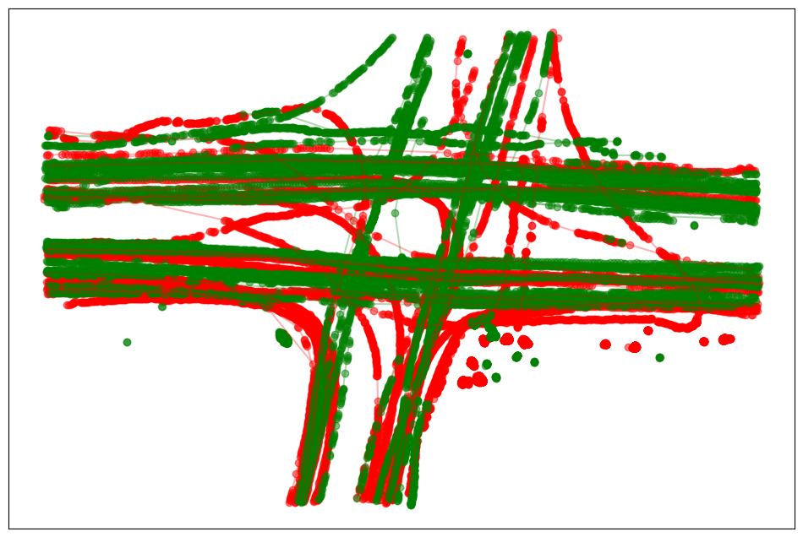
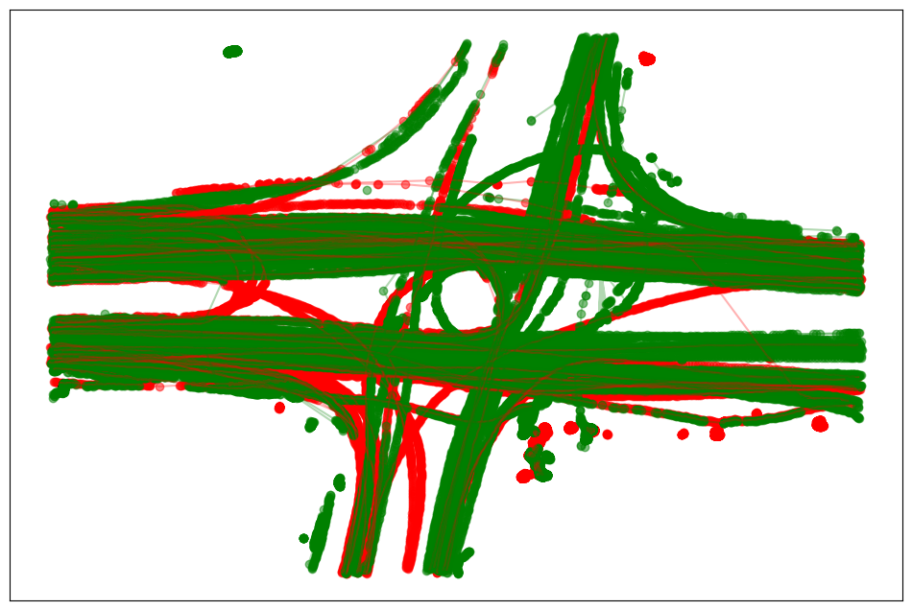
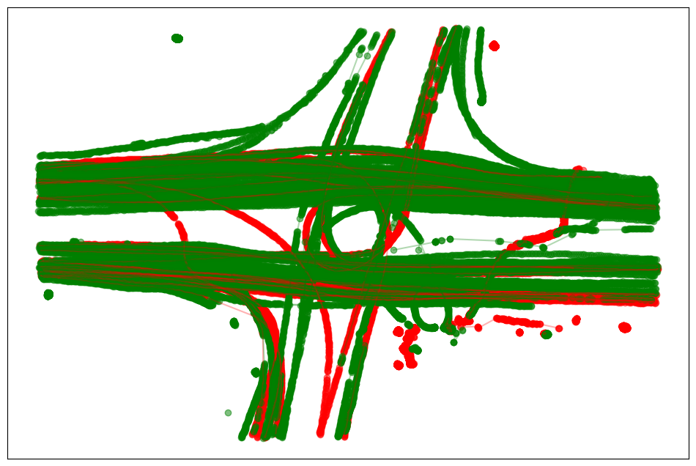
Dataset Discussion(2/2)
The dataset includes 375 normal trajectories and 185 abnormal trajectories, reflecting a 2:1 class imbalance.
Directory 10: 54 normal, 47 abnormal trajectories.
Directory 11: 168 normal, 80 abnormal trajectories.
Directory 12: 153 normal, 58 abnormal trajectories.

Slide 6
Our Approach & Features (1/2)
Feature Extraction
Derive features like central_island_violation (ratio of points in zone 16)
forbidden_transitions (count of invalid zone transitions)
wrong_way_movement (score of counterclockwise violations)
u_turn_violation (pattern matching for U-turns)
curvature_adherence (angle consistency)
circulation_completion (total angle change)
path_efficiency (straight-line to total distance ratio)
and directional_variance (variation in movement direction).
Refine Feature Derivation:
Adjust zone thresholds (e.g., central island to 0.3 * radius) and add features like lane_indiscipline to capture lane misuse.

Slide 7
Our Approach & Features (2/2)
Trajectory Preprocessing
Convert raw CSV data into a list of points using df_to_points, calculating the center of each vehicle’s bounding box (x_center = left + w/2, y_center = top + h/2).
Path Efficiency
Based on the the types of path which a vehicle can take, we can calculate the path efficiency for each type of path and classify based on it whether it is a normal or abnormal trajectory.
Zone and Lane Assignment
Assign zones, directions, and lanes to each point using assign_zone_and_lane, based on distance and angle from the center, defining 36 zones including the central island (zone 16).

Slide 8
Your Approach & Future Work
Enhance Geometry Estimation:
Improve derive_roundabout_geometry by tuning DBSCAN parameters (e.g., eps, min_samples) for better outlier removal.
Future Steps:
We plan to use DBSCAN and RandomForest as our classifiers to process these derived features, focusing on handling class imbalance and ensuring feature robustness before proceeding to model training and evaluation.

Slide 9
References
Yagnik, M., Bhavsar, et al. (2023). Vision-based investigation of road traffic and violations at urban roundabouts in India using UAV video.
Dimitrios, I., Tselentis, & Eleonora Papadimitriou. (2023). Driver Profile and Driving Pattern Recognition for Road Safety Assessment.
Yuxiang Feng, et al. (n.d.). Driving Style Classification using Deep Temporal Clustering with Enhanced Explainability.
Cheng-En Wu, et al. (n.d.). Traffic Pattern Modeling, Trajectory Classification and Vehicle Tracking within Urban Intersections.
Jiang Bian, et al. (n.d.). Trajectory Data Classification: A Review.

Slide 10
Thank you

