Slide 1
CUSTOMER RELATIONSHIP MANAGEMENT SYSTEM

Slide 2
LIST OF CONTENTS
01
Problem statement
02
Proposed Solution
03
Modules
04
Flow diagram
05
Work done till now
06
Future work
07
Conclusion

Slide 3

CRMS?
Customer Relationship Management System

Slide 4
Welcome!!
What is CRMS?
Customer Relationship Management refers to the study of needs and expectations of a customer and provide them with the right solution.

Slide 5
PROBLEM STATEMENT
Problems that are faced by the company as well as customer.
High Manpower needed
01
Service center management
It is a small scale industry. It has low manpower. Registering a small complain manually it needs a lot of manpower.
04
Customer faces a lot of problems while finding a nearby service center. As it becomes a huge task for him/her to find and service their product.
Lots of headache
Difficult as well as time consuming
02
Customer as well as Company facing a lot of problems at the time of complain and after sales service. So it is big headache for both.
05
Right from purchase to complain or any further details the customer has to constantly visit the company or to be in contact with the company members.
Lacking of after sales services
Everything is done manually
03
The existing system has focused on many things but still not much importance is given to the complain after selling of the product due to which customer relationship is not maintained.
06
Product registration, purchasing, complain, after sales services etc. Everything is entered manually which requires time as well as manpower.

Slide 6
Proposed Solutions
We hereby provide the solutions of all the mentioned problems.
Easiness and requires low manpower
Simple and easy to use
Everything is online so it becomes easy for customer to view and check anything at anytime. On the other hand company needs least amount of staff.
After sales services are maintained
We are designing this system to purely maintain the relationship between the industry and customer and it could only be possible by providing best after sales services .
After sales services are maintained
Proper complain management
We are providing all the details regarding the complain and service centers.
Easiness and requires low manpower
Proper complain management
Simple and Easy to use
We make our system user friendly, very easy graphics are provided due to which it becomes handy and easy to operate.

Slide 7
MODULES
A module is a software component or part of a program that contains one or more routines.
CUSTOMER
ADMIN
STAFF
CUSTOMER
ADMIN
STAFF
A person of a specific kind with whom one has to deal.
The administration of a business, organization, etc.
All the people employed by a particular organization.

Slide 8
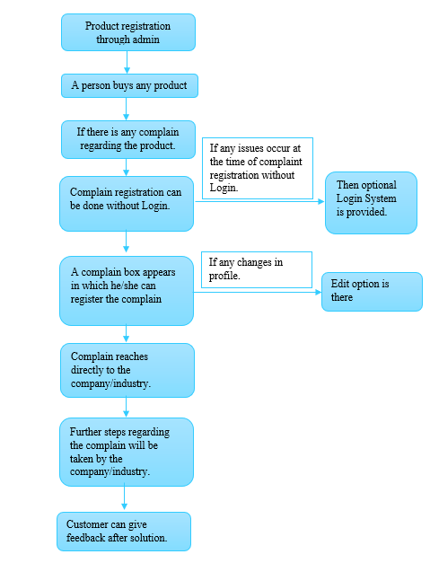
FLOW DIAGRAM

Slide 9
WORK DONE TILL DATE
A
C
D
E
B
A
Problem statement and Language is selected.
Problems are discussed in our group and the challenges are shot-listed, which are being facing in the current system.
B
C
Solution of the challenges has been found.
D
Work has been distributed individually and everyone started to indulged in it accordingly.
E
Planning, plotting, report, etc. are being discussed

Slide 10
IN OUR MIND
Future ideas that we are going to implement.!!
Another option will be provided for complain registration.
We’ll try our level best to maintain the relationship between the customer and company.
Security will be maintained.
The details regarding all the products he/she bought will be displayed online.
All the service center details will be displayed.

Slide 11
CONCLUSION
Our system will provide everything online so it will be easier for customer to view and check anything at anytime.
Using our system least manpower is required.
We are designing a system which will purely maintain the relationship between the industry and customer.
Using our system best after sales services will be provided to all the customers.
We are providing all the details regarding the complain and service centers.
We make our system user friendly, very easy graphics are provided due to which it becomes handy and easy to operate.

Slide 12
Thank you
For having us

