Slide 1



Aurevia Smart Onboarding Platform
A Proposal for Intelligent Banking. Better Experiences.

Slide 2

The Key Takeaway
The Problem
The Solution
Fragmented systems slow onboarding—and 70% of customers say onboarding shapes whether they stay with a bank.
An AI-enabled Smart Onboarding Platform—built alongside existing systems, no replacement required.
The Outcome
Faster onboarding, stronger compliance, and customers who stay.

Slide 3

Why Speed Matters Now
Every day a new applicant waits is a day a competitor wins that customer. The modern banking customer expects speed—but regulators demand rigor. Aurevia needs both.
Competitive Pressure
Regulatory Reality
Slower onboarding directly feeds competitor acquisition.
KYC and AML controls are non-negotiable—but unnecessary friction is.

Slide 4
Three Bottlenecks Blocking Growth
Fragmented Systems
Manual Document Checks
Sequential Compliance
Banking, CRM, KYC, and compliance platforms don't communicate. Staff re-key the same data multiple times, creating delays and error risk at every handoff.
Employees spend hours on repetitive verification. Customers are asked for the same documents twice—eroding trust before the relationship has even begun.
Low-risk applications wait behind high-risk ones in the same queue. Every applicant pays the price for the complexity of a few.

Slide 5



How We Analyzed Aurevia's Onboarding
Our rigorous analysis combined multiple data points and stakeholder perspectives to identify the core challenges within Aurevia's current onboarding process.
Research & Discovery
Pattern Identification
Root Cause Analysis
We thoroughly reviewed existing workflows, system architecture, customer feedback, compliance requirements, and conducted in-depth staff interviews.
Clear patterns emerged, highlighting widespread data re-entry across systems, persistent manual verification delays, and inefficiencies in queue management.
These aren't merely symptoms; they are fundamental issues directly impacting customer experience, compliance accuracy, and operational efficiency.

Slide 6
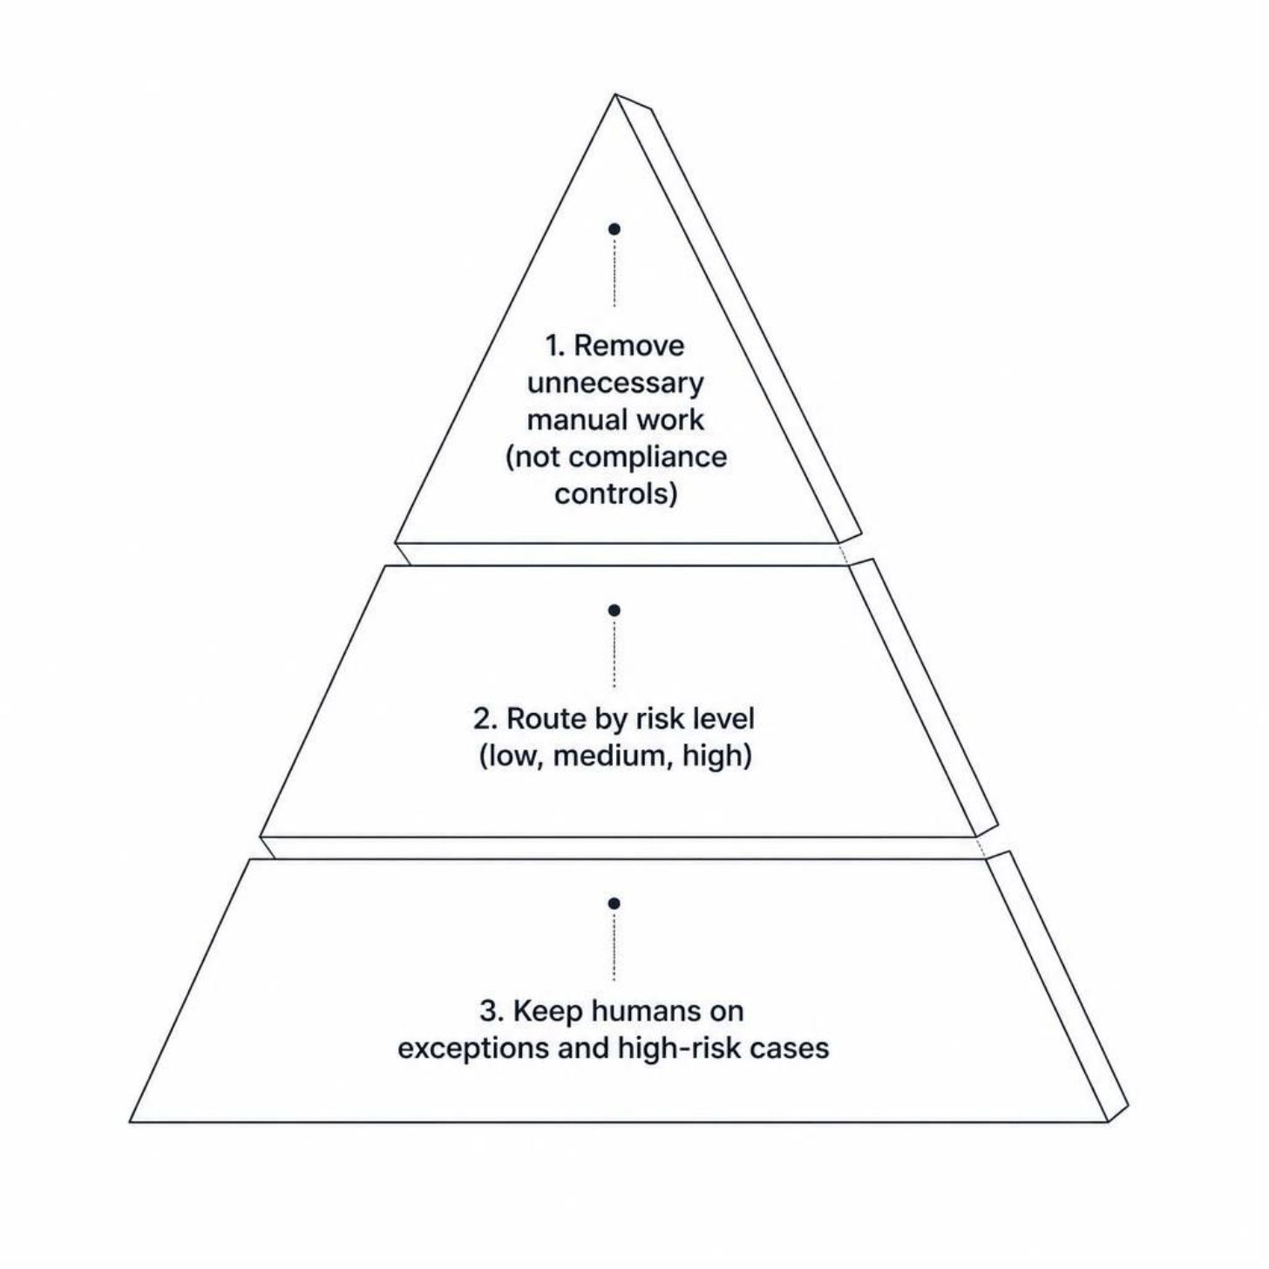
The Real Challenge: Precision, Not Just Speed
The goal is not to cut corners—it is to cut the right steps. Aurevia's competitive advantage lies in removing unnecessary manual work without weakening compliance controls.
Route applications intelligently based on actual risk level—not arbitrary queue position
Keep Aurevia's people where their judgment matters most: exceptions and high-risk cases
Eliminate friction that adds no compliance value

Slide 7




Our Recommended Approach
No Rip-and-Replace
Platform runs alongside Aurevia's legacy core banking system—original channel stays live throughout.
API & Middleware Layer
Connects AI tools to existing CRM, KYC, and compliance systems without rebuilding infrastructure.
Human-in-the-Loop
AI handles routine work; Aurevia's people stay in control of exceptions and every high-risk decision.

Slide 8

How It Works: Four Core Components
Document & Customer
Legacy Integration
Identity & Compliance
Risk-Based Routing
Each component is additive—layered onto Aurevia's existing infrastructure, not replacing it. The core banking system remains the system of record throughout.

Slide 9
Why This Approach Wins
1
Faster to Deploy
Months, not years. No need to rebuild core systems or retrain every workflow from scratch.
Three distinct advantages over a full system rebuild—faster, safer, and compliance-preserving from day one.
2
Lower Risk
Aurevia's original onboarding channel stays live as a safety net throughout the entire rollout.
3
Compliance Intact
Existing KYC and AML investments are protected. Controls are strengthened, not weakened.

Slide 10
Phased Rollout: Test → Measure → Learn → Scale
Phase 1 — Months 1–3
1
Validate & Lead. Establish governance and security. Run a controlled pilot with a small group of staff and customers to prove the model before scaling.
2
Phase 2 — Months 4–6
Frontline Adoption. Roll out to all customer-facing staff. Use live analytics to identify friction points and iterate rapidly before broader expansion.
Phase 3 — Month 7+
3
Scale & Embed. Full expansion once pilot results confirm targets for customer satisfaction, compliance accuracy, and system reliability are met.

Slide 11

Success Looks Like This
Customer Experience
Compliance & Risk
Faster onboarding time. Measurably lower application drop-off rate. Customers who arrive—and stay.
Higher verification accuracy. Stronger fraud detection. Audit trails that give regulators confidence.
Operations
Reduced manual workload for staff. Faster adoption through targeted, role-based training from day one.

Slide 12
Managing Key Risks
Our intelligent onboarding platform is designed with robust safeguards to address potential challenges across data quality, integration, adoption, and compliance.
Data Quality
Integration Failures
Validation checks and fallback procedures ensure accuracy, countering the "garbage in = garbage out" principle with built-in safeguards.
A phased approach with the original channel as a safety net means that if something breaks, Aurevia keeps operating without interruption.
Staff Resistance
False Positives
Role-based training, starting with senior managers who set the tone, ensures change management is built in from day one for smooth adoption.
Threshold tuning and human review prevent over-flagging, embodying the principle that AI flags, but humans decide—compliance stays in control.

Slide 13
Next Steps: From Proposal to Pilot
01
02
Secure leadership approval and confirm data-sharing agreements
Set pilot baselines for onboarding time, drop-off rate, and compliance accuracy
03
04
Launch Phase 1: Validate & Lead
Measure results, learn from pilot, improve, then scale

Slide 14
Thank You
Let’s make Aurevia onboarding faster — without ever compromising trust.
AI Consulting Micro-Internship — Final Proposal Deck

