Slide 1
ECOMMERCE
ANALYSIS

Slide 2
BASIC PROBLEMS
Objective:
Generate strategic and customer-centric insight
PAGE FOUR

Slide 3
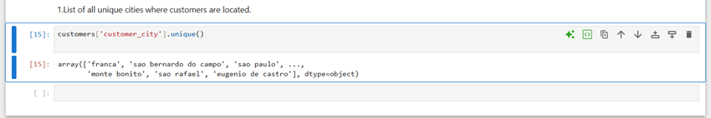
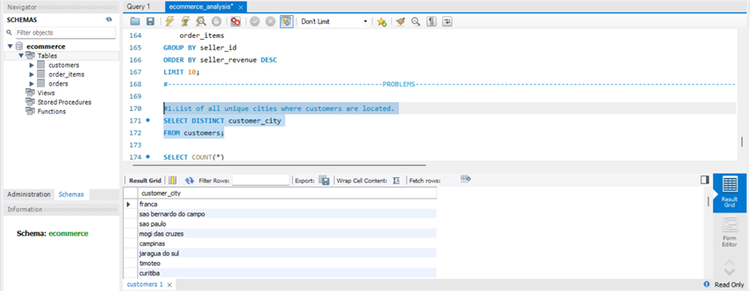
1.LIST OF ALL UNIQUE CITIES WHERE CUSTOMERS ARE LOCATED.
Python;
SQL;

Slide 4
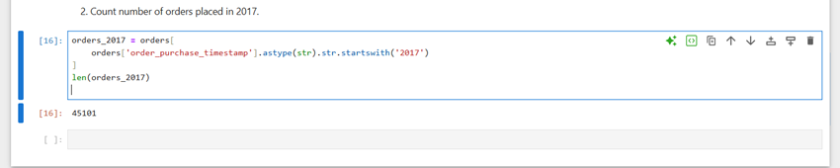
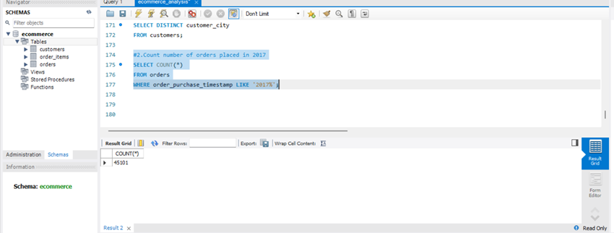
2. COUNT NUMBER OF ORDERS PLACED IN 2017
Python;
SQL;

Slide 5
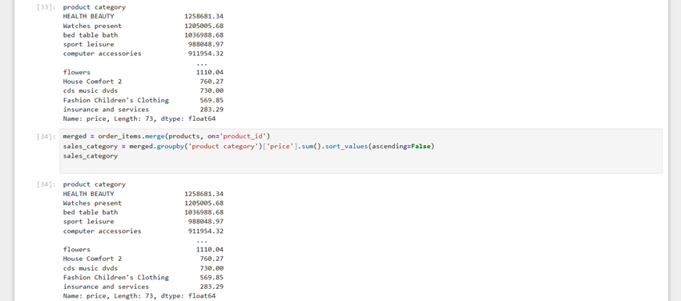
3.TOTAL SALES PER CATEGORY
Python;
SQL;

Slide 6
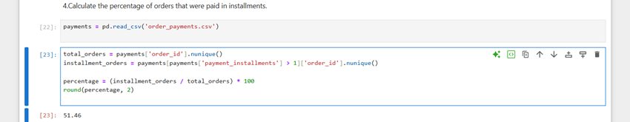
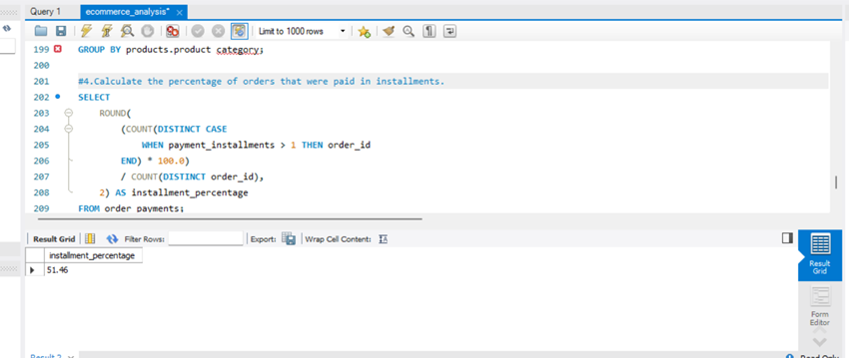
4. CALCULATE THE PERCENTAGE OF ORDERS THAT WERE PAID IN INSTALLMENTS.
Python;
SQL;

Slide 7
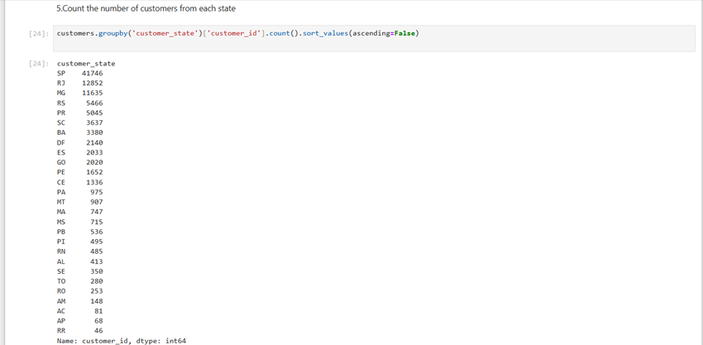
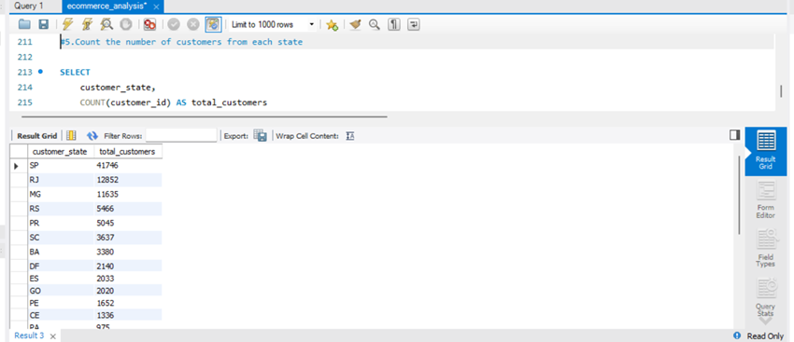
5.COUNT THE NUMBER OF CUSTOMERS FROM EACH STATE
Python;
SQL;

Slide 8
INTERMEDIATE PROBLEMS
Objective:
Extract fundamental insights from the dataset.

Slide 9
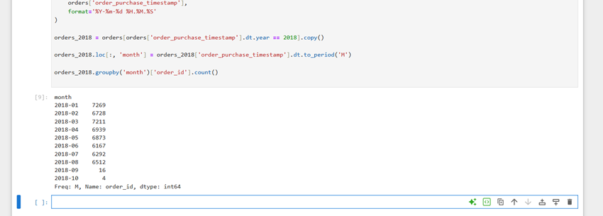
1.NUMBER OF ORDERS PER MONTH IN 2018
Python;
SQL;

Slide 10
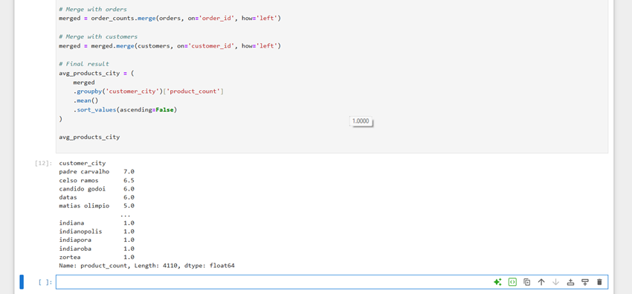
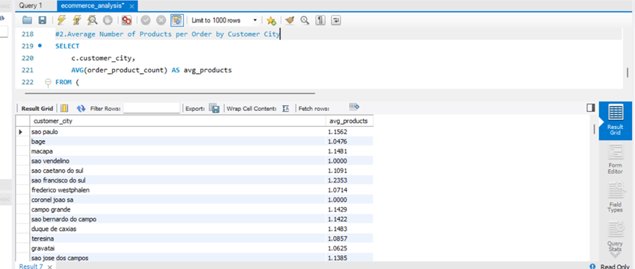
2.AVERAGE NUMBER OF PRODUCTS PER ORDER BY CUSTOMER CITY
Python;
SQL;

Slide 11
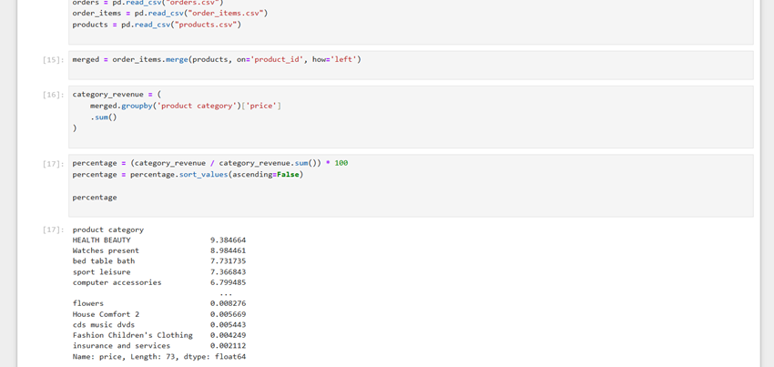
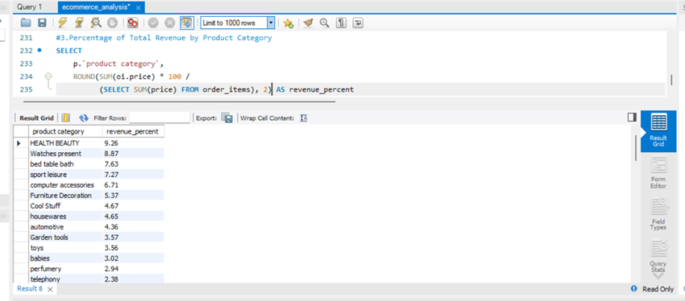
3.PERCENTAGE OF TOTAL REVENUE BY PRODUCT CATEGORY
Python;
SQL;

Slide 12
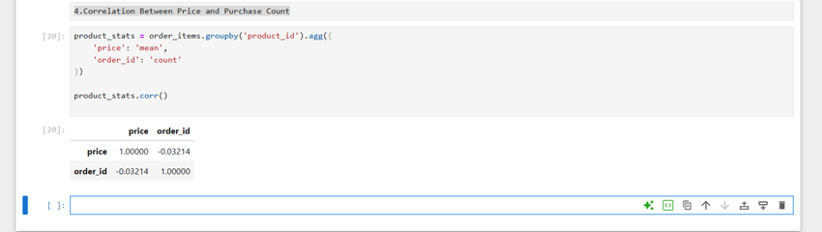
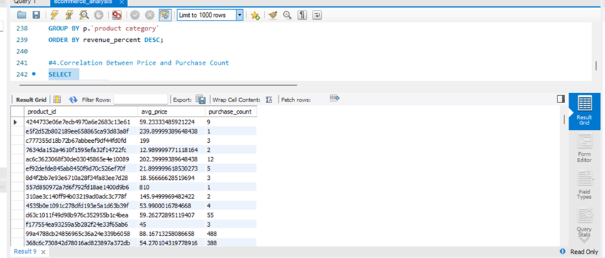
4.CORRELATION BETWEEN PRICE AND PURCHASE COUNT
Python;
SQL;

Slide 13
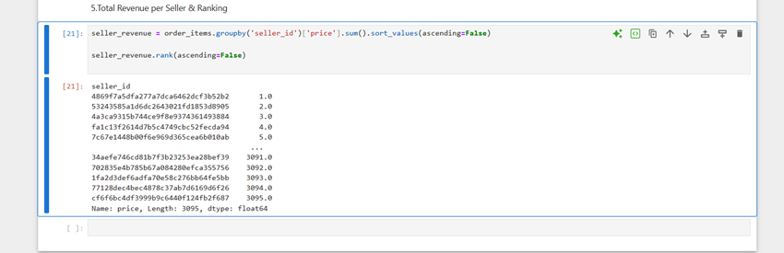
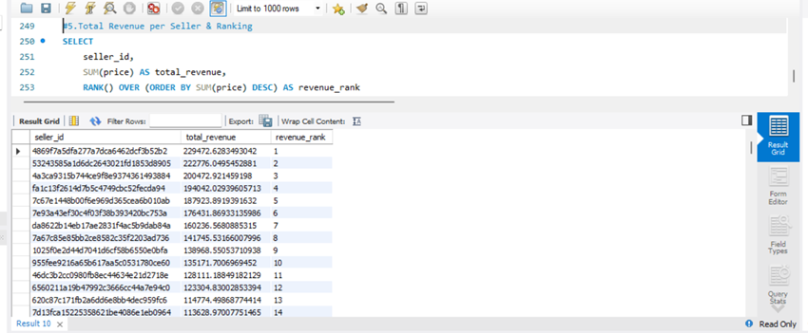
5.TOTAL REVENUE PER SELLER & RANKING
Python;
SQL;

Slide 14
ADVANCE PROBLEMS
Objective:
Dive deeper into sales and order trends.

Slide 15
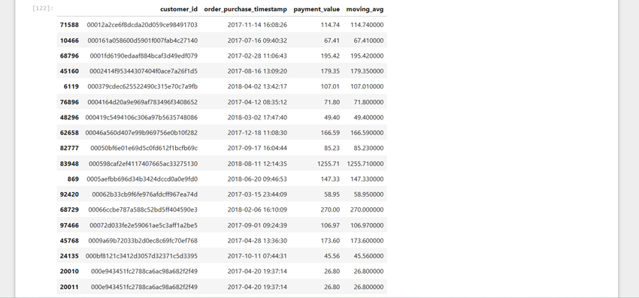
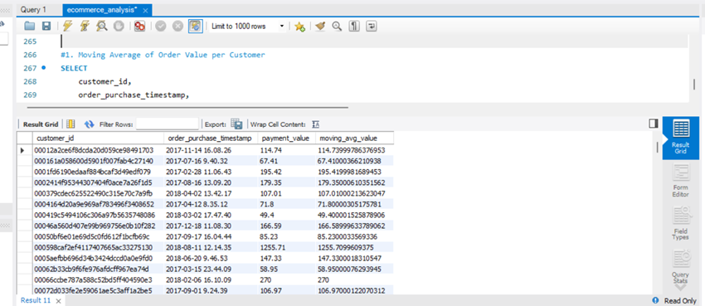
1. MOVING AVERAGE OF ORDER VALUE PER CUSTOMER
Python;
SQL;

Slide 16
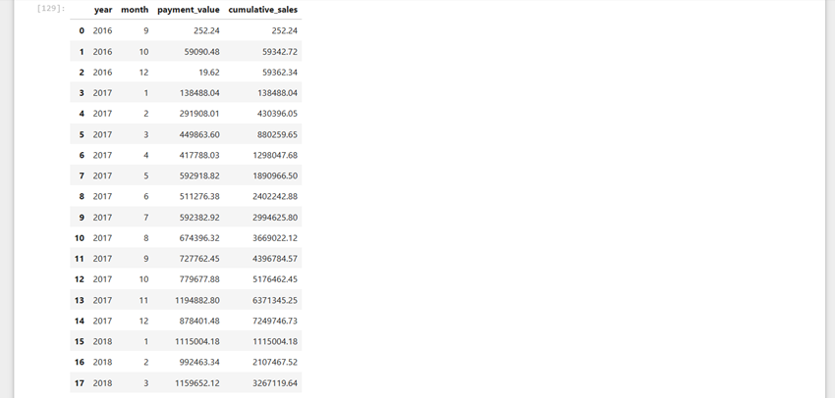
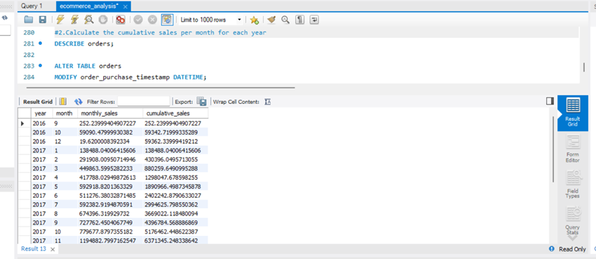
2.CALCULATE THE CUMULATIVE SALES PER MONTH FOR EACH YEAR
Python;
SQL;

Slide 17
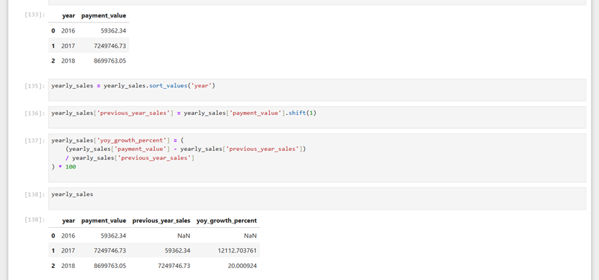
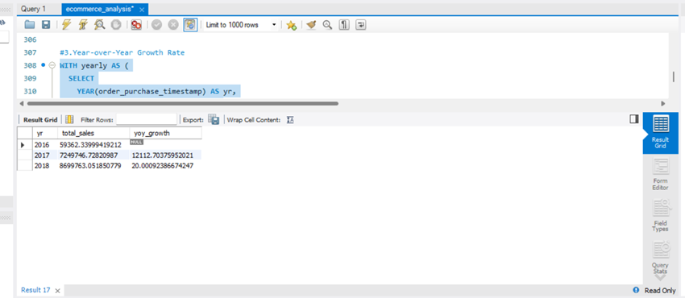
3.YEAR-OVER-YEAR GROWTH RATE
Python;
SQL;

Slide 18
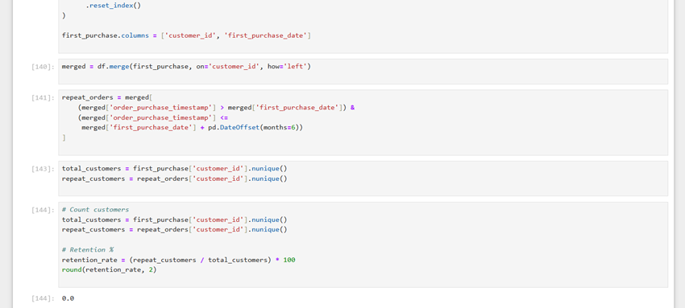
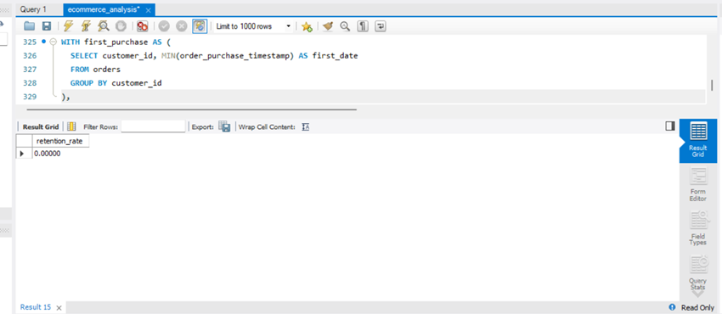
4.CUSTOMER RETENTION RATE (6 MONTHS)
Python;
SQL;

Slide 19
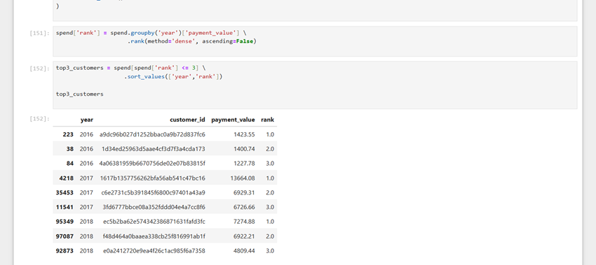
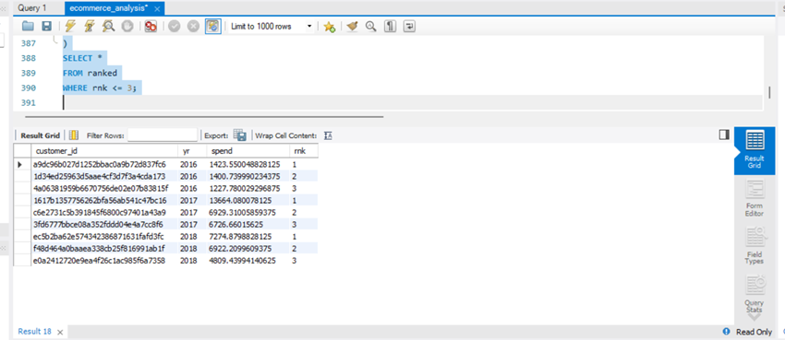
5. TOP 3 CUSTOMERS PER YEAR BY SPEND
Python;
SQL;

