Slide 1


QUAY Container Congestion Predictor & Port Operations Optimiser
Predict early. Optimize collaboratively. Execute safely.
Jay Patel – 23DCS076
Mahi Patel – 23DCS081
Vishwa Valand – 23DCS140
Vasu Vaghasia – 23DCS138
TEAM QUAY · IBM BOBATHON 2026

Slide 2
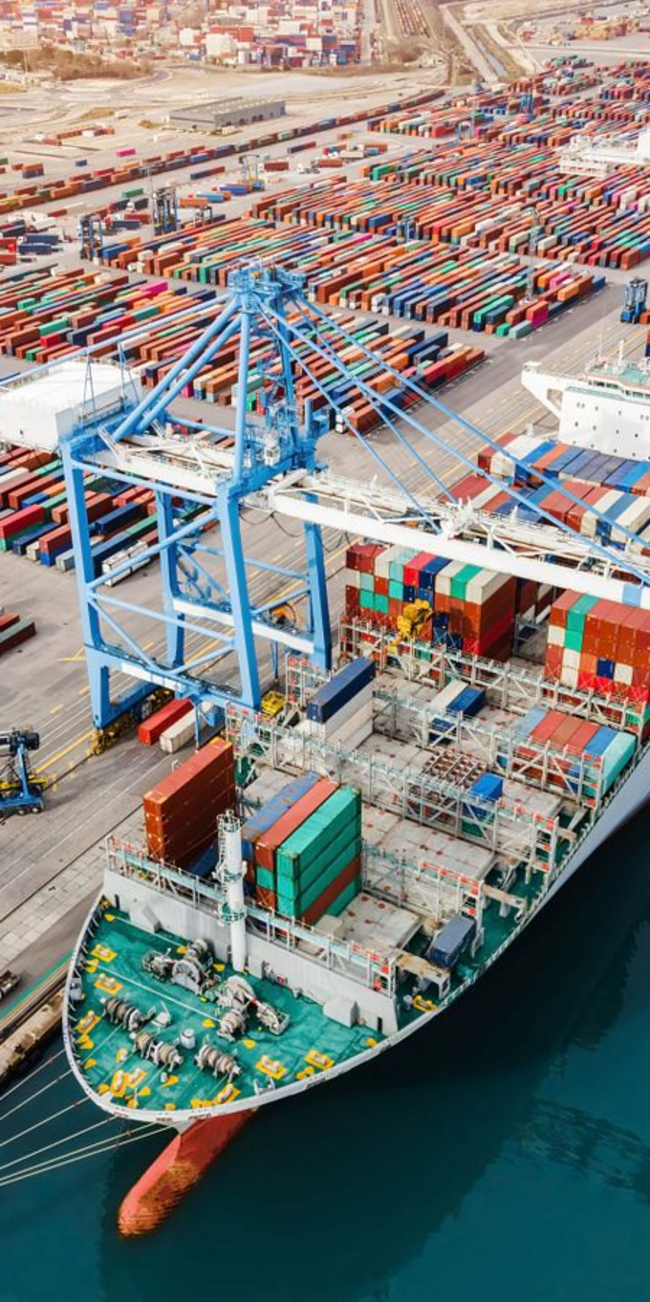

The Problem: Why Port Congestion Becomes a Chain Reaction
Cascading Congestion
1
Vessel surges propagate across limited berths, cranes, and yard capacity.
Fragmented Planning
2
Spreadsheets and siloed systems make multi-resource constraints difficult to reconcile.
Reactive Decisions
3
Bottlenecks are often identified only after queues form, leaving little time to intervene.
The result: Vessel waiting • Resource conflicts • Yard pressure • Operational delays

Slide 3
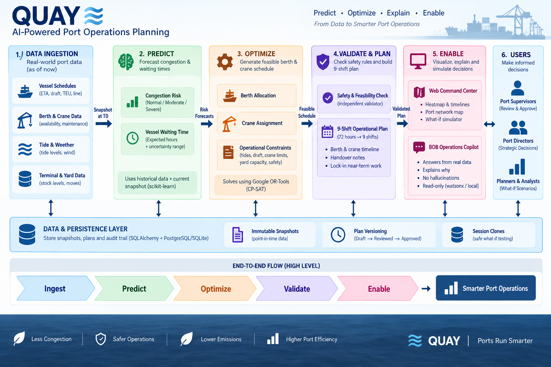

Our Solution: QUAY — From Data to Smarter Port Operations
Ingest
Predict
Optimize
Vessel schedules, berth/crane data, tide/weather, yard status
72-hour congestion risk + vessel waiting-time forecasts
Joint berth and crane scheduling with OR-Tools CP-SAT
Validate
Enable
Independent safety & feasibility checks
9-shift operational plan + AI-assisted explanations
Human-in-the-loop: Review → Approve → Execute

Slide 4
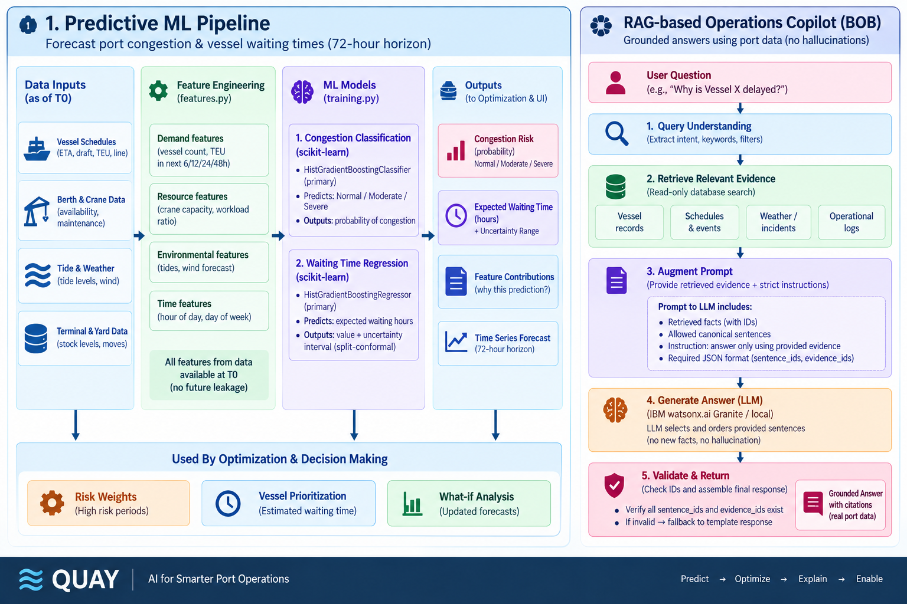
Predictive Intelligence: Predict Congestion. Explain the "Why."

Slide 5
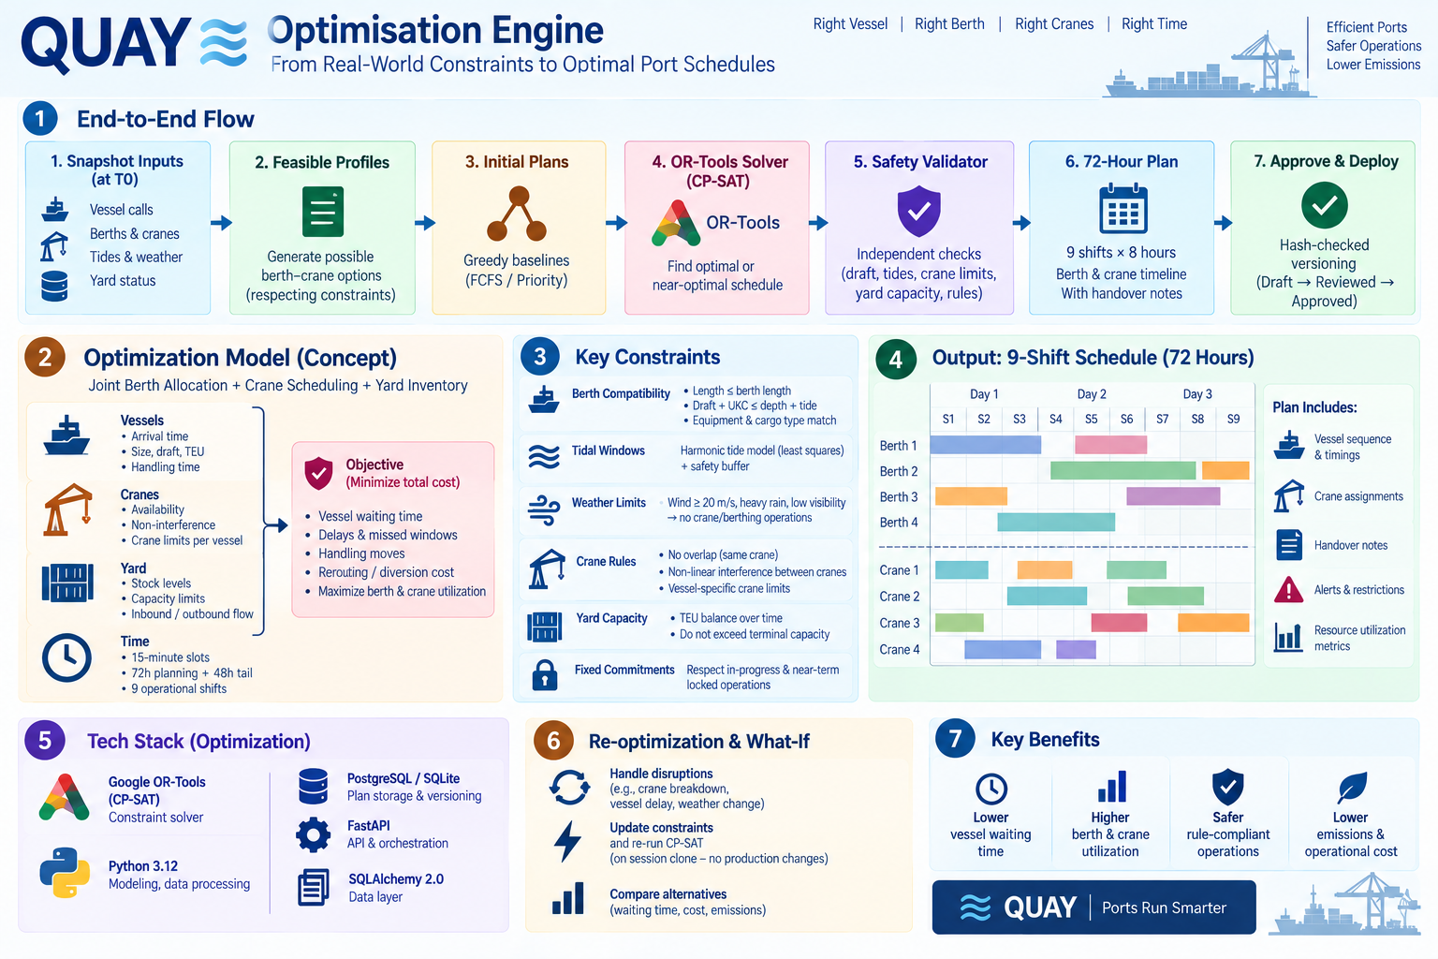
Optimisation Engine: Find the Right Vessel. Right Berth. Right Crane. Right Time.

Slide 6
72-Hour Operational Plan: From Optimisation to Actionable Shift Handover
9 × 8-HOUR SHIFTS
Each plan provides:
Vessel sequence & timings
Berth assignments
Crane allocations
Handover notes
Alerts & restrictions
Resource utilisation
Adaptive Planning: Disruption → Update constraints → Re-optimize → Compare alternatives

Slide 7
IBM Bob / Operations Copilot: Natural Language → Grounded Operational Intelligence
Supervisor asks:
IBM watsonx.ai / Granite:
→ Generates an evidence-grounded explanation.
"Why was Vessel X deferred to Shift 4?"
Governance
QUAY retrieves:
Read-only
Evidence-grounded
Human approval required
Vessel constraints
Berth availability
Crane status
Tide/weather conditions
Solver decision/evidence

Slide 8
Architecture & Tech Stack: Modular Architecture Built for Real-Time Planning
Frontend
Backend
ML & Data
React 19 · TypeScript · Vite · Recharts · Leaflet · Vanilla CSS
Python 3.12 · FastAPI · Uvicorn · Pydantic v2 · SSE
scikit-learn · Pandas · NumPy · Joblib · FIFO Simulation
Optimisation
AI
Persistence & Testing
Google OR-Tools CP-SAT · Independent Validation Engine
IBM watsonx.ai · Granite · IBM IAM
SQLAlchemy · Alembic · SQLite/PostgreSQL · Pytest · Vitest · Playwright
Deployment
Docker · Nginx

Slide 9
Impact & Future: From Reactive Congestion Management to Predictive Operations
Impact
Future Roadmap
🚢 Lower vessel waiting time
⚙️ Higher berth & crane utilisation
🛡️ Safer rule-compliant operations
🌱 Lower operational emissions & cost
👨‍✈️ Faster supervisor decision-making
Live AIS & TOS integration
Multi-port collaborative optimisation
Pilot & tug scheduling
Real-time digital-twin operations
QUAY — Predict. Optimize. Explain. Enable.

