Slide 1

Basic Details of the Team and Problem Statement
Problem Statement Title: AI based Chatbot to answer FAQs
Theme Name: Smart Automation
Team Name: Hypertext Assassins
Team Leader Name: Vishvaa.K
School Code:
School Name: Smt. Kasturba Nimchand Shah P. Muthyalu Chetty Vivekananda Vidyalaya Junior College

Slide 2
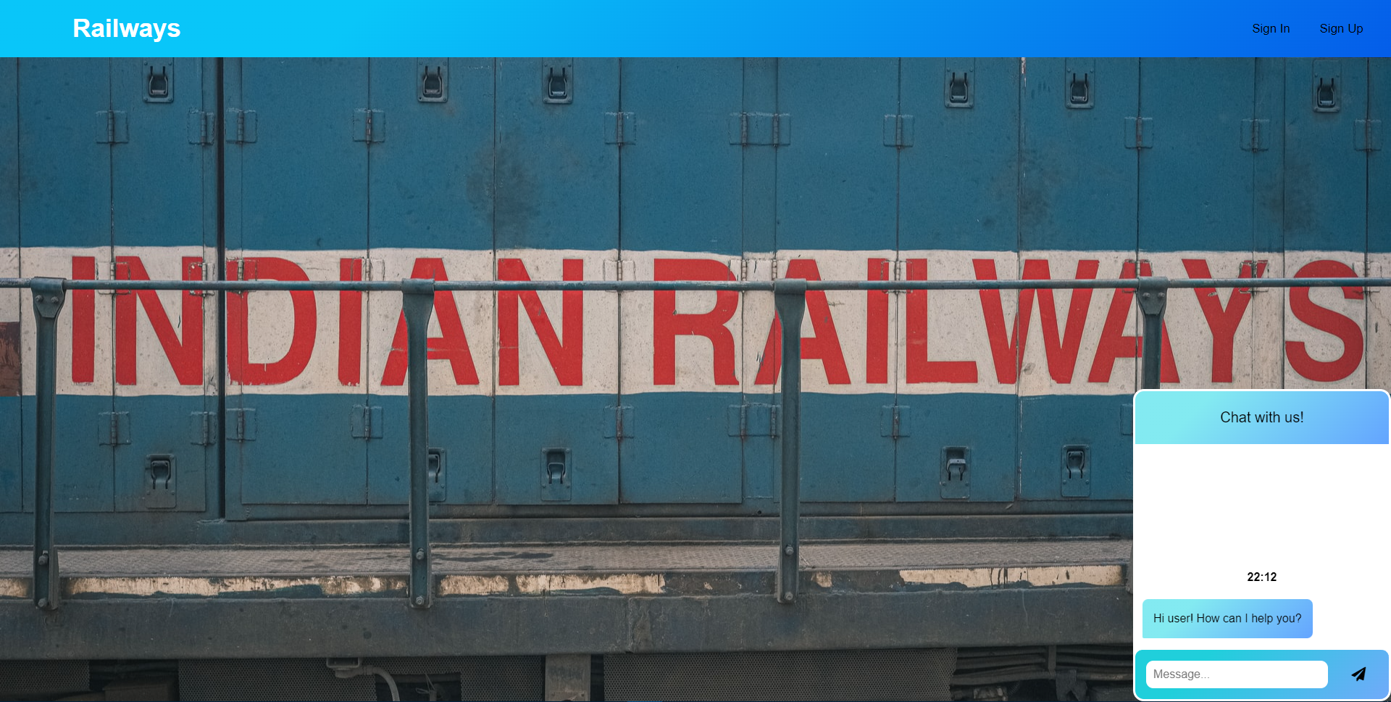
Idea/Approach Details
Add process flow chart or simulated image of prototype or any relevant image related to your idea
Describe your idea/Solution/Prototype here:
Describe your Technology stack here:

Slide 3
Idea/Approach Details
Describe your Use Cases here
Describe your Dependencies / Show stopper here

Slide 4
Team Member Details
Team Leader Name: Vishvaa. K
Class (6th to 12th ): 12th Stream* (Arts/Science/Commerce): Science Age (in number): 17 Gender (M/F): M
Team Member 1 Name: Aravindh. S
Class (6th to 12th ): 12th Stream* (Arts/Science/Commerce): Science Age (in number): 16 Gender (M/F): M
Team Member 2 Name: Abishek Ganesh.B.S.
Class (6th to 12th ): 12th Stream* (Arts/Science/Commerce): Science Age (in number): 16 Gender (M/F): M
Team Mentor 1 Name: Sangeetha.M
Category (Academic/Industry/Parents): Academic Expertise (AI/ML/Blockchain): AI Domain Experience (in years): 2 years

