Slide 1

Customer Analysis Project
Power BI + PySpark ELT Project

Slide 2

Project Overview
This project analyzes customer shopping behavior using Power BI and PySpark-based ELT processes. Raw retail transaction data is transformed into meaningful business insights through data engineering, transformation, and interactive visual analytics.

Slide 3

Project Objectives
Purchasing Behavior
Product Categories
Analyze customer purchasing patterns and trends
Identify top-performing product categories
Customer Loyalty
Seasonal Patterns
Evaluate subscription and loyalty behavior
Study seasonal purchasing trends
Promotion Impact
Interactive Dashboard
Measure discount and promotion effectiveness
Build Power BI dashboard for decision-making

Slide 4

Dataset Overview
The dataset contains comprehensive retail transaction information with 15 key attributes for analysis.
Customer Profile
Customer ID, Age, Gender, Location
Purchase Details
Item Purchased, Category, Purchase Amount, Season
Behavior Metrics
Review Rating, Subscription Status, Frequency of Purchases
Transaction Info
Shipping Type, Discount Applied, Promo Code Used, Payment Method

Slide 5

PySpark ELT Process
PySpark performed ELT operations on raw dataset before Power BI visualization.
Extract
Raw CSV dataset extraction
Load
Data loaded into PySpark DataFrame
Clean & Transform
Data cleaning and transformation operations
Handle Nulls
Null values and datatype conversions
Standardize
Categorical values standardized
Prepare
Analytical dataset prepared for reporting
Export
Transformed data exported for Power BI

Slide 6
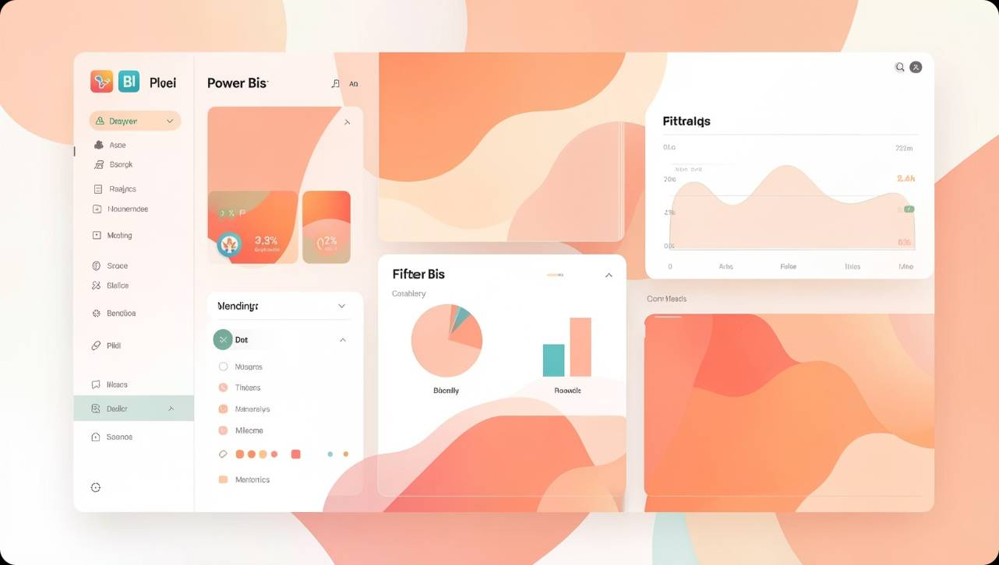
Power BI Dashboard Development
The transformed dataset was imported into Power BI for dashboard development. Various interactive visualizations and KPIs were created to analyze customer behavior.
Sales performance analysis
Customer demographics analysis
Seasonal trend analysis
Subscription behavior analysis
Discount and promotion analysis
Shipping and payment insights
Interactive filters and slicers

Slide 7
Key Performance Indicators
$236k
$59.76
Total Revenue
Average Purchase
Total sales generated
Average transaction value
3.9k
3.75
Total Customers
Average Review
Unique customer count
Customer satisfaction analysis
27%
42.8%
Subscription Rate
Discount Usage
Subscribed customer percentage
Promotion effectiveness

Slide 8
Business Insights
Revenue by Category
Subscription Impact
Seasonal Trends
Certain product categories generated significantly higher revenue.
Subscription customers showed higher purchase frequency.
Seasonal trends affected customer buying behavior.
Promotion Effectiveness
Payment Preferences
Discounts and promo codes positively influenced sales.
Specific payment methods were preferred by customers.

Slide 9
Technologies Used
PySpark
Power BI
Power Query
ELT and data transformation operations
Dashboard development and visualization
Data cleaning and preparation
DAX
CSV Dataset
KPI and measure calculations
Source data storage format

Slide 10

Conclusion
This project demonstrates the integration of PySpark and Power BI for retail analytics. PySpark was utilized for scalable ELT operations, while Power BI enabled the creation of interactive dashboards and business intelligence reports.
The project provides valuable insights into customer purchasing behavior and supports data-driven decision-making for retail operations.
Author: Vishvajeet

