Slide 1
CALORIES BURNT PREDICTION
M. VISHVAKSENA-2203A52207
B.SAI VARDHAN REDDY-2203A52139
T.CHARAN TEJ-2203A52182

Slide 2
INTRODUCTION
The ability to accurately predict the number of calories a person has burnt during a workout can help individuals to better manage their weight and improve their overall health. In this project, we aim to develop a machine learning model using Python that can predict the number of calories burnt by a person during a workout We will use a dataset that includes features such as duration of workout, height, weight, age, and body temperature to train and test our model. The project will involve data preprocessing, exploratory data analysis, model selection, and model evaluation.
The ultimate goal of this project is to develop a model that can accurately pevaluation number of calories burnt by a person

Slide 3
.DATASET EXPLANATION
This dataset contains information about the obesity classification of individuals. The data was collected from a variety of sources, including medical records, surveys, and self-reported data.
Source:Kaggle
It contains the below columns:
ID: A unique identifier for each individual
Age: The age of the individual
Gender: The gender of the individual
Height: The height of the individual in centimeters
Weight: The weight of the individual in kilograms
Duration: the duration of work out
Heartrate:The heart rate of the individual
Body Temperature: the body temperature of the individual is given
Calories:The calories of the individual is given

Slide 4
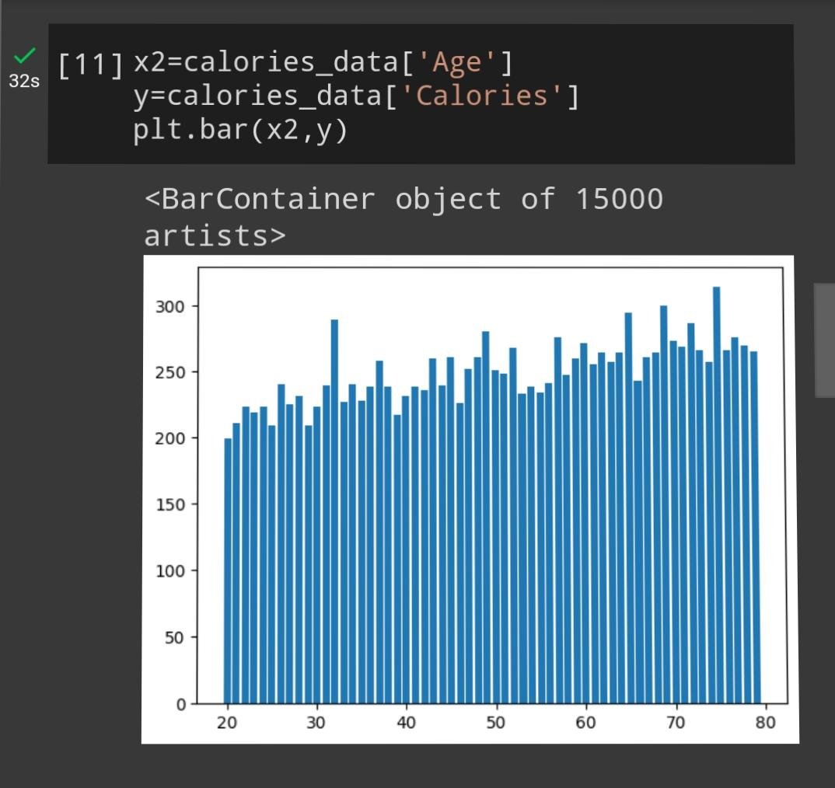
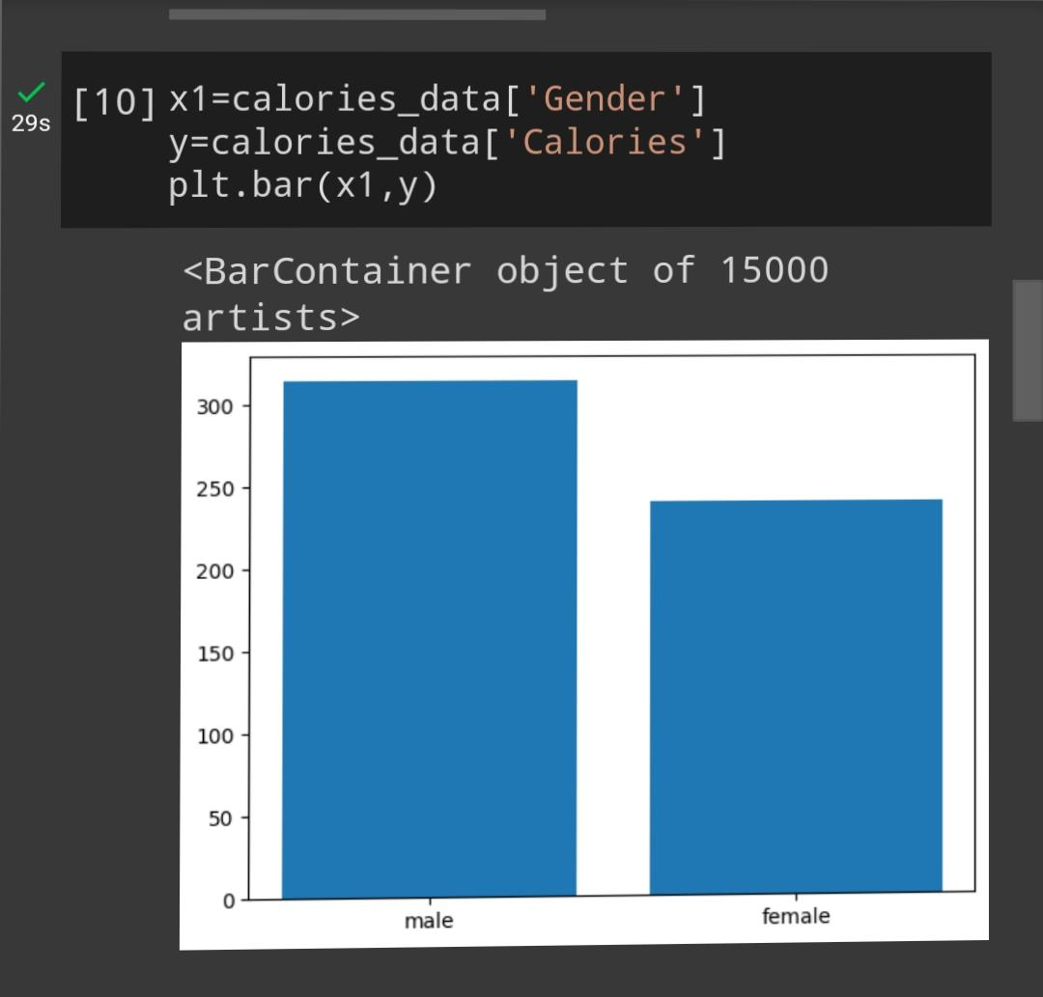
.

Slide 5
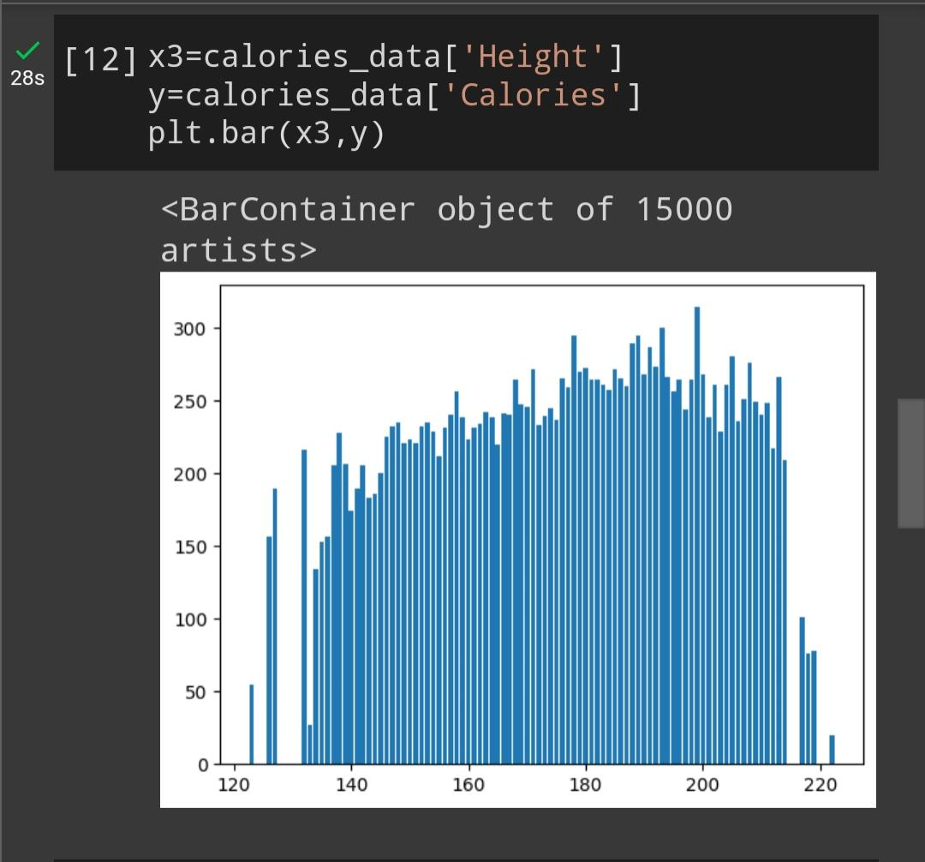
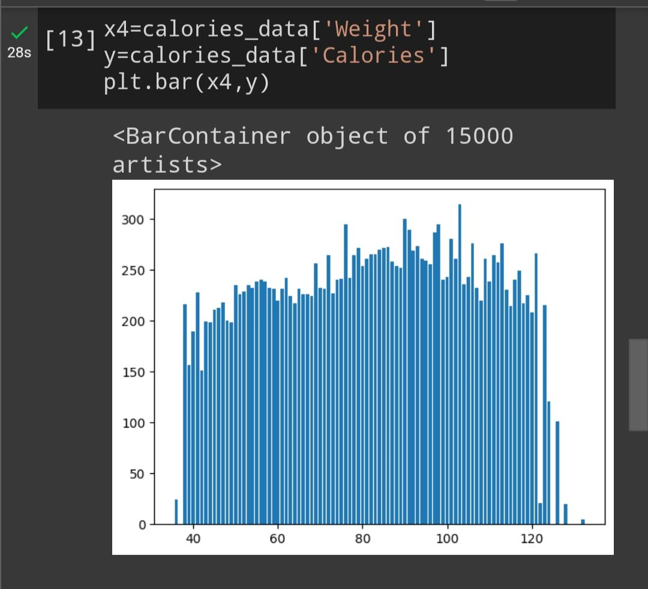

Slide 6
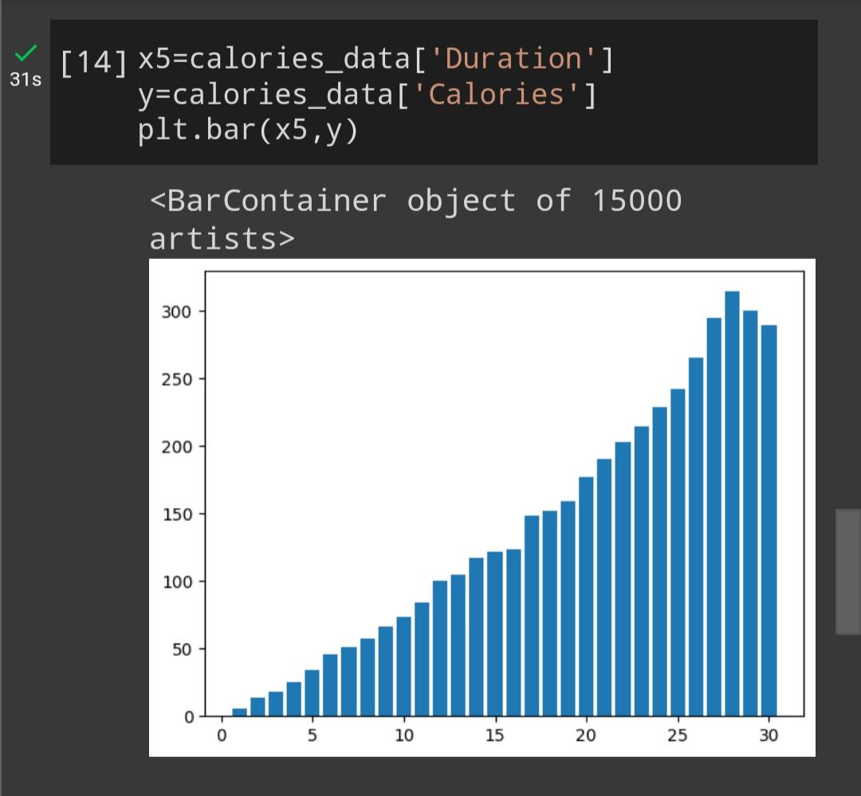
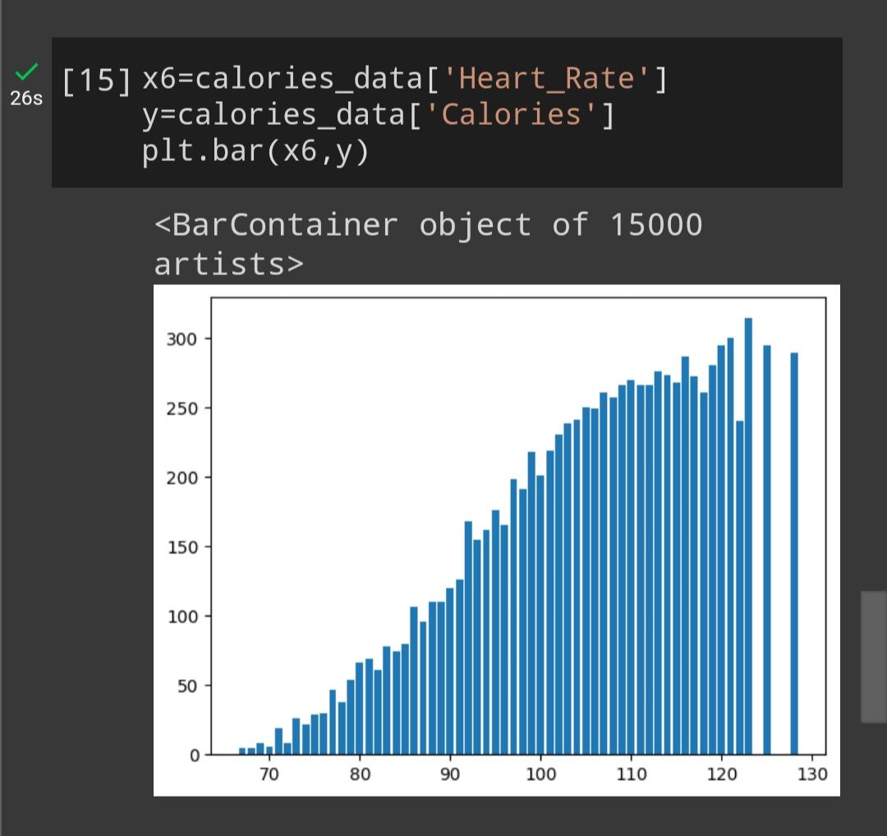
.

Slide 7
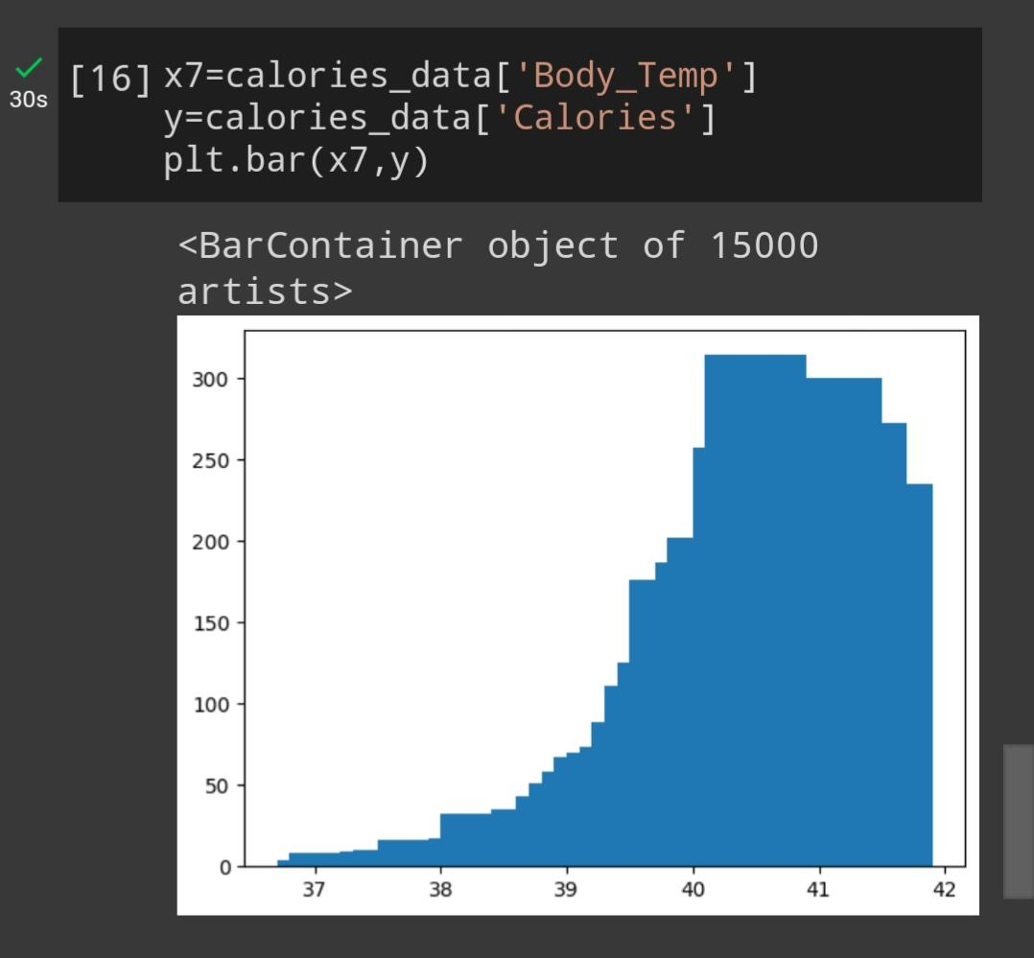
.

Slide 8
IMPLEMENTATION
There are 5 methods to find the mean squared error
They are: linear Regression Support Vector Machine lasso regression
Ridge regression
k-nearest neighbours

Slide 9
LINEAR REGRESSION
Linear regression is a statistical method used for modeling the relationship between a dependent variable (or target) and one or more independent variables (or predictors).
It assumes a linear relationship between the variables, meaning that the change in the dependent variable is proportional to the changes in the independent variables.
The goal of linear regression is to find the best-fitting line (or hyperplane in higher dimensions) that minimizes the difference between the predicted values and the actual data points, typically using a technique called least squares. This line can be used for making predictions or understanding the strength and direction of the relationships between variables. Linear regression is widely used in various fields, including economics, finance, and machine learning..

Slide 10
SUPPORT VECTOR MACHINE
Support Vector Machine (SVM) is a powerful and versatile machine learning algorithm primarily used for classification and regression tasks. It’s particularly well-suited for both linear and nonlinear classification problems and is known for its ability to find an optimal hyperplane or decision boundary that maximizes the margin between different classes. Here are the key concepts and characteristics of SVM: Hyperplane: In SVM, the goal in classification is to find a hyperplane that best separates the data points of different classes. This hyperplane is chosen to maximize the margin, which is the distance between the hyperplane and the nearest data points (support vectors) of each class.

Slide 11
LASSO REGRESSION
Lasso regression, short for "Least Absolute Shrinkage and Selection Operator," is a machine learning technique used for feature selection and regularization in linear regression models.
Lasso regression is particularly useful when dealing with datasets that have a large number of features (high dimensionality).
In summary, Lasso regression is a valuable tool for both feature selection and regularization in machine learning, helping to prevent overfitting and enhance the predictive power of linear regression models.

Slide 12
RIDGE REGRESSION
Ridge regression is a machine learning technique used for linear regression tasks, primarily in the context of supervised learning.
In ridge regression, a penalty term is added to the traditional linear regression cost function. This penalty term, often referred to as L2 regularization, encourages the model to keep the coefficients of the independent variables small. As a result, ridge regression can help prevent the model from fitting noise in the data and can provide more stable and generalizable predictions.
Ridge regression is commonly used in situations where there are many correlated independent variables or when there is a risk of overfitting in the linear regression model.

Slide 13
K-NEAREST NEIGHBOUR
K-Nearest Neighbors (KNN) is a simple and intuitive machine learning algorithm used for classification and regression tasks.
It works by finding the K closest data points in a training dataset to a given input and making predictions based on the majority class (for classification) or the average value (for regression) of those neighbors.
KNN relies on the distance metric, such as Euclidean distance, to measure the similarity between data points. It is a non-parametric method, meaning it doesn't assume any specific underlying data distribution, and it can be used for both supervised and unsupervised learning tasks.

Slide 14
LIBRARIES USED
PANDAS: to load the dataset MATPLOTLIB.PYPLOT:to implement graphs SKLEARN.MODEL_SELECECTION:for test and train split SKLEARN.SVM:for logistic regression in classification
sklearn.linear_model FOR LinearRegression
sklearn.metrics FOR mean_squared_error

Slide 15
RESULT ANALYSIS
Comparison of the results from different sources: My results: LINEAR REGRESSION:
Mean Squared Error: 0.06606897290334093
SUPPORT VECTOR MACHINE
Mean Squared Error: 0.06678272885915795
LASSO REGRESSSION
Mean Squared Error: 0.08385658483591739

Slide 16
.
RIDGE REGRESSION
Mean Squared Error: 0.06820871183853372
K-NEAREST NEIGHBOUR
Mean Squared Error: 0.11995110942027856

Slide 17
GitHub link
https://github.com/Vishvaksena2207/STAT-ML-PROJRCT-2207

