Slide 1
Case study
Crime Mapping and Prediction using Machine Learning
Submitted by - Vinayak (24MCI10064)
Vishvam (24MCI10010)
Submitted to - Dr. Disha Handa

Slide 2
Project Overview
Objective:
Build a machine learning system to predict crime zones and support crime
prevention using data analytics.
Outcome:
Research paper focused on crime Zone Prediction and pattern analysis.
Skills Involved:
  ML: Random Forest, XGBoost
  Data Cleaning & Preprocessing
  Python Visualization Libraries
  Web-based applications

Slide 3
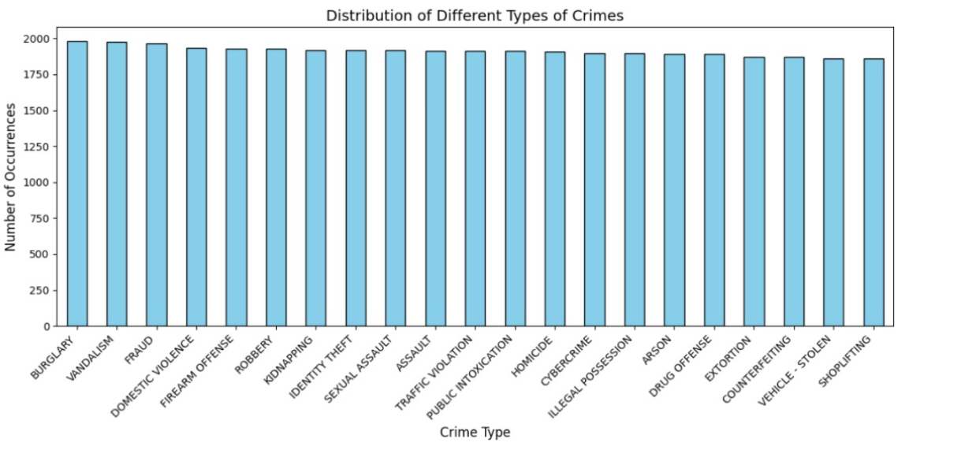
Dataset and Features
Dataset:
Crime Dataset (India)
Key Features:
1. Report Number
2.Date Reported
3.Date of Occurrence
4.Time of Occurrence
5.City
6.Crime Description
7.Victim Age
8.Victim Gender
9.Weapon Used
10.Case Closed

Slide 4
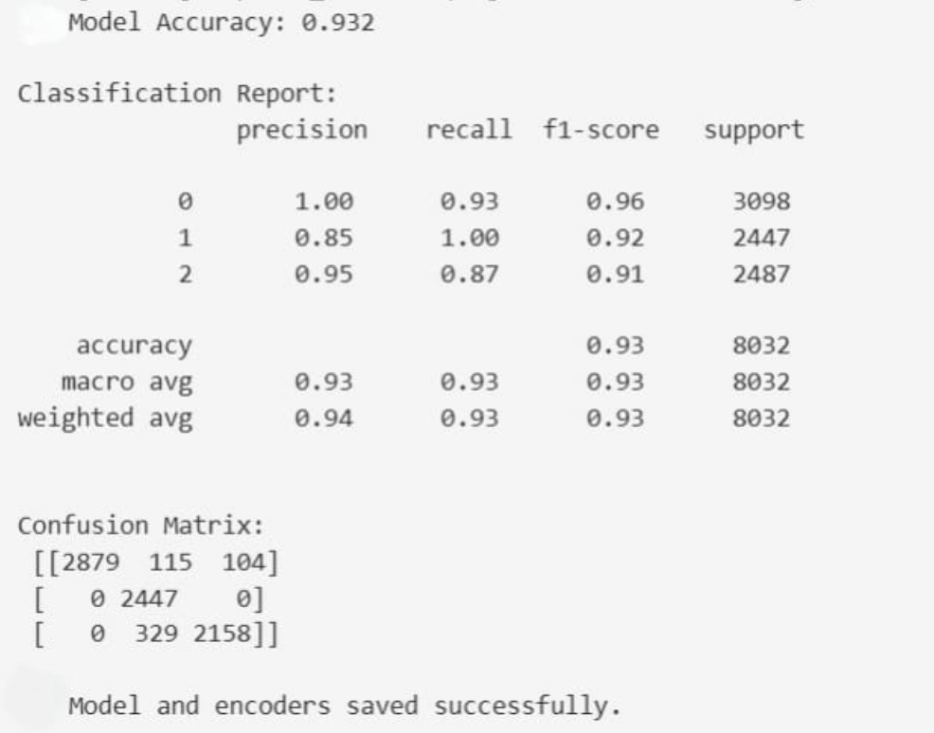
Methodology & Algorithms
Data Preprocessing:
  Handling missing values & redundancies
  Converting nominal to numeric data
Algorithms :
  XGBoost
  Random Forest
  ANN
Evaluation Metrics:
  Accuracy
  Classification Report

Slide 5
Literature Review
Early Research: Focused on GIS-based crime mapping and hotspot detection (e.g., Kernel Density Estimation).
Statistical Approaches: Linked crime with population density, unemployment, socioeconomic status, and time of day.
Theoretical Foundation: Routine Activity Theory – crimes cluster in socially active areas (markets, parks, transit hubs).
Machine Learning Models: Random Forest, SVM, Neural Networks applied for crime prediction with improved accuracy.
Spatio-temporal Features: Adding time and location enhances hotspot forecasting.

Slide 6
RESEARCH GAPS
Data enrichment: Many models rely only on incident data; integrating mobility, POI, and weather data consistently improves performance but is under-utilized in some regions (including parts of India).
Transferability: Models trained in one city often degrade in another due to socio-spatial differences; research on transfer learning and domain adaptation is promising but early.
Ethics & governance: Operational deployment requires auditing, transparency, and safeguards to prevent exacerbation of biases — a growing strand of recent work.

Slide 7
Visualizations & Conclusion
Crime Dataset (India) :
    Total Columns: 14
    Preprocessing: From 14 input features we have reduced it into 5 input features
    and based on which we have trained our two models
    (XGBoost and Random Forest).
    Purpose: To predict risk based on these 5 input features.
Conclusion:
We have created a Machine learning Application, which can help in reducing crime rate and
create a greater impact in the Society.

Slide 8
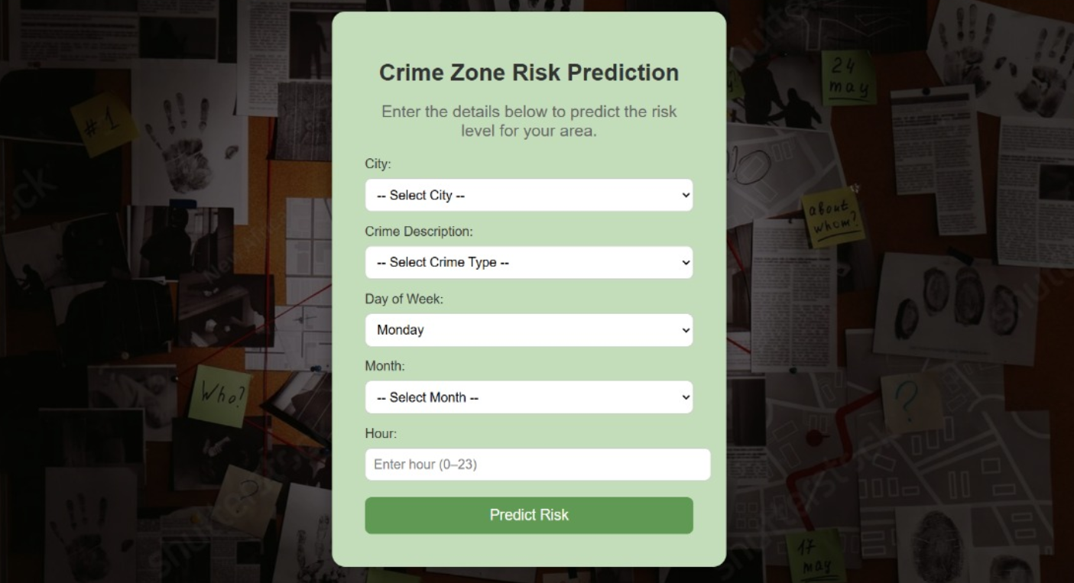
User Interface

Slide 9
Thank you!

