Slide 1

Note: The data and information in this document is reflective of a hypothetical situation and client. This document is to be used for KPMG Virtual Internship purposes only.
Sprocket Central Pty Ltd
Data analytics approach
[Division Name] - [Engagement Manager], [Senior Consultant], [Junior Consultant]

Slide 2
Note: The data and information in this document is reflective of a hypothetical situation and client. This document is to be used for KPMG Virtual Internship purposes only.
Agenda
Introduction
Data Exploration
Model Development
Interpretation

Slide 3
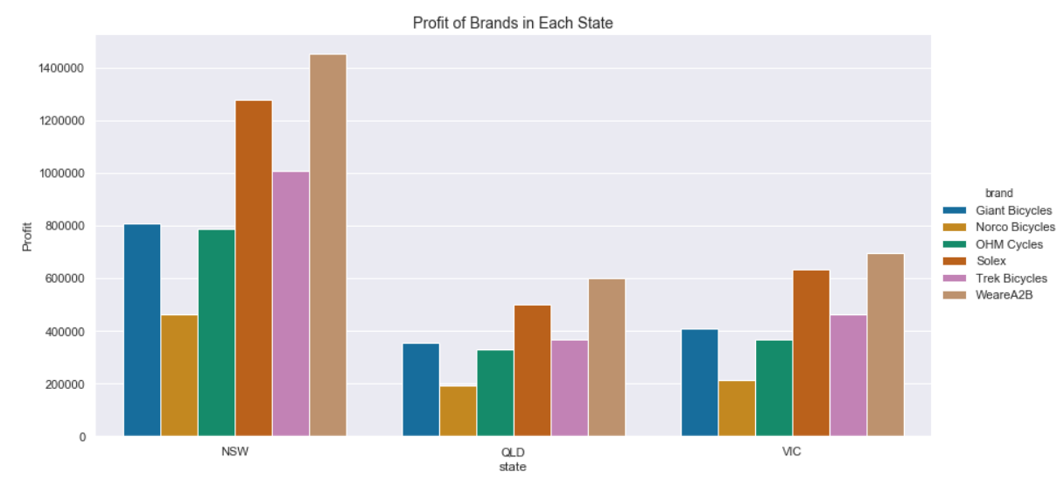
Note: The data and information in this document is reflective of a hypothetical situation and client. This document is to be used for KPMG Virtual Internship purposes only.
Introduction
Business Line - Sprocket Central Pty Ltd
Sprocket Central Pty Ltd is specializing in high-quality bikes and accessible cycling accessories to riders. Here’s the graph showing profit generated by the brands in each state of Australia. More than 47% of the benefits come from New South Wale state where WeareA2B, Solex, and Trek Bicycles products are selling at a high quantity.
Place any supporting images, graphs, data or extra text here.

Slide 4
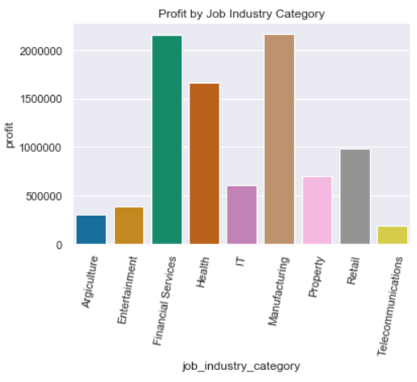
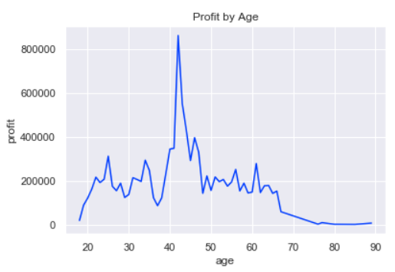
Note: The data and information in this document is reflective of a hypothetical situation and client. This document is to be used for KPMG Virtual Internship purposes only.
Data Exploration
Factors Contributing to Major Source of Profit
Age: Age groups between 40 - 47 generated relatively high profit.
Job Industry Category: About 65% of the profit comes from Manufacturing, Financial Services and Health.
Wealth Segment: More than 50% of the profit comes from Mass Customer.
Place any supporting images, graphs, data or extra text here.
Notes:
Graphs for job-industry-category and wealth-segment are appended as appendix.

Slide 5
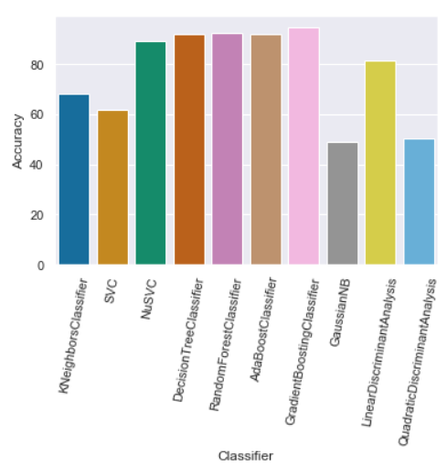
Note: The data and information in this document is reflective of a hypothetical situation and client. This document is to be used for KPMG Virtual Internship purposes only.
Model Development
Labelling of Dataset and Setting Up Model with Random Forest Classifier
Considering the factors contributing to the major profit, Customer Demographic dataset was labeled with 1 for the major-profit generating customers and 0 for the marginal or zero-profit generating customers. Out of 4000 samples, number of label 0 is 2480 and number of label 1 is 1520.
The dataset is split into train/valid set and trained with different classifiers. Here’s the graph showing the accuracy of all the models trained, from which Gradient Boosting Classifier has 94.7% accuracy. So it was chosen as a model to train. With the trained model, the prediction is done on the New Customer List dataset.
Place any supporting images, graphs, data or extra text here.
Place any supporting images, graphs, data or extra text here.

Slide 6
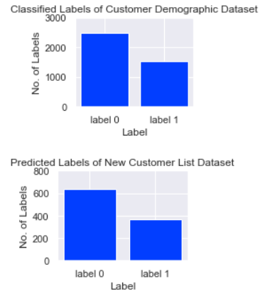
Interpretation
Note: The data and information in this document is reflective of a hypothetical situation and client. This document is to be used for KPMG Virtual Internship purposes only.
Who are Major Marketing Target?
Major marketing efforts need to be centered on the customers predicted to label 1. In the New Customer List, out of 1000 samples approx. 365 samples were predicted to label 1. Considering the accuracy of validation dataset (95%), the actual number of customers belonging to label 1 is estimated to be around 347, that is 34.7% of the list.
The customers predicted to label 0 should not be neglected. In the Customer Demographic dataset, many customers classified into label 0, had at least a transaction history in the year 2017.
Place any supporting images, graphs, data or extra text here.

Slide 7
Note: The data and information in this document is reflective of a hypothetical situation and client. This document is to be used for KPMG Virtual Internship purposes only.
Thank You
Notes:
Additional supporting graphs and tables are appended.

