Slide 1
GROUP 7
Retail Demand
Forecasting
PROJECT SNAPSHOT
913,000 daily sales records
2013–2017 historical data
10 stores • 50 items
Random Forest forecasting
Big Data Analytics Capstone
HDFS • Hive • PySpark • Spark ML
HCL GUVI × JAIN UNIVERSITY
Team members:
Vishvanath S V - 25MSDSR066
Vijay Manklesh - 25MSDSR030
Surya V -25MSDSR038
Sachin R - 25MSDSR063
Group 7 • Retail Demand Forecasting

Slide 2
02
Business Problem & Analytics Objective
THE BUSINESS PROBLEM
ANALYTICS OBJECTIVE
Retail demand changes by store, item and time.
Poor demand estimates can lead to overstocking, stockouts and inefficient inventory planning.
The project uses historical sales at scale to understand demand patterns and forecast future sales.
1. Store historical sales in HDFS.
2. Analyze demand patterns with Hive.
3. Clean and transform data with PySpark.
4. Build lag-based forecasting features.
5. Predict 2017 demand using Spark ML.
6. Evaluate with RMSE and MAE.
913K
2013–17
10 × 50
47.7M
records
date range
stores × items
total sales
Group 7 • Retail Demand Forecasting

Slide 3
03
Dataset
Store Item Demand Forecasting Dataset
Source: Kaggle — Demand Forecasting Kernels Only
SIZE
ENTITIES
SCHEMA
913,000 records
17.3 MB raw CSV
2013-01-01 → 2017-12-31
10 stores
50 items
Daily observations
date → sales date
store → store identifier
item → item identifier
sales → units sold
Target variable: sales
Raw dataset is stored in HDFS; the CSV is intentionally not duplicated in GitHub.
Group 7 • Retail Demand Forecasting

Slide 4
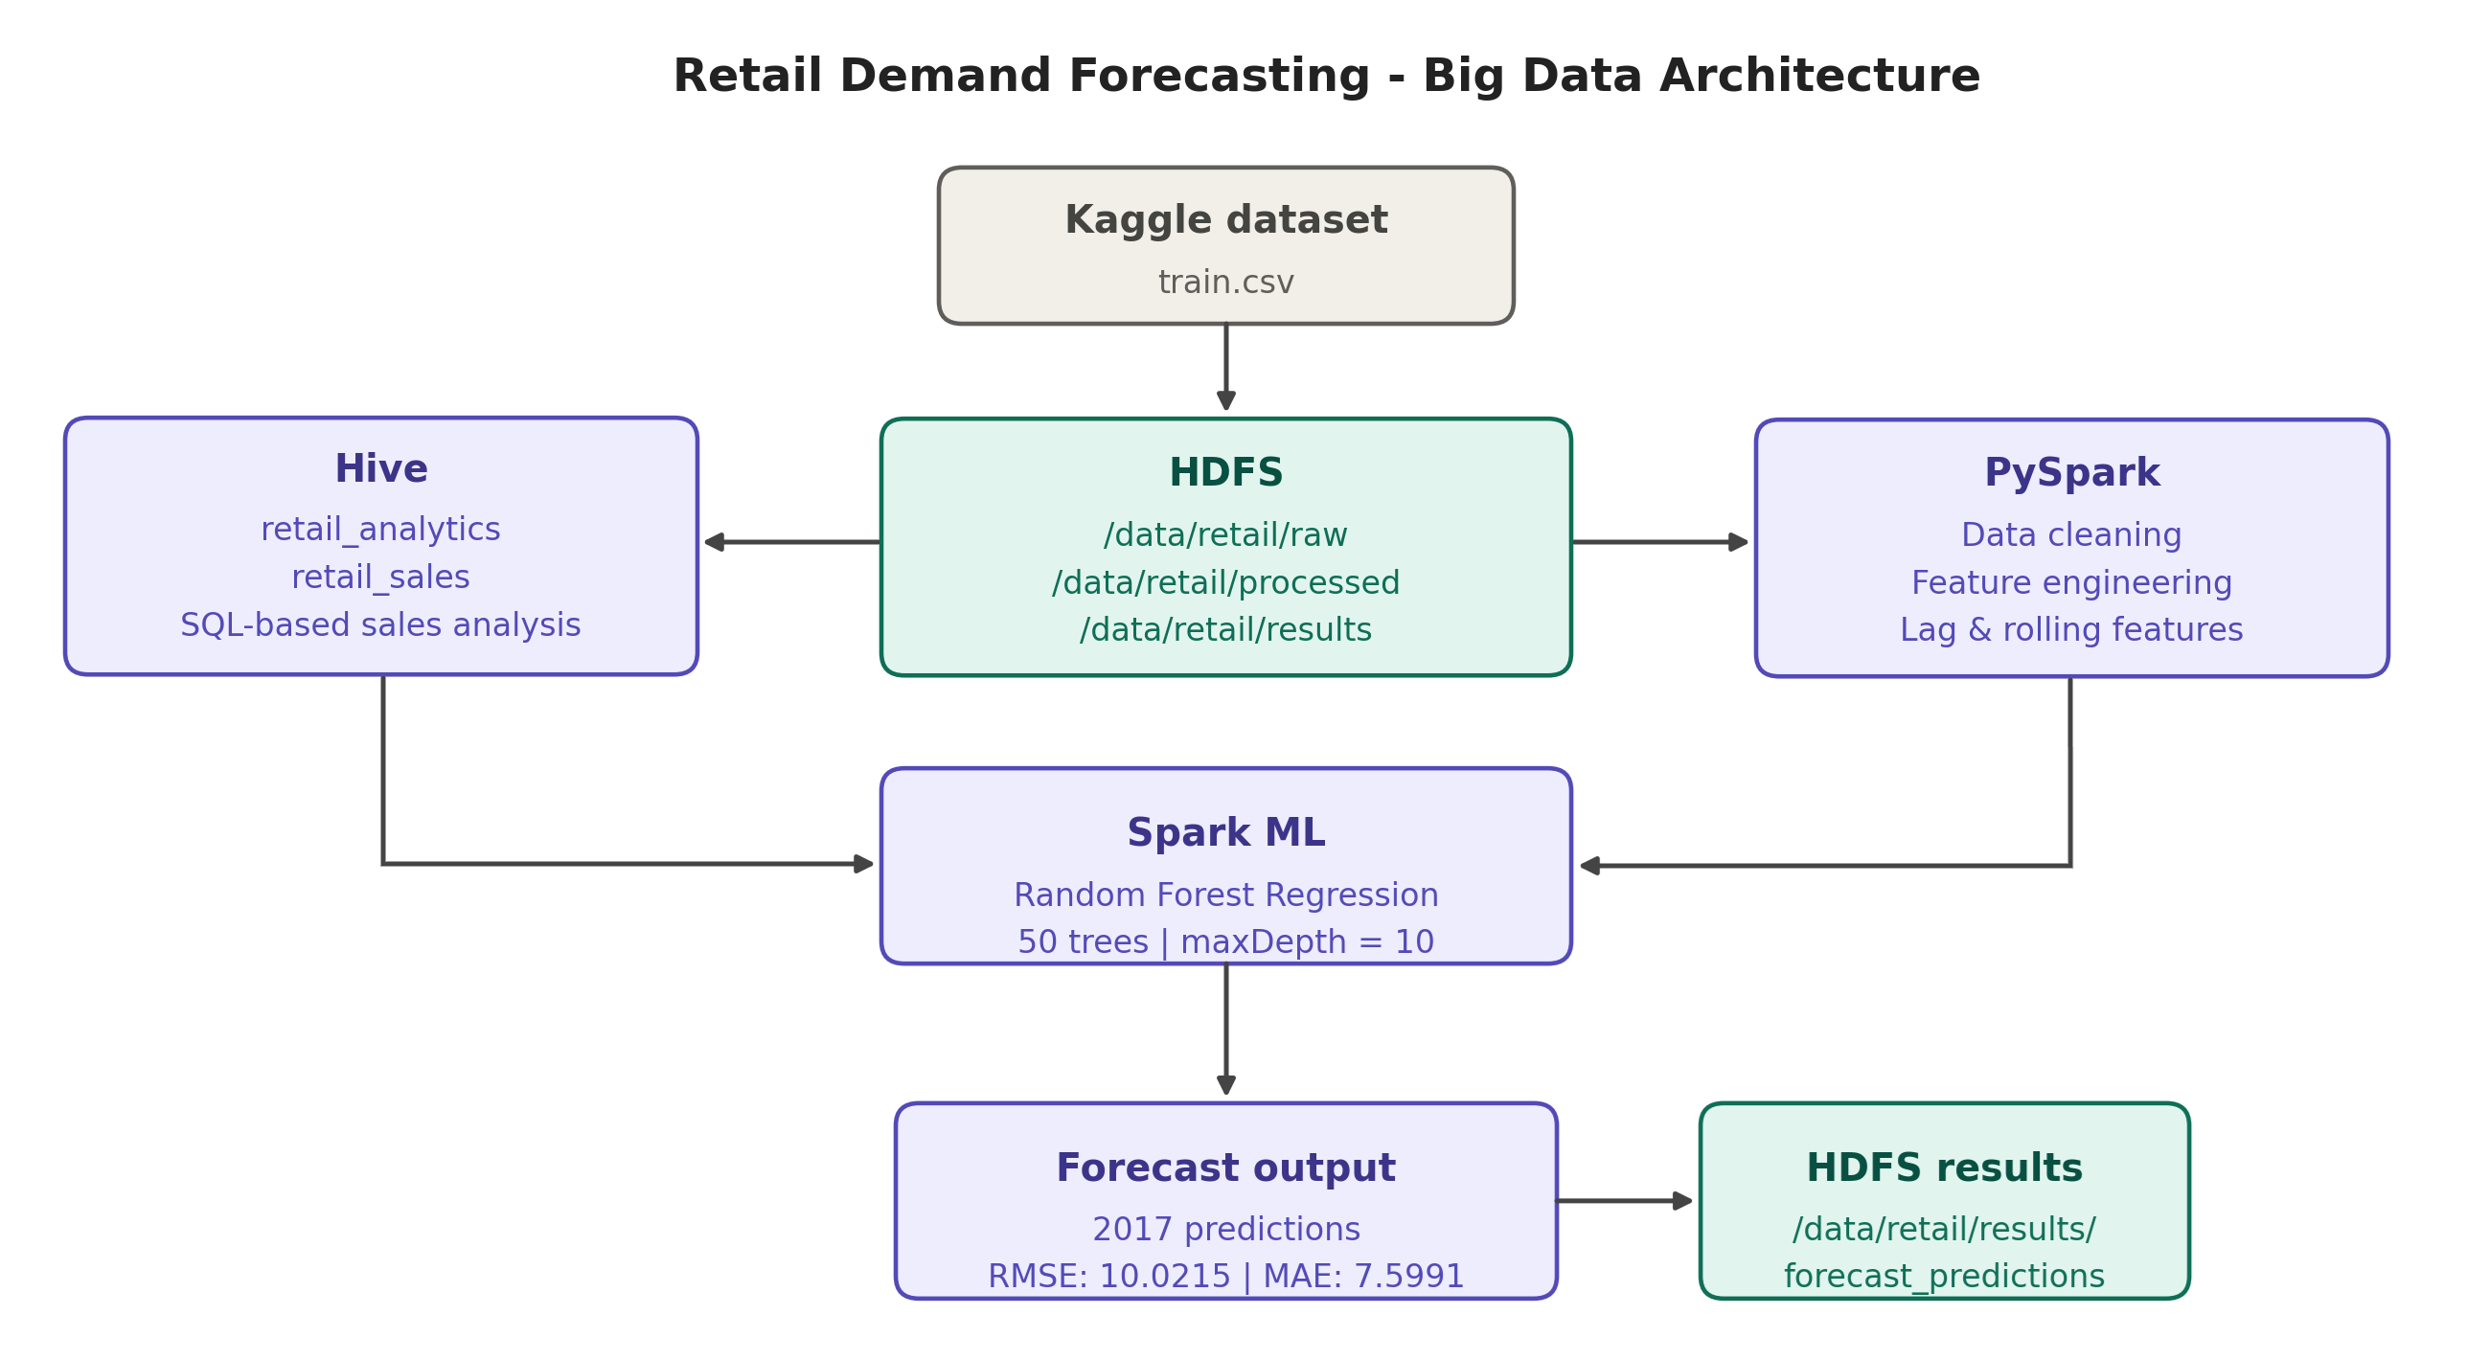
04
End-to-End Big Data Architecture
Storage → SQL analytics → distributed processing → ML → HDFS results
Group 7 • Retail Demand Forecasting

Slide 5
05
HDFS + Hive
HDFS STORAGE
HIVE DATA MODEL
Raw: /data/retail/raw/train.csv
Processed: /data/retail/processed
Results: /data/retail/results
HDFS provides the distributed storage layer.
Database: retail_analytics
Table: retail_sales
External table over HDFS
Hive provides the SQL-oriented analytics layer.
CREATE EXTERNAL TABLE retail_sales (
sale_date DATE,
store INT,
item INT,
sales INT
)
LOCATION '/data/retail/raw/';
SELECT store, SUM(sales) AS total_sales
FROM retail_sales
GROUP BY store
ORDER BY total_sales DESC;
Group 7 • Retail Demand Forecasting

Slide 6
06
Key Hive Findings
6,120,128
1,607,442
10,733,740
1,171,393
Store 2 total sales
Item 15 total sales
2017 annual sales
July 2017 sales
SEASONAL PATTERN
TOP STORE-ITEM COMBINATION
Sales increased across the years from 2013 to 2017.
July repeatedly appears as a strong seasonal demand period, with July 2017 reaching 1,171,393 units.
Store 2 + Item 28
205,677 total sales
Other strong combinations were also concentrated around Stores 2 and 8.
Group 7 • Retail Demand Forecasting

Slide 7
07
Spark / PySpark Processing
Data quality
0
913K
NULL values
distinct records
TRANSFORMATION
FORECAST FEATURES
TIME-BASED SPLIT
Convert date to Spark date type
Extract year, month, day and day_of_week
Prepare analytical fields
lag_1 = previous-day sales
lag_7 = 7-day lag
rolling_7 = previous 7-day average
Train: 2013–2016
727,000 records
Test: 2017
182,500 records
PySpark reads the dataset directly from HDFS and performs distributed transformations before Spark ML training.
Group 7 • Retail Demand Forecasting

Slide 8
08
Forecasting Model
MODEL
FEATURES
WHY TIME SPLIT?
Random Forest Regression
Spark ML
50 trees
maxDepth = 10
seed = 42
lag_1
lag_7
rolling_7
The model is trained only on historical data and tested on the future year 2017.
This avoids using future observations to predict the past.
Prediction output → date, store, item, actual sales, prediction
Group 7 • Retail Demand Forecasting

Slide 9
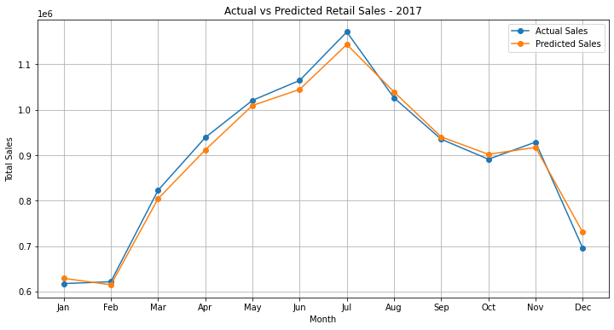
09
Model Performance — 2017
10.0215
7.5991
RMSE
MAE
INTERPRETATION
Predictions follow the broad seasonal movement of 2017 actual sales.
The July peak is captured closely.
The largest visible deviation occurs near December, where predicted demand is above actual demand.
Forecasts were written to HDFS: /data/retail/results/forecast_predictions
Group 7 • Retail Demand Forecasting

Slide 10
10
Distributed Spark Evidence
01 SPARK MASTER
02 APPLICATION / JOBS
03 EXECUTORS
Shows the Spark cluster and worker status.
Evidence of the distributed execution environment.
Shows Spark application jobs/stages after notebook execution.
Evidence that Spark executed the workload.
Shows executor activity/resources.
Evidence supporting distributed processing.
Spark Master → Spark Worker
↓
PySpark Application
↓
Spark Jobs
↓
Executors
Group 7 • Retail Demand Forecasting

Slide 11
11
Integration & Result Storage
HDFS
Hive
PySpark
Spark ML
HDFS
Store raw data
→
SQL analysis
→
Clean + transform
→
Forecast
→
Store predictions
Final result path
HBASE / PIG
/data/retail/results/forecast_predictions
Not used in this implementation.
The official guide allows HBase/Pig where applicable or instructed; we do not claim technologies that were not meaningfully used.
Group 7 • Retail Demand Forecasting

Slide 12
12
Results & Business Insights
47.7M
10.733M
July
10.0215
total sales
2017 sales
peak month
RMSE
• Historical demand increased from 2013 to 2017.
• Store 2 and Item 15 were the strongest overall performers.
• July showed the strongest seasonal demand pattern.
• Random Forest captured the broad 2017 demand movement.
• The complete workflow produced reproducible forecasts and stored them back in HDFS.
Group 7 • Retail Demand Forecasting

