Slide 1
Retail Demand Forecasting
Using Big Data Analytics
HDFS • Hive • PySpark • Spark ML
HCL GUVI × JAIN UNIVERSITY
[Group / Member Names]

Slide 2
1. Business Problem & Objective
Understand retail demand variation across stores, products and time.
Analyze historical demand patterns using Big Data technologies.
Build a reproducible demand forecasting workflow.
Dataset: 913,000 historical store-item daily sales records.

Slide 3
2. Dataset
File: train.csv
Columns: date, store, item, sales
913,000 records
10 stores and 50 items across 2013–2017
Target variable: sales

Slide 4
3. Big Data Architecture
train.csv
HDFS
Raw
Hive
SQL
PySpark
Transform
Spark ML
Forecast
HDFS
Results
HDFS = distributed storage | Hive = SQL analysis | Spark = distributed processing and ML
Docker hosts the Hadoop/Spark ecosystem.

Slide 5
4. HDFS + Hive
Raw HDFS path: /data/retail/raw/train.csv
Hive database: retail_analytics
Hive table: retail_sales
External table reads data from HDFS.
Analyses: store-wise, item-wise, yearly, monthly and store-item demand.

Slide 6
5. Key Hive Findings
Store 2 — highest total sales: 6,120,128
Item 15 — highest total sales: 1,607,442
2017 — highest annual sales: 10,733,740
July 2017 — highest monthly sales: 1,171,393
Store 2 + Item 28 — highest store-item combination: 205,677

Slide 7
6. PySpark Processing & Feature Engineering
Read train.csv directly from HDFS.
913,000 records; 0 NULL values; 913,000 distinct records.
Converted date to Spark date type.
Created year, month, day and day_of_week.
Created lag_1, lag_7 and rolling_7 features per store-item pair.

Slide 8
7. Forecasting Model
Model: Random Forest Regression using Spark MLlib.
Features: lag_1, lag_7, rolling_7.
Time-based split: 2013–2016 training; 2017 testing.
Training records: 727,000.
Testing records: 182,500.

Slide 9
8. Model Performance
RMSE: 10.0215
MAE: 7.5991
Predictions follow the broad 2017 seasonal pattern.
July remains the peak-demand month.
Forecast predictions were stored back in HDFS.

Slide 10
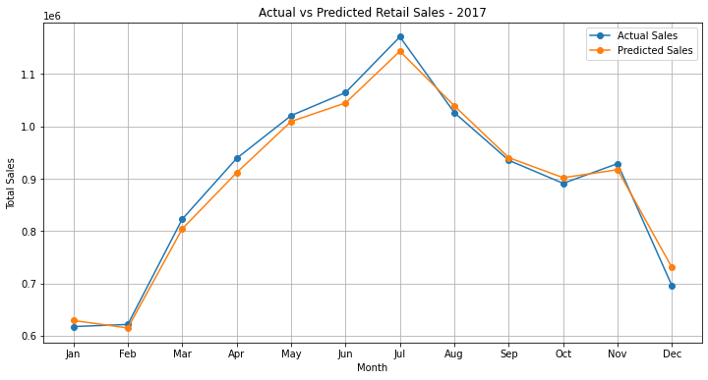
9. Actual vs Predicted Sales — 2017

Slide 11
10. Integration & Result Storage
End-to-end flow: HDFS → Hive → PySpark → Spark ML → HDFS.
Forecast output: /data/retail/results/forecast_predictions
Spark produced distributed part-*.csv files and _SUCCESS.
HBase/Pig were not used in this implementation unless specifically required by the trainer.

Slide 12
11. Conclusion
Historical demand increased from 2013 to 2017.
Store 2 and Item 15 were the strongest overall performers.
July showed the strongest seasonal demand.
Random Forest captured the broad 2017 demand movement.
The complete workflow demonstrates distributed storage, SQL analytics, Spark processing and ML forecasting.

Slide 13
12. Individual Contribution
[Your Name] — Spark/PySpark forecasting, feature engineering, Random Forest and evaluation.
[Member 1] — HDFS/data ingestion.
[Member 2] — Hive/data modeling.
[Member 4] — Advanced technology/integration, only if actually used.
[Member 5] — Integration/documentation.
Replace placeholders with the team's actual contributions.

Slide 14
13. Q&A — Be Ready
Why HDFS? — Distributed storage.
Why Hive? — SQL analysis over HDFS data.
Why Spark? — Distributed processing and ML.
Why time-based split? — Prevents future observations from training on the past.
What are lag features? — Previous demand values used as predictors.
What do RMSE and MAE measure? — Prediction error.
Explain the complete pipeline from CSV to forecast.

