Slide 1

Rainfall Prediction
Code Warriors
AU1841058 DEEPKUMAR PATEL
AU1841068 DEVARSH SUTHAR
AU1841081 DHRUV PANCHAL
AU1841083 VISHVAS PATEL

Slide 2
Introduction
Rainfall prediction is a major problem for the meteorological department as it is closely associated with the economy and human life.
Accuracy of rainfall forecasting has great importance for countries like India whose economy is highly dependent on agriculture.
There are hardware devices for predicting rainfall by using the weather conditions like temperature, humidity, etc. But these traditional methods cannot work efficiently. However, by using machine learning techniques we can produce accurate results by analyzing historical rainfall data.

Slide 3
Problem Statement
India is primarily an agricultural country, with crop productivity and rainfall playing a large role in its economy.
Rainfall prediction is required and mandatory for all farmers in order to analyze crop productivity.
The imprecise and inaccurate prediction lead to inefficient management of crisis like poor agriculture, poor water reserves and poor management of floods.
Predicting the condition of the atmosphere using science and technology is known as rainfall prediction.

Slide 4
GANTT Chart
Week 1
Week 2
Week 3
Week 4
Week 5
Week 6
Week 7
Week 8
Document Analysis
Dataset
Data Preprocessing
Regression Models
Feature Selection
Classifier Models
Comparison
Documentation

Slide 5
Existing body of work
Generating useful and machine understandable Dataset.
Data preprocessing
Feature selection (Permutation Feature Importance / Chi-square)
Normalizing data
Applying different classification model on the dataset and analyzing their accuracy score.
Random Forest Classifier
SVC Classifier
Logistic Regression
Gradient Boosting

Slide 6
Existing body of work
Obtained the Accuracy score for various classifiers with and without feature selection method. Also using different feature selection methods such as permutation importance and Chi-square feature selection.
Applied the various classifiers to the two classifications (Rain, No rain) and four classifications (No rain, Drizzle, Moderate rain, Heavy rain).
Two classifications
Rain
No rain
Four classifications
No rain
Drizzle
Moderate rain
Heavy rain
Comparison of all existing classifiers to the dataset for two classifications and four classifications.

Slide 7
Approach
We first applied the random forest classification algorithm to our dataset and analyzed the accuracy score.
Similarly, we applied the Support Vector Classification (SVC) algorithm to our dataset and analyzed the accuracy score.
For the feature selection, we used the Random forest classifier with permutation importance to achieve the most important features. After that, we trained our model with the selected important features and analyzed the accuracy score.
Similarly, we analyzed accuracy of the support vector classifier (SVC) with the permutation importance feature selection.

Slide 8
Approach
The permutation importance was performed by shuffle every row of feature column one by one. This will act as a noise column in the dataset, and if the predictor’s score goes down, it simply means that that feature is important to the data. When a feature is permuted and the prediction score increases, it indicates that the feature is not very important.
As an example, for the random forest classifier, we obtained important features such as DewPointC, cloudcover, uvIndex, and visibility.
Similarly, we used the Random forest classifier and svc with chi-square test to finds the k best features. After that, we trained our model with the selected important features and analyzed the accuracy score.
In addition, we applied logistic regression and gradient boosting classifiers.
Finally, the best classifier models are chosen by comparing the trained models for two (Rain and no rain) and four classifications (No rain, Drizzle, Moderate rain, Heavy rain).

Slide 9
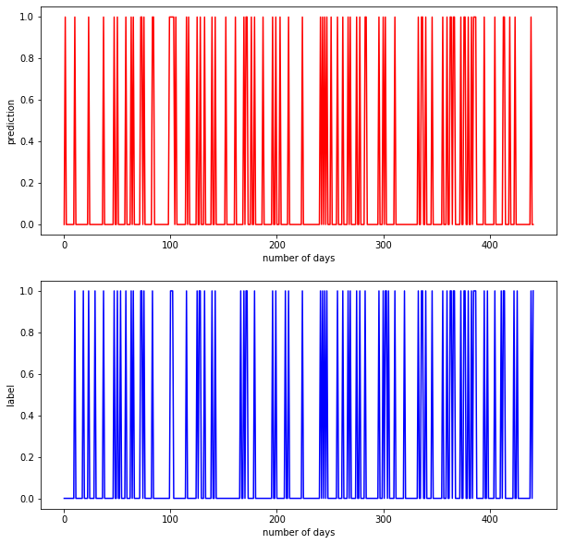
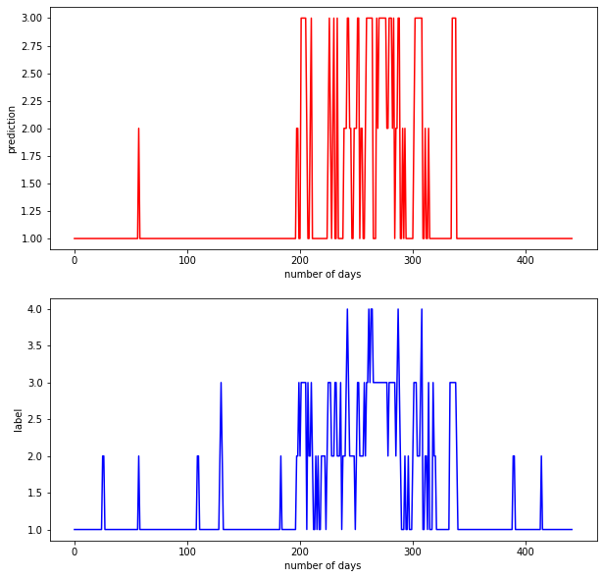
Final Results
Random forest (Permutation Importance)
Random forest (Chi-square)
[Figure 1]
Figure 1 depicts a binary classification ( Rain and No Rain).
The obtained accuracy is 93.44%
[Figure 2]
Figure 2 depicts four classifications ( No Rain, Drizzle, Moderate Rain, and Heavy Rain ).
The obtained accuracy is 83.71%.

Slide 10
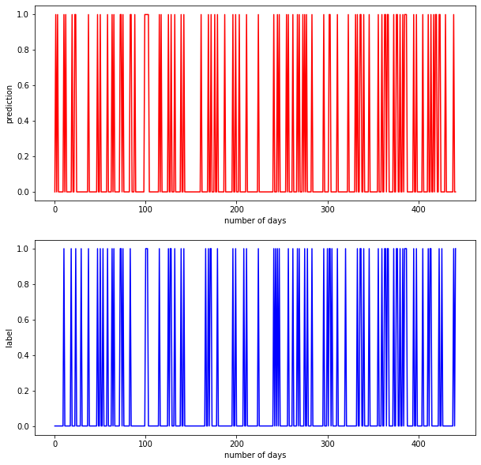
Final Results
SVC (Permutation Importance)
SVC (Chi-square)
[Figure 3]
Figure 3 displays a binary classification ( Rain and No Rain).
The obtained accuracy is 91.17%.
[Figure 4]
Figure 2 depicts four classifications ( No Rain, Drizzle, Moderate Rain, and Heavy Rain ).
Obtained Accuracy is 82.13%..

Slide 11
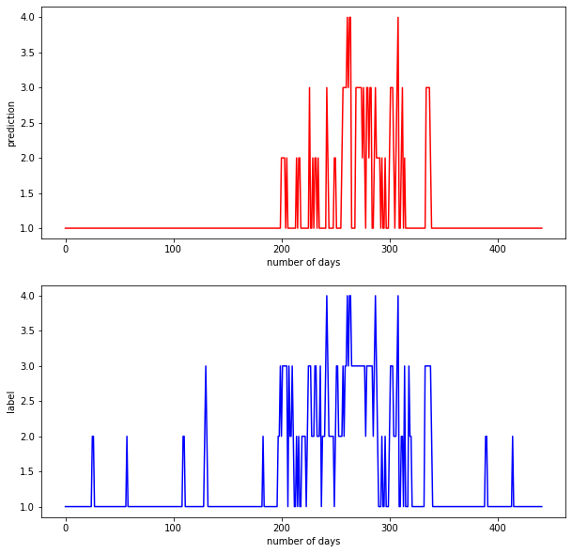
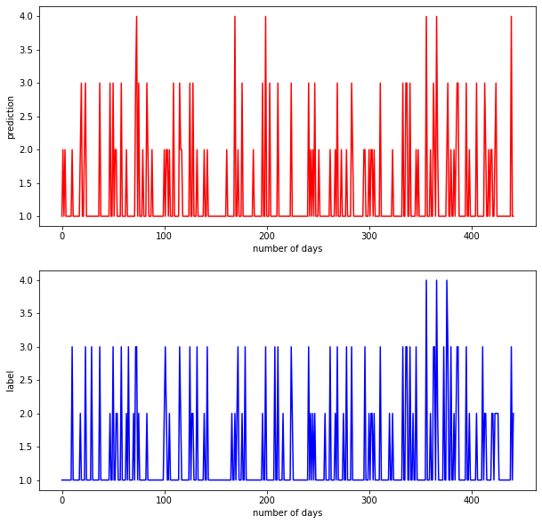
Final Results
Logistic Regression
Gradient Boosting
[Figure 5]
Figure 5 depicts four classifications ( No Rain, Drizzle, Moderate Rain, and Heavy Rain ).
The obtained accuracy is 81.45%.
[Figure 6]
Figure 6 depicts four classifications ( No Rain, Drizzle, Moderate Rain, and Heavy Rain ).
The obtained accuracy is 84.61%.

Slide 12
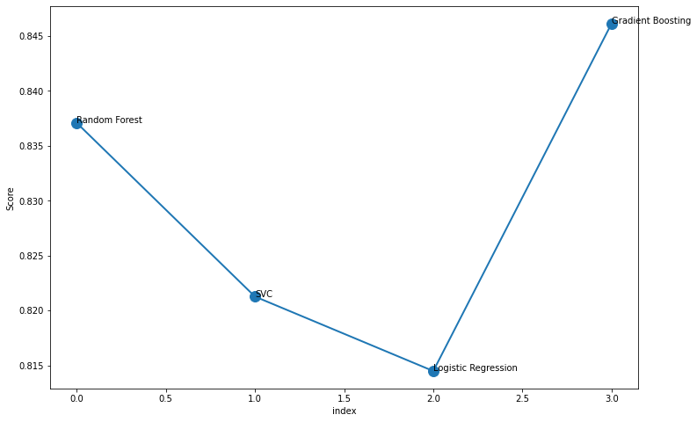
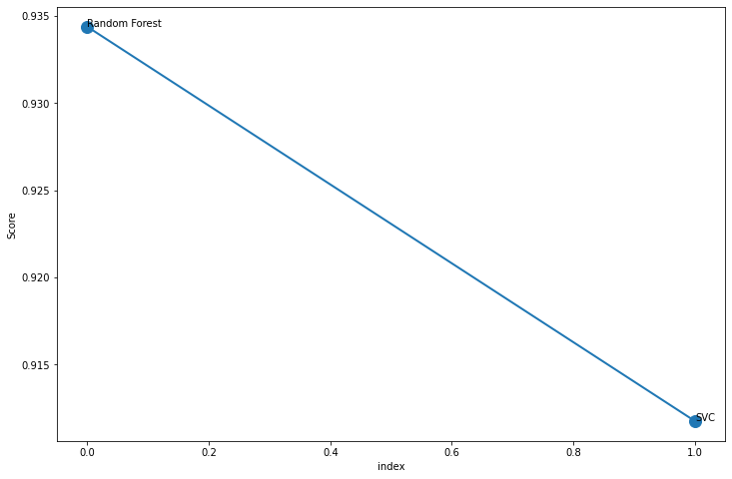
Final Results
Comparison of the four classifiers for the four rain classifications
Comparison of the two classifiers for the two classifications
[Figure 7]
Figure 6 depicts the accuracy-wise comparison of the four classifiers ( Random forest, SVC, Logistic regression, and Gradient boosting) for the four classifications (No Rain, Drizzle, Moderate Rain, and Heavy Rain).
[Figure 8]
Figure 8 depicts the accuracy-wise comparison of the two classifiers ( Random forest and SVC) for the two classifications (Rain and No Rain).

Slide 13
Conclusion
The accuracy of various classifiers such as Random forest, SVC, logistic, and Gradient boosting has been analyzed in our article.
The default accuracy of the random forest classifier (Before applying the permutation importance) is 92.7%. The accuracy improves to 93.4% after applying the permutation importance feature selection.
Whereas, the default accuracy of the Support vector classifier (Before applying the permutation importance) is 86%.
The accuracy improves to 91% after applying the permutation importance. As a result, the permutation importance feature selection helped us improve the model’s accuracy.
We discovered from the comparison graphs that training a model for only two classifications (Rain and No-Rain) gradually increases the model accuracy.
However, if we want a more detailed outcome and we increase the number of classifications (No rain, Drizzle, Moderate rain, and heavy rain ), the obtained accuracy is in the range of 80%~85%.
Furthermore, in the case of four classifications, gradient boosting achieves the highest accuracy. Random Forest is the second best model in terms of accuracy.

Slide 14
Role of each group member
Tasks | Deep | Devarsh | Dhruv | Vishvas
Coding | ✔ | ✔ | ✔ | ✔
Report Writing | ✔ | ✔ | ✔ | ✔
Documentation and Presentation | ✔ | ✔ | ✔ | ✔

Slide 15
References
https://towardsdatascience.com/obtain-historical-weather-forecast-data-in-csv-format-using-python-5a6c090fc828
https://www.ijstr.org/final-print/jan2020/Prediction-Of-Rainfall-Using-Machine-Learning-Techniques.pdf
https://machinelearningmastery.com/feature-selection-with-real-and-categorical-data/

