Slide 1

Rainfall Prediction
Code Warriors
Deepkumar Patel - AU1841058
Devarsh Suthar - AU1841068
Dhruv Panchal - AU1841081
Vishvas Patel - AU1841083

Slide 2
Introduction
Rainfall prediction is a major problem for the meteorological department as it is closely associated with the economy and human life.
Accuracy of rainfall forecasting has great importance for countries like India whose economy is highly dependent on agriculture.
There are hardware devices for predicting rainfall by using the weather conditions like temperature, humidity, etc. But these traditional methods cannot work efficiently. However, by using machine learning techniques we can produce accurate results by analyzing historical rainfall data.

Slide 3
Problem Statement
India is primarily an agricultural country, with crop productivity and rainfall playing a large role in its economy.
Rainfall prediction is required and mandatory for all farmers in order to analyze crop productivity.
The imprecise and inaccurate prediction lead to inefficient management of crisis like poor agriculture, poor water reserves and poor management of floods.
Predicting the condition of the atmosphere using science and technology is known as rainfall prediction.

Slide 4
Existing Body Of Work
Generating useful and machine understandable Dataset.
Data preprocessing
Feature selection (remove highly correlated features)
Normalizing data
Applying different regression model on the dataset and analyzing their regression score.
.

Slide 5
Our Approach
Initially, we started exploring different articles and research papers to understand our topic well.
Further, we created a script to extract the dataset from an API. The API had day-wise rainfall and weather data of every city. We only extracted data of Ahmedabad city from the past 11 years (i.e, 2009-2020 ) by executing the created script. The extracted data contains an hourly forecast of parameters such as precipitation(MM), temperature, wind speed, pressure, visibility, etc.
Further, we defined labels and features for our dataset.

Slide 6
Our Approach
Then we did the feature selection for our model using the correlation method. For that, we found highly correlated features among all the features. If two of the features are highly correlated (i.e, if the correlation is > 90%), we discarded one of the feature.
Further, we splitted our data into training and testing category.
Then we started applying different types of regression models to our dataset.
Initially, we applied linear regression to our dataset and analyzed its regression score.
Similarly, we applied ridge, lasso, and logistic regression on our dataset and analyzed its regression score.

Slide 7
Initial Results
We now have the final dataset to work on with.
To compare outcomes, we used linear, ridge, and lasso regression. However, since rain precipitation has several spikes (for example, in the monsoon, some days there is no rain at all and the next day it is heavy rain). Hence, we got similar pattern of the prediction but predicted values are not nearly as labeled. (figure 1)
Ridge and lasso regression are also less accurate. So we tried to categorise the types of rain (e.g., no rain, drizzle, moderate rain, heavy rain), and while the results are better than before, they are still not satisfactory. (figure 2)
Finally, we used logistic regression and compact out classification in binary form (for example, rain vs. no rain) to achieve an accuracy of nearly 90%. (figure 3)

Slide 8
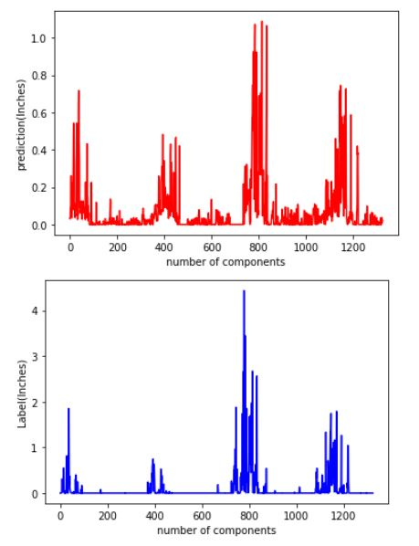
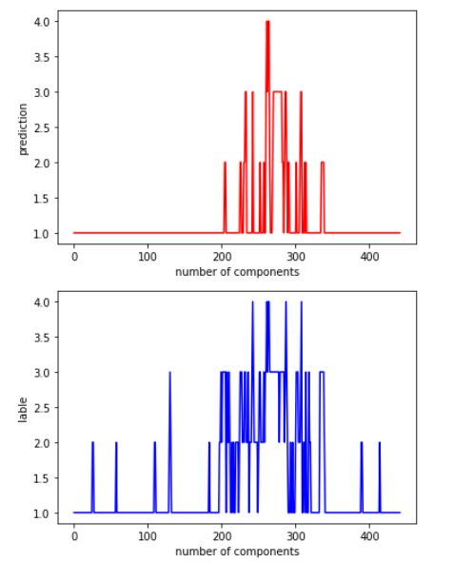
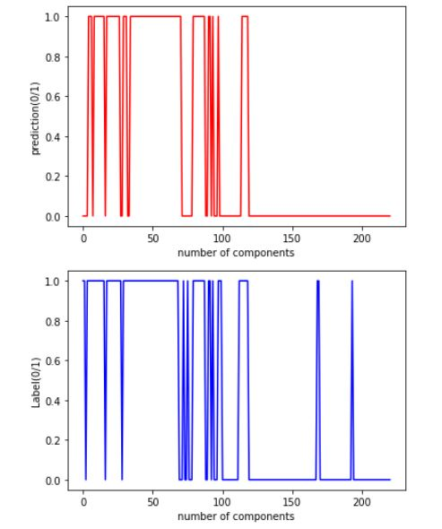
Initial Results
Figure 1
Figure 2
Figure 3

Slide 9
Role of Each Group Member
Tasks | Deep | Devarsh | Dhruv | Vishvas
Coding | ✔ | ✔ | ✔ | ✔
Report Writing | ✔ | ✔ | ✔ | ✔
Documentation and Presentation | ✔ | ✔ | ✔ | ✔

Slide 10
Future Work
We will choose the optimal regression model by comparing the regression score of all the models that have been used.
Furthermore, we plan to categorise the predicted rainfall into four categories: no rain, drizzle, moderate rain or heavy rain. Finally, we aim to achieve higher accuracy of the regression model to improve the prediction.

Slide 11
References
https://towardsdatascience.com/obtain-historical-weather-forecast-data-in-csv-format-using-python-5a6c090fc828
https://www.ijstr.org/final-print/jan2020/Prediction-Of-Rainfall-Using-Machine-Learning-Techniques.pdf
https://machinelearningmastery.com/feature-selection-with-real-and-categorical-data/
https://machinelearningmastery.com/feature-selection-with-real-and-categorical-data/

