Slide 1
Personal Portfolio Website
Project Submission by Vishwas Verma
Technologies Used: HTML, CSS, JavaScript

Slide 2
Introduction
This project is a personal portfolio website created to showcase skills, projects, and resume. It uses HTML for structure, CSS for styling, and JavaScript for interactivity. The objective is to develop a visually appealing, responsive, and interactive portfolio.

Slide 3

Technology Stack
• HTML: Used for the structure of the website.
• CSS: Applied for styling and layout design.
• JavaScript: Adds interactivity and dynamic content to the website.

Slide 4
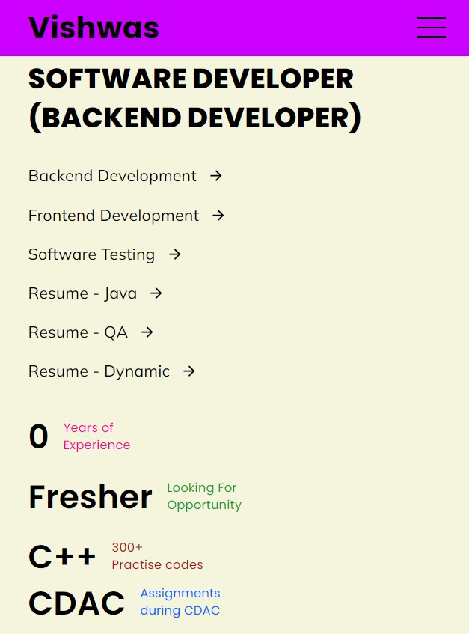
Home Page Design
• The home page features a hero section with your name, bio, and profile picture.
• Includes smooth navigation links to other sections like About, Projects, and Contact.
• The layout is designed to be simple and clean with a focus on user experience.

Slide 5
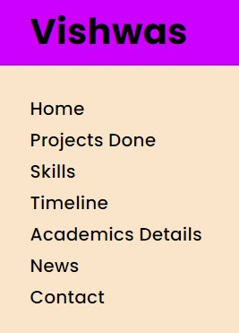
About Page
• The About page provides information about your education, experience, and hobbies.
• HTML is used to structure the content, and CSS styles the page with a balanced layout.
• The page focuses on presenting key information clearly and professionally.

Slide 6
Projects Section
• This section showcases your projects with titles, descriptions, and images.
• Each project is presented with a brief overview and technologies used.
• CSS is used to organize the projects into an appealing gallery layout.

Slide 7
Contact Form
• The contact page includes a form with fields for name, email, subject, and message.
• JavaScript is implemented for form validation, ensuring that required fields are filled out.
• The form provides an easy way for potential employers or collaborators to reach out.

Slide 8
Responsive Design
• The website is responsive, adapting to different screen sizes like desktops, tablets, and mobiles.
• Media queries are used to adjust the layout and ensure the design looks good on all devices.
• CSS flexbox and grid systems are employed for flexibility in layout.

Slide 9
Interactivity with JavaScript
• JavaScript is used to add interactive features like smooth scrolling, toggling the navbar, and hover effects.
• The navbar changes dynamically based on user interaction.
• Form validation is handled through JavaScript, ensuring a smooth user experience.

Slide 10
Conclusion
• The personal portfolio website successfully combines HTML, CSS, and JavaScript.
• It provides a platform to showcase projects and allows potential clients or employers to contact you.
• The project demonstrates strong skills in front-end development and web design.

Slide 11
Contact Information
• Email: vishwasv834@gmail.com
• LinkedIn: https://www.linkedin.com/in/vishwas-verma-364418138/
• GitHub: https://github.com/Vishverwasma
• Url – Link : https://vishwas-personal-portfolio.vercel.app/

