Slide 1
Problem Statement No.7 – AI Agent for Digital Financial Literacy
CAPSTONE PROJECT
Presented By:
Vishvesh Sharma
GLS University-FET
CSE

Slide 2
OUTLINE
Problem Statement (Should not include solution)
Proposed System/Solution
System Development Approach (Technology Used)
Algorithm & Deployment
Result (Output Image)
Conclusion
Future Scope
References

Slide 3
Problem Statement
Millions of Indians lack practical knowledge about digital financial tools like UPI, online banking, budgeting, and personal finance management. Static educational content isn’t enough; people need an interactive, multilingual AI agent that explains, answers, and guides them — especially to avoid frauds and misuse. There’s a need for an AI-driven solution that retrieves trusted information from government portals, bank sites, and educational content to make financial literacy accessible, personalized, and culturally inclusive.

Slide 4
Proposed Solution
The proposed system addresses the challenge of digital financial literacy by offering an AI-powered, multilingual assistant using RAG on IBM Cloud to deliver trusted, real-time answers. The solution includes:
🔹 Data Collection:
Curate verified docs & FAQs from RBI, NPCI, SEBI, and banks.
Regularly update to add new policies and fraud alerts.
🔹 Data Preprocessing:
Clean data, remove duplicates, and split into answerable passages.
🔹 RAG Algorithm:
Watson Discovery retrieves relevant content.
IBM Granite LLM generates clear answers.
Multilingual support (e.g., Hindi, English).
🔹 Deployment:
Chatbot built with IBM Watson Assistant.
Backend APIs via IBM Cloud Functions / Code Engine.
Store user queries and context in IBM Cloudant.
🔹 Result:
Interactive agent that helps users understand topics like UPI, budgeting, and online safety — in their language.

Slide 5
System Approach
Component | Technology
Large language model | IBM Granite (Lite)
Retrieval & NLP | Watson Discovery (Lite version unavailable)
Chat interface | Watson Assistant (Lite)
Backend / APIs | IBM Cloud Functions / Code Engine
Data storage | IBM Cloudant (Lite)
Frontend | React.js (hosted on IBM App Service / Object Storage)

Slide 6
Algorithm & Deployment
In this project, we use Retrieval-Augmented Generation (RAG) to deliver trusted, conversational answers about digital finance.
🔹 Algorithm Selection:
Combine IBM Watson Discovery (retrieves verified content) + IBM Granite LLM (generates natural language answers).
RAG ensures answers stay up-to-date, trusted, and context-aware — critical for financial literacy.
🔹 Data Input:
Curated docs & FAQs from RBI, NPCI, SEBI, and banks.
User questions (English, Hindi, others).
Context (e.g., user’s preferred language).
🔹 Retrieval & Generation Process:
Retrieve: Watson Discovery finds the best-matching passages.
Augment: Combine passages with user query.
Generate: IBM Granite produces the final, clear answer.
🔹 Deployment:
Backend RAG pipeline & APIs on IBM Cloud Functions / Code Engine (Lite).
Chat interface via Watson Assistant (Lite) in a React.js web app.
Store chat history & context in IBM Cloudant (Lite).
Fully deployed on IBM Cloud Lite, making it scalable & low-cost.

Slide 7
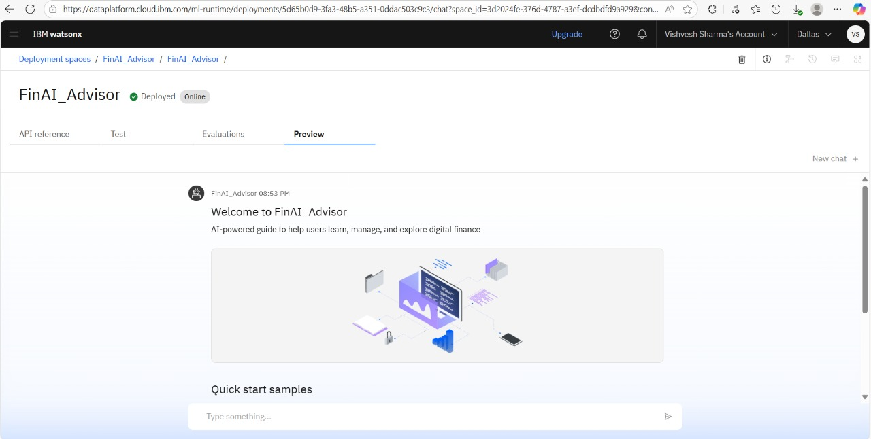
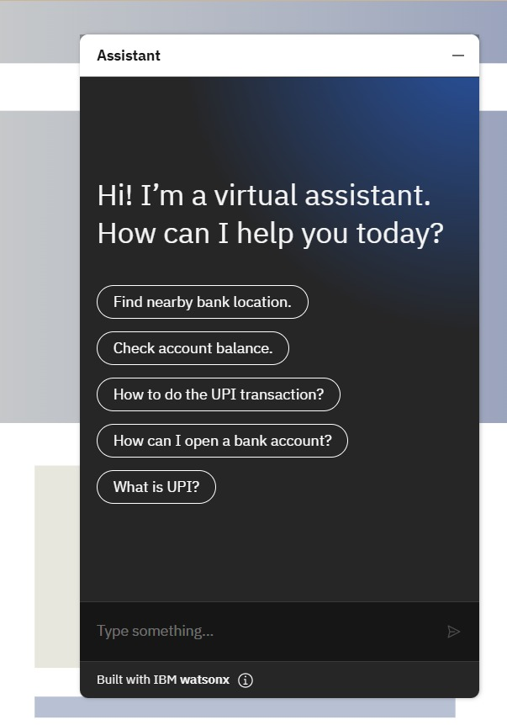
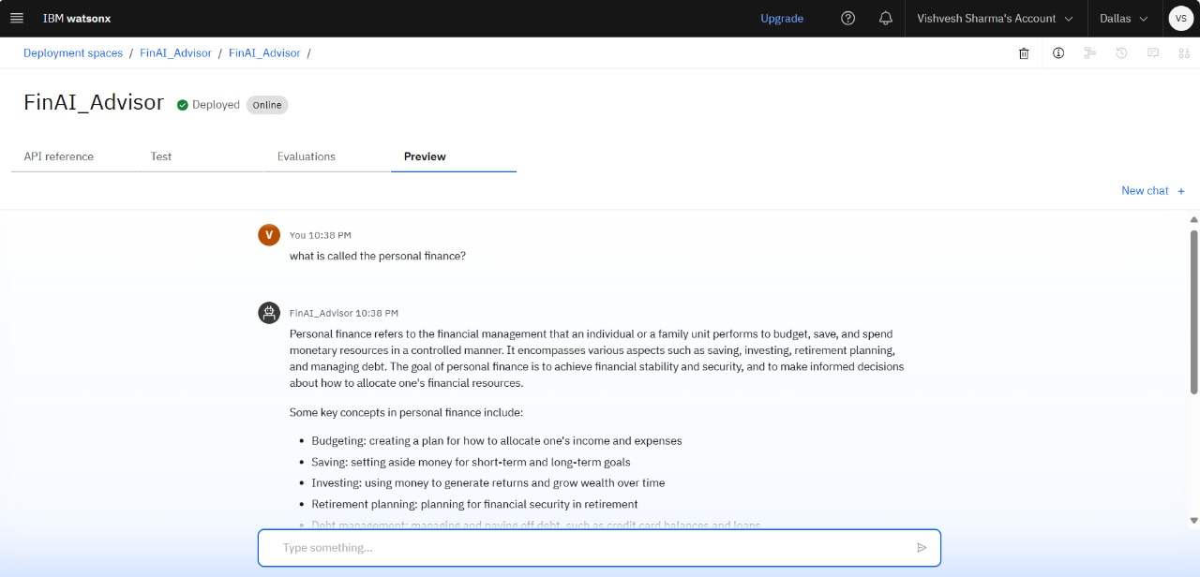
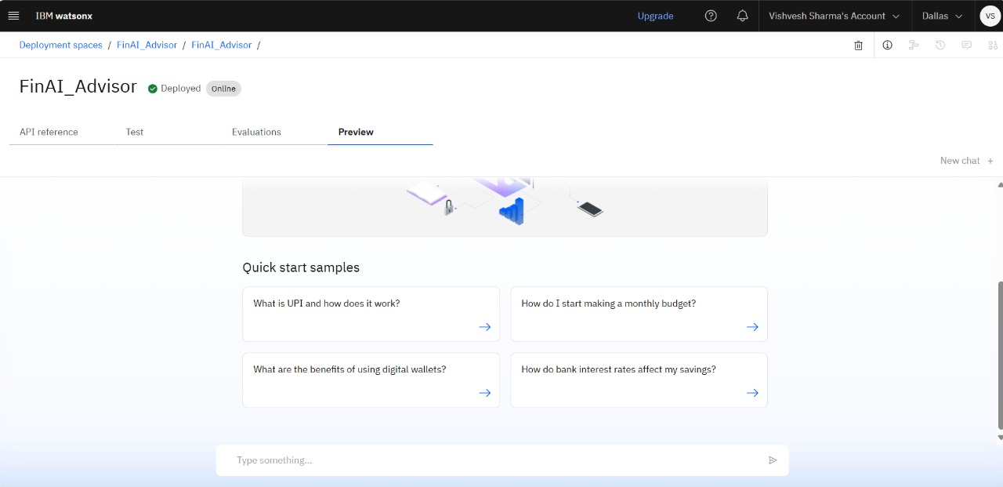
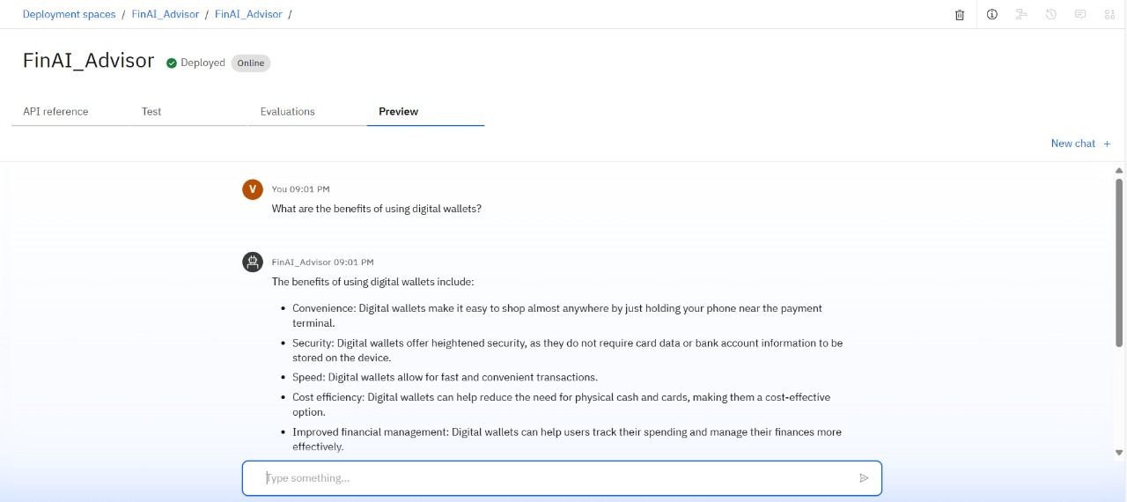
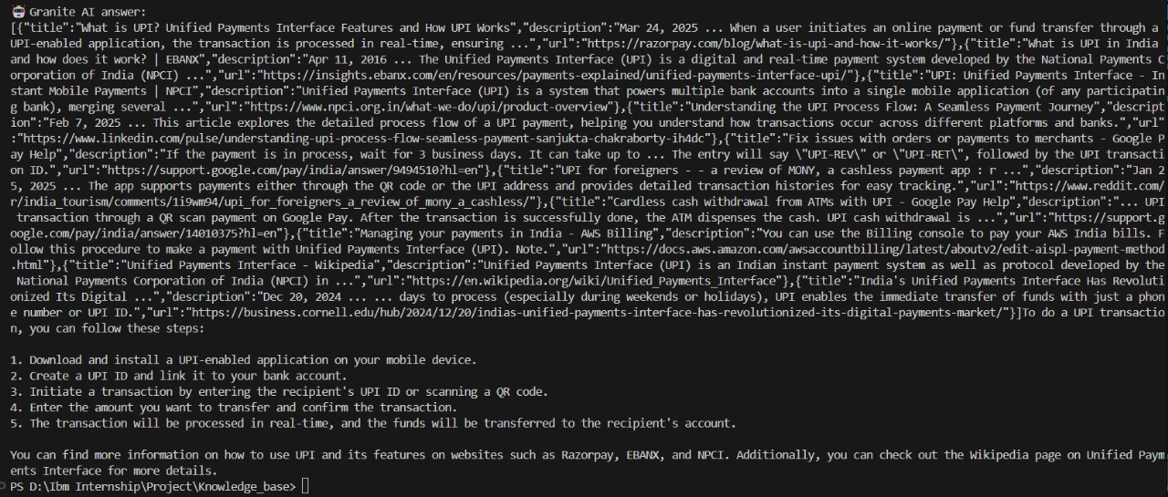
Result
Also Deployed locally with Granite IAM endpoint
GitHub Repo Link:- Link

Slide 8
Conclusion
Developed an AI-powered assistant using RAG (IBM Granite + Watson Discovery) to explain digital finance topics.
Solution effectively delivers trusted, multilingual, and interactive answers to users’ questions.
Faced challenges in data curation and adding multilingual support; scope to extend to more languages.
Enhances digital financial literacy, reduces fraud risk, and builds user confidence in online finance.

Slide 9
Future scope
Expand to 10+ Indian languages.
Add voice assistant.
Integrate live policy / scheme updates.
Connect to government portals via APIs.
Explore integration with mobile apps
Optimize RAG pipeline with better retrieval and answer generation

Slide 10
References
IBM. IBM Watson Discovery Documentation. https://cloud.ibm.com/docs/discovery
IBM. IBM Granite Models Overview. https://www.ibm.com/products/granite-models
NPCI. Unified Payments Interface (UPI) and Digital Payments Awareness. https://www.npci.org.in/what-we-do/upi/product-overvie
Reserve Bank of India (RBI). Digital Literacy and Financial Education Resources. https://www.rbi.org.in/financialeducation/home.aspx
Lewis, P., Perez, E., Kiela, D., et al. (2020). Retrieval-Augmented Generation for Knowledge-Intensive NLP Tasks. https://arxiv.org/abs/2005.11401
IBM Cloud Docs. Building Multilingual Chatbots with Watson Assistant. https://cloud.ibm.com/docs/assistant
Digital Economy and Smart Financial Management: Using AI Tools for Financial Literacy
https://ebooks.iospress.nl/doi/10.3233/ATDE250123
ChatGPT by OpenAI https://openai.com/chatgpt

Slide 11
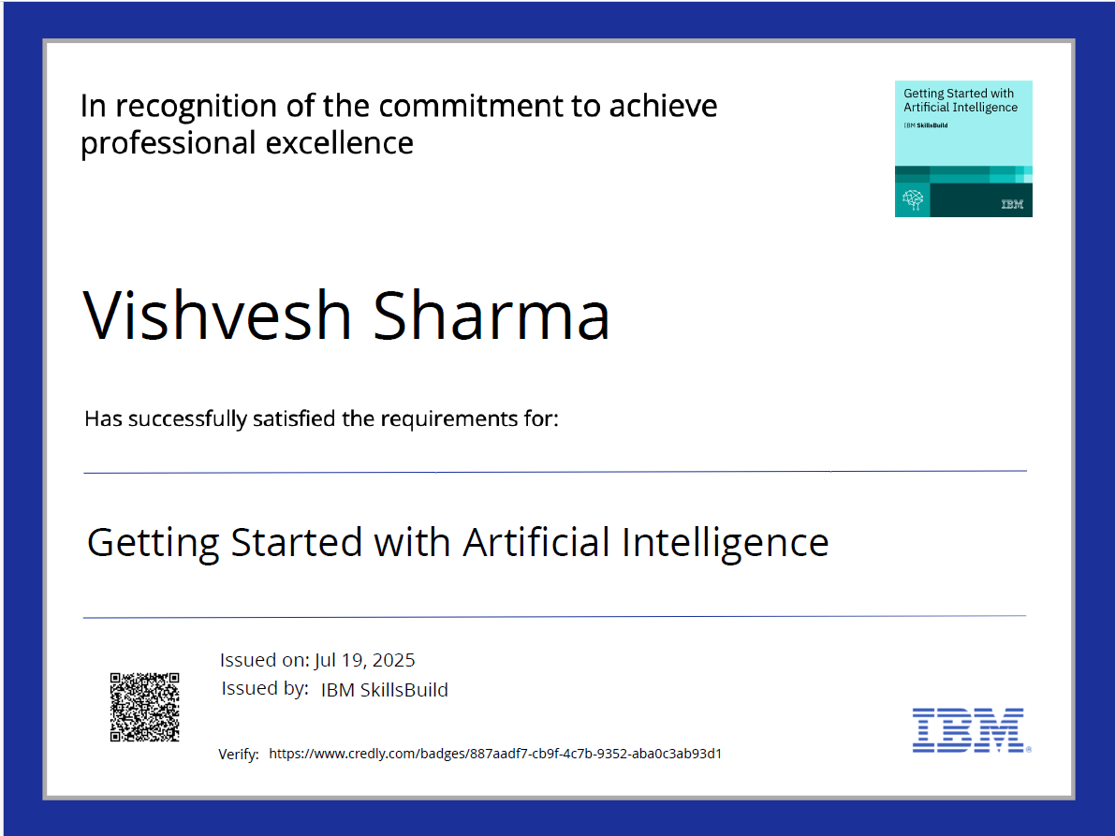
IBM Certifications
Screenshot/credly certificate( getting started with AI)

Slide 12
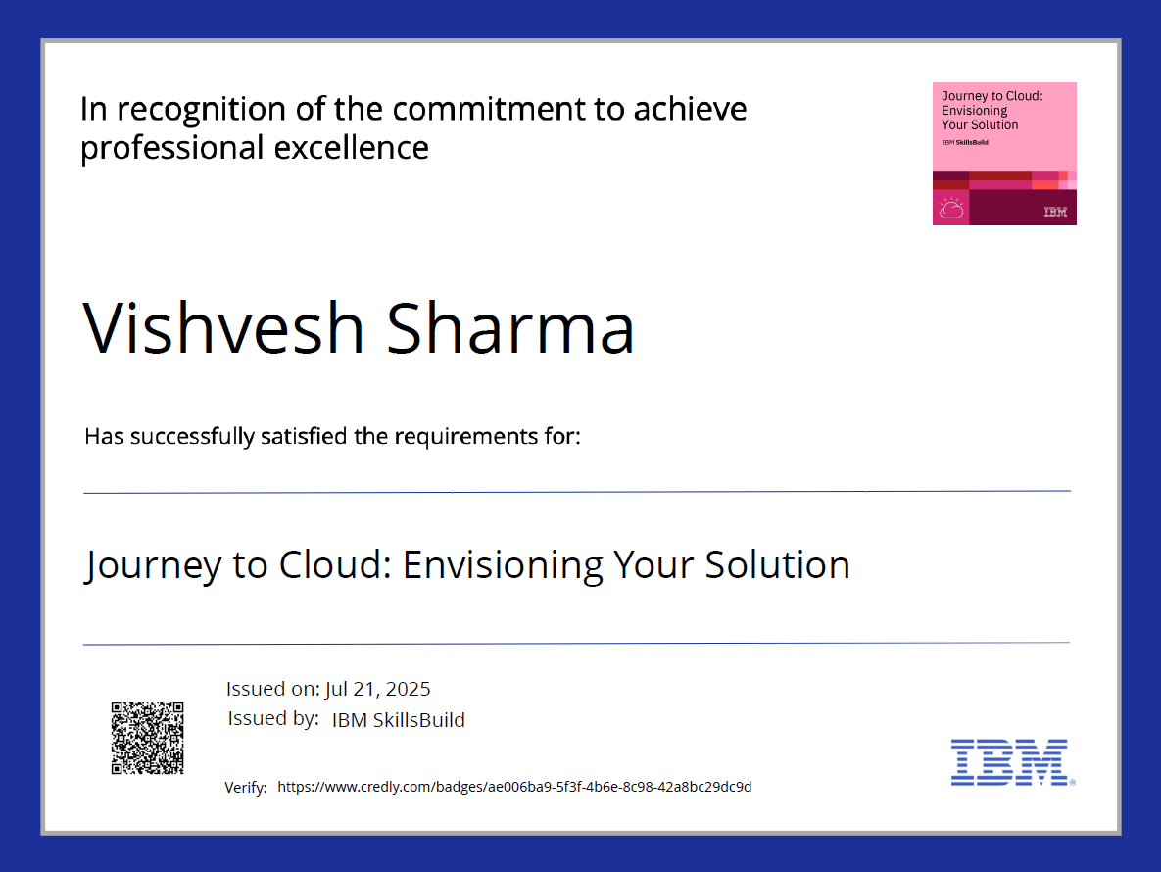
IBM Certifications
Screenshot/credly certificate( Journey to Cloud)

Slide 13
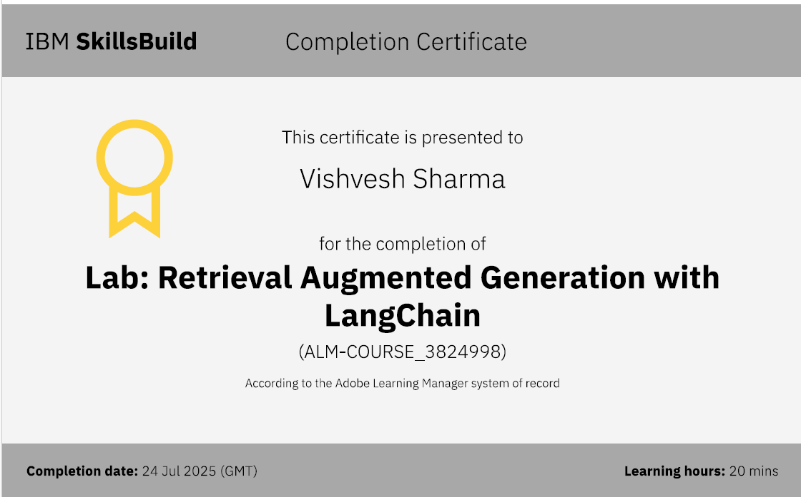
IBM Certifications
Screenshot/credly certificate( RAG Lab)

Slide 14
THANK YOU

