Slide 1

FinX – Loan Agreement Intelligence
Nexus Hackathon
Notes:
1

Slide 2


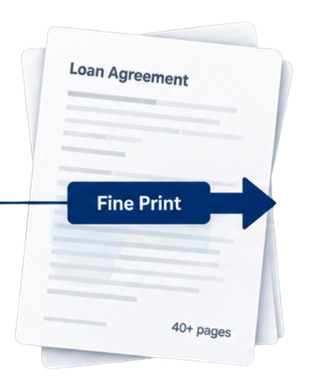

The Problem
Borrowers See the Loan, Not the Risk
A loan agreement contain everything the borrower needs to know – but the important details are spread across pages of legal and financial language.
What borrower see
What gets Overlooked?
The key numbers look simple.
Important details are buried in the fine print.
Loan Amount
35,00,000
Hidden Charges - Processing , legal, insurance and other fees.
Interest Rate
8.35%
Penalty Clauses - What a missed EMI can actually cost.
Monthly EMI
30,152
Rate Changes - How floating rates can affect repayment.
Notes:
2

Slide 3

Research & Existing Gap
COST
PENALTY
Fees add up in silence.
One missed EMI, unclear math.
Processing, legal, technical, CERSAI, MODT and insurance can be scattered across the agreement.
Borrowers rarely know what a missed instalment actually triggers.
RATE
EXIT
Floating rates move the goalposts
Lock-ins buried in the fine print.
A rate reset can change the repayment burden without being obvious month to month.
Prepayment and foreclosure condition can be difficult to identify
EMI Calculator
Rate Aggregator
Neither has actually opened your document.
Does the arithmetic.
Ranks headlines.
Notes:
3

Slide 4


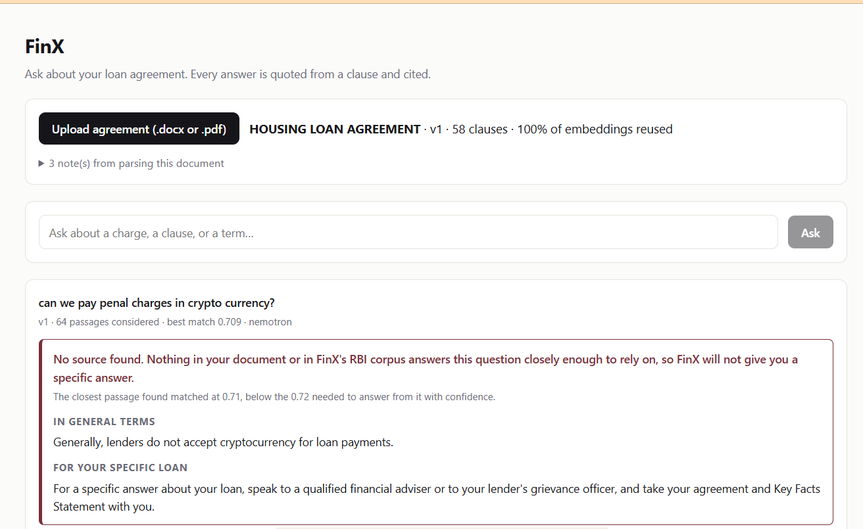


Our Solution- FinX
Understands your document
Checks RBI guidelines
SS of UI
Identifies key clauses
Cites every clause
1.Upload Your Agreement
3. Clear, Cited Answer
2.AI-Powered Analysis
Our system reads, interprets and analyzes your agreement with regulatory and financial context.
Get a plain-language answer with sources: the exact clause, page, and RBI circular behind it.
Provide your loan document in PDF format.
Document-Specific
Regulatory Context
Grounded Answers
Simple Explanations
Analysis based on our actual agreement
Checks applicable RBI guidelines.
Every claim is checked before it is shown.
Complex terms, in plain language.
Same document. A more informed you.
Notes:
4

Slide 5
Our USP- Beyond a RAG Chatbot
Grounded, not generative
Applicability-aware retrieval
Version-aware
Every sentence is checked against its cited clause before being shown. Unsupported claims are removed automatically.
RBI rules are filtered by loan type, lender class and effective date before they are even scored.
A revised agreement is resolved correctly — a clause is only “deleted” if the revision says so, never guessed.
Honest refusal
Coverage-gap detection
Fails safely
When there is not enough evidence, FinX says so and offers a human adviser — instead of a confident guess.
Flags when a loan predates the regulation being asked about, rather than misapplying a newer rule.
If the AI service is unreachable, FinX switches automatically to answering from the quoted clauses — visibly, never silently.
Notes:
6

Slide 6
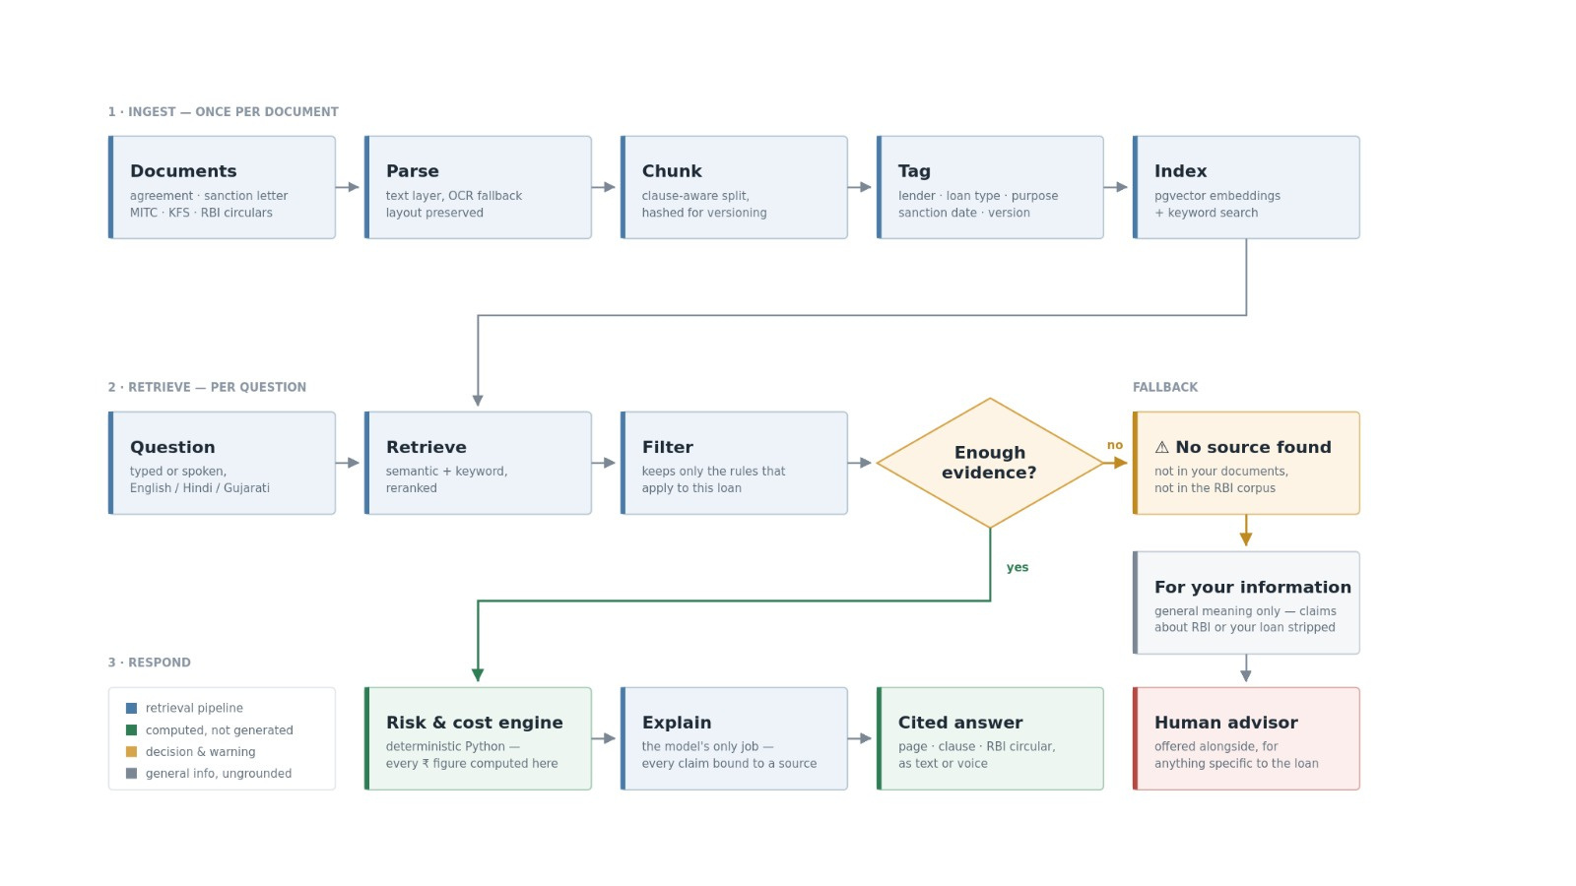
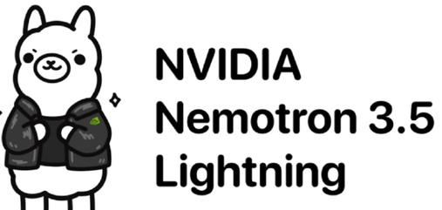



Ingest, retrieve, cite and refuse are built and demoed live. The risk & cost engine ships next; SQLite + NumPy is the tested default, pgvector is implemented but not yet verified.
Fastapi
Technical Architecture & Technology Stack
Notes:
7

Slide 7

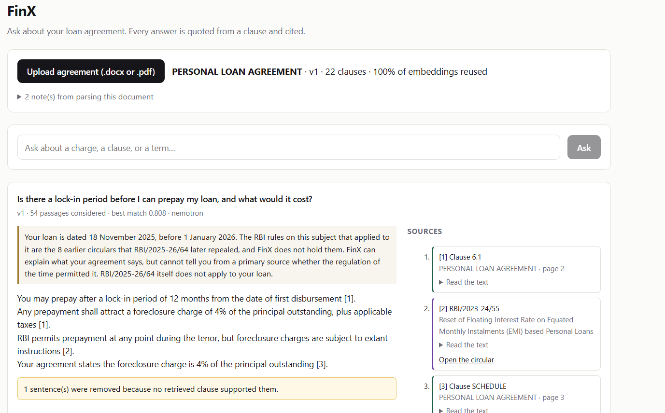
Implementation Roadmap- MVP to Production
Notes:
8

Slide 8


Expected Impact & Future Scope
IMPACT
FUTURE SCOPE
Increased Financial Awareness
Wider Document Support
Help borrowers understand complex agreement in simple terms.
Extend beyond loan agreements to credit cards, insurance, investment and more
2
Greater Trust & Transparency
Multilingual Access
2
Encourages fairer lending practices and responsible borrowing.
Support regional language for broader inclusivity.
Reduced Financial Risk
Personalized Financial Assistant
3
3
Early identification of hidden charges, unfair terms and high-risk clauses.
Proactive alerts, reminders and personalized recommendations.
Institutional Integration
Broader Social impact
4
4
Collaboration with financial institutions and regulators for greater adoption.
Empower first-time borrowers and underserved segment with equal access to insights.
Notes:
9

Slide 9
Thank you
Team Members
Vishvesh Sharma . Marhama Shaikh
Notes:
10

