Slide 1
Future Sales Prediction
BY:
Mohit Reddy Oduru Ramesh mo298
Vishwanath Venkataraman vv425
Rajiv Duve rd364

Slide 2
Goal and Data provided
To forecast total amount of products sold in every shop using historic sales data
6 files , total 101.6 MB containing csvs of train, test, sample submission, items, item_categories and shop.

Slide 3
Data Engineering and EDA
Merge Data sets
Remove Duplicates
Look for values that do not correspond with the data
Find outliers

Slide 4
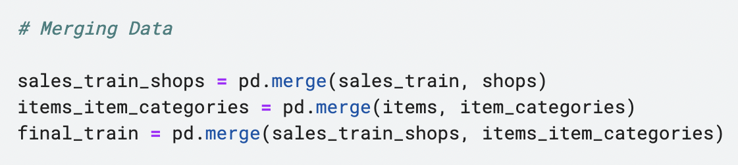
Merge Datasets
We merge all the datasets other than the testing dataset to get all the information into one dataframe.

Slide 5
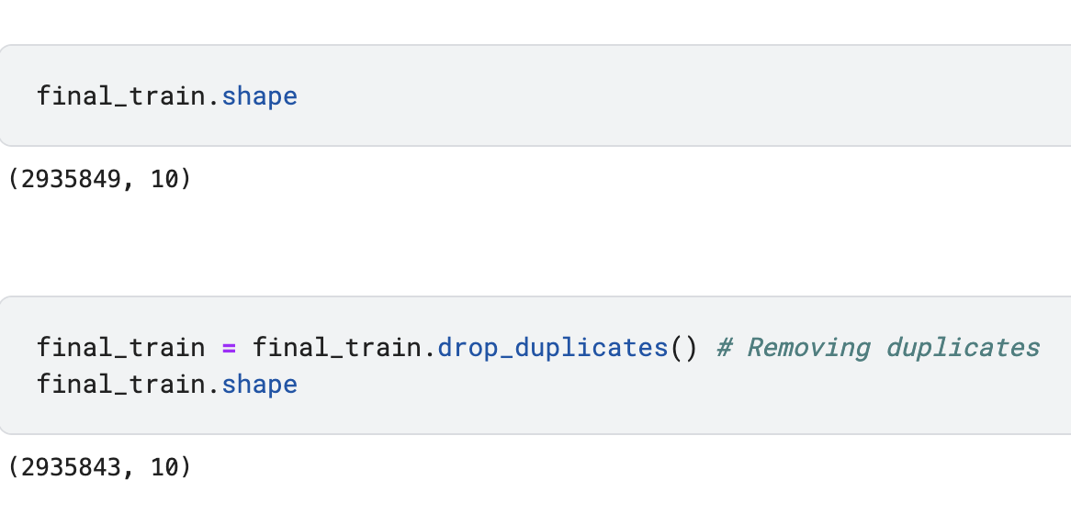
Remove Duplicates
We remove duplicates from the dataset.

Slide 6
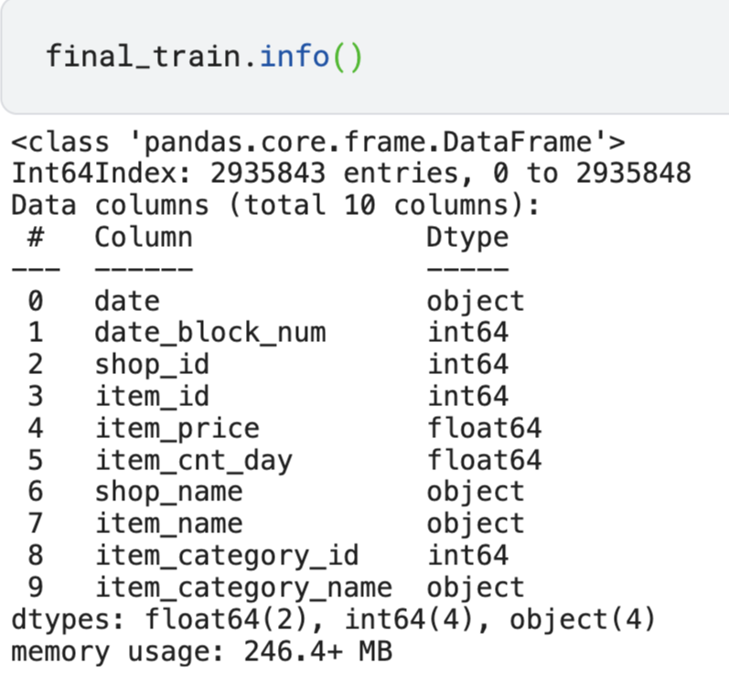
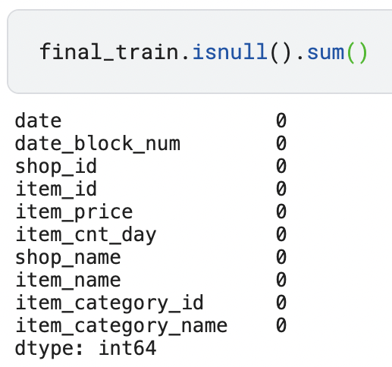
Take a Look at the Dataset
Look at the datatypes
Check for null.

Slide 7
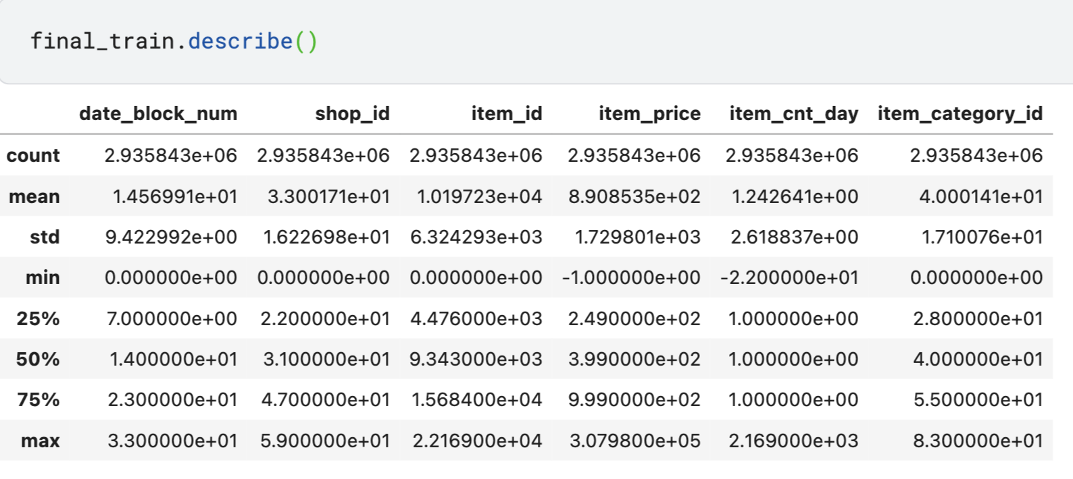
The five number summary of the numerical features.
Some values in item_price and item_cnt_day are negative!

Slide 8
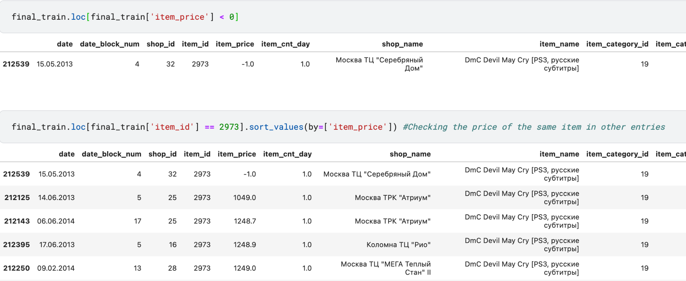
Taking a Closer look at the outliers
Item_price outliers

Slide 9
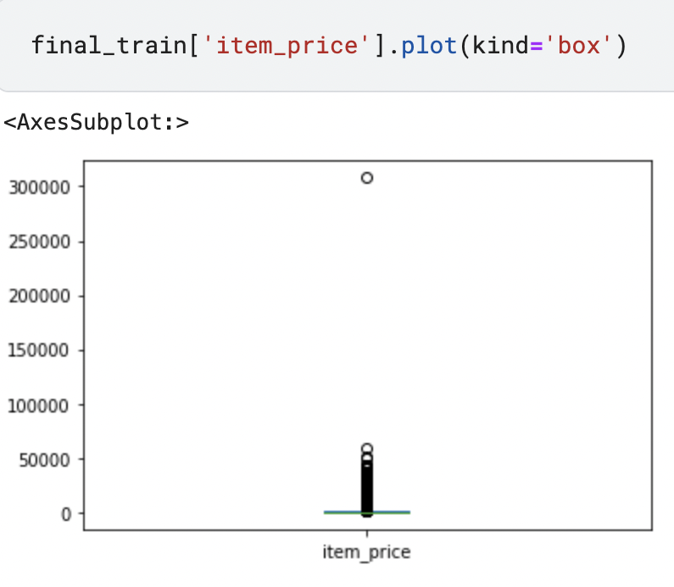
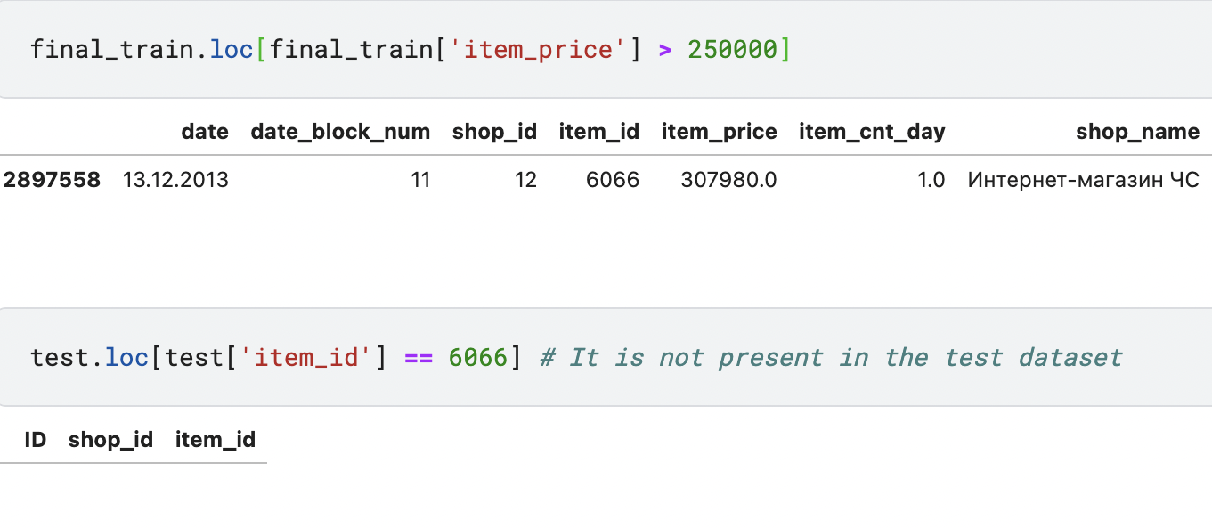
Clearly the datapoint on top is an outlier, and most of the marked points are outliers according to the IQR method, however we won’t be removing them because we might lose information.
We will be removing the topmost outlier because it’s not present in the test dataset.

Slide 10
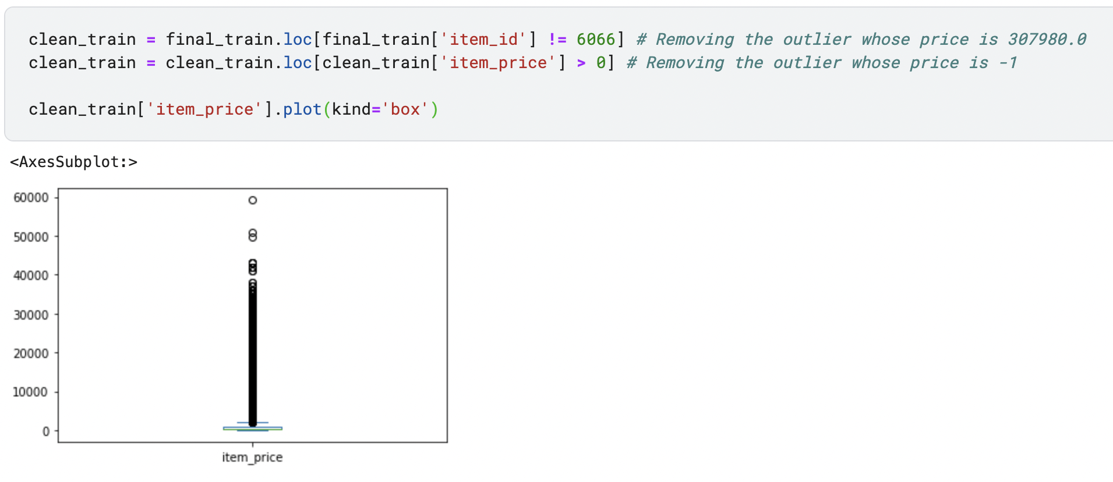
Dealing with outliers

Slide 11
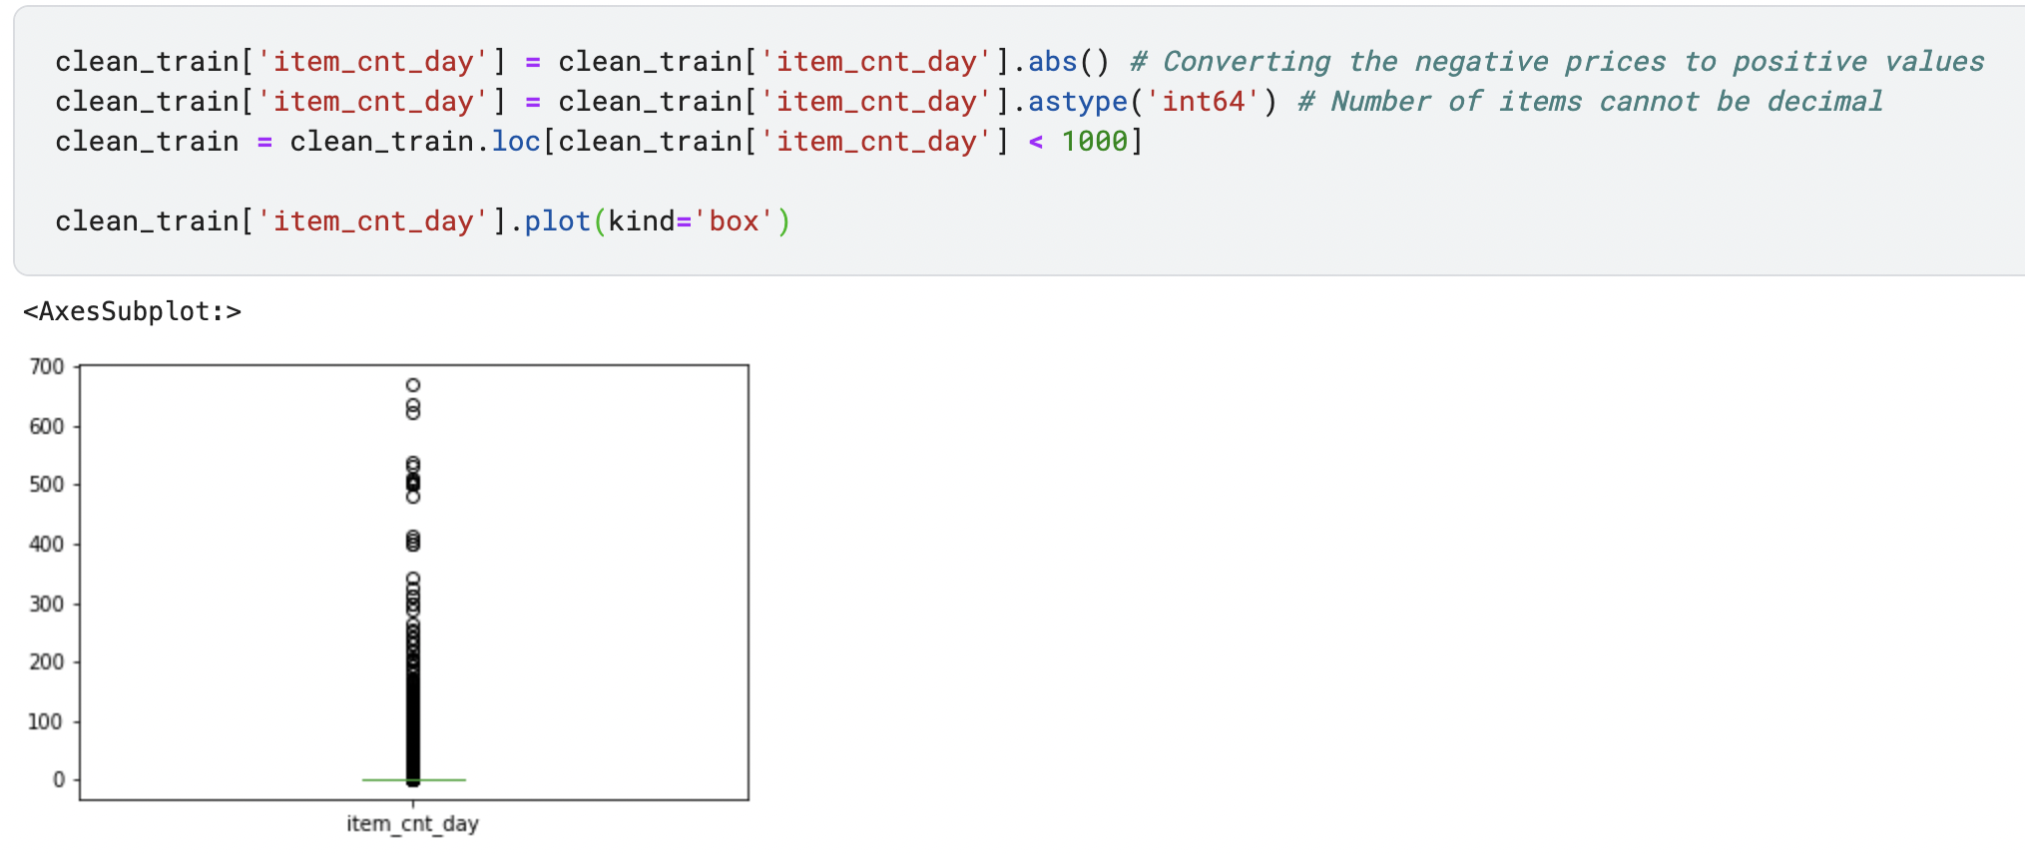

Slide 12
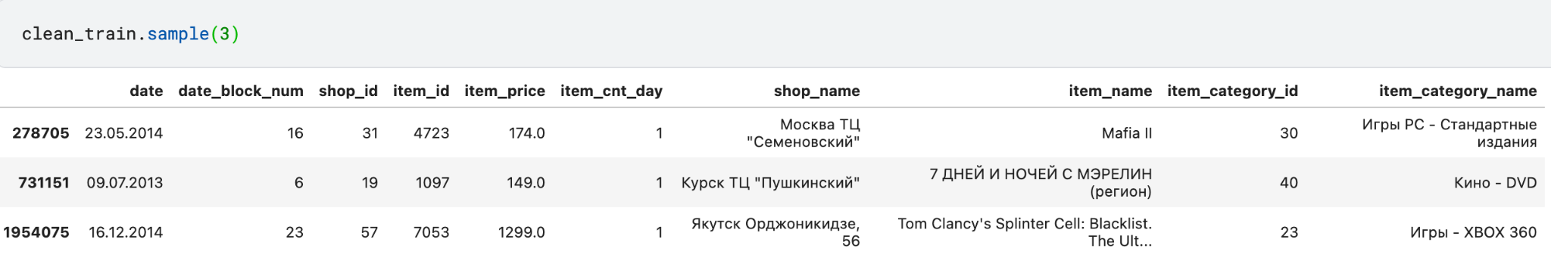
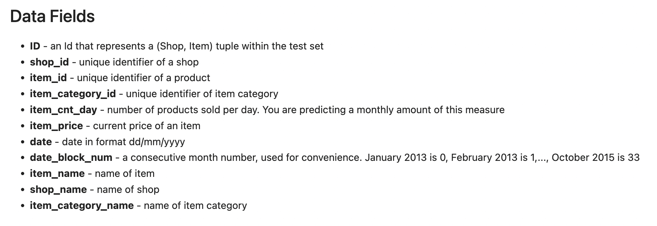
Cleaned Train Dataset

Slide 13
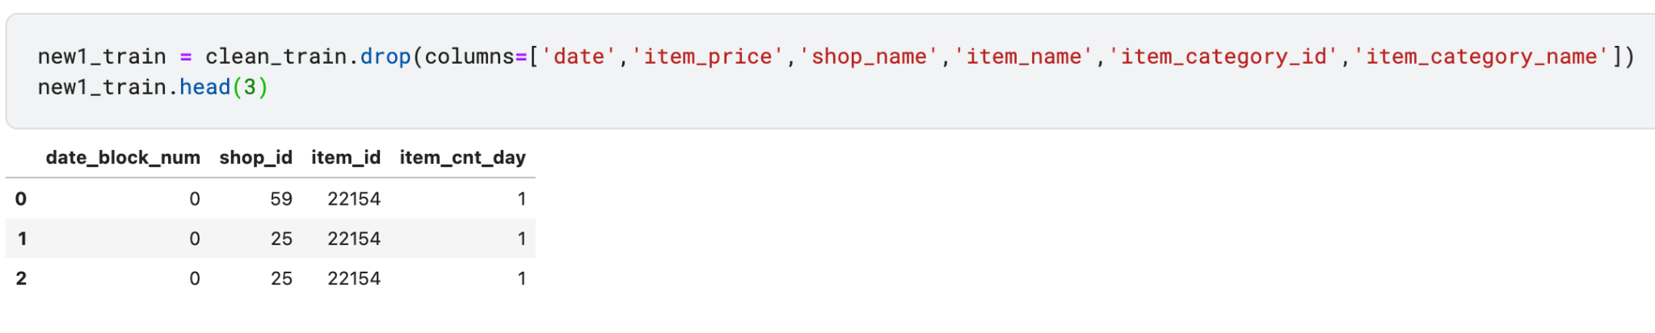
We need to predict the number of items sold in November 2015 using shop_id and item_id. So we keep the shop_id, item_id, and item_cnt_day columns in the training set. Additionally, we also keep the date_block_num column as well, since we need information regarding the months since list of shops and products change every month.

Slide 14
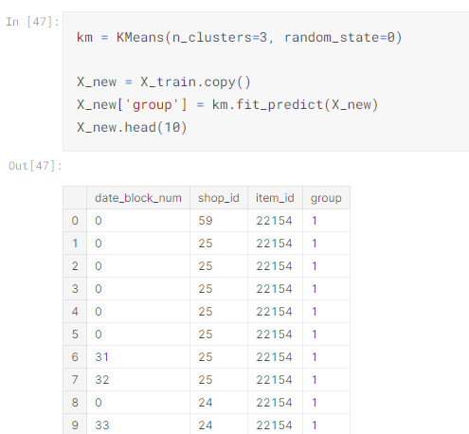
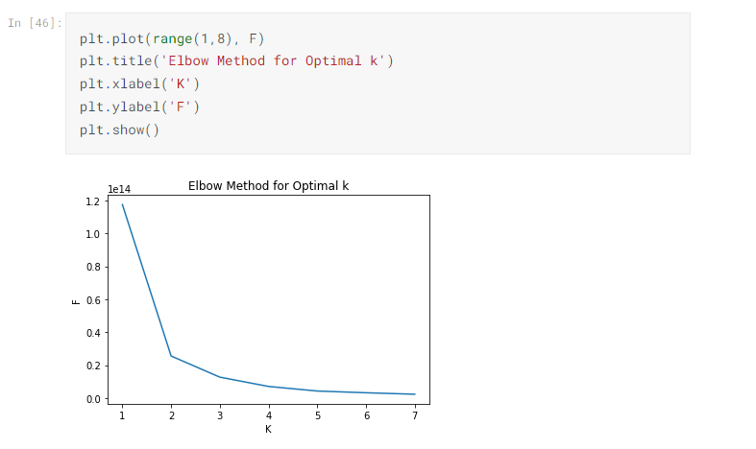
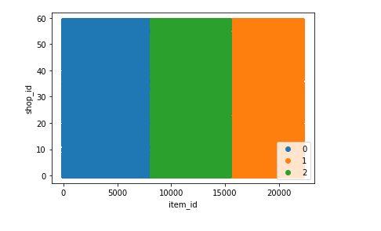
K-Means Attempt
We tried use KNN, but groups formed does not give any valuable inference

Slide 15
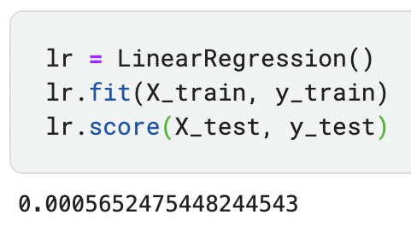
Simple Linear Regression

Slide 16
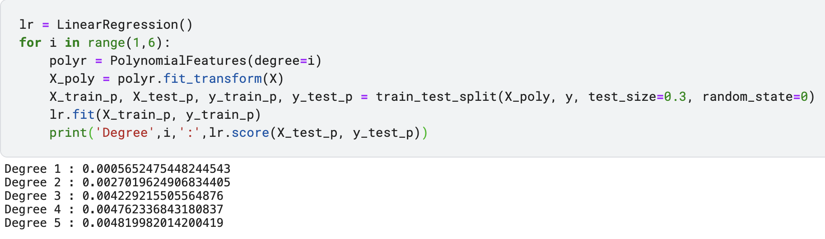
Non-linear regression upto 5 degrees

Slide 17
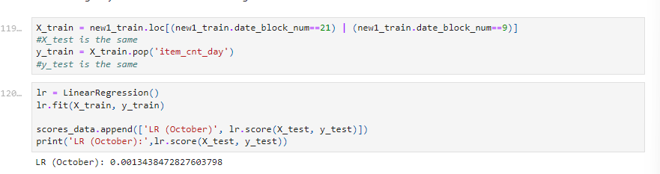
Improvement 1 – Training Particular Month
We filtered the training data to contain only data for the month October (2013 & 2014) and tested it against October 2015

Slide 18
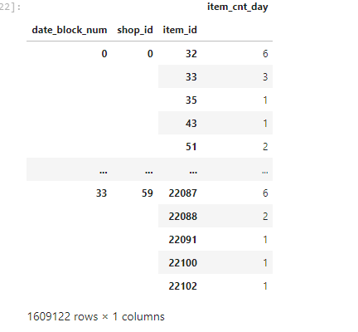
Improvement 2 - Reshaping Data
Steps taken:
Pivoted the table

Slide 19
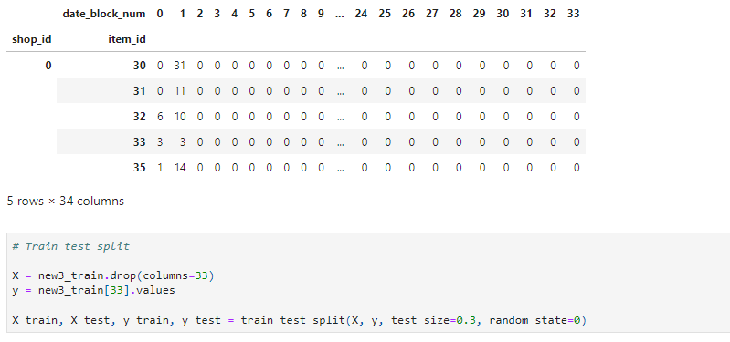
Reshaping cont.
Using date_block_num = 33 which is the data for October 2015 as the target, we train the data set

Slide 20
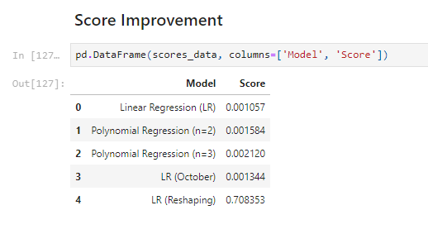
Final Score Comaprison

