Slide 1
Green Campus Performance Dashboard
System Architecture & Flow Presentation

Slide 2
Aim
To design and develop a web-based Green Campus Performance Dashboard for monitoring sustainability metrics.
To track and analyze Energy, Water, and Waste consumption within the campus environment.
To promote environmental awareness and sustainable decision-making using real-time data visualization.
To implement a modern full-stack architecture using React (Frontend), Flask (Backend), and MongoDB (Database).
To build a scalable, secure, and efficient system for long-term environmental monitoring and reporting.

Slide 3
Objectives
Develop a responsive and interactive React dashboard with charts, value cards, tables, and alerts.
Implement secure RESTful APIs using Flask for handling data requests and responses.
Store structured sustainability data efficiently using MongoDB NoSQL database.
Enable smooth communication between frontend and backend using HTTP requests.
Provide role-based access control (Admin/User authentication).
Ensure real-time data updates using JSON-based API responses.
Improve institutional decision-making through data-driven insights and visual analytics.

Slide 4
Project Overview
The Green Campus Performance Dashboard is a full-stack web application that monitors Energy, Water, and Waste data within a campus.
It uses React for the frontend dashboard, Flask for the REST API backend, and MongoDB for data storage.
Users interact with the dashboard, which sends HTTP requests to the backend. The backend retrieves data from the database and returns it as JSON, allowing the dashboard to update charts, cards, and alerts dynamically.

Slide 5
System Architecture Flow
User (Admin/User)
│
▼
React Dashboard (Frontend)
│ HTTP Request
▼
Flask REST API Server
│ Query
▼
MongoDB Database
│ JSON Response
▼
Flask API
▼
React Dashboard Updates Charts, Cards & Alerts

Slide 6
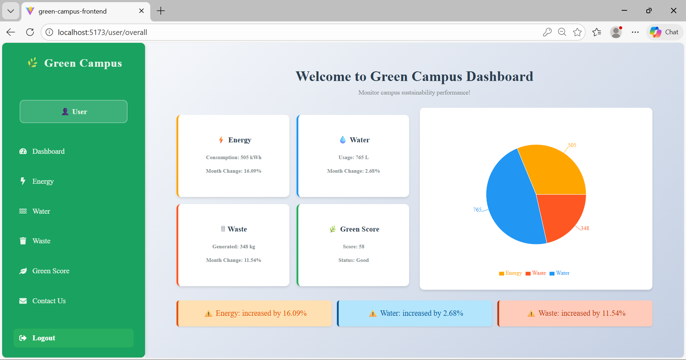

Slide 7
